Slide 1
Lecture 8Medical terminology

Slide 2
Medical Terminology
Word Analysis
We use medical terms daily as a consumer and as a citizens.
Words like arthritis, electrocardiogram, hepatitis, and anemia describes familiar conditions.
Medical words are like individual cross-word puzzles. Once we divide the word to its component parts and learn the meaning of individual parts, we can use that knowledge to understand many other new terms.
Medical term is the professional language of those who are directly or indirectly engaged in the art of healing .

Slide 3
Like the plastic blocks that children play with, these basics forms can be linked in hundreds of different ways to create different meanings. By thinking of them as building blocks, you can make building a medical vocabulary into a game.
Basic Elements of a Medical Term
1. Root
2. Suffix
3. Prefix
4. Combining Vowel
5. Combining Form
These four parts of a word are known as ELEMENTS.

Slide 4
Prefixes
A prefix is a syllable or syllables placed BEFORE a word or word root to alter its meaning or create a new word.
Some prefixes:
Hyper- (excessive)
Pre- (before)
Post- (after)
Homo- (same)
Hypo- (under)

Slide 5
ROOT: The root of a word. For example:
root | Meaning | Example
aden | gland | Adenitis
cardi | heart | Cardiology
cephal | head | Encephalogram
derm | Skin | Dermatosis
flex | bending | Anteflexion
gastr | Stomach | Gastroscopy
hydr | Water | Hydrophobia
my | Muscle | Myalgia
neur | Nerve | Neuritis
pnea | Breath | Dyspnea

Slide 6
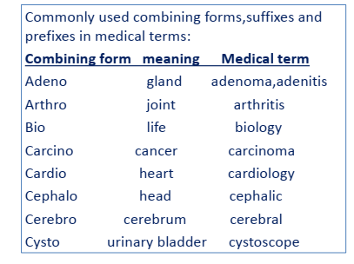

Slide 7
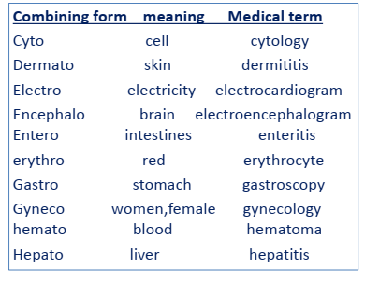

Slide 8
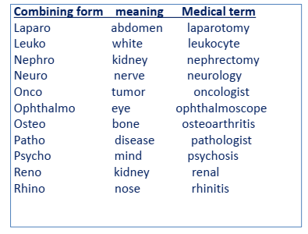

Slide 9
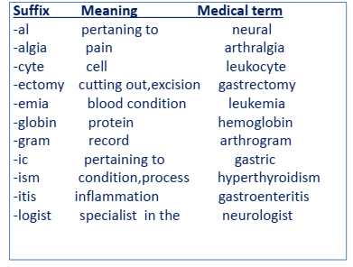

Slide 10
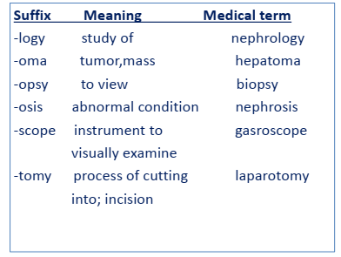

Slide 11
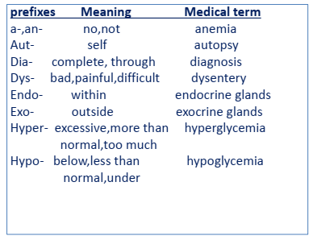

Slide 12
