Slide 1
LEC.7 &8
PLATE TECTONICS
BY
DR. MURTADHA AL-ZIADI
1

Slide 2
Introduction:
Earth is a dynamic, ever changing planet!
If we could go back in time 200 million years, there would be no rocky
mountains and valleys.
Moreover, we would find landmasses with unfamiliar shapes and located in different positions from today's continents.
Earth scientists have shown that the landmass are not fixed, but slowly migrate across the globe. (Figure.10.1).
( Pangaea is meaning all the land ).
Large landmass has splited apart resulting in the formation of oceans, while the
floor of the ocean has been recycled back into earth's interior.
Further, landmass that was separated by vast oceans have since collided and
formed larger continents.
The movement of earth's outer layer continues today. Result of this movement
includes earthquakes, volcanoes and building of earth's mountains.
2

Slide 3
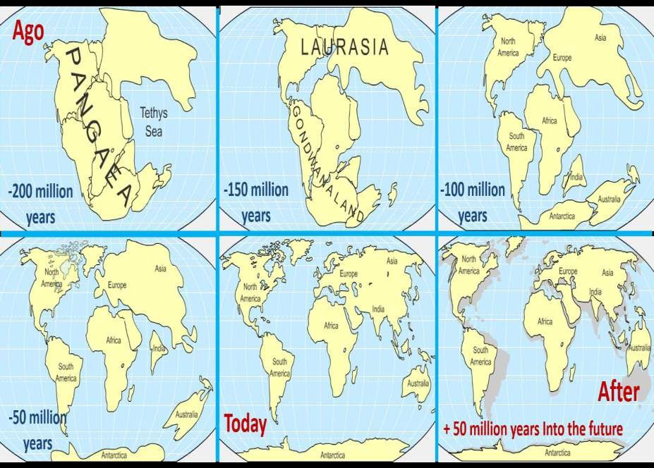
3

Slide 4
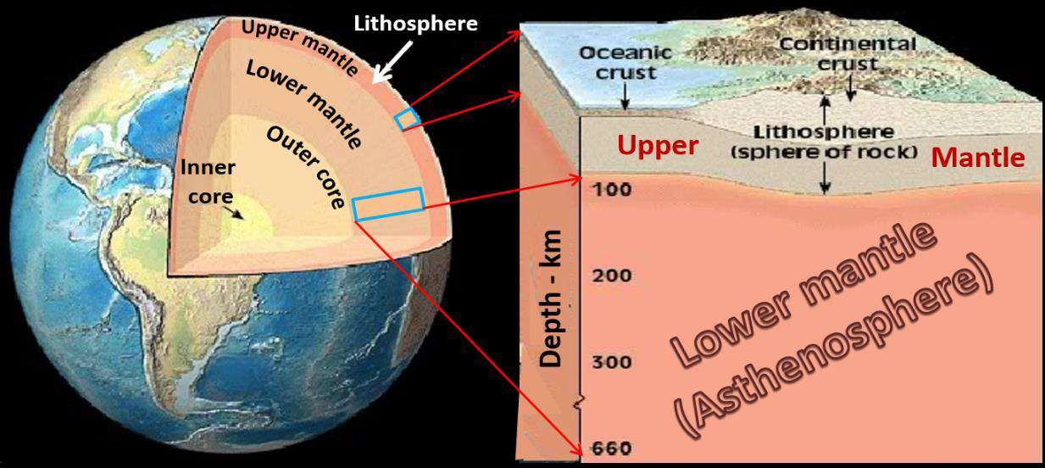
The modern scientific theory which describes the movement of earth' outer
layers is called plate tectonics.
According to the plate tectonics theory, the uppermost mantle, along with the
overlying crust, behave as a strong, rigid layer known as the lithosphere. So
Lithosphere = Upper mantle + earth crust
(Figure.10.2).
4

Slide 5
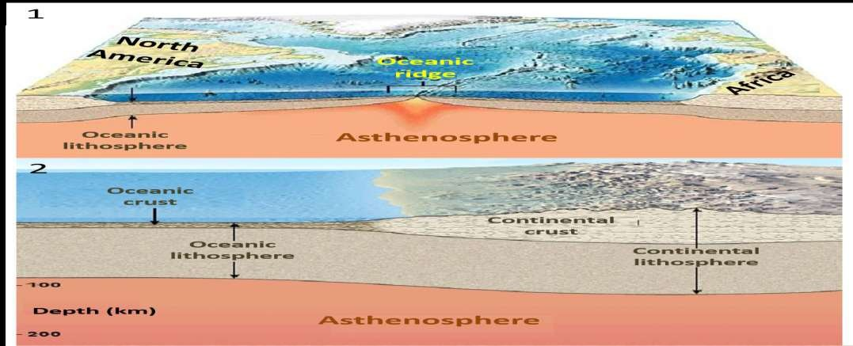
Lithosphere is thinnest in the oceans where its thickness may vary from as little as a few kilometers at the oceanic ridge to 100 kilometers in the deep-ocean basins. (Figure.10.3). 1. By contrast, continental lithosphere is generally 100-150 kilometers thick but may be more than 250 kilometers thick below older portions of the continents. 2. This rigid outer shell (lithosphere) overlies a hotter, weaker layer in the upper mantle known as the asthenosphere. 1 and 2.
5

Slide 6
Scientists think that the weak rock within the asthenosphere allows earth's rigid
outer shell to move.
Further, the lithosphere is broken into numerous segments, called lithospheres
plates, or simply plates into:
A-Seven major lithospheric plates are recognized. They are:
1-South American plate. 2-North American.
3-Pacific plate. 4-Austtralian-Indian. 5-Antaractic. 6-Eurasian
7-African plate. (Figure.10.4).
The largest is the pacific plate, which encompasses a significant portion of the
pacific ocean basin.
Notice that most of the largest plates include an entire continent plus a large area
of ocean floor.
B- Intermediate-size plates include:
1-Philippine plate. 2-Arabian.
3-Scotia. 4-Caribbian
5-Nazca. 6-Cocos
7-Juan de Fuca plate. (Figute.10.4).
6

Slide 7
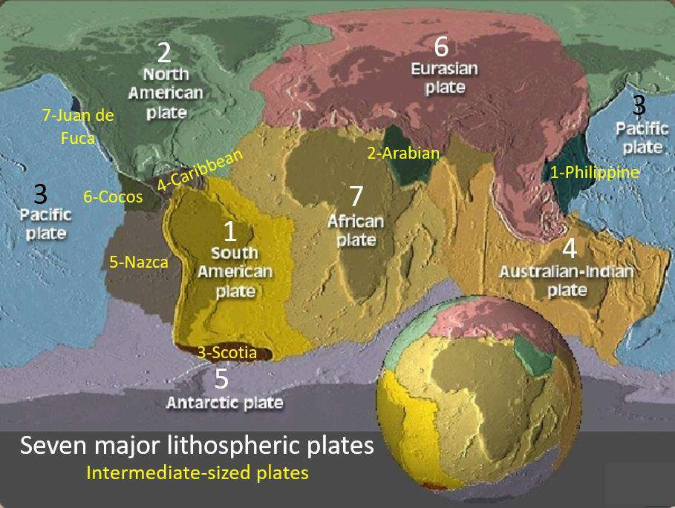
7

Slide 8
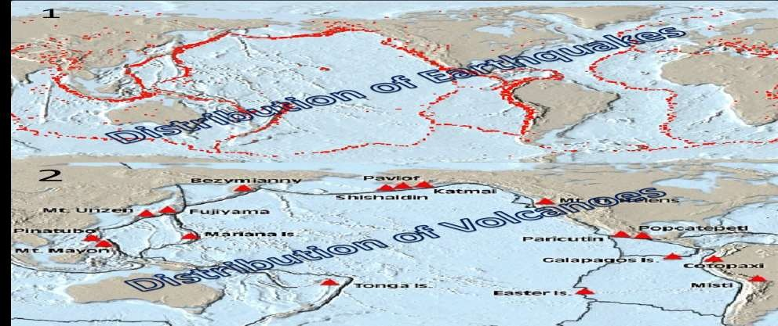
Each plate is in constant motion relative to all other plates. As the plates move, the distance between two locations on the same plate remains constant whereas the distance between sites on different planets gradually changes. Most interactions occur at the margins (edges) of planets. For example, most of our planet's earthquakes, volcanoes and mountain building occur along boundaries. Notice how the distribution of moderate to strong earthquakes is related to plate boundaries. (Figure.10.5). 1. Volcanoes are also associated with plate boundaries. 2.
8

Slide 9
types of plate boundaries:
Divergent plate boundaries: Occur where two plates move apart from each
other.
Convergent plate boundaries: Two plates move together toward each other.
Transform fault boundaries: Occur where two plates grind to each other. Typically, all three types of boundaries can be found surrounding a plate.
1- Divergent boundaries:
At divergent plate boundaries, plates move apart. (Figure.10.6). 1.
Most divergent plate boundaries are located along crests of oceanic ridges. 2. Let's examine the Mid-Atlantic ridge which extends along a north-south path down the center of the Atlantic ocean. 3.
Here as a plates move apart, the gap is filled with molten rock that oozes up from
the hot mantle below. 4.
9

Slide 10
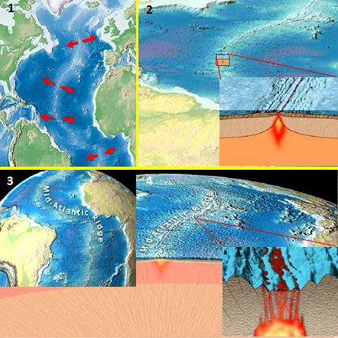
10

Slide 11
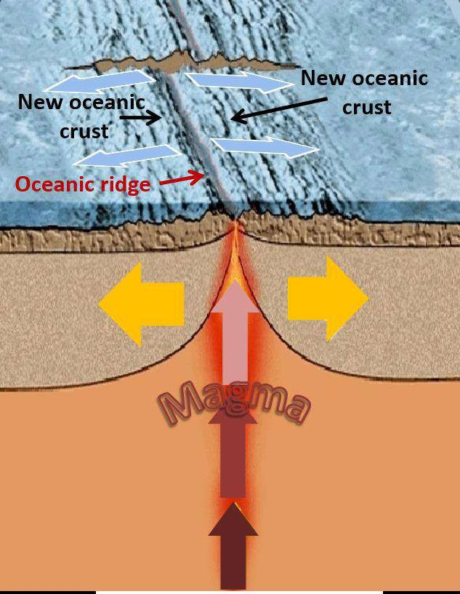
Gradually, this molten rock, called magma, Cools to make new slivers of sea floor. (Figure.10.7).
11

Slide 12
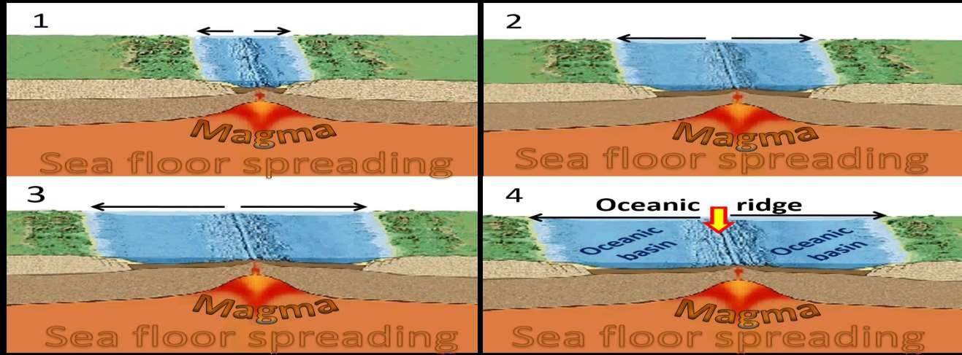
In a continuous manner, spreading and upwelling of magma add oceanic lithosphere to the edges of the diverging plates. This mechanism has created the floor of the Atlantic ocean during the past 160 million years and is called seafloor spreading. (Figure.10.8). 1..6.
Average rates of seafloor spreading are about 5 centimeters per year.
12

Slide 13
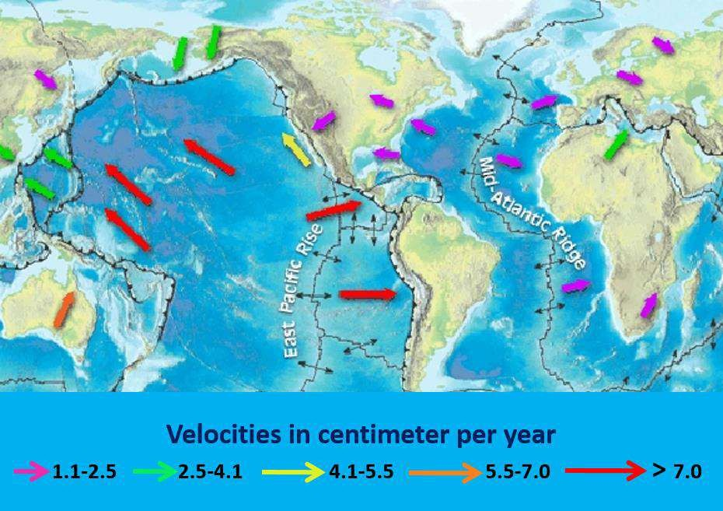
Some of the slowest spreading rates (2 centimeters per year) occur along the Mid- Atlantic Ridge; whereas rates exceeding 15 centimeters per year have been recorded along the East Pacific Ridge. (Figure.10.9).
13

Slide 14
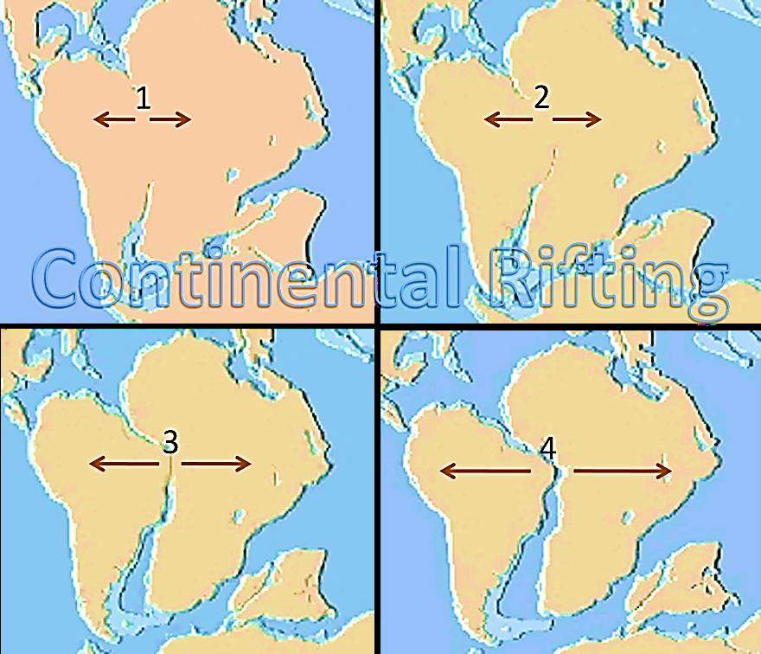
Although these rates of seafloor spreading seem slow on human time scale, they are rapid enough to have generated all Earth's ocean basins in the last 200 million years. Spreading centers can also develop within a continent, in which case the landmass may split into two or more smaller continents. This is known as continental rifting. (Figure.10.10). 1 … 4.
14

Slide 15
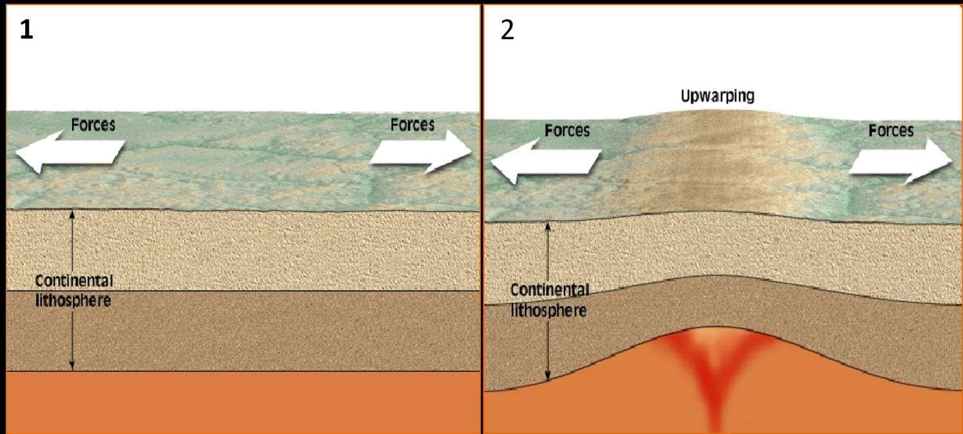
Continental rifting takes place where forces pull two plates in opposite directions.
(Figure.10.11). 1.
As the lithosphere stretches, molten rock rises from below to up warp the crust. 2
.
15

Slide 16
Eventually, the crust fractures to form a long trough called a rift valley.
Recall that rift valley is also found along the crests of some oceanic ridge.
(Figure.10.12). 1.
Slowly, the rift valley lengthens and deepens. 2.
16

Slide 17
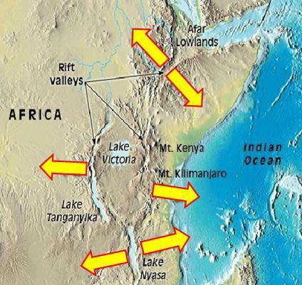
The East African rift valleys are Examples of such features. (Figure.10.13).
17

Slide 18
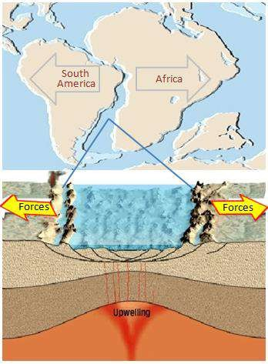
If spreading continues, it will extend to the plate margin and split the landmass into two, like South America and Africa did over 100 million years ago. (Figure.10.14).
18

Slide 19
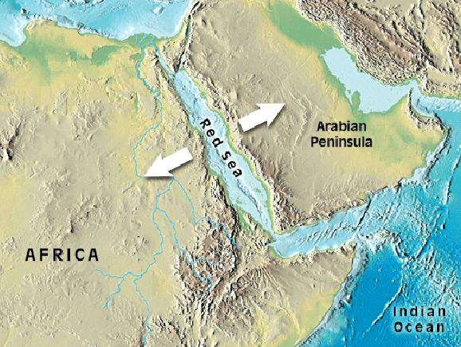
At this point the rift valley becomes a long, narrow sea with an outlet to the
ocean, similar to the red sea. (Figure.10.15).
19

Slide 20
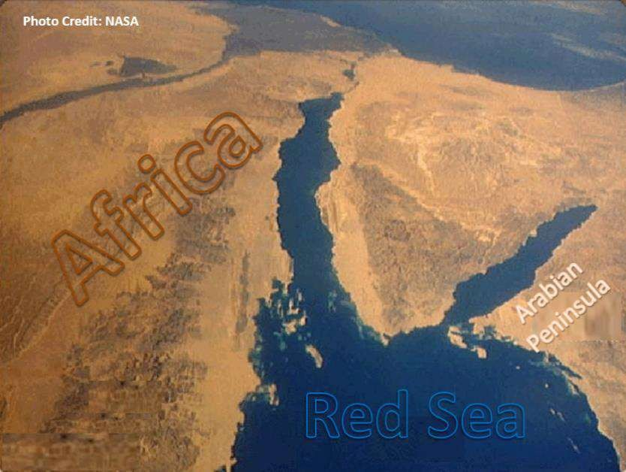
The red sea formed as the Arabian peninsula separated from North Africa. Consequently, the Red sea provides Earth scientists with a view of how the Atlantic ocean may have looked in its infancy. (Figure.10.16). Continued divergence brings us back "full-circle" to the development of a spreading center such as the present- day Mid-Atlantic Ridge.
20

Slide 21
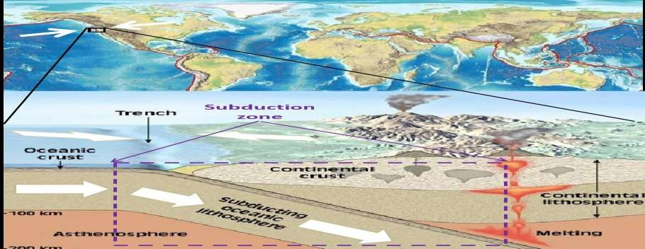
2- Convergent boundaries:
Although new lithosphere is continually being produced at divergent plate
boundaries, the surface of our planet is not growing larger.
To balance the amount of newly created lithosphere, older portions of oceanic lithosphere descend into the mantle along convergent plate boundaries.
Convergent plate margins occur where two plates are moving toward each other
and the motion is accommodated by one plate sliding beneath the other. Convergent plate boundaries are also called subduction zones, because they are sites where lithosphere is descending (Being subducted) into the asthenosphere. (Figure.10.17).
21

Slide 22
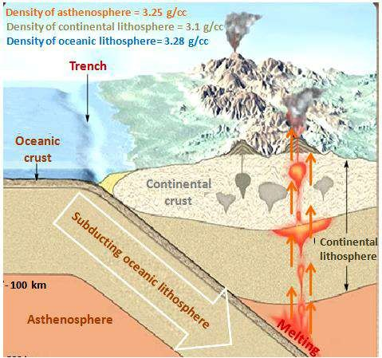
Deep-oceanic trenches:
develop between two converging plates and indicate where the subducting plate
begins its descent beneath the overriding plate.
Subduction occurs because the density of the subduction lithospheric plate is greater
than that of the underlying asthenosphere.
Older oceanic lithosphere is cooler and denser than the underlying asthenosphere. By contrast continental lithosphere is less dense and therefore more buoyant, which prevents it from being subducted to any great depth.
As a consequence, the subducted plate is almost always oceanic. (Figure.10.18).
22

Slide 23
Some plates of oceanic lithosphere descend into the asthenosphere at angles of only a few degrees, whereas others plunge nearly vertically (90 degrees). (Figure.19.19). 1 and 2.
The angle at which oceanic lithosphere descends into the asthenosphere, depends on its density. When a plate of lithosphere is less than 10 million years old it is typically less dense than the underlying asthenosphere and subduction is nearly horizontal. 3.
As oceanic lithosphere ages (gets further from the spreading center), it cools. This causes it to thicken and increase in density. Once the age of oceanic lithosphere exceeds 10 million years, it is denser than the asthenosphere and will sink given the opportunity. 4.
23

Slide 24
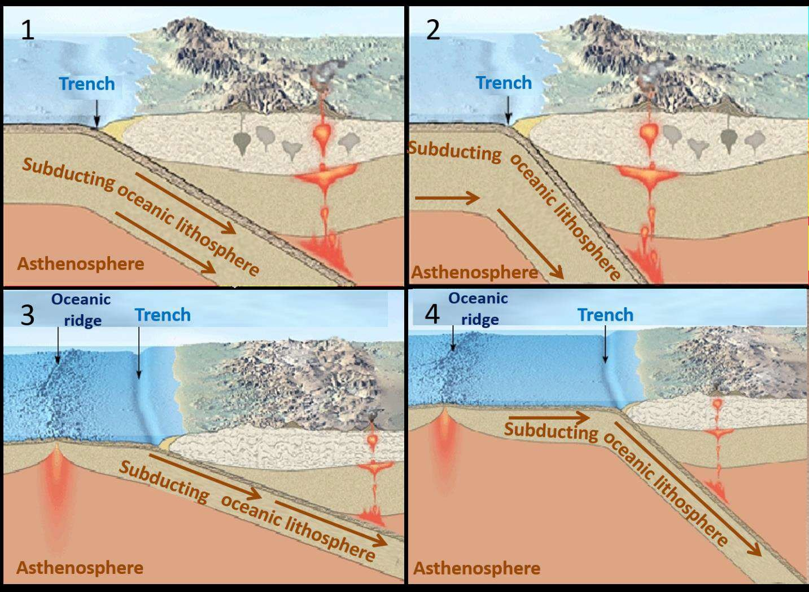
24

Slide 25
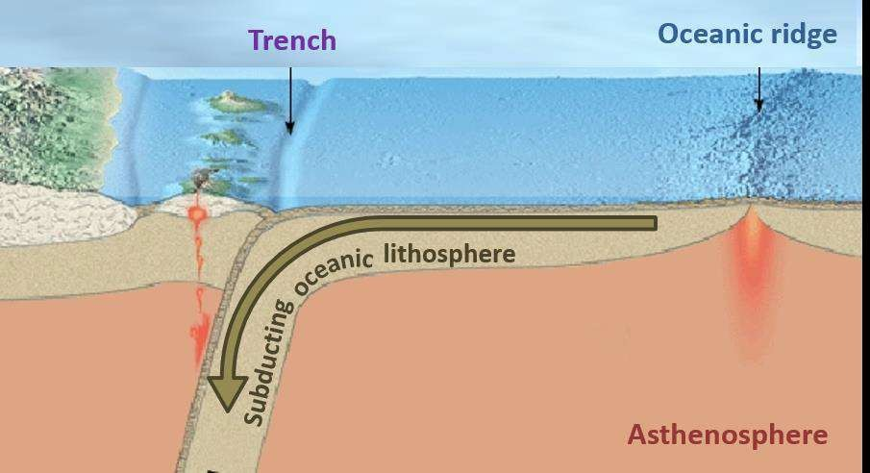
In parts of the Western Pacific some oceanic lithosphere is older than 160 million years. This is the thickest and densest in today's oceans. The subduction plates in this region typically descend into the mantle at angles approaching 90 degrees. (Figure.10.20).
25

Slide 26
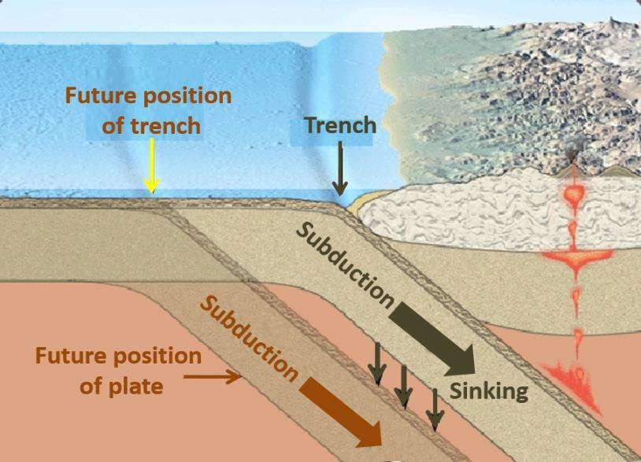
It is important to realize that a subducting plate does not follow a fixed path into the mantle. Rather, it sinks vertically as it descends, causing the trench. (Figure.10.21).
26

Slide 27
When the subduction plate sinks, it creates a flow in the asthenosphere that "pulls" the overriding plate toward the retreating trench. (Imagine what would happen if you were sitting in a lifeboat near the titanic as it is sank!) (Figure.10.22) 1.
Convergent plate boundaries form:
A-Continental lithosphere overrides oceanic. 2. B-Plate of oceanic lithosphere is subducted beneath another. 3.
C-Two plates of continental lithosphere
converge and eventually collide. 4.
27

Slide 28
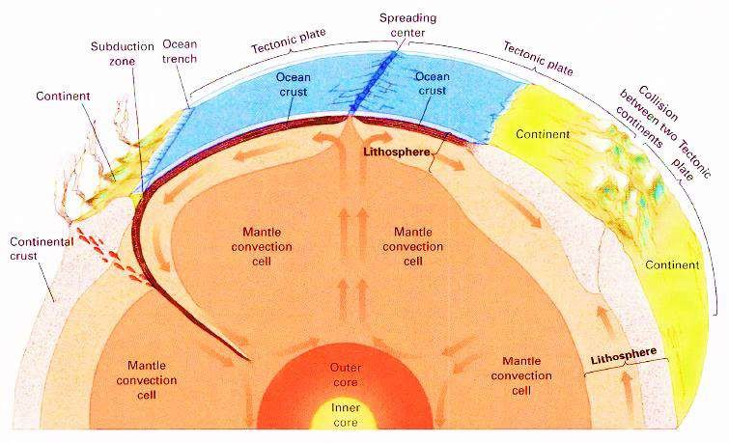
The spreading, Collision, Subduction zone and trench of Tectonic plates is showing in (Figure.10.23).
28

Slide 29
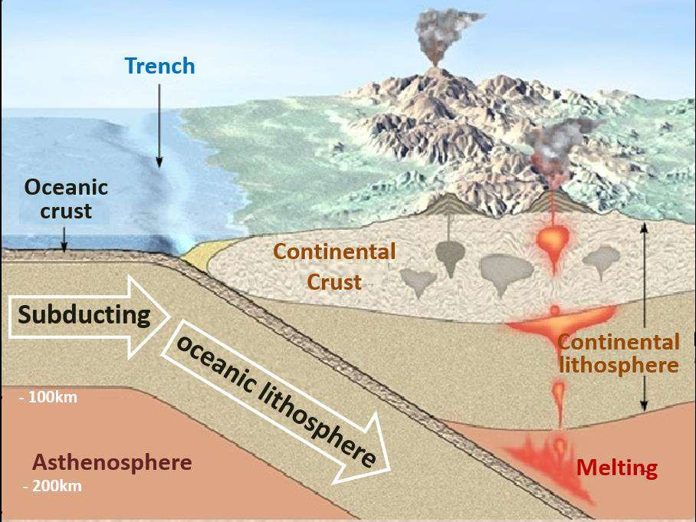
A. Continental lithosphere overrides Oceanic:
Let's take a look at what happens when an oceanic plate converges with continental lithosphere. Whenever a plate capped with continental crust converges with a plate of oceanic lithosphere, the buoyant continental plate remains "floating" while the denser oceanic plats descends into the mantle. When the descending oceanic plate reaches a depth of roughly 100 killiometers, melting is caused within the hot asthenosphere that lies above it. (Figure.10.24).
29

Slide 30
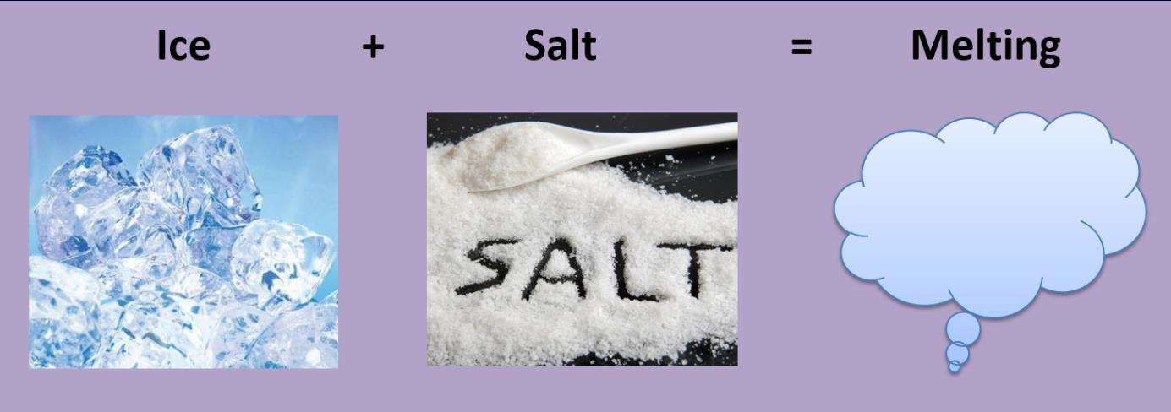
But how the subduction of cool plate of oceanic lithosphere causes mantle rock to
melt?
The answer lies in the fact that water acts like salt does to melt ice. That is, "wet" rock, in a high temperature environment, melts at a lower temperature than "dry" rock. (Figure.10.25).
30

Slide 31
Sediments and oceanic crust contain a large amount of water which is carried to
great depths by a subduction plate.
When the plate plunges downward, water is "squeezed" from pore spaces as
confining pressure increases.
At greater depths, heat and pressure drive water from hydrated (water-rich) minerals such as amphiboles. (Figuure.10.26). 1.
At a depth of roughly 100 kilometers, the asthenosphere is sufficiently hot that introduction of water typically leads to partial melting. 2.
The semi-molten rock generated by this process contains as little as 10 percent melt, which is mixed with unmelted mantle rock. Being less dense than the surrounding mantle, this hot mobile mixture gradually rises toward the surface as tear-drop shaped structures. 3.
When this partially molten material reaches the base of the crust, it is thought to "pond"beneath the somewhat less dense continental rocks. Here fluid basaltic magma separates from the unmelted components and continues its ascent. 4.
Depending on the environment, Mantle-derived, basaltic magma may rise through
the crust to feed volcanic eruption at the surface.
31

Slide 32
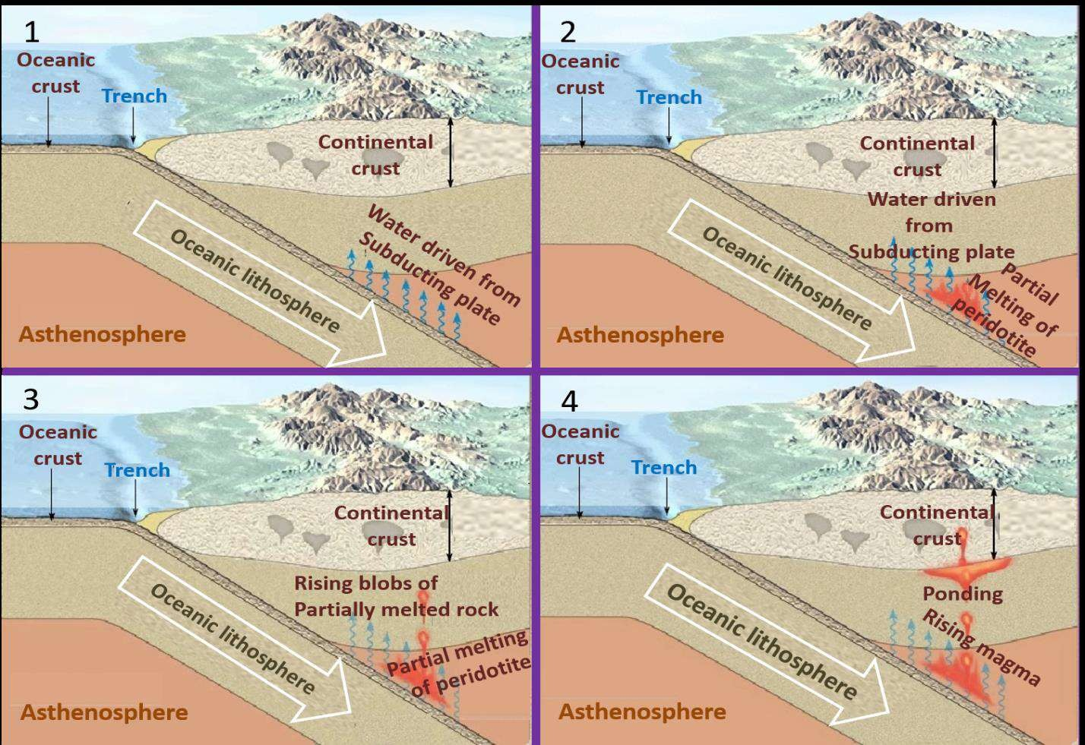
32

Slide 33
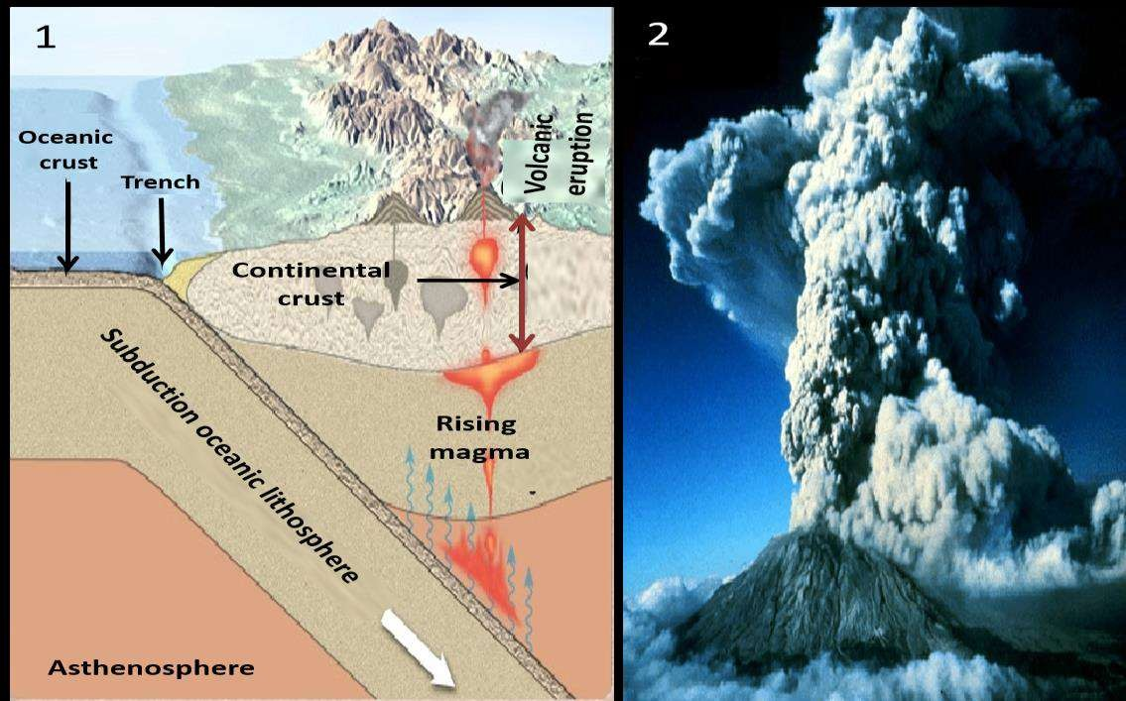
In a continental setting, basaltic magma typically melts and assimilates some of the crustal rocks through which it ascends. The result is the formation of the silica-rich magmas having an andesitic composition, or less often, a rhyolitic composition. (Figure.10.27). 1. On occasions when andesitic magmas reach the surface, they often erupt explosively, generating large columns of volcanic ash, pumice and gases. 2.
33

Slide 34
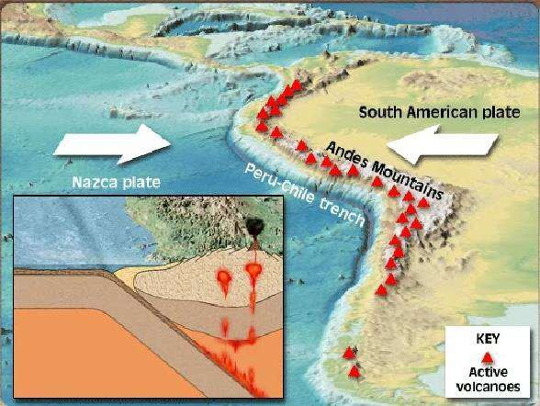
The volcanoes of the towering Andes are the products of magma generated by the
subduction of the oceanic Nazca plate beneath the South American continent.
This chain of volcanic peaks, termed a continental volcanic arc, identifies the region of intrusive and extrusive igneous activity associated with an oceanic- continental convergent boundary. (Figure.10.28).
34

Slide 35
A- Plate of oceanic lithosphere is subducted
beneath another:
Now let's look at what happens:
when two plates composed of oceanic lithosphere converge.
In this setting, one oceanic plate descends beneath the other, often initiating volcanic activity at the surface.
Here, volcanoes grow up from the ocean floor, rather than on a continent. Should the volcanoes continue to grow, they will eventually reach the surface to form a volcanic island arc, or simply, an island arc. (Figure.10.29).
35

Slide 36
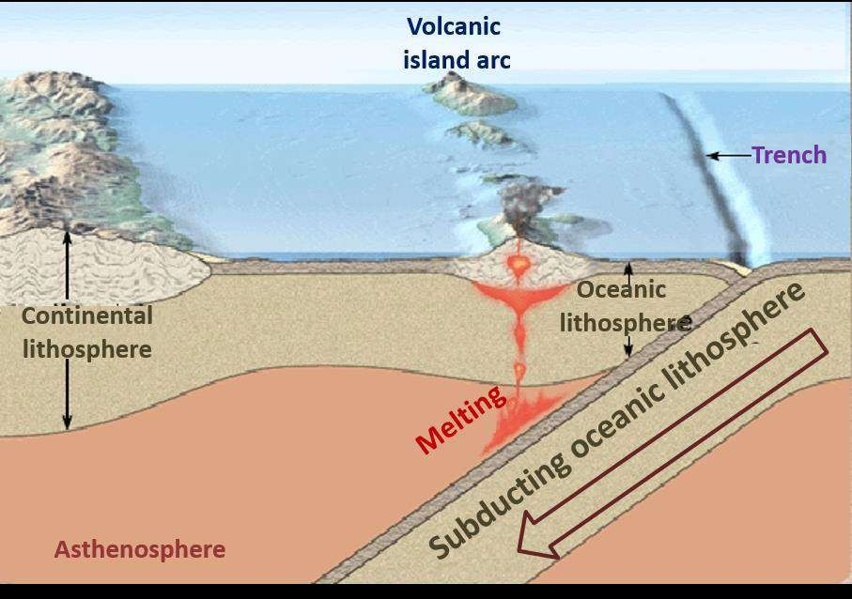
36

Slide 37
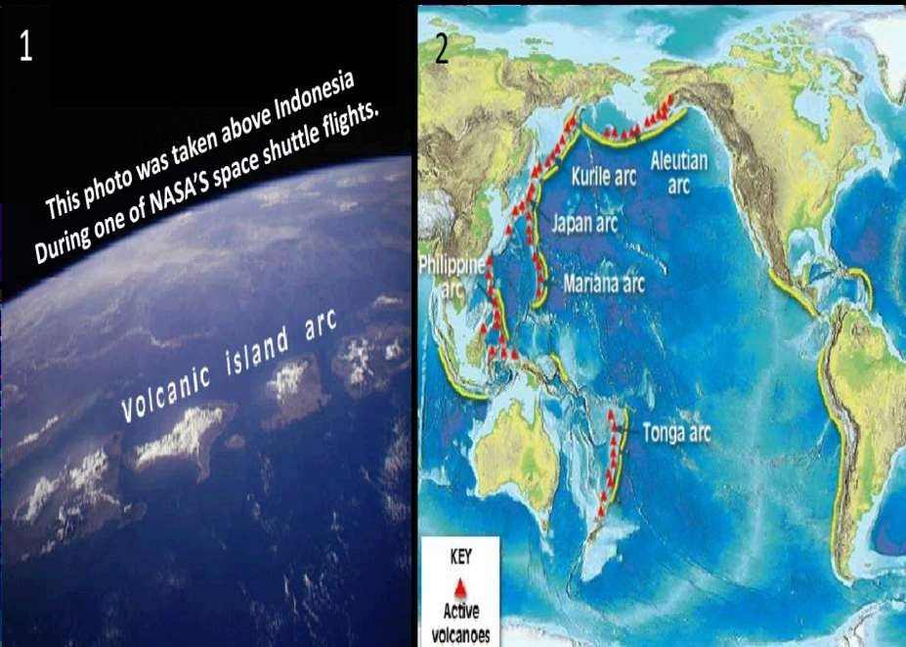
The image below (Figure.10.30). 1, shows a volcanic island arc that is part of
Indonesia.
Most volcanic island arcs located in the Western Pacific, where they form parallel to
a deep-oceanic trench. 2.
37

Slide 38
c- Two plate of continental lithosphere
converge and eventually collide:
The third type of convergent plate boundary exists where two lithospheric plates, each carrying continental crust, collide. If the subduction plate also contains continental lithosphere, continued subduction eventually brings the two continents together. (Figure.10.31). 1 … 4.
38

Slide 39
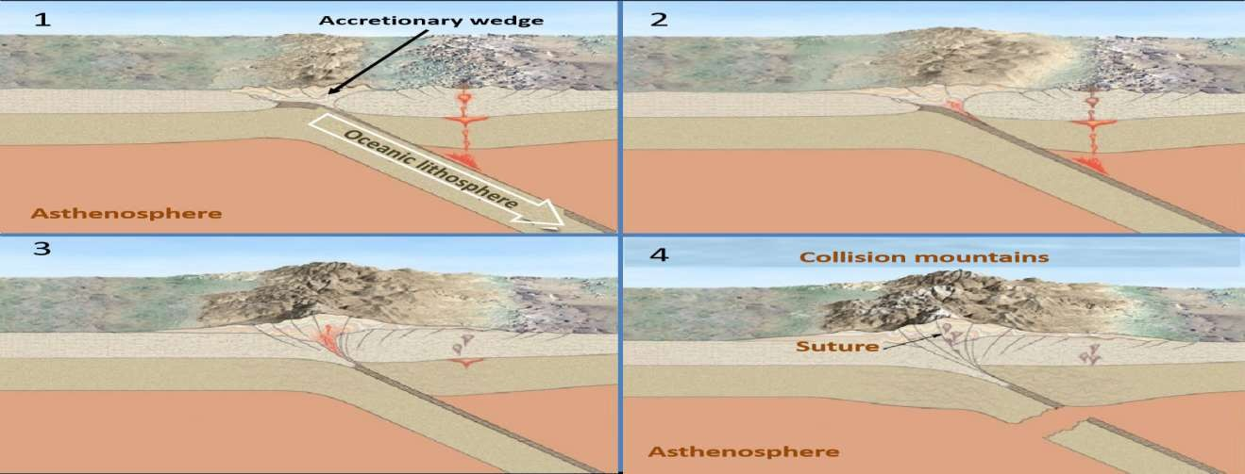
Because continental crust is too buoyant to undergo appreciable subduction, a
collision between the continental plates results. (Figure.10.32). 1 … 4.
39

Slide 40
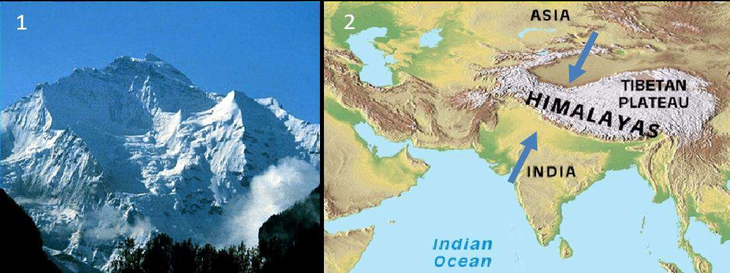
Such a collision occurred when India "rammed" into Asia and produce the Himalayas-the most spectacular mountain range on Earth and the Tibetan Plateau. (Figure.10.33). 1 and 2.
Other examples are the Urals, Caucasus, Pyrenees, Caledonians, Appalachians and
Alps.
40

Slide 41
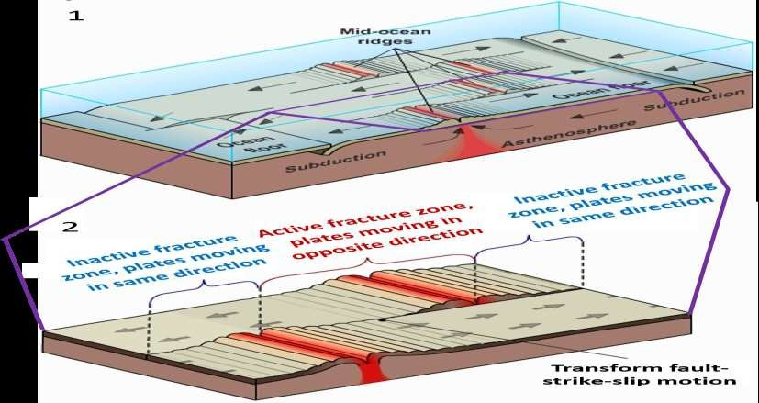
3- Transform fault boundaries:
The third type of plate boundary is called a transform fault. It is found where plates slide horizontally past one another without generating new lithosphere as occurs along divergent plate boundaries and without the destruction of lithosphere as occurs along convergent zones. (Figure.10.34). 1. Most transform faults join two segments of the oceanic ridge system. 2.
41

Slide 42
Transform faults join the globe's active belts (convergent and spreading centers)
into a continuous network. (Figure.10.35).
42

Slide 43
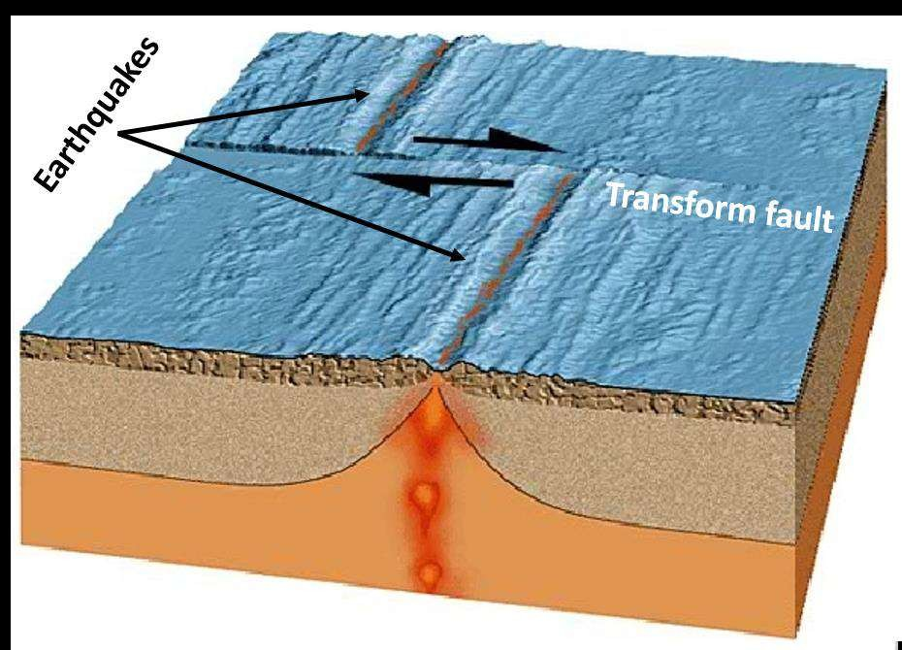
The adjacent plates of oceanic crust grind past one another, sporadically generating
earthquakes. (Figure.10.36).
43

Slide 44
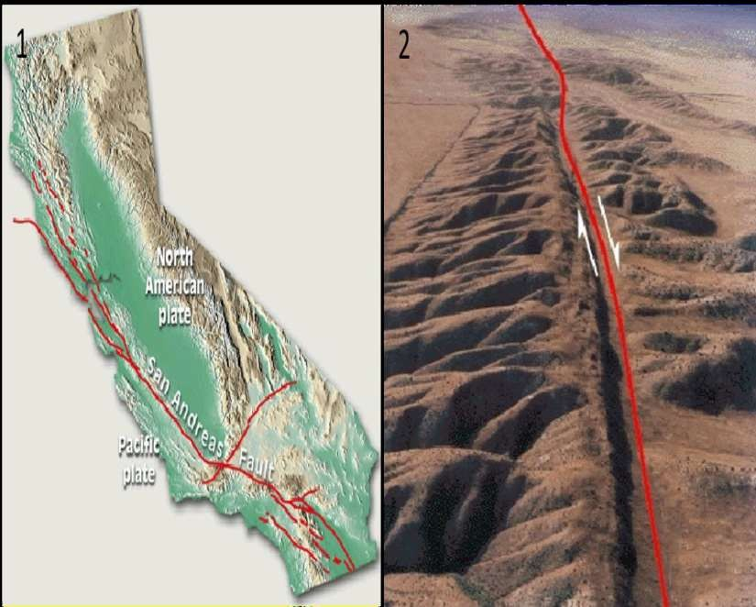
Although most transform faults are associated with oceanic ridge, some like the Andreas Fault in California, cut through continental crust. (Figure.10.37). 1.
Such situations provide geologists an opportunity to study transform faults first
hand. 2.
Along the San Andreas Fault, the Pacific plate is moving toward the northwest,
past the North American plate.
44

Slide 45
Test your knowledge
1. Earth's rigid outer layer overlies a zone of weaker and hotter material known as the :
cry sphere.
lithosphere.
asthenosphere.
mesosphere.
Great earthquakes can be generated at transform fault boundaries.
true.
false.
Most volcanic island arcs located in the ------------------.
western pacific.
Gulf of Mexico.
Caribbean Sea.
South Atlantic.
45

Slide 46
46

