Slide 1
POROSITY AND SATURATION

Slide 2
Applications of Porosity
Porosity data are used in these basic reservoir evaluations:
Volumetric calculation of fluids in the reservoir
Calculation of fluid saturations
Geological characterization of the reservoir
Calculating hydrocarbon in a reservoir
HCPV = A x h x φ x (1 – Swi)
where: A = surface area of the reservoir, h = thickness of the formation, φ = porosity, S_{wi}= the percent of the pore volume occupied by the water.
N = 7758 X As X H X φ X Soi/ Boi
OR
Where: N= HC volume in the reservoir, res.bbl, As = surface area, acres , H= thickness of formation, ft
φ = porosity, fraction, Soi = initial oil saturation (1.0 – Swi), fraction, Boi = formation volume factor

Slide 3
Porosity Measurements
From definition of porosity,porosityof rock samplecan be determined by measuring any two of these quantities:
bulk volume
pore volume
grain volume
Sources of Porosity data:
Core analysis – direct measurement
Well logging analysis
Well testing indirect measurement

Slide 4
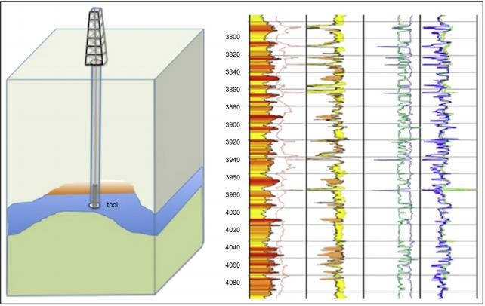
Porosity from logs
3 Main Log Types
Sonic log
Bulk density log
t  t_{m}1t_{f} 
Where : Dt = sonic travel time recorded by log,
Dt_{m} = sonic travel time for the matrix mineral grains (w/o porosity), (55.5, 47.5 and 43.5 microsec/ft for quartz, limestone and dolomite, respectively)
Dt_{f} = sonic travel time for fluid in the pore space (freshwater mud = 189 μsec/ft; saltwater mud = 185 μsec/ft)
 = porosity, fraction
Sonic (acoustic) log
Compensated neutron log
These logs do not measures porosity directly. To accurately calculate porosity, the analyst must know:
Formation lithology
Fluid in pores of sampled
reservoir volume
Density log
Δρ_{b} = Δρ_{m} (1− φ)+Δρ_{f} (φ)
Δρ_{b} = bulk density recorded by log
Δρ_{m} = density of the matrix mineral grains (w/o porosity), (2.65, 2.71 and 2.87 gm/cc
for quartz, limestone and dolomite, respectively)
Δρ_{f} = density of the fluid in the pore space (1 – 1.1 gm/cc)

Slide 5
Lab. Measurements of porosity
Several methods: involves only the determination of two out of three basic parameters (V_{p}, V_{m}, & V_{b})
Note: all methods of determination of bulk volume are in general applicable to determining both total and effective porosity.
Bulk volume by the following methods
Coated sample with paraffin or a similar substance and immersed in water, or
Water-saturated sample immersed in water, or saturating the sample with the fluid into which it is
to immersed.
Using mercury (Dry sample immersed in Hg method)
Grain volume: by Melcher- Nutting method in which the sample is crushed and its volume measured
with a pycnometer
Pore volume : by Boyle’s Law porosimeter (determined using gas expansion methods)

Slide 6
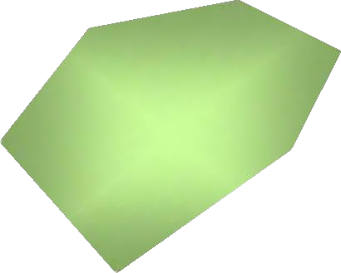
Lab. Measurements of porosity
Porosity measurement
– V_{b}, bulk volume directly measured (Irregular & regular sample shapes)
AA
Direct measure, V_{b}
Common shaped sample (cylinder, or cubic) measured
the dimensions and consider bulk volume
L
To measure V_{b} in laboratory, must prevent fluid
penetration into the pore sample by:
coating with wax
saturating the core with same fluid
using mercury

Slide 7
Example 1.1 – Porosity Calculation
Determination of V_{b} – Coating Method (A sand stone sample with ρm = 2.67 gm/cc)
A = mass dry sample in air = 20.0 gm
B = mass dry sample coated with paraffin = 20.9 gm Sg_{paraffin} = 0.9
C = mass of coated sample immersed in H₂O at 40ºF = 10 gm (Sg_{water}= 1.0)
Mass of paraffin = B – A = 20.9 – 20.0 = 0.9 gm
Volume of paraffin = 0.9/0.9 = 1 cc
Mass of water displaced = B – C = 20.9 – 10.0 = 10.9 gm
Vol. of water displaced = mass of water/ρ of water = 10.9/1.0 =
10.9 cc
Bulk volume = volume of water displaced – volume paraffin
• = 10.9 – 1.0 = 9.9 cc
Bulk volume of rock = 9.9 cc

Slide 8
Example 1.2 – Porosity Calculation
From Example 1.1
Mass of dry sample in air = 20 gm
Bulk volume of sample = 9.9 cc
Grain volume of sample = (mass of dry sample in air)/ (sand-grain density)
Grain density of some minerals
Rock | Density (gm/cc)
Sandstone | 2.65
Limestone | 2.71
Dolomite | 2.87
Anhydrite | 2.98
Salt | 2.17- 2.05
gypsum | 2.35
feldspars | 2.50-2.67
water | 1
• = 20/2.67 = 7.5 cc
Total porosity = Ø_{t} = [(bulk vol. – grain vol.)/bulk
volume] x 100
• = [(9.9 – 7.5)/9.9] x 100 = 24.2 per cent

Slide 9
Example 1.3
A clean and dry core sample weighting 425g was 100% saturated with a 1.07 specific gravity brine. The new weight is 453g. The core sample is 12 cm long and 4 cm in diameter. Calculate the porosity of the rock sample.
SOLUTION:
The bulk volume of the core sample is:
Vb = π(r)² (12) = 150.80 cm³
The pore volume is:
Vp = 1/џ (V_{wet} - V_{dry}) = (453-425)/ 1.07 = 26.17 cm³
Then; Porosity of the core is:
φ = Vp/Vb =26.17 / 150.8= 0.173 or 17.3%

Slide 10
Variation of porosity with depth
The reservoir rock may generally show large variations in porosity vertically but does not show very great variations in porosity parallel to the bedding planes. In this case, the arithmetic average porosity or the thickness-weighted average porosity is used to describe the average reservoir porosity.
A change in sedimentation or depositional conditions, however, can cause the porosity in one portion of the reservoir to be greatly different from that in another area. In such cases, the areal weighted average or the volume- weighted average porosity is used to characterize the average rock porosity.
These averaging techniques are expressed mathematically in the following forms:
where n = total number of core samples
hi = thickness of core sample i or reservoir area i Ø= porosity of core sample i or reservoir area i Ai = reservoir area i

Slide 11
Example
Calculate the arithmetic average and thickness-weighted average from the following measurements:
sample | Thickness, ft | Porosity %
1 | 1 | 10
2 | 1.5 | 12
3 | 1 | 11
4 | 2 | 13
5 | 2.1 | 14
6 | 1.1 | 10
Solution:
Arithmetic average:
10 + 12 + 11 + 13 + 14 + 10
∅ =
= 11.67%
6
Thickness – weighted average
(1)(10)+(1.5)(12)+(1)(11)+(2)(13)+(2.1)(14)+(1.1)(10) _{= 12.11%}
∅ =
1+1.5+1+2+2.1+1.1

Slide 12
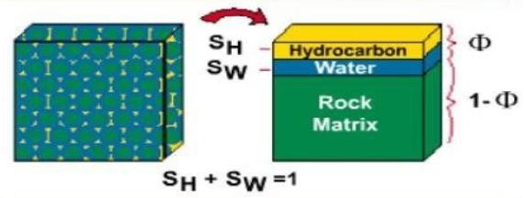
Saturation
Saturation is defined as that fraction, or percent, of the pore volume occupied by a particular fluid (oil, gas, or water). This property is expressed mathematically by the following relationship:
_{𝐹𝑙𝑢𝑖𝑑 𝑠𝑎𝑡𝑢𝑟𝑎𝑡𝑖𝑜𝑛 =} total volume of the fluid
pore volume
Applying the above mathematical concept of saturation to each reservoir fluid gives:
volume of oil (𝑉 )
𝑜𝑖𝑙 𝑠𝑎𝑡𝑢𝑟𝑎𝑡𝑖𝑜𝑛(𝑆 ) =
𝑜
𝑜
pore volume
(𝑉_{𝑃})
volume of 𝑤𝑎𝑡𝑒𝑟 (𝑉_{𝑤)}
) =
Water 𝑠𝑎𝑡𝑢𝑟𝑎𝑡𝑖𝑜𝑛(𝑆
𝑤
pore volume (𝑉_{𝑃})
volume of 𝑔𝑎𝑠
(𝑉_{𝑔𝑠})
gas 𝑠𝑎𝑡𝑢𝑟𝑎𝑡𝑖𝑜𝑛(𝑆 ) =
𝑔
pore volume (𝑉_{𝑃})

Slide 13
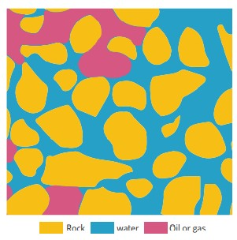
Thus, all saturation values are based on pore volume.
The saturation of each individual phase ranges between zero to 100%. By definition, the sum of the saturations is 100%, therefore:
Sg + So + Sw = 1.0
The fluids in most reservoirs are believed to have reached a state of equilibrium.
It is important to note that hydrocarbon saturation rather than water saturation is of prime interest to the explorationist.
Hydrocarbon saturation is usually determined by the difference between unity and water saturation:
𝑺_{𝒉} = 𝟏 − 𝑺_{𝒘}
The major saturation types of interest in a Reservoir are: Critical Oil saturation, Soc ; Movable oil saturation, Som ; Residual Oil Saturation, Sor ; Connate water Saturation, Swc

Slide 14
Critical oil saturation, Soc
For the oil phase to flow, the saturation of the oil must exceed a certain value, which is termed critical oil saturation. At this particular saturation, the oil remains in the pores and, for all practical purposes, will not flow.
Residual oil saturation, Sor
During the displacing process of the crude oil system from the porous media by water or gas injection (or encroachment), there will be some remaining oil left that is quantitatively characterized by a saturation value that is larger than the critical oil saturation. This saturation value is called the residual oil saturation, Sor. The term residual saturation is usually associated with the no wetting phase when it is being displaced by a wetting phase.
Movable oil saturation, Som
Movable oil saturation Som is another saturation of interest and is defined as the fraction of pore volume occupied by movable oil as expressed by the following equation:
Som = 1 − Swc − Soc
Where: Swc = connate water saturation , Soc = critical oil saturation

Slide 15
Critical gas saturation, Sgc
As the reservoir pressure declines below the bubble-point pressure, gas evolves from the oil phase and consequently the saturation of the gas increases as the reservoir pressure declines. The gas phase remains immobile until its saturation exceeds a certain saturation, called critical gas saturation, above which gas begins to move.
Critical water saturation, Swc
The critical water saturation, connate water saturation, and irreducible water saturation are extensively used interchangeably to define the maximum water saturation at which the water phase will remain immobile.

Slide 16
Types of Measurements
There are two methods to determine or measure fluid saturation
Direct: using core samples through:
Retort distillation
Solvent extraction (Dean-Stark method)
Centrifugal
For lab. Measurement we used the following eq.:
₌ 𝑊𝑒𝑖𝑔ℎ𝑡 𝑜𝑓 𝑤𝑒𝑡 𝑐𝑜𝑟𝑒,𝑔𝑚 −𝑊𝑒𝑖𝑔ℎ𝑡 𝑜𝑓 𝑑𝑟𝑦 𝑐𝑜𝑟𝑒,𝑔𝑚 −𝑊𝑒𝑖𝑔ℎ𝑡 𝑜𝑓 𝑤𝑎𝑡𝑒𝑟,𝑔𝑚 ∗
𝟏
𝑺
𝒐
𝑃𝑜𝑟𝑒 𝑣𝑜𝑙𝑢𝑚𝑒,𝑐𝑐 𝐷𝑒𝑛𝑠𝑖𝑡𝑦 𝑜𝑓 𝑜𝑖𝑙,𝑔𝑚/𝑐𝑐
Indirect: capillary pressure and well log analysis (resistivity logs), also material balance equation.
Factors Affecting Saturation
There are many factors that affect saturation. For example, core samples from reservoir get affected by filtrate from drilling mud. The mud can usually be water or oil based and depending on the wettability of the rock could affect saturation differently. Another factor that affects fluid saturation would be the differences in pressure and temperature that are caused by bringing the core sample from the reservoir to the surface. Those differences in pressure and temperature cause fluids such as gas trapped in oil to be released. This is especially important to know when conducting direct measurements to find the fluid saturation using core samples. The reason fluid saturation is very important is that it helps in estimating the amount of hydrocarbons stored in the reservoir.

Slide 17
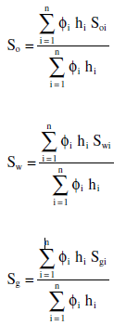
Average Saturation
Proper averaging of saturation data requires that the saturation values be weighted by both the interval thickness (h) and interval porosity Ø. The average saturation of each reservoir fluid is calculated from the following equations:
where the subscript i refers to any individual measurement and hi represents
the depth interval to which
Ø, Soi, Sgi, and Swi apply.

Slide 18
Example

