Slide 1


AL-AYEN UNIVRSITY
COLLEGE OF
PETROLEUM ENGINEERING
TECHNICAL ENGLISH
Lecture#12- PIPELINE CONSTRUCTION
2022-2023
NASIR ALSHMLH
ASMAA ALGHAZI

Slide 2
PIPELINE CONSTRUCTION
Pipeline transport is a transportation of goods through a pipe. Most commonly, liquid and gases are sent, but pneumatic tubes that transport solid capsules using compressed air have also been used.
As for gases and liquids, any chemically stable substance can be sent through a pipeline. Therefore, sewage, slurry, water, or even beer pipelines exist; but the most important are those transporting oil and natural gas.
In the petroleum industry, pipelines are used for a variety of purposes:
1. gathering crude oil from individual leases and delivering it to a central location for processing;
2. transporting crude oil from fields to port terminals for tanker transportation;
3. moving crude oil from processing centers and supply points to the refineries and other markets;
4. moving gas from fields to gas processing plants and from these plants to markets;
5. distributing petroleum products from the refineries to the distribution centers.

Slide 3
A pipeline system is comprised of the following components:
1. line pipe – the main component of every pipeline and is usually metallic (carbon steel / corrosion resistant alloy);
2. pig traps – allow safe loading, launching, receiving and retrieval of pigs without disrupting the fluid in the pipelines;
3. block valve stations – isolate section of the pipeline and limit the release of line contents in case of a leak or pipeline rupture;

Slide 4
4. emergency shut-down valves (ESD) – located at both ends of the
pipeline and enable automatic shut down of the line in case of an emergency;
5. slug catcher – installed at the end of a multi-phase pipeline to prevent slugs and to ensure a constant gas flow into the receiving station;
6. cathodic protection system – installed as a backup to the external coating to prevent corrosion of the external surface of the pipelines;
7. pressure protection system – protects a pipeline when the line pressure exceeds) the max. allowable pressure;
8. telemetry system – permits pipeline monitoring and remote operation from a central location;
9. leak detection system – installed to warn that a leak occurred.

Slide 5
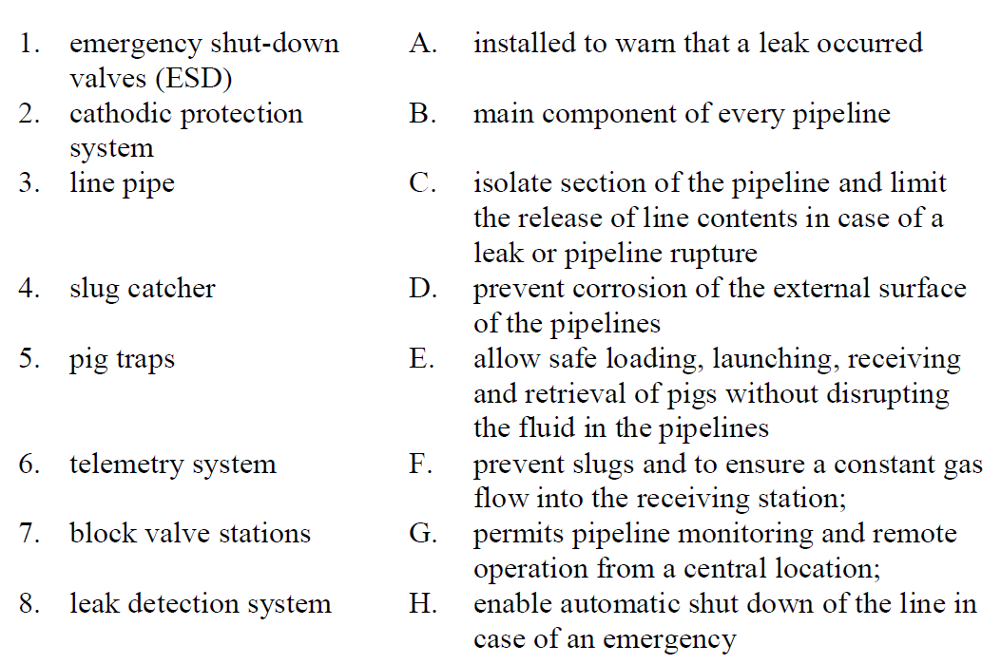
Exercises
1. Match the terms with their functions.

Slide 6
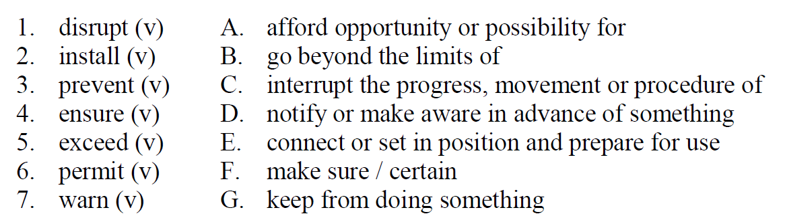
Exercises
2. Match the term with the appropriate meaning.

Slide 7
Exercises
3. Fill in the gaps with the correct words
individual leases to warn pig traps telemetry system monitoring
1-Telemetry system permits pipeline …….and remote operation from a central location.
2-Leak detection system installed …….that a leak occurred.
3. …….allow safe loading, launching, receiving and retrieval of pigs without disrupting the fluid in the pipelines.
4……..permits pipeline monitoring and remote operation from a central location;
5 gathering crude oil from …………and delivering it to a central location for processing;.

