Slide 1
AL-AYEN UNIVRSITY COLLEGE OF ENGINEERING
RESERVOIR ENGINEERING I
Rock-Fluid Interaction Properties
Wettability
2022-2023
NASIR ATALLAH
ASMAA ALGHAZI

Slide 2
Wettability
Outline
Wettability definition
Importance of wettability
Reservoir wettability determination
Interfacial & surface tensions
Contact angle
Wettability classification by contact angle
Wetting and non-wetting phase
Oil-wet or water-wet example
Wettability classification by its variation

Slide 3
Wettability
Wettability: the tendency of one fluid to spread or adhere to a solid surface in the presence of other immiscible fluid
In a reservoir rock:
The liquid phase can be water or oil or gas
The solid phase is the rock mineral
In oil reservoirs, oil & water are immiscible with each other
The fluid which spreads more is called the wetting phase fluid and the other is called the non-wetting phase fluid

Slide 4
Wettability
The degree of wettability depends on:
1- Chemical composition of the wetting & non-wetting phase
Asphaltene content of the oil
2- The nature of the wall pore
Pure quartz sandstone or calcite surfaces are likely to be wetted by water
The presence of certain autogenic clays may promote oil wet character
It is an important factor for:
Residual fluid saturation and distribution
Capillary pressure curves
Relative permeability curves
Electrical properties
EOR processes

Slide 5
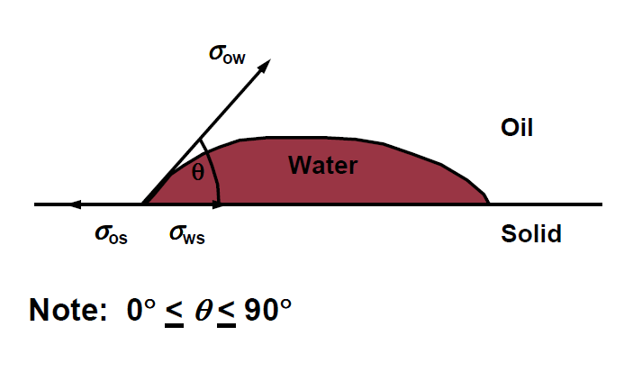
Wetting and non-wetting phase
Wetting phase fluid preferentially wets the solid rock surface.
Attractive forces between rock and fluid draw the wetting phase into small pores.
Non-wetting phase does not preferentially wet the solid rock surface. Repulsive forces between rock and fluid cause non-wetting phase to occupy largest pores.
Natural gas is never be the wetting phase in hydrocarbon reservoirs.
Reservoir wettability determination
Reservoir wettability can be evaluated through measuring of interfacial tension and the contact angle
It is a microscopic characteristic, thus, it is measured by micro-scale laboratory investigation techniques

Slide 6
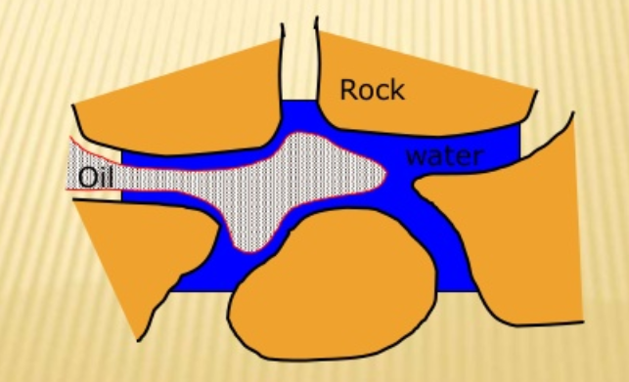
Interfacial & surface tension
Interfacial tension, $σ$: boundary tension between two immiscible liquids or between a fluid and a solid
$σ$wo = Interfacial tension between oil & water
$σ$ws = Interfacial tension between water & solid
$σ$os = Interfacial tension between oil & solid
$σ$gs = Interfacial tension between gas & solid
Surface tension, $σ$: boundary tension between gas & liquid
$σ$go = Surface tension between gas & oil
$σ$gw = Surface tension between gas & water
Interfacial tension between oil and water in pores

Slide 7
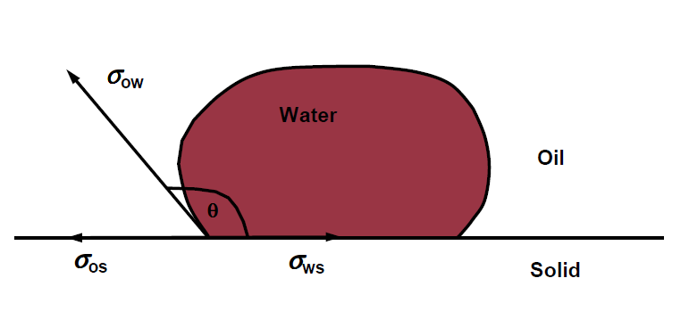
Contact angle
Contact angle, θ: contact angle between the oil/water/solid interface measured through the water
It is influenced by the tendency of one of the fluids (water) to spread on pore wall surface in preference to other fluid (oil)
Reservoirs can be considered oil-wet or water-wet according to the contact angle
Water-wet rock is preferred as it adheres the water. Thus, much oil can be produced

Slide 8
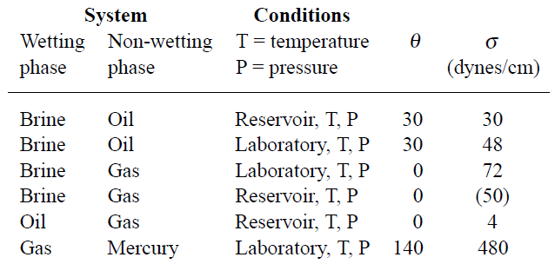
Contact angle
Typical Contact angle & interfacial tension under reservoir &llab conditions:

Slide 9
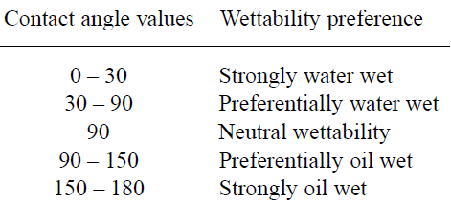
Wettability classification by contact angle
Wettability classification by contact angle, θ

Slide 10
Oil-wet or water-wet ?
Water-wet rock
Oil-wet rock
Reservoir rock is considered to be water-wet if water preferentially wets the rock surfaces
The rock is water-wet under the following conditions:
σws > σos
0° < Ɵ < 90°
If Ɵ is close to 0°, the rock is considered to be “strongly water wet
Reservoir rock is considered to be oil-wet if oil preferentially wets the rock surfaces
The rock is oil-wet under the following conditions:
σos > σws
90° < Ɵ < 180°
If Ɵ is close to 180°, the rock is considered to be “strongly oil wet

Slide 11
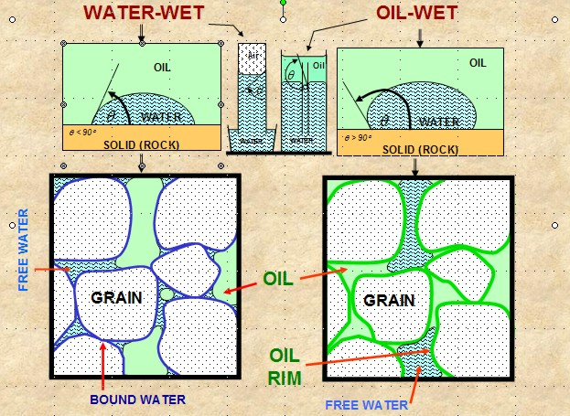
Oil-wet or water-wet ?

