Slide 1
AL-AYEN UNIVRSITY COLLEGE OF ENGINEERING
RESERVOIR ENGINEERING I
- Multi-layered Reservoir
- Applications of Darcy Law
2022-2023
NASIR ATALLAH
ASMAA ALGHAZI

Slide 2
Outline
Multi-layered Reservoir
Weighted-average permeability for Horizontal, linear flow
Weighted-average permeability for Horizontal, radial flow
Harmonic-average permeability for Horizontal, linear flow
Harmonic-average permeability for Horizontal, radial flow
Applications of Darcy Law
Darcy law for linear- horizontal system
Darcy law for linear- non horizontal system
Darcy law for radial- horizontal system

Slide 3
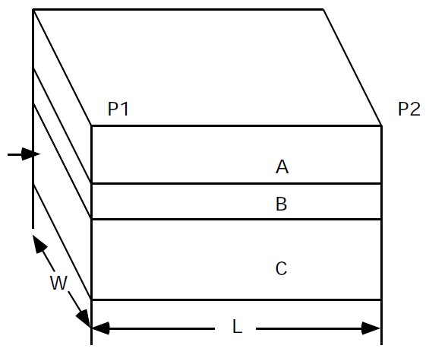
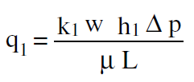
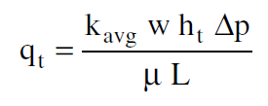
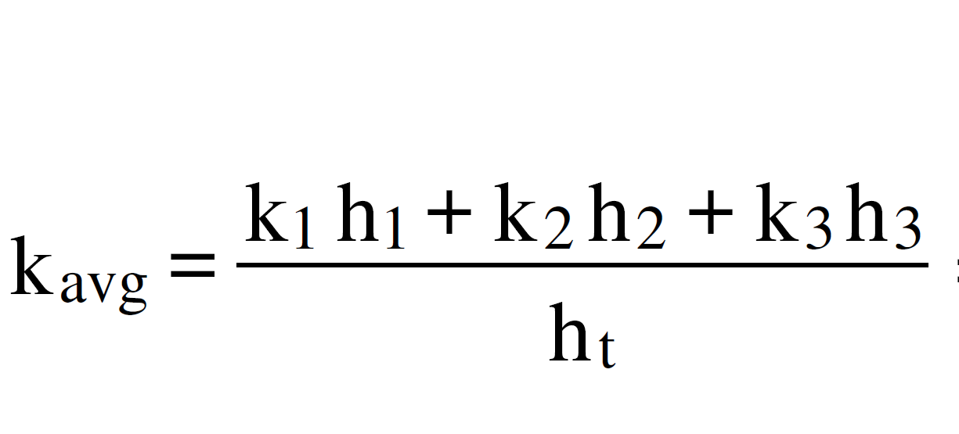
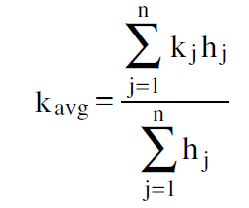
Permeability in layered system
Weighted-average permeability: Horizontal, linear flow
This averaging method is used to determine the average permeability of layered-parallel beds with different permeabilities that are separated from one another by thin impermeable barriers, i.e., no cross flow among layers.
The total flow rate $Q_{T}$ is equal to the sum of the flow rates through each layer or:
q
1
2
3

Slide 4
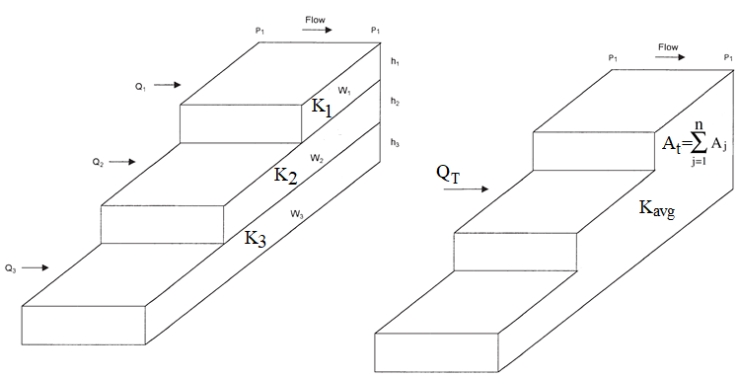
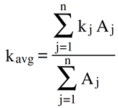
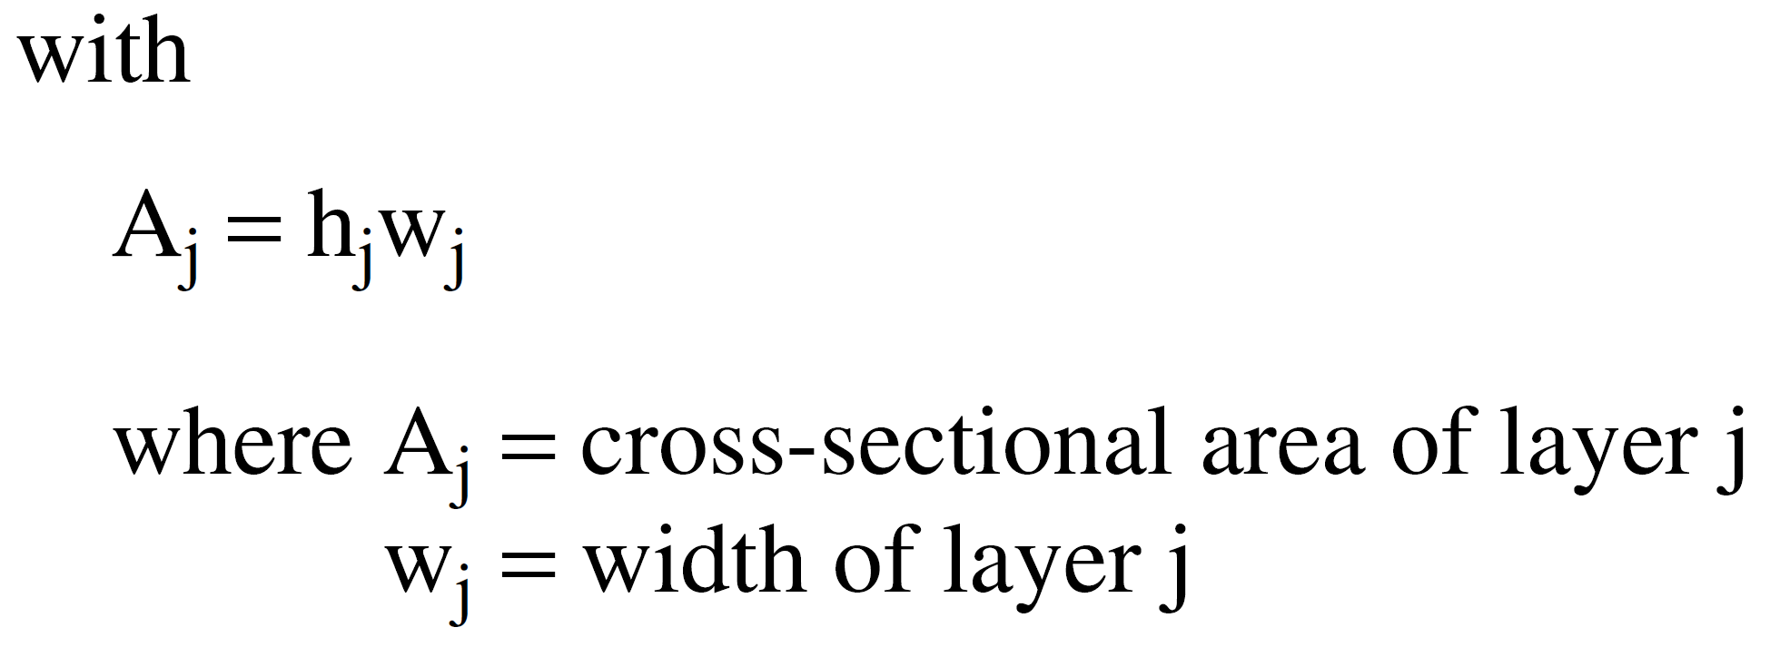
Permeability in layered system
Weighted-average permeability: Horizontal, linear flow
The Figure shows layered-parallel beds with variable widths. Assuming no cross-flow between the layers, the average permeability can be approximated in a manner similar to the previous derivation to give:

Slide 5
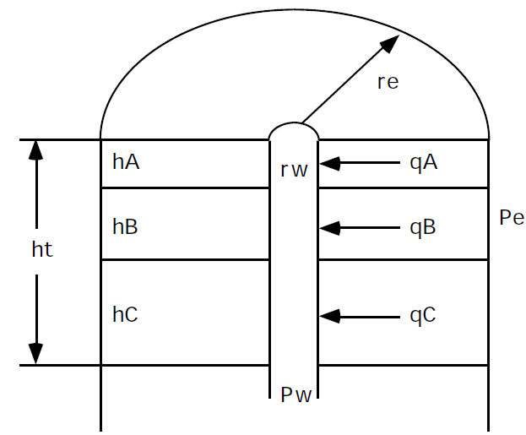
Permeability in layered system
Weighted-average permeability: Horizontal, radial flow
q

Slide 6
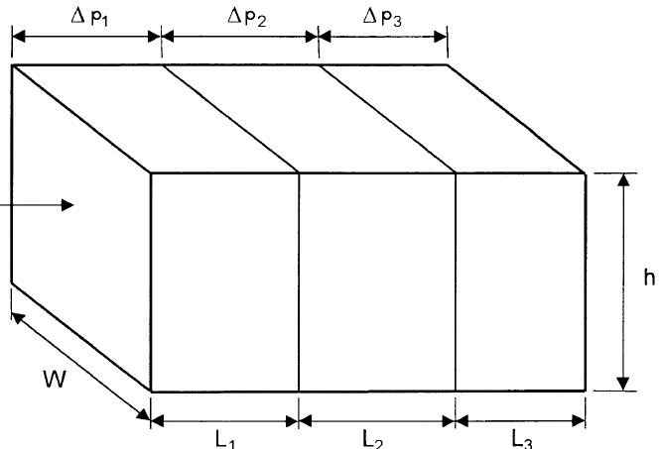
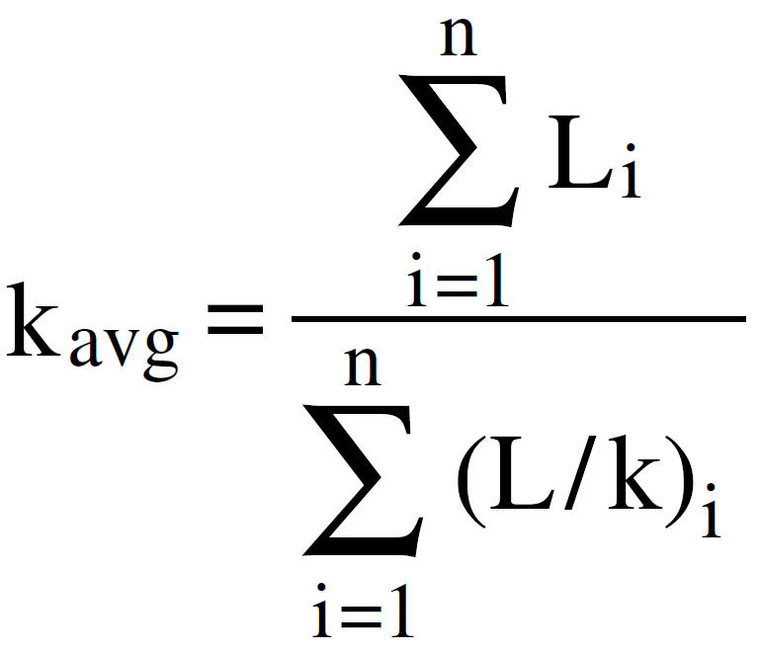
Permeability in layered system
Harmonic-average permeability: Horizontal, linear flow
This method is used when flow perpendicular to bedding (Series beds).
The flow rate is constant.
The total pressure drop Dp is equal to the sum of the pressure drops across each bed.
q
K1
K2
K3

Slide 7
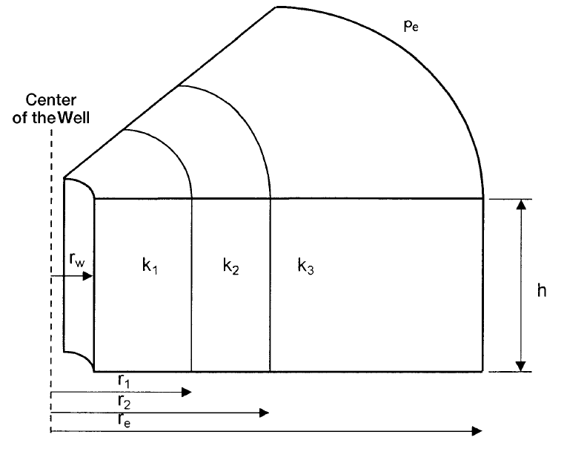
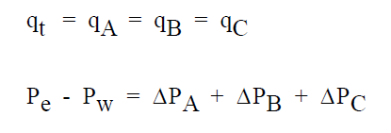
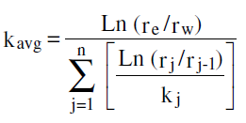
Permeability in layered system
Harmonic-average permeability: Horizontal, radial flow
In the radial system shown in the Figure, the previous averaging methodology can be applied to produce the following generalized expression:
A
B
C

Slide 8
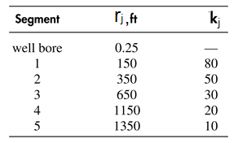
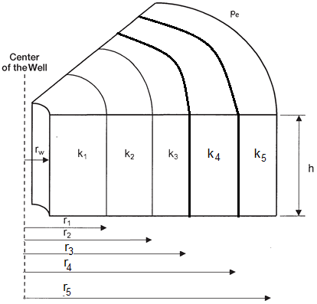
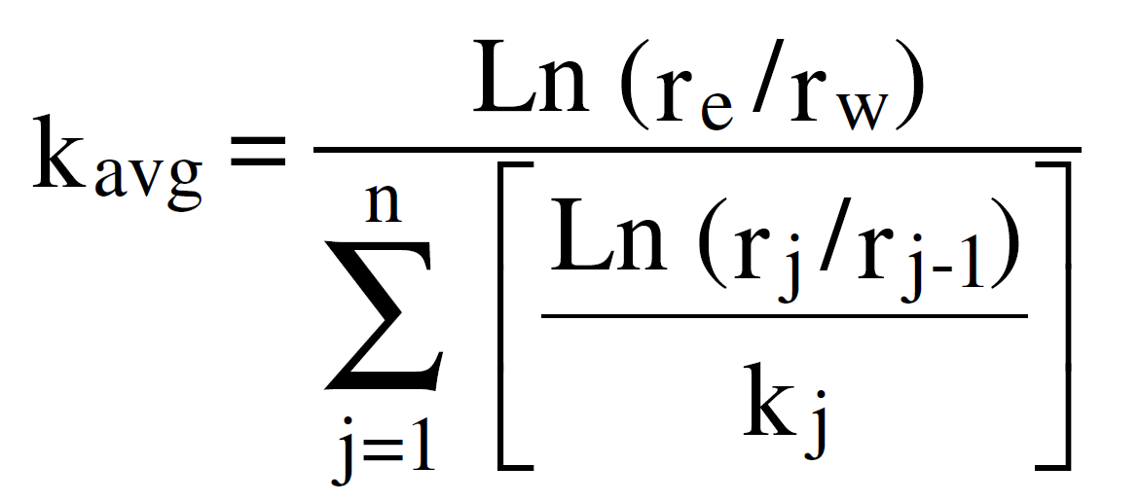
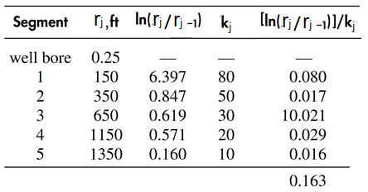
Example
A hydrocarbon reservoir is characterized by five distinct formation segments that are connected in series. Each segment has the same formation thickness. The radii and permeability of each section of the five-bed reservoir are given below. Calculate the average permeability of the reservoir.
Solution

Slide 9
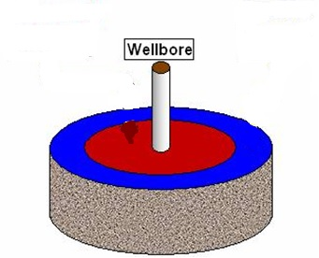
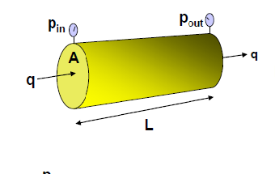
Application of Darcy law
Reservoir systems
Radial system
Linear system

Slide 10
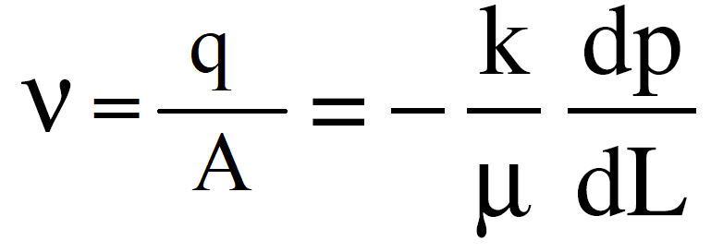
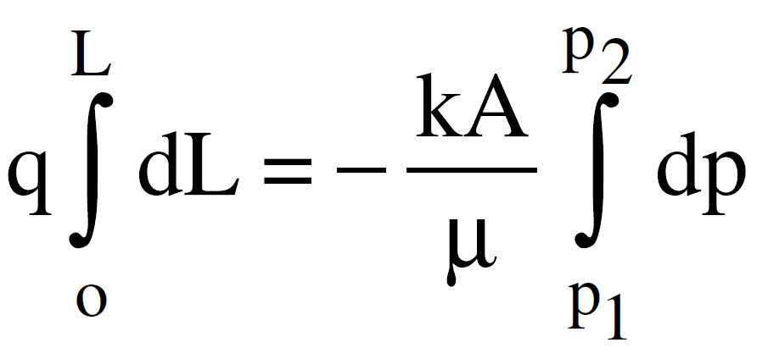
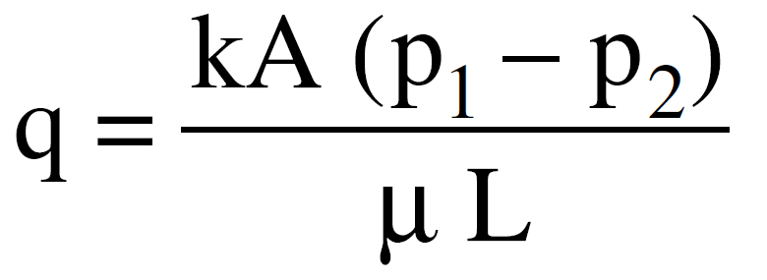
Application of Darcy law
Linear flow of Incompressible Fluids
If a horizontal linear flow of an incompressible fluid is established through a core sample of length L and a cross-section of area A, then the governing fluid flow equation is defined as:
V= apparent fluid flow velocity cm/sec
q=flow rate, cm³/sec
K=Permeability, Darcy
P=Pressure, atm
μ=Viscosity, cp
L=Length, cm
A=Area, cm2
Dp/dL= pressure drop per unit length atm/cm

Slide 11
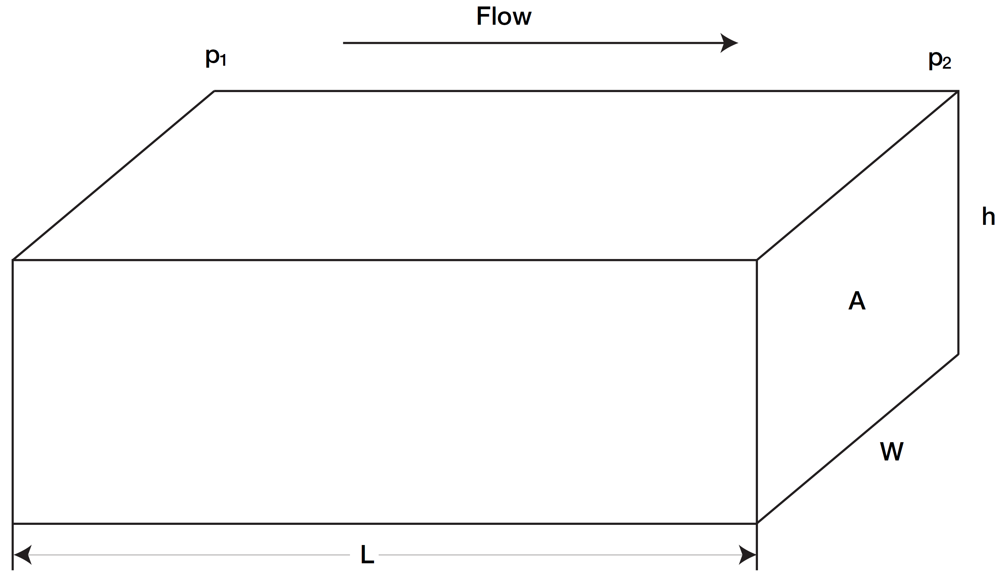
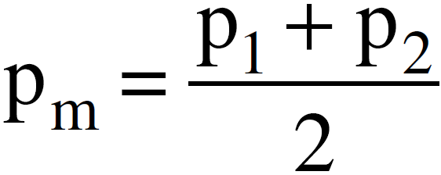
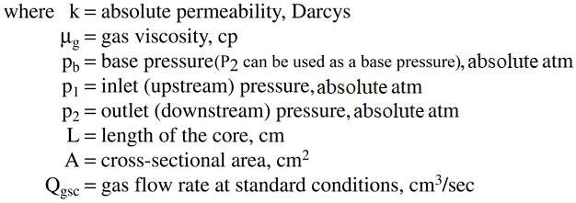
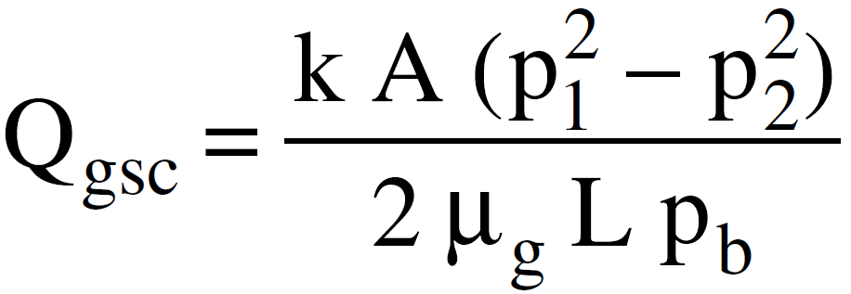
Application of Darcy law
Linear Flow of compressible fluids
The gas volumetric flow rate q varies with pressure because the gas is a highly compressible fluid.
Assuming the used gases follow the ideal gas behavior (at low pressures) with constant temperature, using Boyle’s law, the following relationships apply:
The gas flow rate is usually measured at base (atmospheric) pressure Pb and, therefore:
Substituting Darcy’s Law in the above expression gives
or

Slide 12
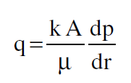
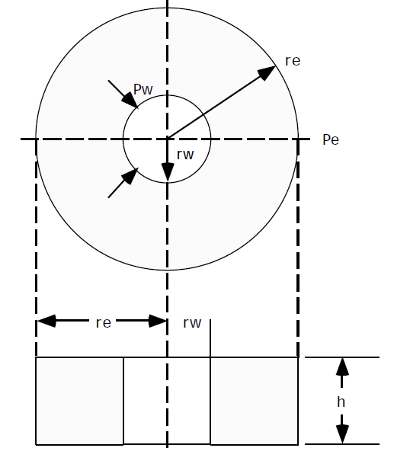
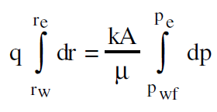
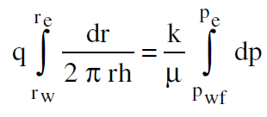
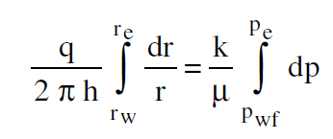
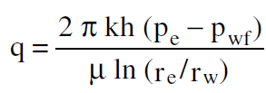
Application of Darcy law
Radial Flow of Incompressible Fluids
For a horizontal radial flow, Darcy’s equation can be written as:
A=the surface area of a cylinder, which is 2πrh
Integrating Darcy’s equation gives:
Assumptions:
Homogenous reservoir
single liquid phase flow
Integrating and solving for q:

Slide 13
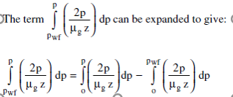
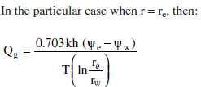
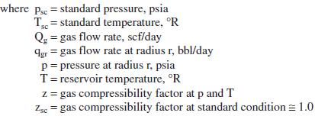
Application of Darcy law
Radial Flow of compressible Fluids

Slide 14
Application of Darcy law
Radial Flow of compressible Fluids
Approximation of the gas flow rate
Removing the term and integrating gives

Slide 15
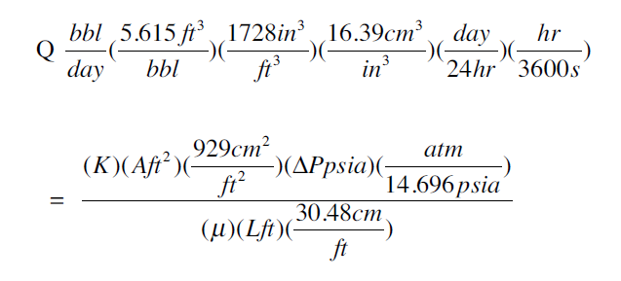
Application of Darcy law
Darcy law in field units:
A conversion factor is required in Darcy law To ensure units compatibility and expressing flow rate in field units.
Symbol | Darcy units | Field units
q | cm³/sec | bbl/day
K | Darcy | md
L | cm | ft
A | cm² | ft²
h | cm | ft
r | cm | ft
P | atm | Psia
μ | cp | cp
Conversion factor
K=Darcy
Linear system
$$q=0.0011271 \frac{\left.K A (P_{1 }−P_{2}\right)}{μ L}$$
q=flow rate, bbl/day
K=Permeability, mD
h=Thickness, ft
P=Pressure, psia
μ=Viscosity, cp
L=Length, ft
R=Radius, ft
Radial system

Slide 16
Application of Darcy law
Darcy law in field units- For multiphase flow in porous media:
$$q_{o}=0.0011271 \frac{\left.K_{o} A (P_{1 }−P_{2}\right)}{μ_{o} L}$$
qo= oil flow rate, bbl/day
qw= water flow rate, bbl/day
qg= gas flow rate, Mscf/day
Kw= water effective permeability, mD
Ko= oil effective permeability, mD
h=Thickness, ft
Pe=reservoir pressure, psia
Pwf= bottom hole flowing pressure, psia
μo=oil viscosity, cp
μw=water Bo= oil formativiscosity, cp
on volume factor, RB/STB
Bw= water formation volume factor, RB/STB
re= drainage raduis, ft
rw = wellbore radius, ft
L=Length, ft
T= Temperature, °R
Linear system
$$q_{w}=0.0011271 \frac{\left.K_{w} A (P_{1 }−P_{2}\right)}{μ_{w} L}$$
$$q_{o}=\frac{0.007082 k_{o} h \left(P_{e}−P_{wf}\right)}{μ_{o}B_{o} ln\left({r_{e}}/{r_{w}}\right)}$$
Radial system
$$q_{w}=\frac{0.007082 k_{w} h \left(P_{e}−P_{wf}\right)}{μ_{w}B_{w} ln\left({r_{e}}/{r_{w}}\right)}$$
$$q_{g}=\frac{kg h \left({P²}_{e}−{P²}_{wf}\right)}{{1422 (μ}_{g}{z) }_{avg} T ln\left({r_{e}}/{r_{w}}\right)}$$

