Slide 1
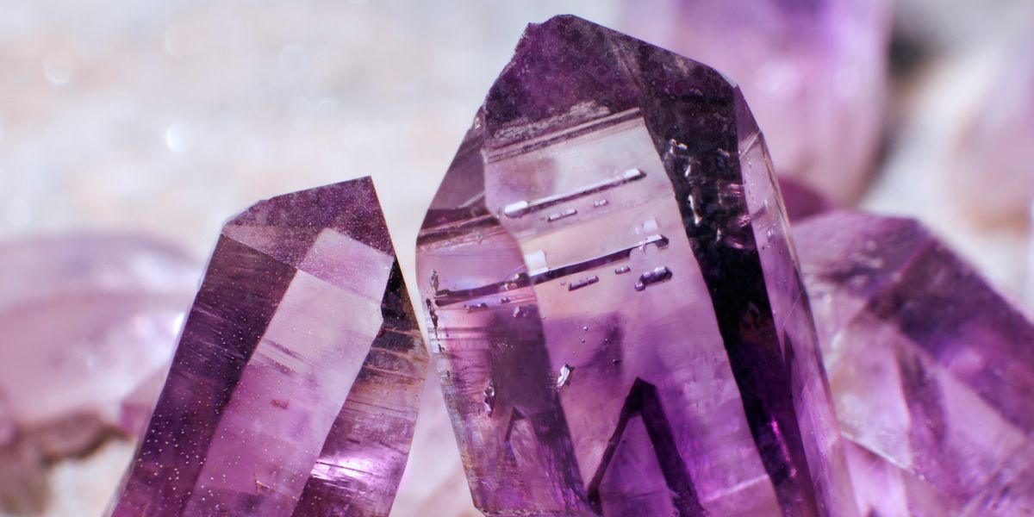
Lecture :2 The Crystals
by Dr. Murtadha Al-Ziadi

Slide 2
Crystals
Introduction:
Some of us may be surprised when they learn that the common metals such as copper, silver, aluminum and other ... As well as most of the solids are crystalline materials.
Although we are accustomed to features of crystalline materials such as quartz and diamonds and salt, the faceted Clear and specific angles between the facets that may not seem to the eye while cutting metal familiar.
However Body is crystalline metals, metal products, hiding in the susceptibility of metals as a result of roads and configuration. The judgment on the substance not is because of their outward appearance, but over the regularity of atoms and molecules of the arrangement League.
Crystallography dawned in 1913 with evidence of scientific based on X-ray and its potential.

Slide 3
Lattice: Typical crystal consists of a repeat of a regular infinite in vacuum units constructivism identical, in the simplest crystals such as crystal copper or silver, for example, as well as in crystals of alkali metals, the unit reconstructive contain a single atom, and may contain the Constructivism unit in the general situation on several atoms or molecules until it reaches about hundred atoms in inorganic crystals, and to about ten thousand atom in the crystallization of proteins.
Crystal: It is a solid body, The arrangement of atoms are repeating pattern.

Slide 4
Crystals properties: They depending on:
1-Crystal faces: Are the surfaces that define the shape of the crystal which is mostly flat, and rarely to be convex or concave. These surfaces Indicate a regular atomic arrangement engineering firm, which consists on the basis of the crystal material.
2- Crystal angles:
a- Edge angle: It is an angle between two neighbor faces.
b- Interfacial angle: c- Solid angle: It is an angle between three neighbor faces.
3- Crystal form:
They are similar surface of the crystal in which consists of each type of face or two faces and at least one related to the crystal axes.
The crystal can be formed of one shape of faces named (simple form) or many shapes named (compound form).

Slide 5
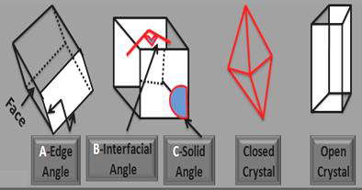

Slide 6
Crystal symmetry:
It is a phenomenon of the formation of a regular crystal form depending on the arrangement of atoms and ions of the constituent material in accordance with the coordination of certain natural, and show to the symmetry repetitive exchange aspects of the body as per their positions to take the crystal single-mode twice or more if they are administered in the crystal full cycle around the axis given.
3.6- Elements of symmetry:
Are signs of a fake attributed to the crystal symmetry, a point or line or level, single or combined, as follows:
1- Plane of symmetry.
2- Axis of symmetry.
3- Center of symmetry.
4- Inversion axis of symmetry.

Slide 7
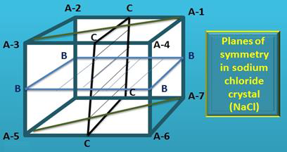
1- Plane of symmetry:
It is the plane at which the crystal is divided into two equal halves, each half a mirror image of the other.

Slide 8
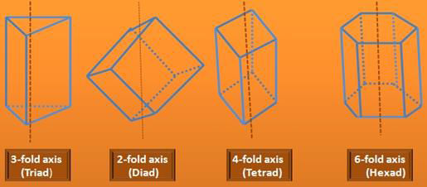
2- Axis of symmetry:
It is an imaginary line passes through crystal center. If the crystal is rotated around that line (360°), face, edge and any line of crystal repeating its self twice or more.

Slide 9
Center of symmetry:
It is a central imaginary point into crystal, that's where the distance of face, edge, and angle in certain side are equal to the other in opposite side from the center.
4- Inversion axis of symmetry:
This element collects between rotation symmetry and inversion through the Center of crystal. If the crystal has double inversion at rotation axis, it needs crystal rotation for (180°) firstly, and then inversion every face, edge, or surface in crystal through symmetry center until the crystal takes its situation in vacancy. This axis is called (two-fold inversion) or (2).So for(3),(4)and (6).
Crystallographic axes:
Imaginary lines intersect within the crystal in its traditional downstream and up to different indications described for it place the crystal facets, each face more cuts at the center or at a distance from the center, which is normally three axes: a. b. c.
Axis a: It is the line that extends vertically in a reading from the crystal examined.
Axis b: is the axis that runs parallel to the development of reading for those who examine the crystal.
Axis c: Are the vertical axes, which are more axes mostly uniform.

Slide 11
Crystal Systems = (Crystallographic systems):
Denominations of the crystals were similar in terms of the lengths of its member's crystalline axes and angles between them, and each system crystalline symmetry elements of its own, and also distinctive crystalline axes.
3.9- System of the crystals:
The crystal systems are divided into two classes:
A- Depend on the axis lengths of crystal
and the axial angles between (α, β, γ).
B- Depend on the elements of symmetry
grade in the crystal.
On the basis of (A and B) above, the crystal systems divided into seven systems:
Cubic system.
2-Tetragonal sys.
3-Hexagonal sys.
4-Orthorhombic sys.
5-Monoclinic sys.
6-Triclinic system.

Slide 12
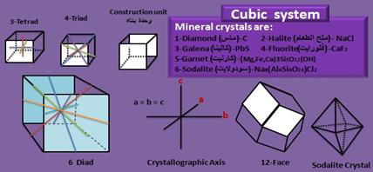
1-Cubic system:
A- Crystallographic axis: 1- Three axes.
2- Equal axes.
3- Perpendicular axes.
B-Elements of symmetry:
1- Axis of Symmetry=13 axis (3.Tetrad +
+ 4.Triad + 6.Diad).
1- Planes of symmetry= 9
3- Center of symmetry= present.

Slide 13
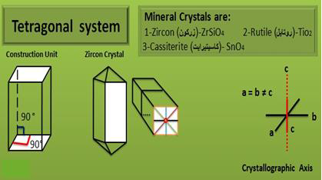
2- Tetragonal System:
A- Crystallographic Axes:
Three axes (two are equal, perpendicular and horizontal, while the third is longer or shorter and vertical on the two equal axes).
B- Elements of Symmetry:
1- Axis of symmetry= 5 Axis (1.Tetrad + 4.
Diad).
2- Planes of symmetry= 5
3- Center of symmetry= present.

Slide 14
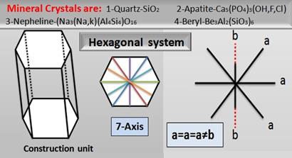
3- Hexagonal system:
A- Crystallographic axes:
Four axes (Three are equal; The angle between each two Axis is (120°). Fourth axis is longer or shorter and perpendicular on the plane of three equal axes).
B- Elements of symmetry:
1- Axes of symmetry= 7axes (1. Hexad +
6. Diad).
2- Plane of symmetry= 7
3- Center of symmetry= present.

Slide 15
4- Trigonal system:
The Trigonal system is like hexagonal system
except:
A- One axis of symmetry (1- Triad).
B- Non existence to any horizontal planes of symmetry.
Mineral crystals are:
1- Calcite- CaCO3 2- Corundum.Al2O3 3- Hematite-Fe2O3 4- Dolomite. (CaMg)CO3
5- Orthorhombic system:
A- Crystallographic axes:
1-Three different length axes.
2-The axes are perpendicular on each other.
b-Elements of symmetry:
1- Axes of symmetry = 3 (Diad).
2- Planes of symmetry = 3
3- Center of symmetry = present.

Slide 17
6- Monoclinic system:
A- Crystallographic axes:
1- Three unequal axes.
2- Two axes intersects (A and C) at inclined angle (β).
Beta angle sandwiched between a and b axes. Differ in the value of different metal crystals, which is less than 90 degrees in the lateral direction, and more than 90 degrees in the direction of the medial.
3- Third axis (B) is perpendicular on the plane of (A and C).
B- Elements of Symmetry:
1- Axis of symmetry = 1 (Diad) conformable with (b) Axis.
2- Planes of Symmetry = 1 pass by (a and c axis).
3- Center of symmetry = present.

Slide 18
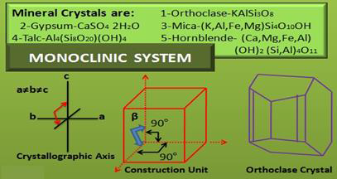

Slide 19
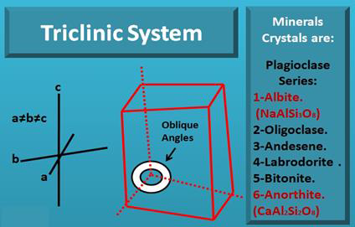
7- Triclinic system:
A- Crystallographic axes:
1- Three unequal axes.
2- Un-perpendicular axes.
B- Elements of Symmetry:
1- Axes of symmetry = absent.
2- Planes of symmetry = absent.

Slide 20
Thank you for listening

