Slide 1
AL-AYEN UNIVRSITY COLLEGE OF ENGINEERING
RESERVOIR ENGINEERING I
Rock-Fluid Interaction Properties
Relative Permeability
2022-2023
NASIR ATALLAH
ASMAA ALGHAZI

Slide 2
Relative Permeability
Outline
Effective permeability
Relative permeability
Relative permeability curve
Rock wettability & relative permeability
Effect of saturation history
Application of relative permeability data
Measurement of relative permeability

Slide 3
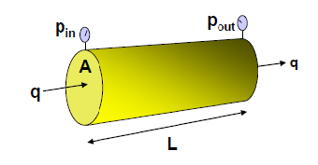
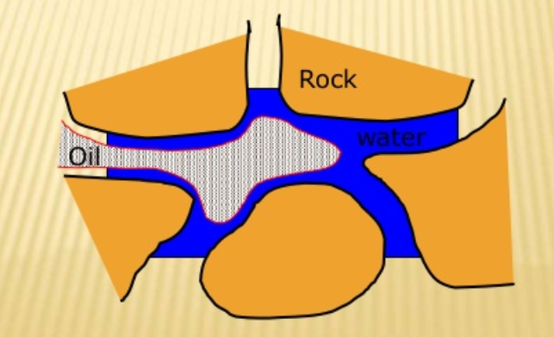
Effective permeability
Absolute permeability is applied when pores are 100% filled with one fluid
$$q=\frac{K A ∆p }{μ L}$$
When pores contain more than one fluid (e.g oil & water), Darcy equation becomes:
$$q_{o}=\frac{K_{o} A ∆p }{μ_{o} L}$$
ko = Effective permeability to oil, Darcy
kw = Effective permeability to water, Darcy
μo = oil viscosity, cp
μw = water viscosity, cp
qo = oil production rate, cm3/sec
qw = water production rate, cm3/sec
$$q_{w}=\frac{K_{w} A ∆p }{μ_{w} L}$$
Effective permeability, Ke: measure of the fluid conductance capacity of porous media to a particular fluid when the pores media is saturated with more than one fluid.
Effective permeability depends on:
1- Geometry of the pores of the rock
2- Rock wetting characteristic
3- Fluid saturations

Slide 4
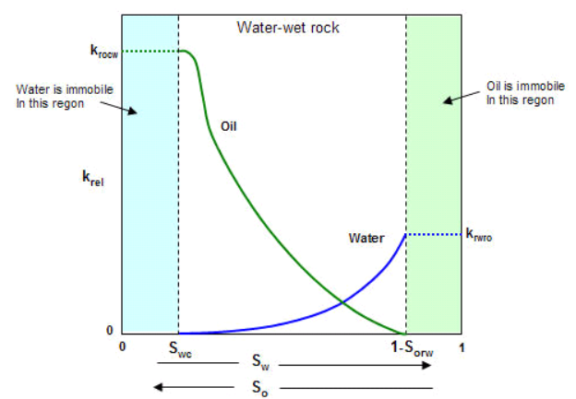
Relative Permeability, Kr
When two or more fluids flow in a porous medium at the same time, it defined as the ratio of the effective permeability to a fluid at a given saturation to the effective permeability to that fluid at 100% saturated (absolute permeability)
$$K_{ro}=\frac{K_{o} }{K}$$
$$K_{rw}=\frac{K_{w} }{K}$$
$$K_{rg}=\frac{K_{g} }{K}$$
Kro= relative permeability to oil, fraction
Krw= relative permeability to water, fraction
Krg= relative permeability to gas, fraction
$$0 ≤Effective Permeability≤Absolute Permeability$$
$$0 ≤Relative Permeability≤1$$
$$k_{ro}+k_{rg}+k_{rw}≤1$$
Typical Kr curve for two phase
Oil-Water system
As water saturation increases (oil saturation decrease), Kro decreases
As water saturation increases (oil saturation decrease), Krw increases

Slide 5
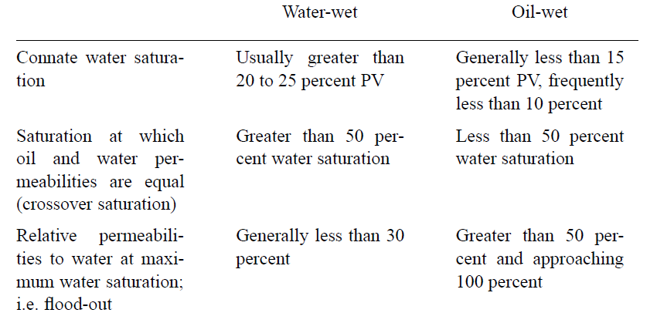
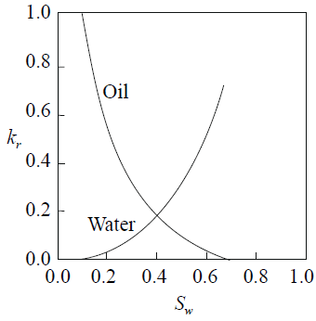
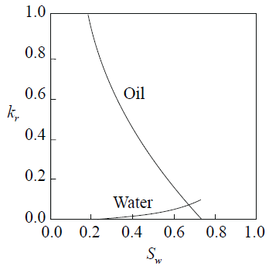
Rock wettability & relative permeability
The wetting phase occupies the smaller pore openings and will affect the nonwetting phase permeability only to a limited extent.
The nonwetting phase occupies the central or larger pore openings that a small nonwetting phase saturation will drastically reduce the wetting phase permeability.
Wettability from Kr curve: A rule of thumb

Slide 6
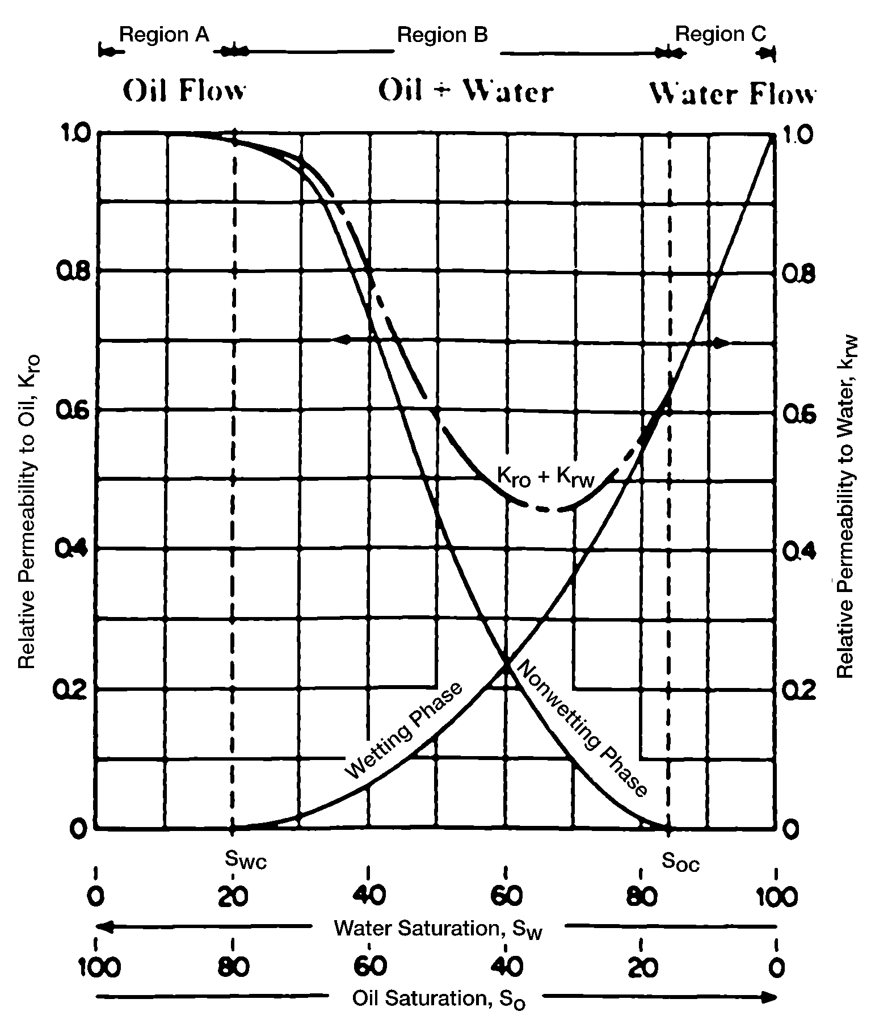
Relative Permeability Curves for a Water-Oil System
A small saturation of the nonwetting phase will drastically reduce the relative permeability of the wetting phase.
The nonwetting phase begins to flow at the relatively low saturation of the nonwetting phase. This saturation is called the critical saturation (shown on the curve as Soc, critical oil saturation) or residual oil saturation, Sor.
The wetting phase starts to flow at a relatively large saturation. The water saturation at this point is referred to as the irreducible water saturation (Swir), connate water saturation (Swc) or initial water saturation (Swi).
The lower saturations of the wetting phase have only a small effect on the nonwetting phase relative permeability curve.
The total permeability to both phases, krw + kro, is less than 1, in regions B and C.
For an oil-wet system, the curve shapes shown in the Figure should be reversed.
Typical relative permeability curves for a water-wet reservoir

Slide 7
Effect of saturation history
Drainage process: wetting phase is displaced by non-wetting phase, i.e., wetting phase saturation is decreasing.
Imbibition process: non-wetting phase is displaced by wetting phase, i.e., wetting phase saturation is increasing.
Hysteresis Phenomenon : The hysteresis phenomenon is the difference in the relative (and effective) permeability between the drainage process and the imbibition process in the same rock.

Slide 8
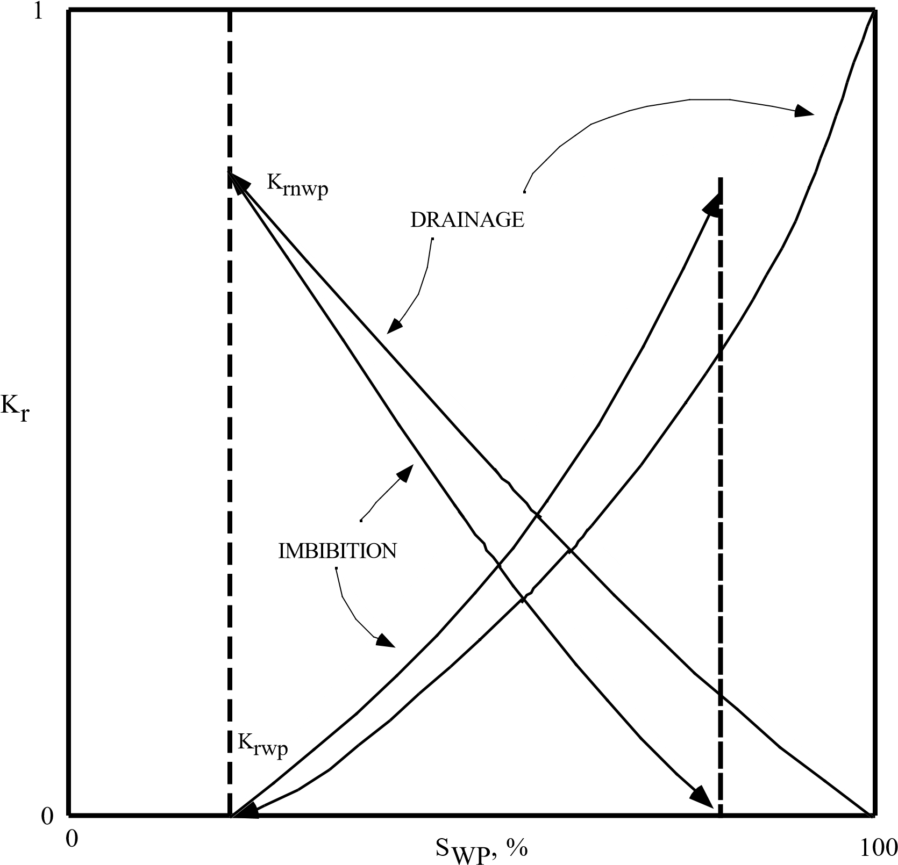
Effect of saturation history
Process begins with porous rock 100% saturated with wetting phase (Swp = 100%)
Wetting phase is displaced with non-wetting phase (drainage) until wetting phase ceases to flow (Swp = minimum interstitial wetting phase saturation)
Then non-wetting phase is displaced with wetting phase (imbibition) until non- wetting phase ceases to flow (residual non-wetting phase saturation)
The word "hysteresis" describes the process in which the results (kr) are different when measurements are made in different directions
The procedure (drainage or imbibition) used to obtain kr data in laboratory must correspond to the process in the reservoir:
initial distribution of fluids in reservoir was by drainage
at and behind a water front (flood or encroachment) the process is imbibition
Minimum wetting
phase saturation
Residual non-wetting
phase saturation

Slide 9
Applications of relative permeability data
Determination of residual fluid saturation
Determination of irreducible fluid saturation
Reservoir wettability
Use to calculate the effective permeabilities to predict fluids flow rates (Darcy law)
Imbibition curve used in water flooding calculations (construct fractional flow curve)

Slide 10
Measurement of relative permeability
Methods:
1- Laboratory Methods
Steady-state flow process & Displacement (unsteady-state process).
Kr is determined through special core analysis, SCAL
2- Calculation from capillary pressure data (Correlations)
3- Calculation from field performance data

Slide 11
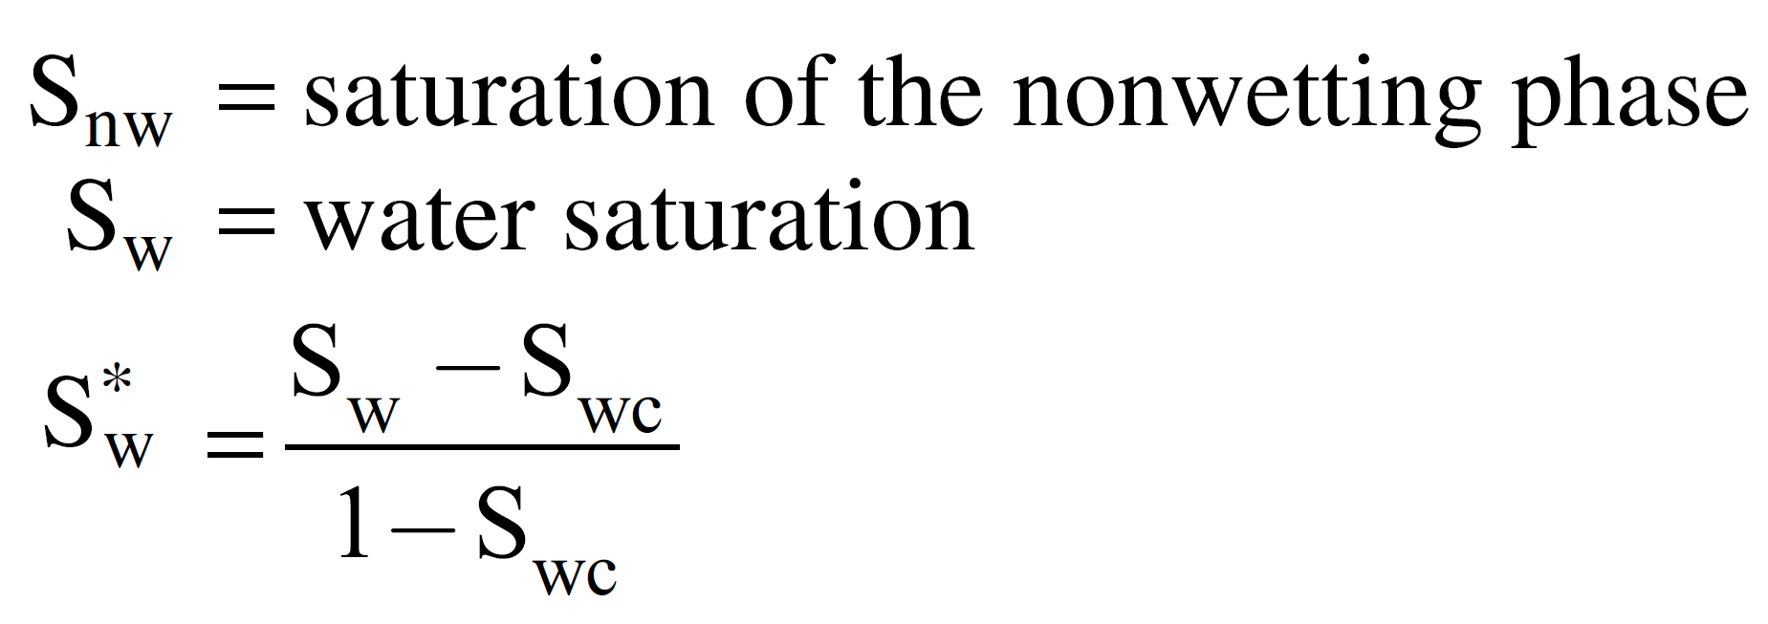
Calculation of Relative Permeability
Pirson’s Correlation
Pirson (1958) derived generalized relationships for determining the two-phase relative permeability. These generalized expressions are applied for water-wet rocks.
For the water (wetting) phase:
(This equation is valid for both the imbibition and drainage processes)
For the nonwetting phase:
Imbibition:
Drainage:

