Slide 1
COLLAGE OF DENTISTRY
الفرع: امراض الفم
Dental Radiology المادة:
Normal radiographic anatomyالمحاضرة:
10 رقم المحاضرة:
اسم تدريسي المادة: م.م. مسار عبدالخالق

Slide 3
The enamel characteristically appeared more radiopaque than the other tissue, because is the most dense naturally occurring substance in the body. Being 90% minerals , it causes the greatest attenuation of the x ray photons, the dentin is about 75% mineralized and because of its lower mineral content, its radiographic appearance it is roughly comparable with bone. Thin layer of cementum cover the root surface has mineral content 50% comparable of that in dentin. Cementum is not usually apparent radiographlly because cementum layer is so thin.

Slide 4
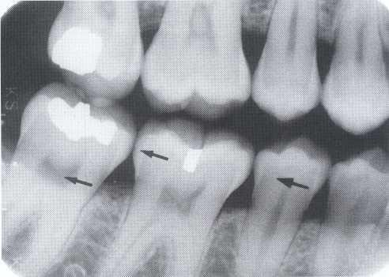
E
P
D

Slide 5
The pulp of normal teeth is composed of soft tissue and consequently appears radiolucent. The chambers
and root canals containing the pulp extend from the interior of the crown to the apices of the roots. Although the shape of most pulp chambers is fairly uniform within tooth groups, great variations exist among individuals in the size of the pulp chambers and the extent of pulp horns.
A radiograph of sound teeth in a normal dental arch demonstrates that the tooth sockets are bounded by a thin radiopaque layer of dense bone. Its name, lamina dura (hard layer).

Slide 6
Because the periodontal ligament (PDL) is composed primarily of collagen, it appears as a radiolucent space between the tooth root and the lamina dura. This space begins at the alveolar crest, extends around the portions of the tooth roots within the alveolus, and returns to the alveolar crest on the opposite side of the tooth.

Slide 7
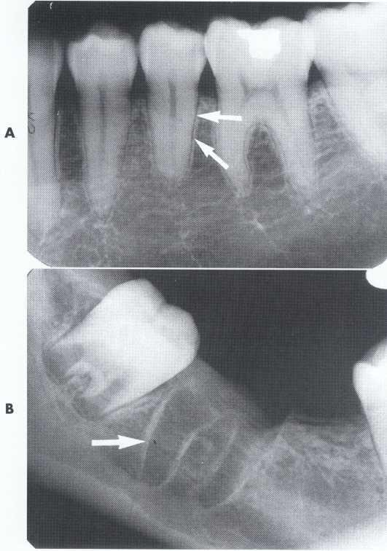
PDL
Lamina dura

Slide 8
Cancellous bone
The cancellous bone (also called trabecular bone or spongiosa) in both jaws.
To evaluate the trabecular pattern in a specific area, the practitioner should examine the trabecular distribution, size, and density and compare them throughout both jaws. This frequently demonstrates that a particularly suspect region is characteristic for the individual. The trabeculae in the anterior maxilla are typically thin and numerous, forming a fine, granular, dense pattern, and the marrow spaces are consequently small and relatively numerous.
In the posterior maxilla the trabecular pattern is usually quite similar to that in the anterior maxilla, although the marrow spaces may be slightly larger.

Slide 9
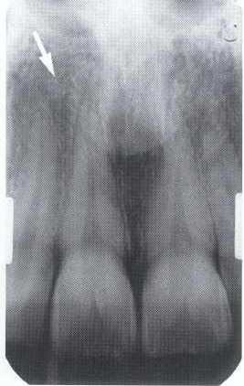

Slide 10
In the anterior mandible the trabeculae are somewhat thicker than in the maxilla, resulting in a coarser pattern, with trabecular plates that are oriented more horizontally. The trabecular plates are also fewer than in the maxilla, and the marrow spaces are correspondingly larger. In the posterior mandible the periradicular trabeculae and marrow spaces may be comparable to those in the anterior mandible but are usually somewhat larger.
Note… Occasionally the trabecular spaces in this region are very irregular, with some so large that they mimic pathologic lesions.

Slide 11
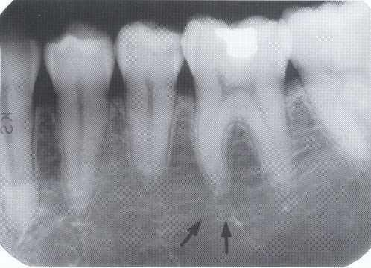

Slide 12
Maxillary landmarks
1-Intermaxillary Suture
The intermaxillary suture (also called the median suture) appears on intraoral periapical radiographs as a thin radiolucent line in the midline between the two portions of the premaxilla.
It extends from the alveolar crest between the central incisors superiorly through the anterior nasal spine.

Slide 13
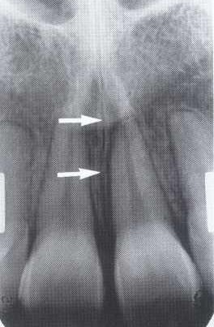

Slide 14
2-Anterior Nasal Spine
The anterior nasal spine is most frequently demonstrated on periapical radiographs of the maxillary central incisors.
Located in the midline, it lies some 1.5 to 2 cm above the alveolar crest, usually at or just below the junction of the inferior end of the nasal septum and the inferior outline of the nasal fossa.
It is radiopaque because of its bony composition and is usually V-shaped.

Slide 15
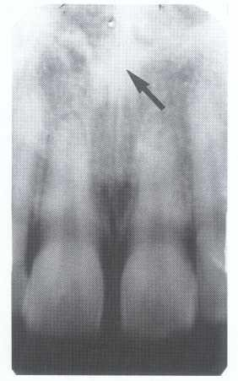

Slide 16
3-Nasal Fossa
Because the air-filled nasal fossa (cavity) lies just above the oral cavity, its radiolucent image may be apparent on intraoral radiographs of the maxillary teeth, especially in central incisor projections. On periapical radiographs of the incisors the inferior border of the fossa appears as a radiopaque line extending bilaterally away
from the base of the anterior nasal spine.
Above this line is the radiolucent space of the inferior portion of the fossa

Slide 17
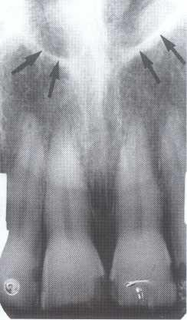

Slide 19
4-Incisive Foramen
The incisive foramen (also called the nasopalatineor anteriorpalatineforamen) in the maxilla is the oral terminus of the nasopalatine canal. It transmits the nasopalatine vessels and nerves (which may participate in the innervation of the maxillary central incisors) and lies in the midline of the palate behind the central incisors at approximately the junction of the median palatine and incisive sutures. Its radiographic image is usually projected between the roots and in the region of the middle and apical thirds of the central
incisors.

Slide 21
5-Lateral Fossa
The lateral fossa (also called incisive fossa) is a gentle depression in the maxilla near the apex of the lateral incisor. On periapical projections of this region it may appear diffusely radiolucent. The image will not be misinterpreted as a pathologic condition, however, if the radiograph is examined for an intact lamina dura around the root of the lateral incisor. This finding, coupled with absence of clinical symptoms, suggests
normalcy of the bone

Slide 22
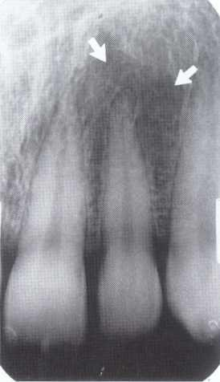

Slide 23
6-Nose
The soft tissue of the tip of the nose is frequently seen in projections of the maxillary central and lateral incisors, superimposed over the roots of these teeth. The image of the nose has a uniform, slightly opaque appearance with a sharp border.

Slide 24
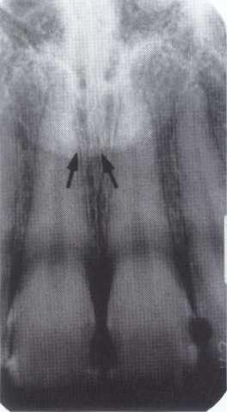

Slide 25
7-Maxillary Sinus
The maxillary sinus, like the other paranasal sinuses, is an air- containing cavity lined with mucous membrane so it appeare as a radiolucent area.
The borders of the maxillary sinus appear a thin, delicate, tenuous radiopaque line (actually a thin layer of cortical bone)

Slide 26
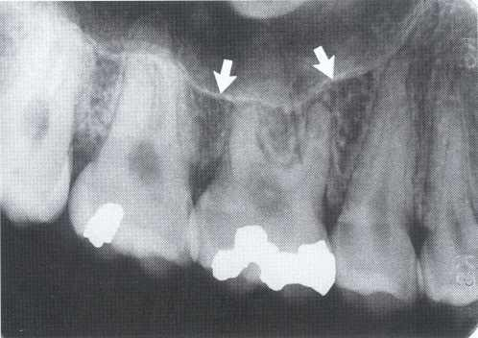

Slide 27
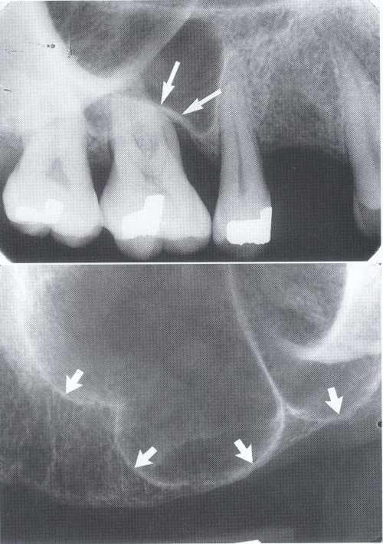

Slide 28
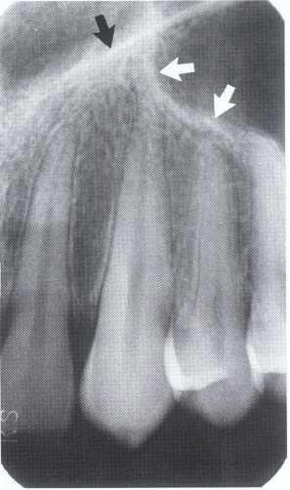
on periapical radiographs of the canine, the floors of the sinus and nasal cavity are often superimposed and may be seen crossing one another, forming an inverted Y in the area.

Slide 29
8-Zygomatic Process and Zygomatic Bone
The zygomatic process of the maxilla is an extension of the lateral maxillary surface that arises in the region of the apices of the first and second molars and servens as the articulation for the zygomatic bone. On periapical radiographs the zygomatic process appears as a U-shaped radiopaque line with its open end directed superiorly.

Slide 30
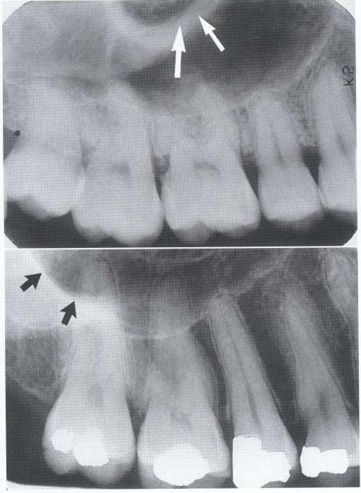

Slide 31
Mandibular landmarks
1-Genial Tubercles
The genial tubercles (also called the mental spine) are located on the lingual surface of the mandible slightly above the inferior border and in the midline. They are well visualized on mandibular occlusal radiographs as one or more small projections.

Slide 32
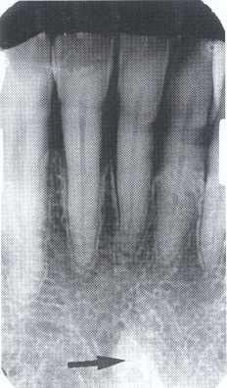
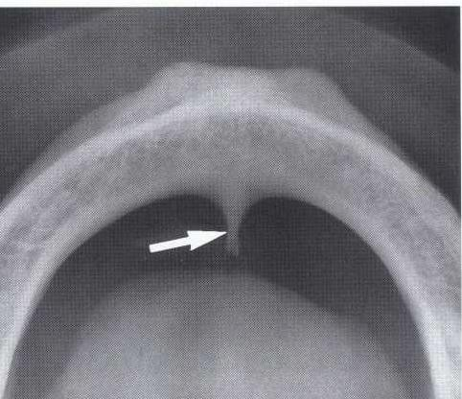

Slide 33
Their appearance on periapical radiographs of the mandibular incisor region may vary: a radiopaque mass in the midline below the incisor roots. When not delineated on periapical films, a small radio-lucent dot (the lingual foramen) surrounded by the cortical wall of the termination of the incisive branch of the mandibular canal is usually quite apparent.

Slide 34
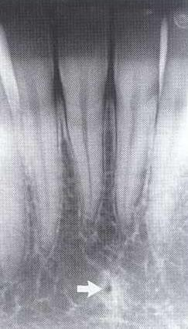

Slide 35
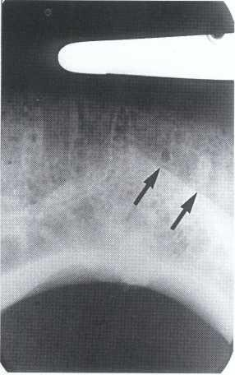
2-Mental Ridge
On periapical radiographs of the mandibular central incisors, the mental ridge (protuberance) may occasionally be seen as two radiopaque lines sweeping bilaterally forward and upward toward the midline.

Slide 36
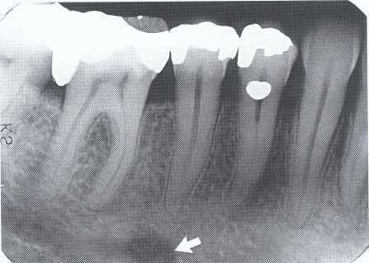
3-Mental Foramen
The mental foramen is usually the anterior limit of the inferior dental canal that is apparent on radiographs. It may be round, oblong, slitlike, or very irregular radiolucent and partially or completely corticated. The foramen is seen usually in the region of the apex of the second premolar.

Slide 37
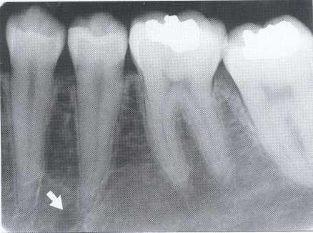
When the mental foramen is projected over one of the premolar apices, it may mimic periapical disease. In such cases, evidence of the inferior dental canal extending to the suspect radiolucency or a detectable lamina dura in the area would suggest the true nature of the dark shadow.

Slide 38
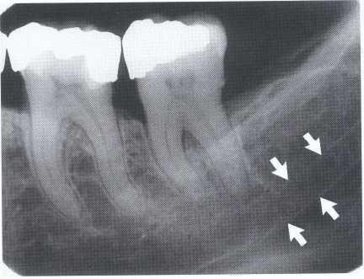
4-Mandibular Canal
The radiographic image of the mandibular canal is a dark linear shadow with thin radiopaque superior and inferior borders cast by the lamella of bone that bounds the canal.

Slide 39
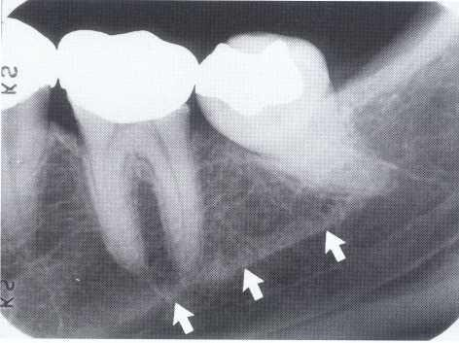
5-Mylohyoid Ridge
The mylohyoid ridge is a slightly irregular crest of bone on the lingual surface of the mandibular body. Extending from the area of the third molars to the lower border of the mandible in the
region of the chin

Slide 40
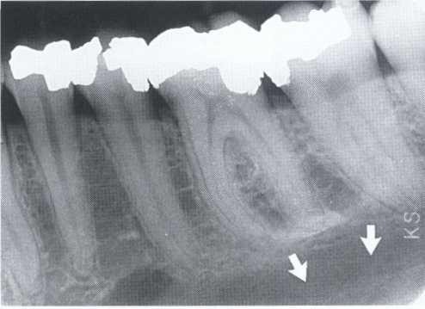
6-Submandibular Gland Fossa
On the lingual surface of the mandibular body, immediately below the mylohyoid ridge in the molar area, there is frequently a depression in the bone. This concavity accommodates the submandibular gland and often appears as a radiolucent area with the sparse trabecularpattern characteristic of the region.

Slide 41
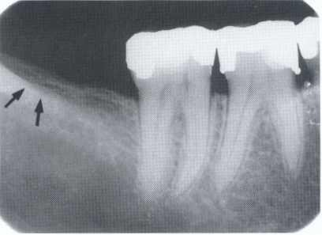
7-External Oblique Ridge
The external oblique ridge is a continuation of the anteriorborder of the mandibular ramus.

Slide 42
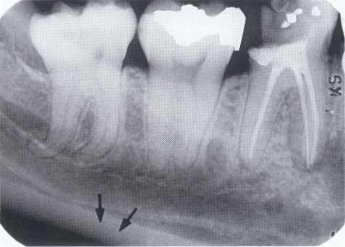
8-Inferior Border of the Mandible
Occasionally the inferior mandibular border will be seen on periapical projections as a characteristically dense, broad radiopaque band of bone.

Slide 43
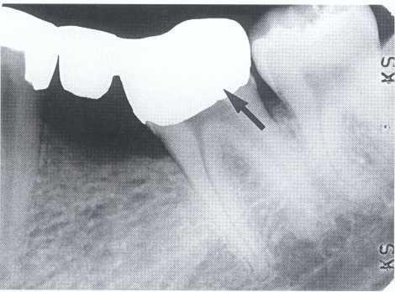
Restorative Materials
A cast gold crown, appearing completely radiopaque
(arrow), serves as the terminal abutment of a bridge

Slide 44
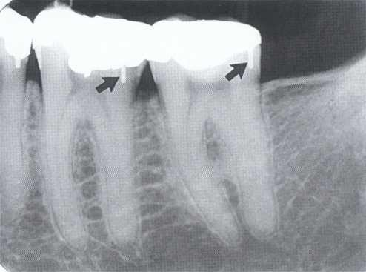
Stainless steel pins (arrows) provide
retention for amalgam restorations.

Slide 45
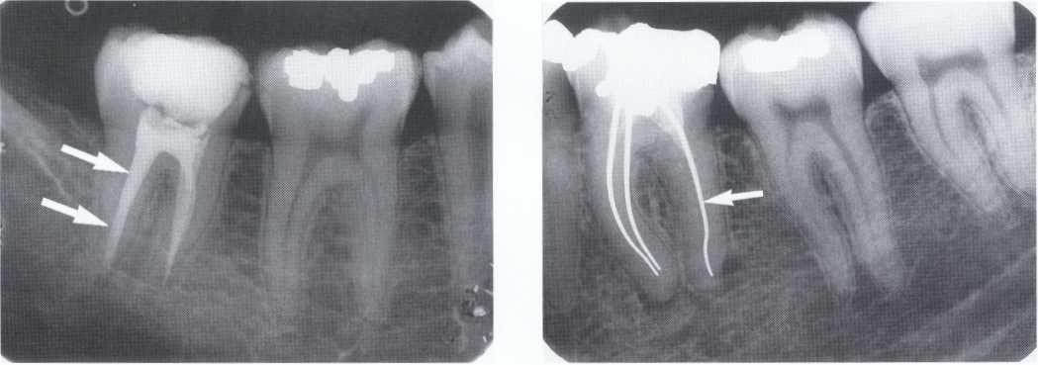
Gutta percaz
Silver cone

Slide 46
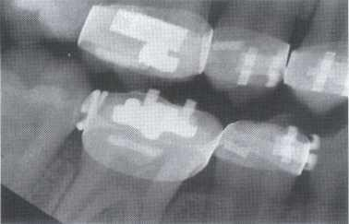

Slide 47
THANK YOU

