Slide 1
Pharmacodynamics
AL-AYEN UNIVERSITY
COLLEGE OF HEALTH AND MEDICAL TECHNOLOGY
DEPARTMENT OF ANESTHESIA
By PhD Karima Aboul Fotouh
Lecturer 3

Slide 2
Pharmacodynamics
The actions of the drug on the body.
Pharmacodynamics considers the sites, modes, and mechanisms of action of drugs.
Mode of action; The character of an effect produced by a drug is called the mode of action of that drug.
Site of action: The receptor site where a drug acts to initiate a group of functions is that drug's site of action.
Mechanism of action: The identification of molecular and biochemical events leading to an effect is called the mechanism of action of that drug.

Slide 3
The drug may produce its action by one of the following mechanisms:
1- On the cell membrane by:
- Acting of ion channel
- Acting on specific receptors.
- Acting on enzymes.
- Acting on carrier molecule (transporters)

Slide 4
2- On metabolic processes within the cell by:
- Enzyme inhibition e.g. allopurinol inhibits Xanthine oxidase.
Inhibition of transport processes that carry substances across cells e.g. probenecid delays excretion of penicillin.
3- Outside the cell:
- Direct chemical interaction e.g. antacid
- Physical interaction e.g. Kaolin adsorb toxins

Slide 5
Body Control system (Drug Targets)
Four main kinds of regulatory protein are commonly involved as primary drug targets
namely:
1 - Enzymes 2- Ion channels 3- Carrier molecule (transporters) 4- Receptors
1- Enzymes
Drugs may inhibit enzyme activity and this inhibition may be reversible inhibition
(Competitive) The drug is structurally similar to natural substrate and compete with it
for the enzyme or irreversible inhibition (Non-Competitive) where drug combine irreversibly with enzyme.

Slide 6
2-Transporters (Carrier proteins)
Several substrates which cannot penetrate the lipid
membrane (Too Large- Too Polar) are translocated
across membranes by binding to specific transporters
(carriers).
3-Ion Channels
Selective pores in the cell membrane that allow passage of ions down their concentration gradient
Types of ion channels
A- Voltage sensitive channel: controlled by membrane potential
B- ligand sensitive channel: controlled by ligand or transmitter

Slide 7
4 - Receptors
What is the receptor?
Receptors are protein macromolecules that react specifically with a ligand (drug, transmitter or hormone) they may be activated or blocked.
Drug + Receptor —Drug-receptor complex —► Biologic effect

Slide 8
Pharmacokinetic interaction (PK)
PK Absorption interaction: Alteration in PH, Complexation, Adsorption, Gastric emptying rate, Alteration of intestinal flora.
PK Distribution interaction: Aspirin + warfarin: Displace warfarin from p.p.binding site . (↑ free warfarin) à ↑ Activity)
PK Metabolism interaction: Induction or inhibitors of liver microsomal enzymes
PK Elimination interaction: Probenecid competes with penicillin’s on the acidic carrier, Alteration of urine PH.

Slide 9
Pharmacodynamic interaction (Alteration in drug response):
1- Summation or addition: ) 1+1=2)
Combined effect of two drugs is equal to the sum of their individual effects occurs between drugs having the same mechanism, for example, the use of two simple analgesics together.
2- Synergism: (i.e. 1+1=3)
combined effect of two drugs is greater than the sum of their individual effects The two drugs usually have different mechanisms of action, for example, the use of penicillin with aminoglycosides to exert bactericidal effect

Slide 10
3-Potentiation (i.e. 1+0=2)
the effect of one drug itself is greatly increased by intake of another drug without notable effect, for example, Phenobarbitone has no analgesic action but it can potentiate the analgesic action of aspirin
4- Antagonism (1+1=0 )
One drug abolishes the effect of the other

Slide 11
Cell Receptor Regulation
➢ Down regulation: Continuous exposure of tissue to an agonist leads to decrease in the number of its receptors.
➢ Up regulation: The number of receptors increases on prolonged exposure
to an antagonist (due to formation of new receptors)

Slide 12
Most Common Side Effects of Drugs
The side effects of therapeutic agents in man may be due to any of the following
causes:
1) Over dosage:
A pharmacological response similar to its normal effect, but exaggerated in degree,
e.g. hypoglycemic shock due to excess insulin.
2) Allergy and Hypersensitivity:
The symptoms which may occur in form of hypersensitivity reactions include the
following:
i. Skin Reactions: Urticaria, skin rashes, angioneurotic edema, and photosensitivity.
ii. Fever. iii. Asthmatic attacks iv. Anaphylactic shock
v. Blood reactions: e.g. agranulocytosis, aplastic anemia, and hemolytic reactions.
Examples of drug causing allergic reactions: penicillin, aspirin, sulfonamides
3) Teratogenicity: Mal formation of the fetus if his mother used certain medication
during period of pregnancy especially first trimester
4) Intolerance: Exaggerated normal response with the use of usual dose of drug

Slide 13
5) Tolerance: Gradual decrease of response to certain drug due to its use for long time, to achieve the original response you should increase the dose from time to time.
6) Secondary effects: Deficiency of vitamins B as a result of long use of broad spectrum antibiotics
7) Causing disease: "iatrogenic" e.g. chlorpromazine causes parkinsonism
8) Idiosyncrasy: Abnormal response to the usual dose of drug (genetic abnormality)
9) Hepatotoxicity (liver toxicity): e.g. Chloroform, and carbon tetrachloride.
10) Nephrotoxicity (kidney toxicity): e.g. Aminoglycosides
11) Nerve Damage: e.g. Streptomycin may cause damage to the eighth cranial nerve.
12) Hematological toxicity: e.g. Sulfonamides may cause thrombocytopenia, granulocytopenia or even aplastic anemia

Slide 14
Autonomic Nervous System

Slide 15
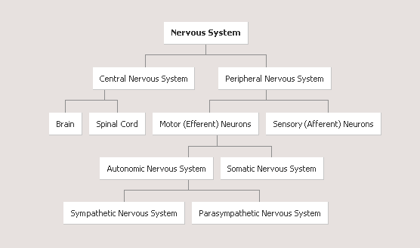

Slide 17
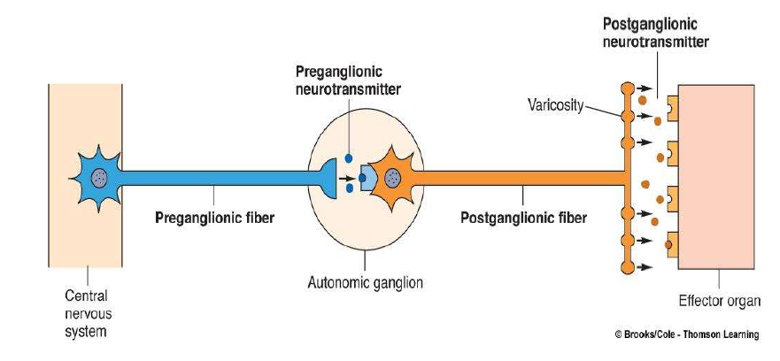

Slide 18
Autonomic nervous system (ANS) divided into
 | Sympathetic | Parasympathetic
Origin | Thoracolumbar(all thoracic & upper 3 lumber segments). | Craniosacral (cranial 3,7,9,10&sacral 2,3,4 segments).
Character | *Short preganglionic & long post-ganglionic fibres. * Ganglia is on either side of vertebral column | *Long preganglionic & short post-ganglionic fibres. * ganglia embedded in the effector organ
Action | *Generalized *Fight and flight | *Localized *Rest and digest

