Slide 1
Geophysics
Lecture 3

Slide 2
Introduction
Geophysical analysis is done when:
-You can’t get direct access to the rocks.
-When you want to “model” a large area quickly.

Slide 3
ELASTIC WAVE PROPAGATION
In an elastic media, a oscillation of the ground generates a wave that propagates in two different modes :
Through compressional wave – or P waves
Through shear waves – or S waves.

Slide 4
Seismology
Seismology is the study of the passage of elastic waves through the earth.
Earthquake seismology is the best tool to study the interior of the earth.
When an earthquake or explosion occurs, part of the energy released is as elastic waves that are transmitted through the earth.

Slide 5
Seismology
The waves are then detected and recorded by seismometers, which measure, amplify and record the motion of the ground.
The information is then used to determine earthquake locations, the subsurface structures and etc.

Slide 6
Basic Physics
There is some basic terminology and physics that describe the various aspects of wave form and motion.
The wavelength (λ) is the distance between two adjacent points on the wave that have similar displacements, one wavelength is the distance between successive crest.

Slide 7
Basic Physics
Amplitude (A) of the wave is the maximum displacement of the particle motions, or the height of the ripple crest.
Period (T) is the time it takes for two successive waves to pass a reference point or the motion to complete one cycle.
The cycle of seismic waves or repetitions in a given unit of time is called frequency (f).
Frequency and period are related by this relationship:
f = 1 / T [unit: hertz (Hz) or 1/s]

Slide 8
Basic Physics
The speed in which the wave front (or ripple crest) travel can be detected if the time the wave front takes to reach a known distance is recorded:
V = distance / time [unit: m/s]
Or if wavelength and frequency are known:
V= f λ

Slide 9
Basic Physics

Slide 10
Basic Physics

Slide 11
Basic Physics

Slide 12
Basic Physics

Slide 13
Elastic Moduli
The sound wave velocity depends on density and elastic moduli.
Elasticity is the behavior of a material that when subjected to a stress (force/area), deforms and changes shape (strain), but returns to original shape when the stress is removed.

Slide 14
Elastic Moduli
The manner and speed of seismic waves travel through material is controlled by their elastic properties.
The linear relationship between applied stress, σ, and resulting strain ε is:
σ = Eε

Slide 15
Elastic Moduli
E is the constant of proportionality called an elastic modulus.
We are concerned with two types of deformation:
uniform compression or expansion,
and shear deformation:

Slide 16
Seismic reflection use mostly the compressional waves

Slide 17
Body Waves
Body waves are seismic waves that travel through the body of the earth.
Body waves are reflected and transmitted at interfaces where seismic velocity and/or density change.
The two different types of body waves are:
-P-Waves (P stands for primary or pressure or push-pull).

Slide 18
These waves are also called longitudinal waves or compressional waves due to particle compression during their transport.
These waves involve compression and rarefaction of the material as the wave passes through is but not rotation.
P-wave is transmitted by particle movement back and forth along the direction of propagation of the wave.
The most correct description of P-waves is it is a dilational or irrotational waves.
P-waves has the greatest speed and appears first on seismograms.

Slide 19
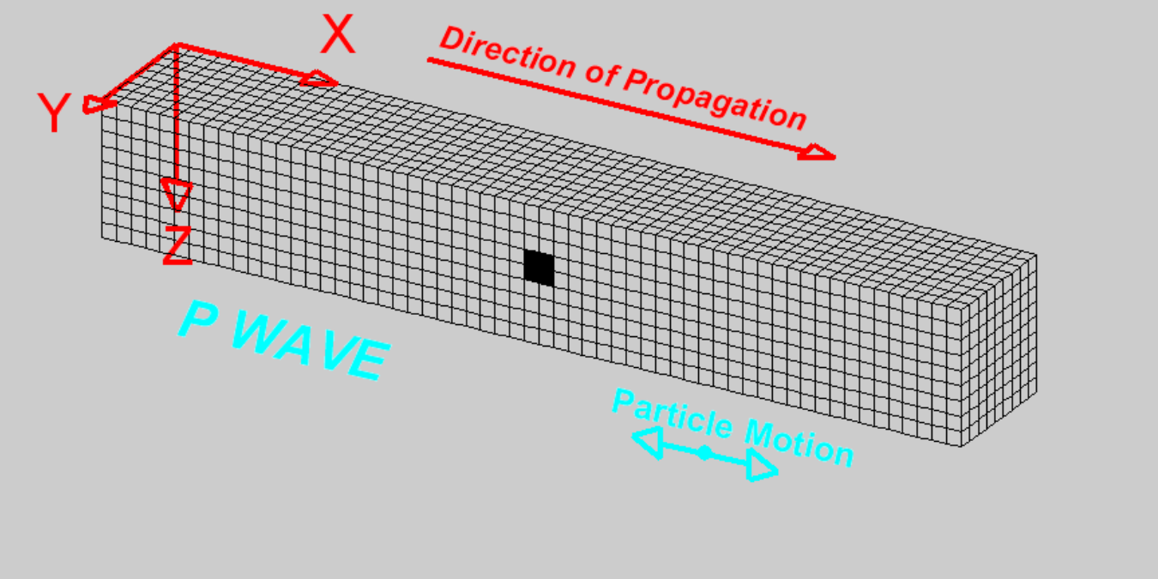
Body Waves

Slide 20
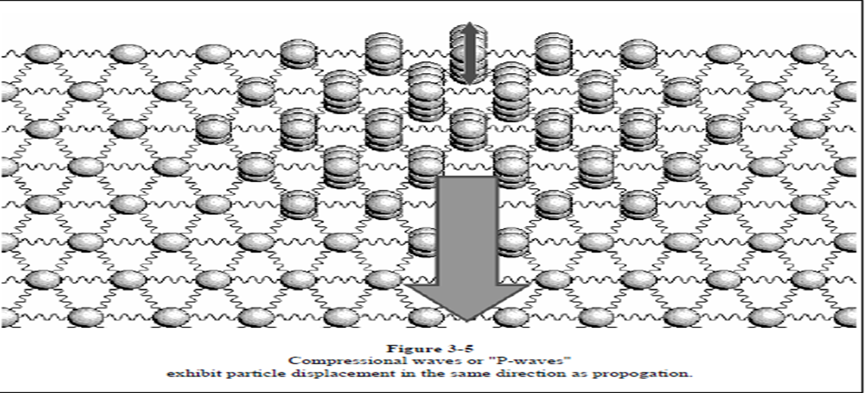

Slide 21
S-WAVES
S-Waves (S stands for secondary or shear or shake).
Also known as transverse waves, because particle motions are transverse to the direction of movement of the wave front, or perpendicular to the ray.
These waves involve shearing and rotation of the material as the wave passes through it, but not volume change.
S-waves have speeds less than P-waves, and appear on seismograms after P-waves.

Slide 22
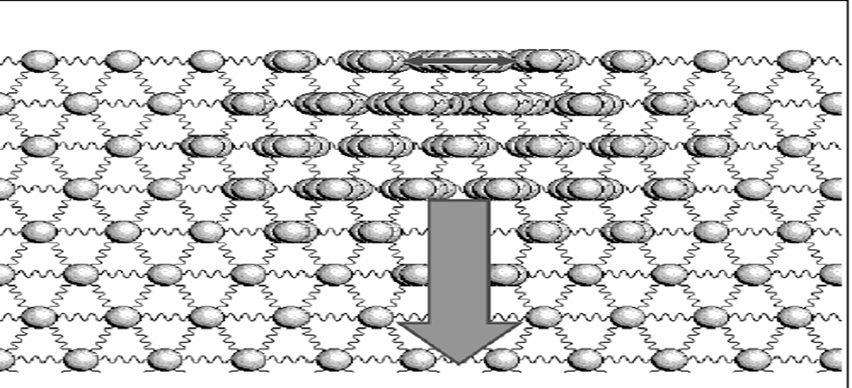
S-WAVES

Slide 23
Surface Waves
Surface waves are seismic waves that are guided along the surface of the Earth and the layers near the surface.
These waves do not penetrate the deep interior of the earth, and are normally generated by shallow earthquakes.

Slide 24
Surface Waves
Surface waves are larger in amplitude and longer in duration than body waves.
These waves arrive at seismograph after the arrival of P- and S-waves because of their slower velocities.

Slide 25
The two different surface waves are
Rayleigh waves or descriptively called "ground roll" in exploration seismology.
The particle motion of this wave is confined to a vertical plane containing the direction of propagation and retrogrades elliptically.
The particle displacements are greatest at the surface and decrease exponentially downward.
Rayleigh waves show dispersion, and its velocity is not constant but varies with wavelength.
This wave is similar to how ocean waves propagate.

Slide 26
Surface Waves
Love waves (named for A.E.H. Love, who discovered them) travel by a transverse motion of particles that is parallel to the ground surface.
This wave is somewhat similar to S-waves.
Love waves cannot exist in a uniform solid, and can only occur when there is a general increase of S- wave velocity with depth.
Their existence is another proof of the Earths vertical inhomogeneity.
The particle motion is transverse and horizontal.
Generally, Love wave velocities are greater than Rayleigh waves, so Love waves arrive before Rayleigh waves on seismograph.
VR < VL< VS< VP

Slide 27
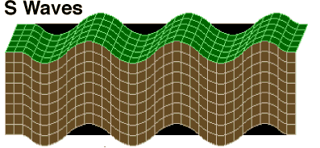
S-WAVES

