Slide 1
AL-AYEN UNIVRSITY COLLEGE OF ENGINEERING
RESERVOIR ENGINEERING I
Rock-Fluid Interaction Properties
Capillary Pressure
2022-2023
NASIR ATALLAH
ASMAA ALGHAZI

Slide 2
Capillary Pressure
Outline
Capillary pressure
Capillary pressure curve
Capillary pressure variation
Converting Pc Lab data to reservoir condition
J-function

Slide 3
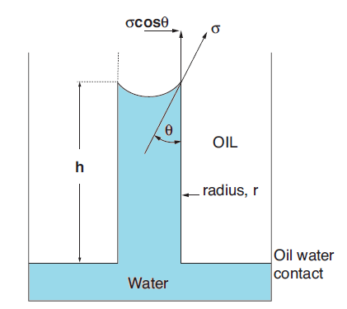
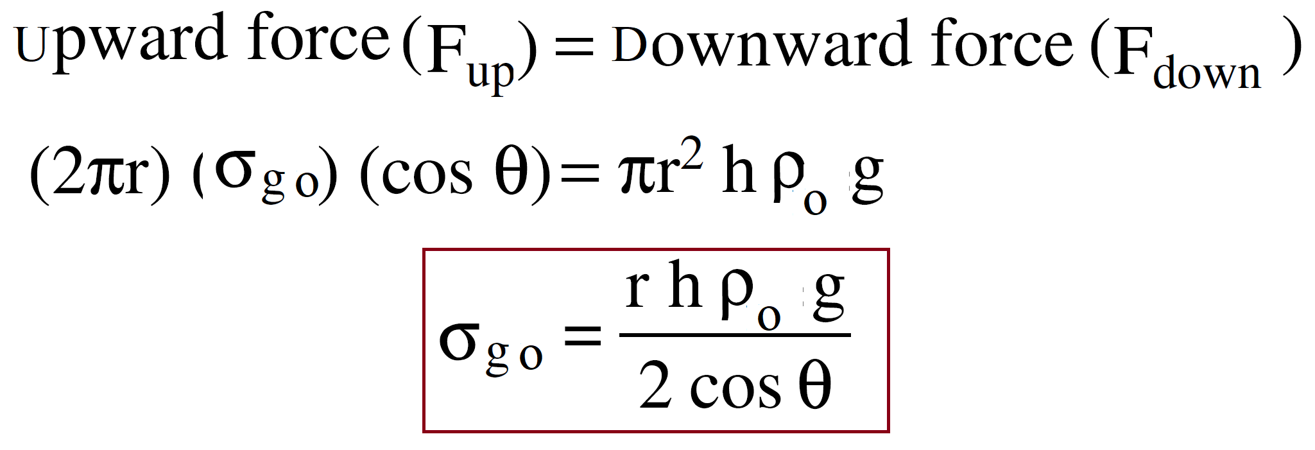
Capillary pressure
Capillary pressure, Pc: pressure difference between the non-wetting phase and the wetting phase.
Capillary pressure is as a result of interfacial forces.
The difference in pressure causes the interface between the two immiscible fluids to rise up the capillary tube until the weight of the suspended column of fluid balances the capillary forces that is associated with capillary pressure.
If a glass capillary tube is placed in a large open vessel containing water, the combination of surface tension and wettability of tube to water will cause water to rise in the tube above the water level in the container outside the tube.
The water will rise in the tube until the total force acting to pull the liquid upward is balanced by the weight of the column of liquid being supported in the tube.
Assuming the radius of the capillary tube is R, the total upward force F up, which holds the liquid up, is equal to the force per unit length of surface times the total length of surface.
Oil
Water

Slide 4
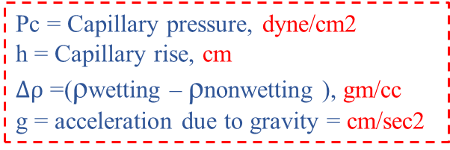
Capillary pressure
There are three types of capillary pressure
1-Water-Oil capillary pressure, Pcwo
2- Gas-Oil capillary pressure, Pcgo
3- Gas-Water capillary pressure, Pcgw
$$P_{cwo}=P_{o}−P_{w}$$
$$P_{cgo}=P_{g}−P_{o}$$
$$P_{cgw}=P_{g}−P_{w}$$
Air- Water system
Pc = P1 – P2
P2 = P4 – g h ρw
P1 = P3 – g h ρair
P3 = P4
Pc = P1 – P2 = (P3 – g h ρair) – (P4 – g h ρw)
Pc = – g h ρair + g h ρw)
1
In field units:
Air
Pc = g h (ρw-ρair)= $gh ∆ρ$
2
For Gas-Oil system
$$P_{c}=\frac{h}{144} ∆ρ$$
Pc = Capillary pressure, dyne/cm2
h = Capillary rise, cm
$∆ρ$ =(ρwetting – ρnonwetting ), gm/cc
g = acceleration due to gravity = cm/sec2
$P_{c}=\frac{h}{144} (ρ_{o}−ρ_{g}$)
For Oil-Water system
$P_{c}=\frac{h}{144} (ρ_{w}−ρ_{o}$)
3
4

Slide 5
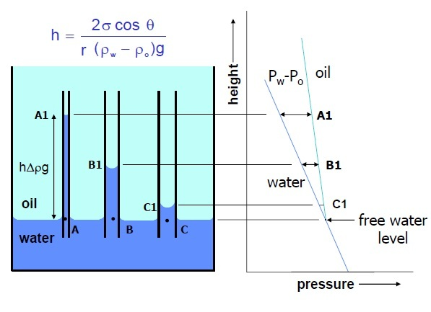
Capillary pressure, Pc
For Gas - Oil system
$$P_{cgo} =\frac{2σ_{go} cos{θ }}{r }$$
r = radius of capillary (pore throat), cm
$θ$ = contact angle
$σ_{wo }$= surface or interfacial tension , dyne/cm2
For Oil - Water system
Capillary pressure can be expressed in terms of interfacial tension:
$$p_{c}=\frac{2 σ_{wo }\cos{θ}}{r}$$

Slide 6
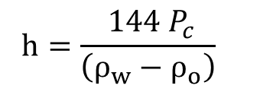
Capillary pressure, Pc
Capillary pressure is dependent on:
1- Interfacial tensions, $σ_{wo }$, $σ_{ws }$, $σ_{os }$
2- Contact angle measured through the water phase, $θ$
3- Rock porosity
4- Rock permeability
5- Fluid saturations and wettability of the rock
6- Fluid densities
Applications of capillary pressure:
Determine:
Water saturation distribution in the reservoir.
Transition zone thickness.
Free water level (zero capillary pressure).
Oil water contact.
$P_{c}=\frac{h}{144} (ρ_{w}−ρ_{o}$)
$$p_{c}=\frac{2 σ_{wo }\cos{θ}}{r}$$
Capillary pressure curve
Plotting Pc versus Sw is called the capillary pressure curve
Pc can also be converted to height above free water level and plot versus Sw in order to identify some important parameters
$$P_{c}=\frac{h}{144} \left(ρ_{w}−ρ_{o}\right)$$
$${h=\frac{ 144 P_{c}}{\left(ρ_{w}−ρ_{o}\right)}}_{}$$

Slide 7
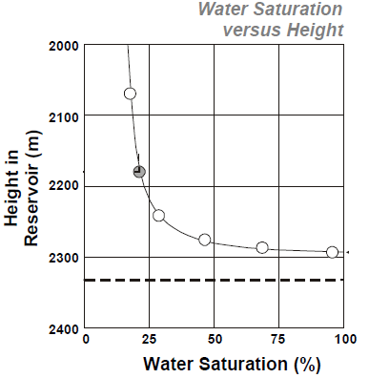
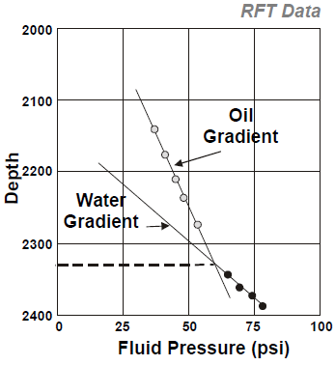
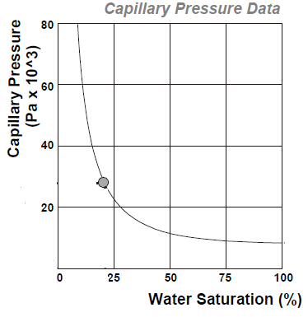
Capillary pressure curve
FWL

Slide 8
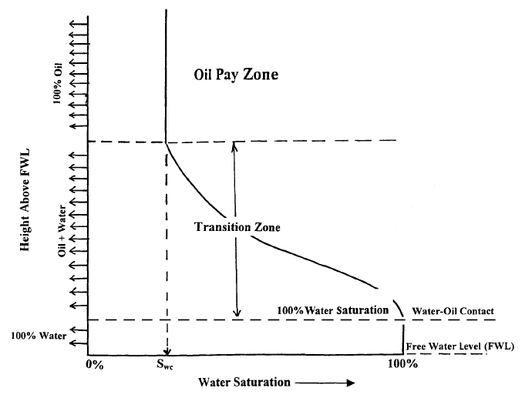
Capillary pressure curve
Sw is gradually decreasing from Sw=100 % at water zone to Swi some vertical distance above the water zone
Transition zone: the vertical thickness over which Sw ranges from 100% to Swi
Transition zone occurs due to capillary pressure effect
FWL = Depth at which water saturation =100% and the capillary pressure = zero
OWC = Depth at which 100% water saturation exists
At large pores and no capillary rises in the this size pores, then FWL= OWC

Slide 9
Capillary pressure curve
FWL and OWC can be expressed mathematically as:
When oil displace water in the reservoir, there is small value of pressure which must be exceeded to displace water, this is called the displacement pressure, Pd

Slide 10
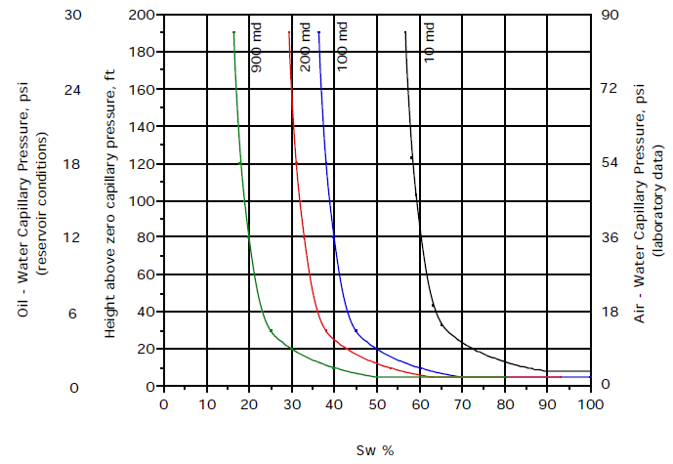
Capillary pressure variation
Effect of permeability
Permeability is related to pore radius, r
Pc increases as permeability decreases
Swi increases as Permeability decreases

Slide 11
Converting Pc Lab data to reservoir condition
It is common in the laboratory determination of capillary pressure to use air-mercury or air-brine systems, rather than the actual water-oil system characteristic of the reservoir.
When properties of the rock-core sample represents average of the reservoir rock , we can calculate reservoir capillary pressure using the following equation:
$${Pc}_{ res}={Pc }_{lab} \frac{σ_{res} }{σ_{lab} }$$
Pc res = Reservoir capillary pressure, psi
Pc lab = Lab capillary pressure, psi
$σ_{res}$ = Reservoir interfacial tension, dynes/cm
$σ_{lab}$ = Lab interfacial tension, dynes/cm
${cos θ}_{ res}$ = Reservoir contact angle
${cos θ}_{ lab}$ = Lab contact angle

Slide 12
Leverette J-Function
Capillary pressure data are obtained on small core samples.
These core samples represent a small part of the reservoir.
All Pc data of these cores is combined to characterize a reservoir.
Pc at any point in the reservoir should consider:
The porosity
Permeability
Interfacial tension
Leverette defined the dimensionless function of saturation, which he called the J-function as follow:
$$J \left(Sw\right)=0.21645 \frac{P_{c}}{σ} \sqrt{\frac{K}{∅}}$$
J(Sw) = Leverett J-Function
Pc = Capillary pressure, psi
$σ$ = Interfacial tension, dynes/cm
K = permeability, md
$∅$ = Porosity
J-Function is used for predicting the Pc curve at any point in the reservoir taking porosity and permeability into account.

Slide 13
Leverette J-Function
Procedure for calculations:
Determine J(Sw) for each core sample at each saturation
Plot J(Sw) vs Sw for all samples together
Fit best line between points
Now, we have a general relationship between J(Sw) and Sw for the whole reservoir
Generate Pc curve for each point in the reservoir depending on its porosity and permeability using Leverette dimensionless function of saturation
$$∅ ?$$
K ?

