Slide 1
Autonomic Nervous System
AL-AYEN UNIVERSITY
COLLEGE OF HEALTH AND MEDICAL TECHNOLOGY
DEPARTMENT OF ANESTHESIA
By PhD Karima Aboul Fotouh
Lecturer 4

Slide 2
Autonomic Innervation
Almost every organ in the body receives both sympathetic and parasympathetic supply .
Some organs are supplied only one division of the autonomic nervous system.
The organs supplied by the sympathetic fibers only are: the Sweat glands, dilator pupillae muscle, the ventricles of the heart, most of the blood vessels, the spleen, the adrenal medulla and the skin.
The organs supplied by the parasympathetic fibers only are the constrictor pupillae muscles, and glands of stomach and pancreas.
The function of the two divisions of the ANS are antagonistic to each other e.g. the properties of the heart are activated by sympathetic stimulation and inhibited by parasympathetic stimulation.
In addition, blocking of the sympathetic supply to an organ will produce an effect similar stimulation of the parasympathetic supply to this organ and vise versa.

Slide 3
Control of the ANS:
The ANS is mainly under the control of the hypothalamus
Autonomic tone:
Certain organs and tissues in the body are in a permanent state of activity maintained through continuous discharge of impulses along their autonomic supply; a phenomenon known as the autonomic tone.
The parasympathetic (vagal) tone to the sinoatrial node (SAN) and to the intestine and the sympathetic tone to most blood vessels are examples.

Slide 4
Chemical transmitters Acetylcholine and noradrenaline or norepinephrine.
are stored in vesicles near nerve endings.
Impulses from CNS on reaching the nerve endings will push these vesicles towards the presynaptic membrane where they open and release their contents.
This leads to creation of a postsynaptic potential ( excitatory or inhibitory) when the neurotransmitter reacts with its corresponding receptors on the postsynaptic membrane.
The effect of the released neurotransmitter is finally terminated by enzymatic degradation ( as with Ach) or by degradation or reuptake by nerve endings ( as with NA).

Slide 5
1-Acetylcholine
Acetylcholine synthesis
Co-A + acetate Acetyl Co-A (active)
CAT
Acetyl Co-A + choline Acetylcholine + CoA
Choline acetyl transferase
Fate of acetylcholine
Ach is hydrolysed by the enzyme cholinesterase in two steps:

Slide 6
There are two types of cholinesterase enzyme
True cholinesterase
Present at cholinergic neurons, RBCs
Specific
Regenerated in 2-3 months.
Pseudo cholinesterase
Present in liver& plasma.
Non specific (can hydrolyses other ester)
Regenerated in 2-3 weeks.

Slide 7
Noradrenaline (NA)
Tyrosine
Active transport
Synthesis:
Tyrosine
Tyrosine hydroxylase
DOPA
Dopa Decarboxylase
Dopamine
Dopamine
Storage:
ATP
NA
Dopamine β-hydroxylase
D
β-H
NA
NA
Do
NA
ATP
NA
Presynaptic neurons

Slide 8
Adrenaline (NA)
Synthesis:
In adrenal medulla
&
Some areas in brain
NA
Phenylethanolamine-N-
methyl transferase
Adr

Slide 9
NA
Fate:
a. Re-uptake (80%)
Granular Uptake
MAO
b. Enzymatic metabolism
15%
ATP
NA
D
β-H
NA
NA
Neuronal
Uptake I
NA
Do
NA
NA
NA
NA
NA
NA
MAO
COMT
C.Excretion:(5%)
NA
NA
Tissue
Uptake II
α₁
β
MAO
Urine
COMT

Slide 10
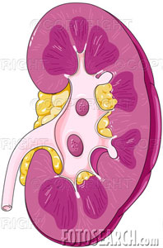
b. Enzymatic metabolism
15%
?
MAO
NA
Dihydroxymandelic acid
COMT
COMT
MAO
VMA
Normetanephrine
Normal VMA
2-6mg/ day
26 mg/ day
Pheochromocytoma
Excreted in urine

Slide 11
The major areas where Ach acts as a neurotransmitter are:
In the preganglionic nerve fiberes (both parasympathetic and sympathetic)
In the postganglionic parasympathetic fibres
In the postganglionic sympathetic fibres going to the sweat glands of the skin and some vessels.
In the somatic fibres innervating skeletal muscle

Slide 12
AUTONOMIC NERVOUS SYSTEM
ACh
(nic)
ACh
(musc)
PARASYMPATHETIC TARGETS
CRANIAL
NA
(α + β)
SYMPATHETIC TARGETS
THORACIC
ACh
(nic)
ACh
(musc)&(α)
Sweat glands, piloerector muscles etc.
LUMBAR
ACh
(nic)
ADRENAL MEDULLA
SACRAL
ACh
(nic)
ACh
(musc)
PARASYMPATHETIC TARGETS
ACh
(nic)
SKELETAL MUSCLE
SOMATIC EFFERENT SYSTEM

Slide 13
Autonomic Nervous System
It regulates the activity of the following involuntary organs:
Cardiac muscle
Smooth muscle
Exocrine glands

Slide 14
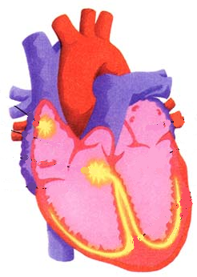
Sympathetic
Parasympathetic
M₂
β₁
H.R
Tachycardia
Bradycardia
SAN
Atrial conduction
AVN
A.V conduction
٭No effect
Ventricular conduction
& contraction

Slide 15
Blood vessels
Sympathetic
Parasympathetic
٭ Not innervated !!!
Skin, m.m.
mesentery
skeletal muscles
coronay
α₁
β₂
V.C.
(vasoconstriction)
V.D.
(vasodilatation)

Slide 16
Sympathetic
Parasympathetic
Pupil
M
α₁
٭ Dilator pupillae muscle
constrictor pupillae muscle
٭ Dilated → Mydriasis
Constricted → Miosis

Slide 17
Sympathetic
Parasympathetic
Bronchi
↓secretion
↑secretion
M₂
M₃
α₁
β₂
α₁
Broncho-dilatation
V.C. of m.m vessels
Broncho-spasm

Slide 18
Sympathetic
Parasympathetic
Salivation:
↑ Viscid
↑ Profuse Watery

Slide 19
Sympathetic
Parasympathetic
G.I.T
Relax the wall
Contract the wall
M₂
β₂
α₁
M₃
↑secretion
Relax the sphincters
Contract the sphincters
β₂
Urinary bladder
M₂
α₁

Slide 20
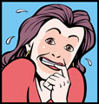
Sympathetic
Parasympathetic
Sex organs
Ejaculation
Erection
Sweat glands
٭ No effect

Slide 21
Usually each organ has double nerve supply
except:
٭ Ventricles
٭ Most of blood vessels
٭ Dilator pupillae muscle
constrictor pupillae muscle
٭ Sweat glands
Parasympathetic supply only
sympathetic supply only

Slide 22
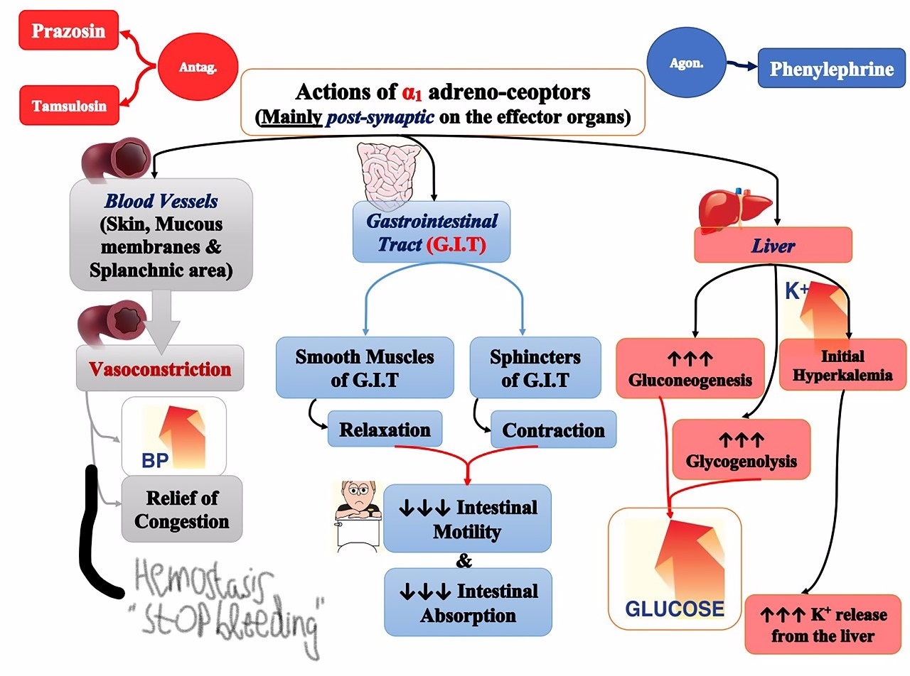

Slide 23
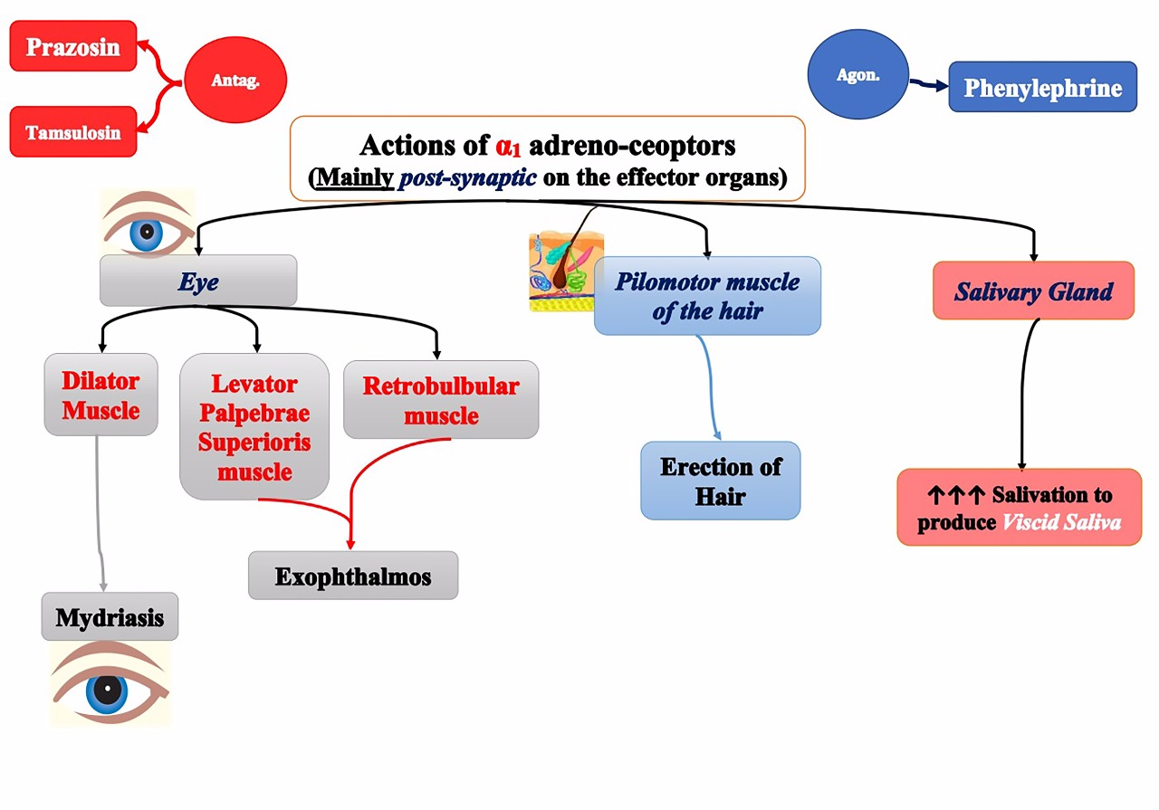

Slide 24
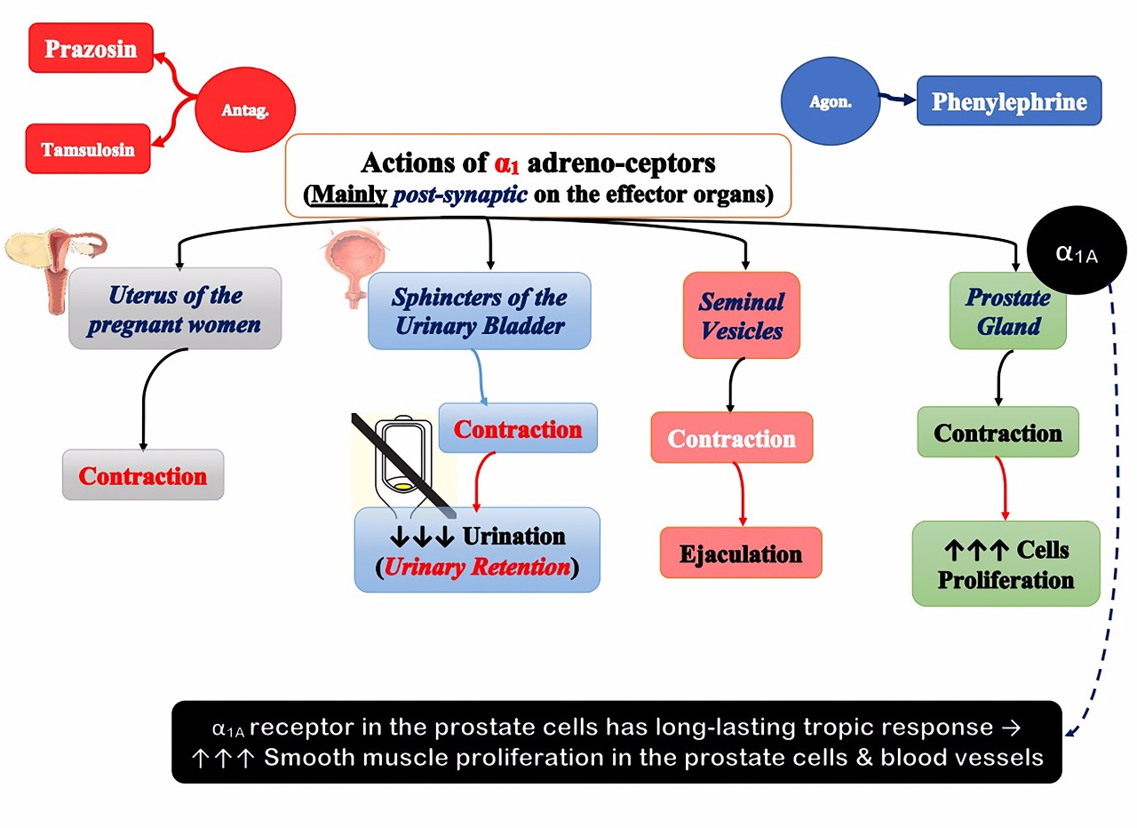

Slide 25
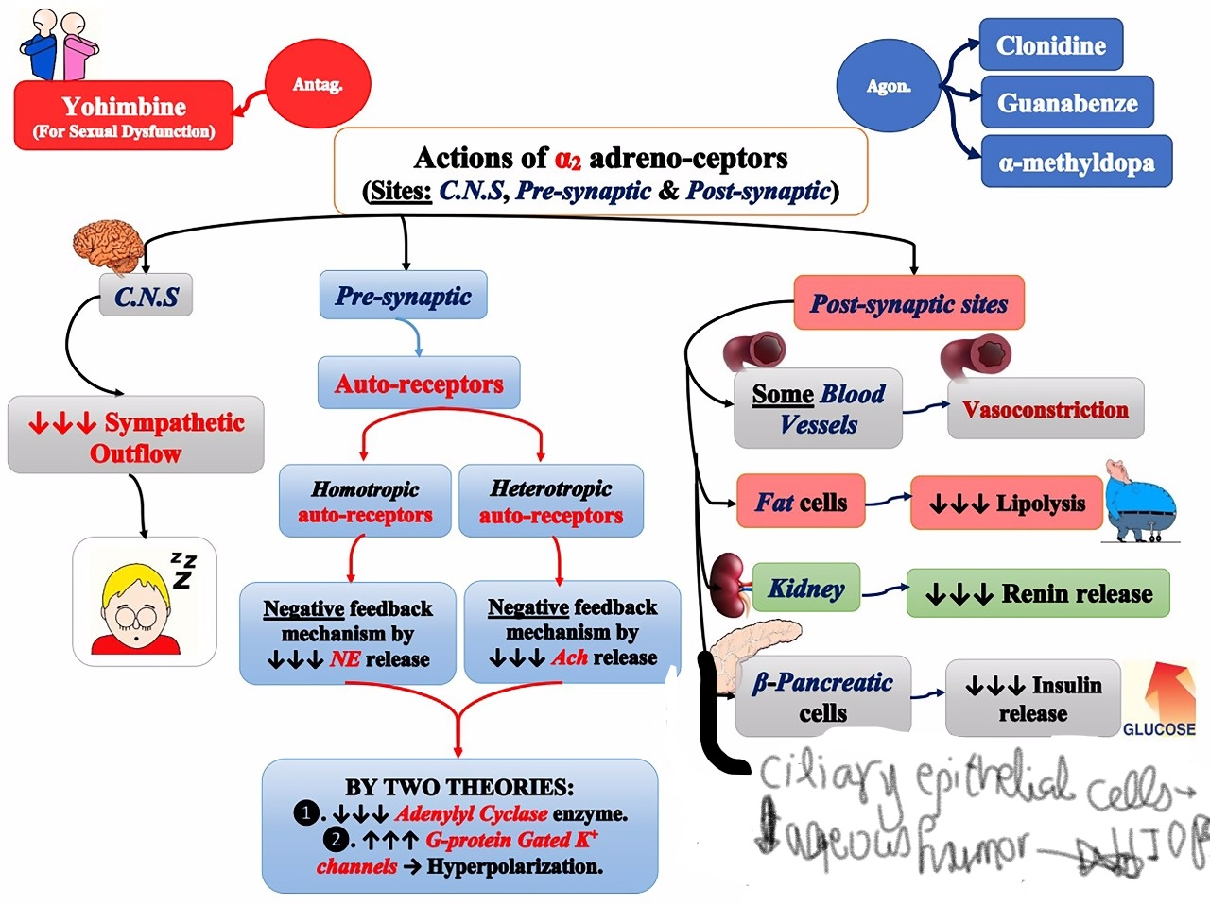

Slide 26
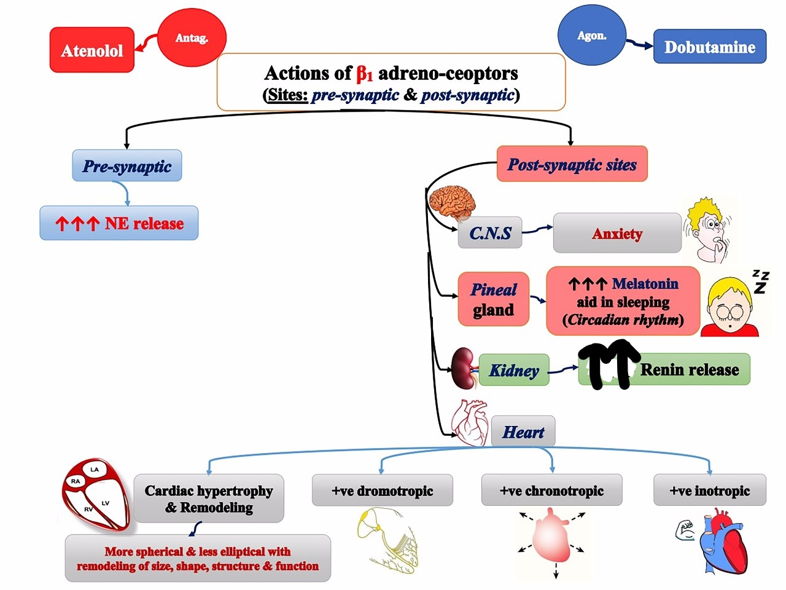

Slide 27
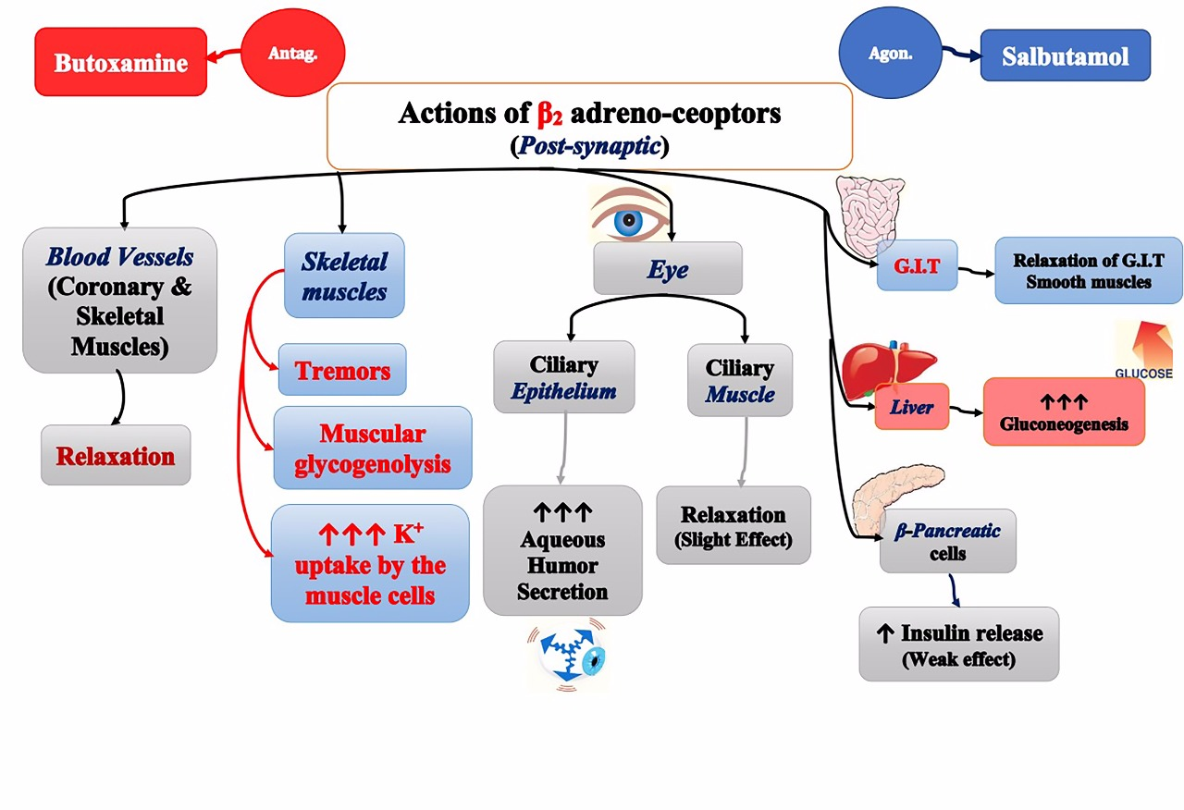

Slide 29
Sympathomimetics
Catecholamines
Contain catechol nucleus
Natural
Dopamine
Noradrenaline
Adrenaline
Synthetic OH
Isoprenaline OH
Dobutamine Chatechol nucleus
Isoetharine
Non-catecholamine
ephedrine
amphetamine,

Slide 30
Mechanism of action:
Direct action on adrenergic receptors as catecholamines, phenylephrine, salbutamol.
Indirect acting by releasing noradrenaline as tyramine, amphetamine and ephedrine or by blocking uptake-1 (cocaine).
Mixed acting ( dual mechanism) as ephedrine.

Slide 31
Adrenaline (Epinephrine)
Pharmacokinetics:
Ineffective orally
Slowly absorbed if given S.C. (V.C.) , rapidly absorbed after I.M. injection .
Action:direct agonist on α and β receptors.
Local actions:
Decongestant and haemostatic (stop hemorrhage from nasal mucosa) (V.C. α₁)
Delay absorption of drugs when given S.C.
Inhalation in bronchial asthma (bronchodilatation β₂).
One eye: decongestion. I.O.P. is decreased due to reduced aqueous formation, increased drainage (α receptors).

Slide 32
Systemic actions:
C.V.S.:Heart (β₁ ) : +ve inotropic (contraction), +ve chronotropic(↑HR), increased excitability,+ve dromotropic (conduction), ↑ COP.
B.V.: V.C. of skin and mucous membrane vessels (α₁ ),V.D. of skeletal muscle vessels(β₂ ).
B.P.: increases systolic due to ↑ COP while diastolic is usually decreased. But large dose ↑ peripheral resistance. The hypertensive effect is reversed by α-blocker.
Respiration: Bronchodilatation (β₂), decongestion (α₁ ).
GIT: Decreases tone and motility (α & β).
Urinary tract: relaxes wall (β₂ ) contracts sphincter (α₁ ).
Uterus: contracts nonpregnant uterus ( α-effect), but relaxes in late pregnancy (β₂).
Eye: Active mydriasis (α₁ ).
Increases sweat secretion (α) from apocrine sweat gland located in palms of hands.

Slide 33
Metabolic actions:
Hyperglycemia due to ↑liver glycogenolysis (β₂ ) and ↓ insulin release (α₂ ).
↑bood lactate level, ↑lipolysis (β_{1,3}).
Antiallergic action: physiological antidote to histamine on bronchi & B.P.
Hypokalemia: ↑K⁺ uptake in cells.

Slide 34
Therapeutic uses:
Allergy and anaphylactic shock( which affect both respiratory system and CVS, ch. By brochospasm, mucous membrane congestion, hypotension).
Used with local anesthetic to decrease absorption, prolonged duration, haemostatic
In nasal bleeding ( epistaxes) locally.
Cardiac arrest ( intracardiac).
In open ( wide ) angle glaucoma. ( dipivefrin which is prodrug is better).
Acute bronchial asthma.

Slide 35
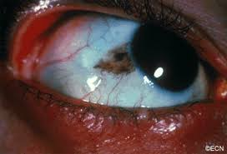
Adverse effects:
Restlessness, tremors, anxiety, headache.
Tachycardia, palpitation, anginal pain.
Cardiac arrhythmia with halothane and digoxin ( treated by β-blocker).
Sudden rise of B.P. leading to cerebral hemorrhage if given rapid IV.
Gangrene if used with local anaesthetics in fingers and toes.
Long use on eye → blurred vision, conjunctival pigmentation.

Slide 36
Contraindications:
Coronary heart disease (CHD) (angina pectoris).
Hypertension
Hyperthyroidism
With cardiac glycosides ( digitalis) or halothane.
With local anaesthetics in fingers, toes.
With nonselective β-blockers.
With MAO inhibitors (MAOIs).
NB: (CHD) is the narrowing or blockage of the coronary arteries, by atherosclerosis or coronary vasospasm.

Slide 37
Noradrenaline (Norepinephrine)
Pharmacokinetics: it is given only by I.V. infusion.
Actions: Direct on α and β₁ receptors.
C.V.S.:
Heart (β₁): ↑ H.R. ( masked by reflex bradycardia).
B.V.:
V.C. of skin, mucous membrane and skeletal muscle vessels so ↑ total peripheral resistance (TPR)→ ↑ B.P.→ reflex bradycardia mediated through vagus nerve which masks the β₁ stimulant effect.
It stimulates isolated heart (β₁ effect),also stimulates the heart after vagotomy or atropine.
Other action: as adrenaline but with predominant α- effect.

Slide 38
Uses: Used as hypertensive agent, e.g., in spinal anaesthesia, after sympathectomy or overdose with ganglion blockers.
Adverse effects:
Anxiety, headache, bradycardia.
Excessive hypertension.

Slide 39
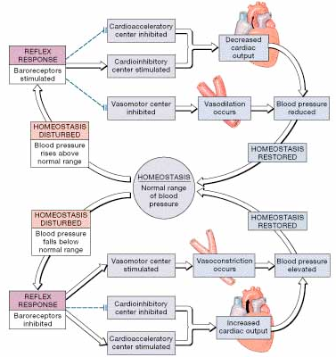
The Baroreceptor Reflexes

