Slide 1
LECTURE 2 – PETROLEUM EXPLORATION

Slide 2
Petroleum Exploration
Geologists and geophysicist work closely together using a variety of methods. All the information is carefully considered, with the help of computer analysis, before any decisions to drill are made. A geologist collects small samples of rock. Sometimes the samples of rock are dug out by hand or cylindrical cores are drilled to give samples, which can be cut and studied under a microscope.
These help them to find out:
-where the rocks have come from (their origin)
-what they are made of (their composition)
-how the rocks are arranged in strata.
Geologists also find out about the physical and chemical properties of the rocks (mineralogy) and the fossil record from ancient times (paleontology). All these clues give information to build up a picture of the area being surveyed.
A geophysicist adds to the information of a geologist by studying the physics of the earth. Surveys are
made of the magnetic field, the gravity and how waves travel through the layers.

Slide 3
Petroleum Exploration
Petroleum exploration: a process of determining the location of petroleum reservoir. This process
include three techniques which are:
Direct indications
Geological methods
Geophysical methods
A- Direct indications:
All of the great oil providences of the world exhibit some surface evidence of the presence of petroleum. Typical of these indications are natural seepages of oil, outcrops of oil bearing rocks, and various forms of gas seepages such as mud volcanoes.
Limitations ???
Not that much Effective.
It Does not necessarily prove that oil exists in commercial quantities. (i.e. Does not tell you about
quantity of oil which is present beneath).

Slide 4
Petroleum Exploration
B- Geological exploration methods:
A petroleum geologist’s main job is to select the promising sites for the drilling of exploratory wells based on his prediction of an area’s subsurface stratigraphy and structure
In order to make predictions about the occurrence of petroleum in a particular area, the geologists prepare maps, both surface and subsurface.
1- Surface Maps :
These maps prepared measuring surface features such as elevations, dips and strikes of the outcrops and lithological changes.
Also, Aerial photographs are sed to locate the most promising of these structures which are then mapped in detailes by field geologists.
The value of surface mapping is restricted to shallow areas.

Slide 5
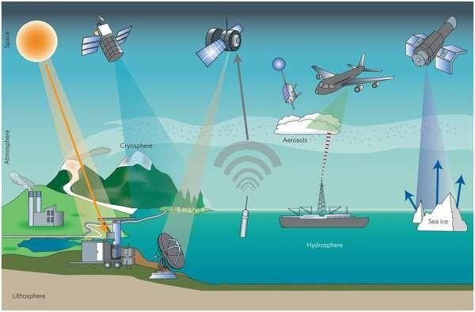
Remote Sensing Method
Remote sensing refers to using infrared or other
means to map an area.
This method is used to study the basic of petroleum geological conditions.
The remote sensing images have characteristics of realty and provide accurate visual data for directly determining geometric shapes of sedimentary basins.
The remote sensing techniques are more effective and useful for understanding and studying those basins in the out-of-the- way mountains and remote deserts.
Remote sensing equipments can be carried by
airplanes or by satellites.
Companies using remote sensing data, however, still need traditional exploration information to pinpoint the location of commercial deposits.

Slide 6
2- Subsurface maps:
Are numerus in variety and type, which include:
Structural contour maps:
Composed of lines connecting points of equal elevation above or below a datum (normally
sea level).
Used to find out the presence of traps
Used to find out the probable location of hydrocarbons.
Isopachous maps:
Maps composed of lines connecting points of equal bed thickness.
Used to find out the volume of hydrocarbons.
Used to find out the drilling depths
Cross Section Maps:
A form of subsurface presentation which depicts the position and thickness of various strata.
Note: subsurface maps are necessary part of any reservoir engineering study, petroleum engineering and geologist.

Slide 7
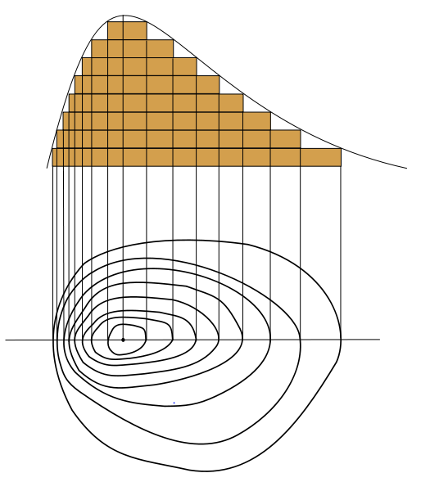
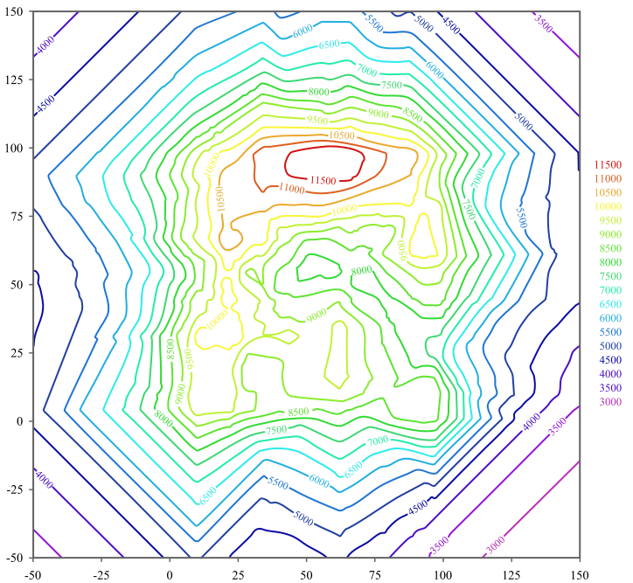
How to construct contour Map:

Slide 8
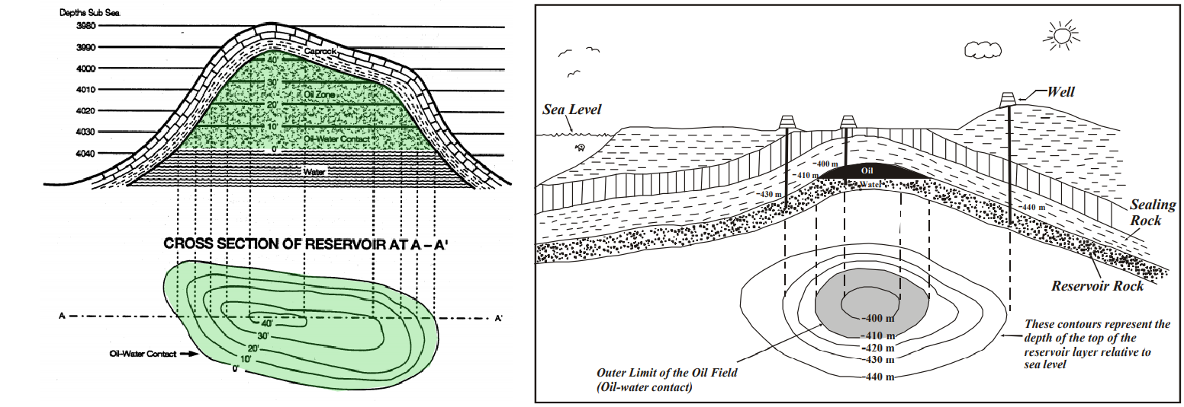

Slide 9
The subsurface maps are prepared from subsurface data. The sources of subsurface
data are:
Well logs: a representation of some rocks properties with depth, example of well
log: Sample log, Drilling time log, Electric log, caliper log, radioactive log, resistivity log.
Core drilling: shallow, small hole drilling for information purposes only. The formation encountered are cored , i.e., obtained as a small cylindrical sample ( core sample) of formation which are readily and accurately identified.
Strata tests: Deep exploratory holes drilled primarily for information ( such as build up test, drawdown test).
Note : the construction of subsurface maps required great interpretive skill.

Slide 10
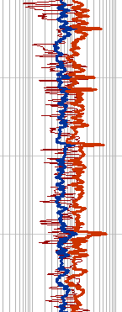
Well Correlation
Consists of establishing correlations by matching strata, rock hardness or softness, and electrical and radioactivity data to determine the origin, composition and distribution of rock strata.
Electrical logs, radioactivity logs, and acoustic logs help geologists predict where oil bearing strata occur.
Sample logs, compiled from well cuttings and cores, are used to identify key beds and lithologic sequences..
Core samples are taken from the top to the bottom of a well and shows rock in sequential order as it appears in the ground.
Core samples also provide information on porosity, permeability,
and saturation of rock in the well.
Cuttings are not a continuous record like core samples, but provide a means for identifying sections within larger thick layers through fossil and mineral deposits.

Slide 11
Petroleum Exploration
C- Geophysical methods:
It is a physical measurement of subsurface condition made from surface location. There are three types of methods, which are:
Gravitational ( gravity survey)
Magnetic survey
Seismic survey

Slide 12
1- Gravitational Method:
The Earth's gravitational attraction varies slightly from one place to another on the Earth's surface. Some of this variation occurs because the Earth is not a perfect sphere, and some is related to differences in elevation on the Earth's surface.
In gravity prospecting, geophysicists measure variations in the force of gravity from rocks up to a few miles beneath the earth's surface (i.e. measures the variation in the acceleration due to gravity).
This method is based on the Newton’s hypothesis that every particle in the universe attracts
every other particle in the manner, which defined by the equation:
𝑚₁𝑚₂
𝐹 = 𝛾
_{𝑟}2
Where :
F = attractive force.
𝑚_{1,2} = masses of particles in equation.
r = distance between particles.
𝛾 = gravitation constant =6.67* 10⁻¹¹ 𝑚³𝐾⁻¹ 𝑆⁻² or 6.67* 10⁻⁸ 𝐶𝑔𝑠 unit.
𝑔

Slide 13
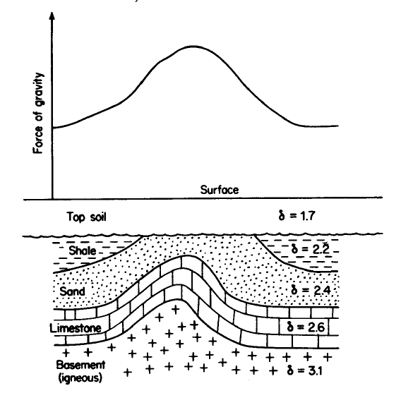
Different types of rocks have different densities, and the denser rocks have the greater gravitational attraction. (very important point)
If the higher-density rock formations are arched upward in a structural high, such as an anticline, the Earth's gravitational field will be greater over the axis of the structure than along its flanks.
A salt dome, on the other hand, which is generally less dense than the rocks into which it is intruded, can be detected from the low value of gravity recorded compared with that measured on either side.
Igneous rocks like granite is denser than
sedimentary rocks.
Gravimeter is used to pick up a reflection of
the density of subsurface rock.
Previously used instruments were torsion
balance and pendulum.
𝛿 = specific gravity of various rock

Slide 14
2- Magnetic Method:
This method seek to maps anomalies in earth’s magnetic field and correlate these with
underground structure. In other mean, it used to investigate the subsurface geology by
measuring the strength or intensity of the earth’s magnetics fields (Measure changes in the Earth magnetic field caused by variations in the magnetic properties of rocks).
Sedimentary rocks generally have a very small magnetic or non magnetic susceptibility compared with igneous or metamorphic rocks, which tend to have a much higher magnetite (a common magnetic mineral) content.
By conducting a magnetic survey over a given area, a prospector can determine where oil- bearing sedimentary rock is more likely to be found.
The magnetometer is used to measure the magnitude of the earth's total magnetic field
over a large area.
A magnetometer can be towed behind a ship or an airplane to cover large areas. It transmits data to a device on board which records the information onto paper or magnetic tape

Slide 15
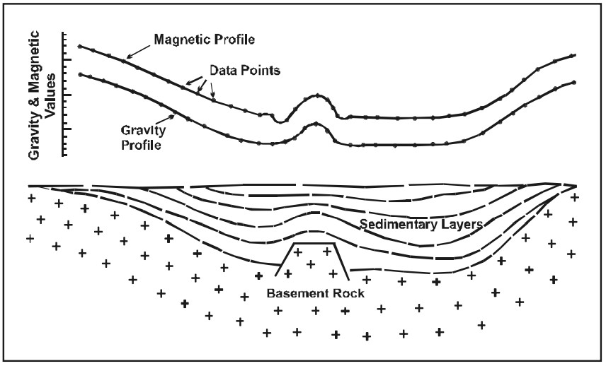
A development of airborne magnetics is the micro magnetic technique for oil exploration. An airplane tows a micro-magnetometer from a low altitude, normally about 300 ft above the ground. It detects micro-magnetic anomalies, or deviations from the norm.
Any Irregularity spotted is attributed to depth
variation of basement rock.
Anomalies in earth magnetic field proportional
to the depth of burial of the basement rock.
Instruments used in this method vary from dip
needle to compass.
The geophysicist, by taking the magnetic measurements through an area, can estimate the geological structure of the basement rocks, as well as the thickness of the sedimentary
cover rocks (i.e. predict the characteristics of
overlying sediment ).
Gravity and Magnetic Profiles

