Slide 1
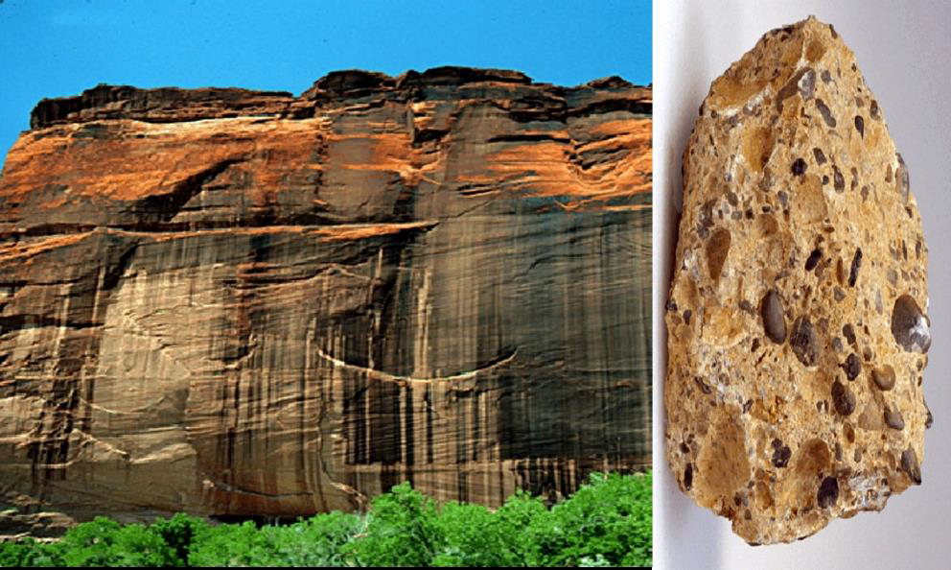
Lec. 5
Sedimentary Rocks by :
Dr. Murtadha Al Zaidi

Slide 2
SEDIMENTARY ROCKS: are the secondary rocks which are formed from the loose fragments or detrital or clastic sediments produced by weathering of older rocks.
Almost 90% of earth crust is made up of igneous rocks
75% of land surface on the earth is covered by thin veneer of sediments or sedimentary rocks.
These sediments are transported and deposited by river water, wind or by movement of glacial ice. Transportation is either in suspension or in solution.
When settle down on the beds of ocean, river and lakes undergo compaction/cementation for millions of years to form SEDIMENTARY ROCKS
Recall from the rock cycle that sedimentary rocks form when the products of weathering are transported to a new location where they are deposited and eventually lithified into solid rock.
Weathering which begins the process can be either:
A- Mechanical weathering.
B- Chemical weathering.

Slide 3
Erosion agents such as running water, wind, waves and ice remove the products of weathering and transport them to other locations.
Eventually, these solids particles and dissolved substance, called sediments, are deposited.
Next, the sediments undergo Lithification, which means "conversion to rock" by compaction.
or by cementation as percolating water coats the sediments with mineral maters, and gradually cements the particles together. The result is sedimentary rocks such as shale, sandstone and conglomerate.
Some sedimentary rocks are not compacted or cemented but form as solid masses of intergrowth crystals.
Rock salt-NaCl is one example.

Slide 4
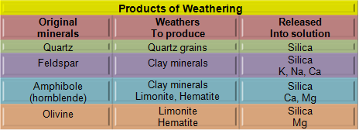
Types of sedimentary rocks:
a-Detrital sedimentary rocks.
b-Chemical sedimentary rocks.
c-Organic (biochemical) sedimentary rocks.
a- Detrital sedimentary rocks.
The products of weathering include materials that originated and are transported as solid particles.
These particles are called and the sedimentary rocks they form are called detrital sedimentary rocks.
Two minerals are the especially common in Detritus rocks:
1- Clay.
2- Quartz.
The (Table.4.1) below is showing the products of weathering:

Slide 5
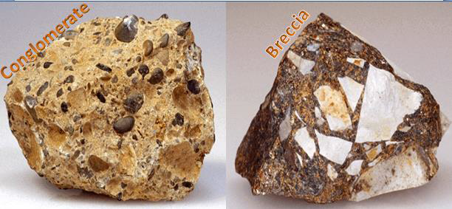
Geologist use particle size to distinguish among detrital sedimentary rocks.
The common sediment name for all particles larger than 2 millimeters is gravel.
When gravel-sized particles predominate, the rock is called conglomerate if the particles are rounded and breccias if the pieces are angular.
The particles in conglomerate become rounded as they are transported, most frequency by streams. (Figure.4.32).
The angular pieces of brachia indicate the particles were not transported very far from their source prior to deposition.

Slide 6
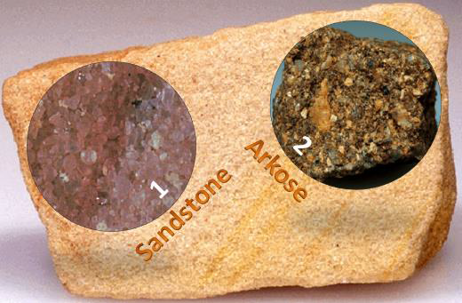
The common sediments name for particles between 1/16 mm and 2mm is sand and sandstone, And it is the name given to rocks when sand-sized grains dominate.
Because it is very durable, quartz is the predominant mineral in the most sandstone. (Figure.4.33). 1.
When essential quantities of feldspar are present in sandstone, the rock is called arkoses. 2.

Slide 7
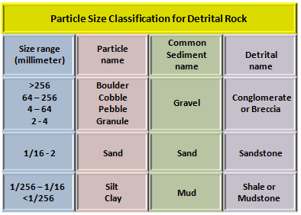
The presence of abundant feldspar suggests there was little chemical weathering of the sediments, something we might associate with a dry climate.
When the tiniest silt and clay- sized particles predominate, the common sediment name is mud and shale or mudstone is the name given for the rock.
The (Table.4.2) below shows the particles size classification for detritus rocks:

Slide 8
b- Chemical sedimentary rocks:
Unlike detritus rocks which form from the solid products of weathering, the source of sediments for chemical sedimentary rocks is materials dissolved in water.
Three kinds of chemical sedimentary rocks:
1- When materials in solution precipitate, it forms chemical sediments, which become rocks such as limestone, chart and rock salt.
2- Precipitation of dissolved materials occurs by inorganic processes such as evaporation, temperature change and chemical activity.
3- Or by life-processes of water-dwelling organism. These materials are called biochemical sediments.
Limestone: the most abundant chemical sedimentary rock, is composed chiefly of the mineral calcite. (Figure.4.36).1. Most limestone has a biochemical origin.
Example includes coquina, Which consists of shell fragments. 2.
Chalk: which is made of the hard parts of microscopic marine organisms. 3.
And limestone that originated as coral reefs. 4.

Slide 9
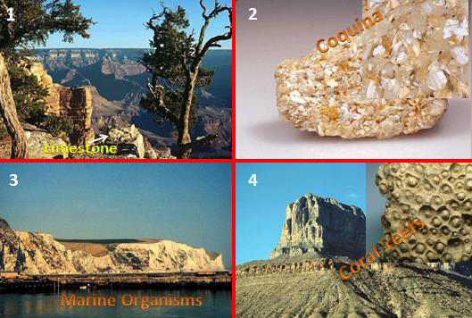
Travertine: is Limestone with an inorganic origin, which is often seen decorating caves. (Figure.4.37). 1.
Halite: Evaporates form when evaporation causes minerals to precipitate from water. Such minerals include halite (NaCl), the main component of rock salt. 2.
Chert: is the name used for a number of hard, compact rocks made of microcrystalline silica.
These rocks may have either inorganic or a biochemical origin. It is not usually possible to determine this by looking at a hand sample.3. 4. 5.
Gypsum: (CaSO4.2H2O), the main ingredient of rock gypsum. (Figure.4.38). 1.
Thick evaporate deposits may form when a large body of seawater isolated by reefs or sand barriers. 2.

Slide 11
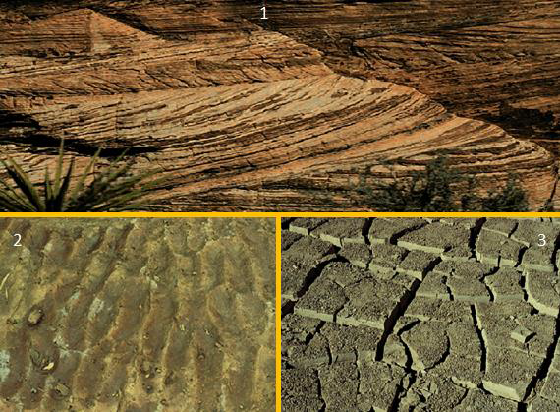
Sedimentary environments:
Sedimentary rocks form as layer upon layer of sediments accumulates. These strata are the single most characteristic of sedimentary rocks.
Each layer is unique. The variations among strata reflect the conditions under which each layer was deposited.
Sedimentary rocks show a variety of structures that help us to interpret past geologic conditions like:
Cross-bedding: occurs in sand dunes and certain stream deposits. (Figure.4.40). 1.
Ripple – marks: are associated with currents of air and water or with the back and forth movement of waves. 2.
Mud-cracks: When they are preserved, they indicate alternating wet and dry conditions and are associated with such places as desert basins and shallow lakes. 3.

Slide 12
Fossils: They are preserved in sedimentary rocks, and important keys to past environments. (Figure.4.41).

Slide 13
The size of particles in sedimentary rocks provides useful information about environments of depositions.
Currents of water and air sort particles by size. The stronger the current, the larger the particles size carried.
For example, in very turbulent water only large gravel-sized particles can settle out.
Whereas fine particles settle in the waters of a swamp, lake or lagoon. 6.
The mineral composition of the rock can also contribute useful information about past environment.
For example, evaporates can indicate an arid setting.
And certain limestone, like coquina, can indicate a warm, shallow marine environment.

Slide 14
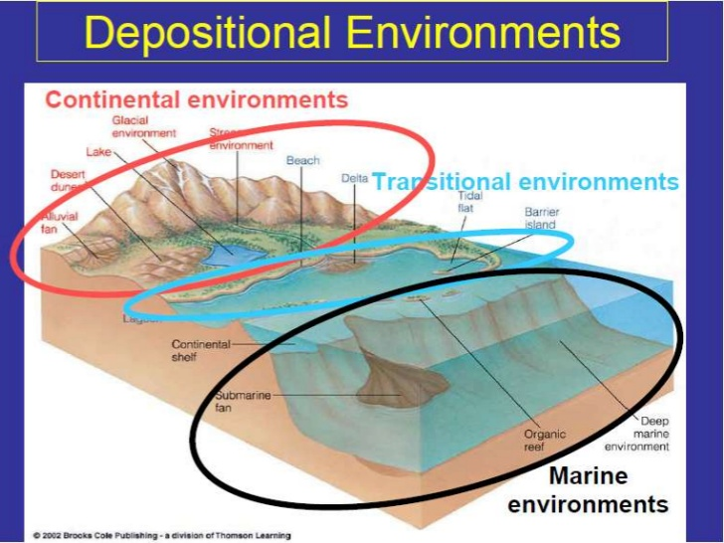

Slide 15
Types of Depositional Enviornment There are four major types of depositional environments they are Continental, Transitional, Marine and Other categories. In continental deposits, it can be further classified into Alluvial, Fluvial and Lacustrine environment. In transitional deposits, it can be classified into Deltaic, Tidal, Lagoonal and Beach environment. In marine deposits, it can be classified into evaporative and glacial environments.
Continental Environments
The continental environments are those environments which are present on the terrestrial plains of continents. They are alluvial fans, fluvial environments (rivers), lacustrine environments (lakes), aeolian or eolian environments (deserts), and paludal environments (swamps). On the continents, sedimentation might be thought to begin with clastic materials, shed from the flanks of mountain ranges.
These alluvial fans are characterized by poorly sorted, boulder and gravel dominated debris of conglomerates.
Fluvial (river) facies include cross-bedded and rippled river sandstones and parallel or cross-bedded floodplain mudstones (siltstones and clay shales).
Lacustrine (lake) facies include sands deposited at the mouths rivers which empty into the lake, along the shoreline as well as muddy facies on the deep lake bottom.
In the continental environment, most sediment transport is accomplished by the flows that move in response to the gravity.

Slide 16
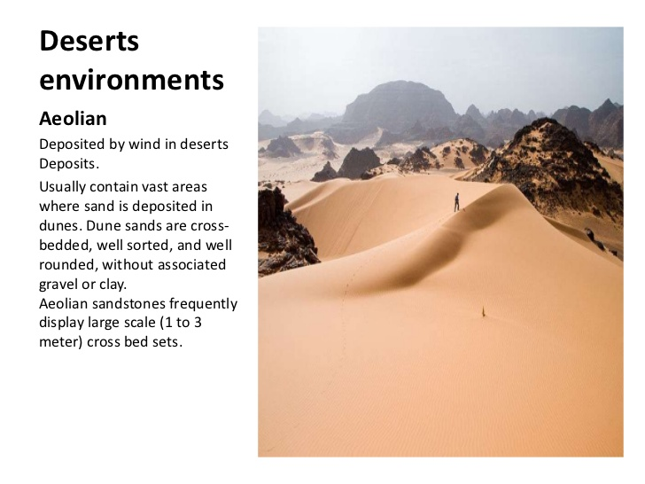
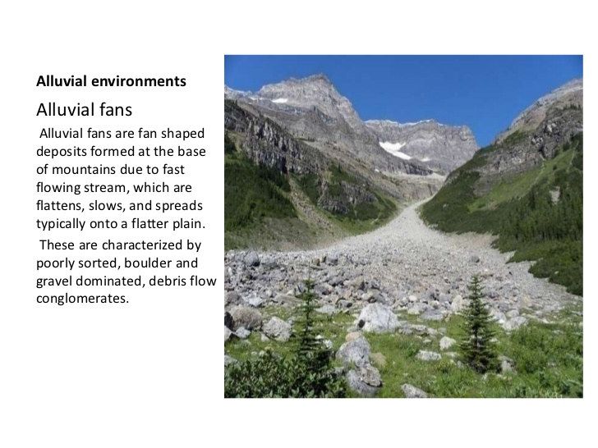

Slide 17
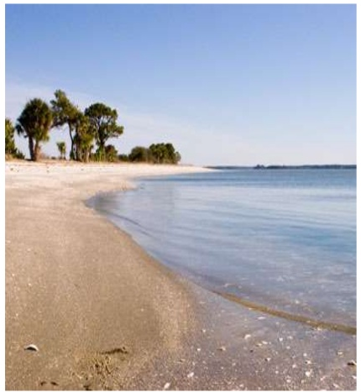
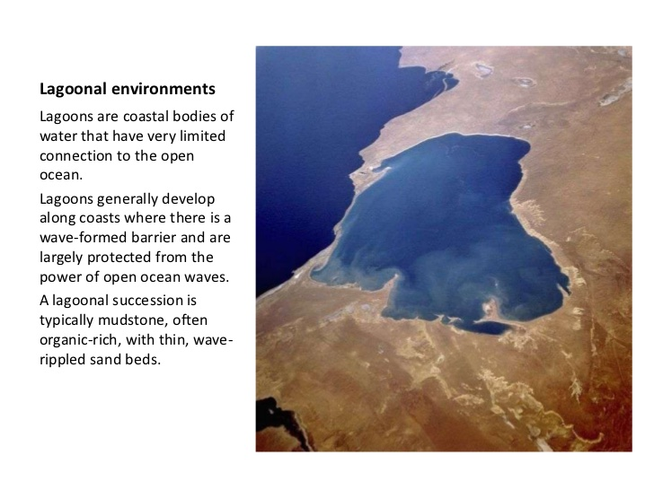
Transitional Environment The Transitional environments are those environments at or near where the land meets the sea. Transitional sedimentary environments include deltas, beaches and barrier islands, lagoons, salt marshes, and tidal flats. The tidal flats are low-lying areas that are alternately covered by water and exposed to the air each day. The Transition zone between continents and marine environments.

Slide 18
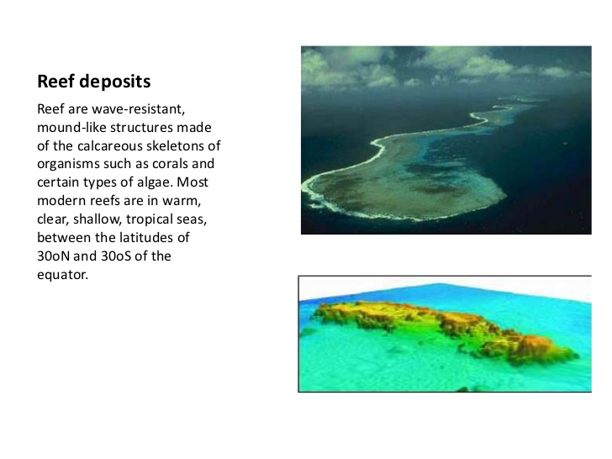
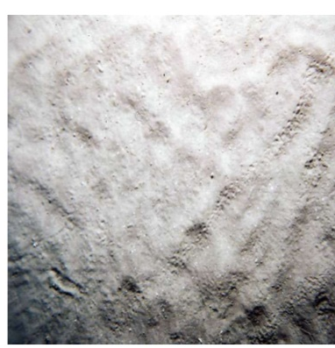
Marine Environments The Marine environments are in the seas or oceans. The marine environments include reefs, the continental shelf, slope, rise, and abyssal plain. The reefs are wave-resistant, mound-like structures made of the calcareous skeletons of organisms such as corals and certain types of algae.

Slide 19
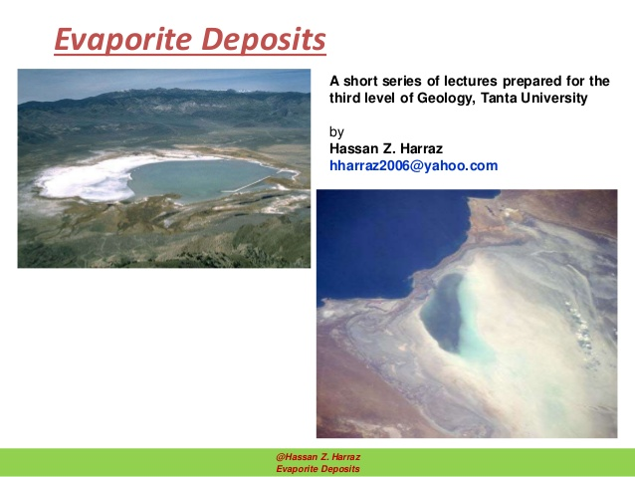
Other Types In this category there are about two types, they are Evaporite and Glacial deposition environments. Evaporite is a name for water-soluble mineral sediment. This results the concentration and crystallization by evaporation from an aqueous solution. There are two types of evaporate deposits: marine, which can also be described as ocean deposits, and non-marine, which are found in standing bodies of water such as lakes. Evaporites are considered sedimentary rocks.

Slide 20
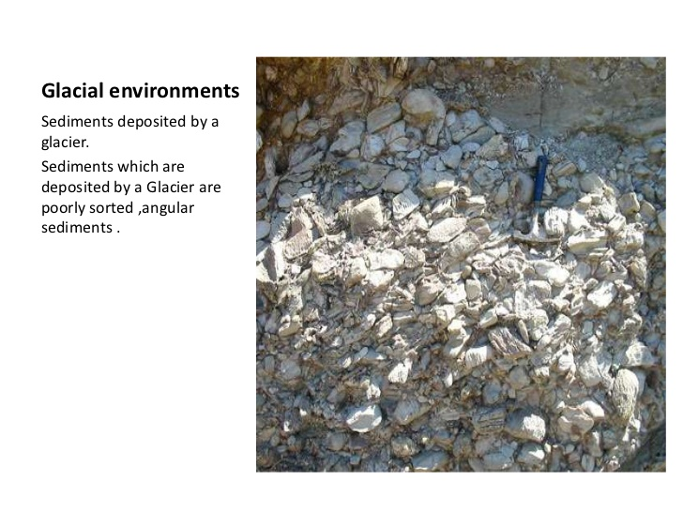
Glacial The glaciers are flowing streams of ice. They may be huge continental ice sheets or small alpine (mountain) glaciers. All glaciers scrape up sediments and incorporate them into the base of the ice sheet. The glaciers do not sort sediments as flowing water and wind do. The poorly sorted glacial sediments are known as till.

Slide 21


