Slide 1
AL-AYEN UNIVRSITY COLLEGE OF ENGINEERING
RESERVOIR ENGINEERING I
Reservoir Fluid Properties
Properties of Gases
2022-2023
NASIR ATALLAH
ASMAA AHMED

Slide 2
Properties of Natural Gases
Outline
Introduction
Ideal and Real gas
Mixture of gases
Gas properties
Apparent Molecular Weight, Ma
Gas density
Gas specific gravity
Compressibility factor
Gas viscosity
Behavior of Real Gases
Compressibility factor
Gas formation volume factor
Coefficient of isothermal compressibility
Gas viscosity

Slide 3
Introduction
The natural gas is a mixture of hydrocarbon and non hydrocarbon gases .
The hydrocarbon gases that are found in a natural gas are methane, ethane, propane, butane, pentane, and small amounts of hexanes and heavier.
The non hydrocarbon gases include carbon dioxide, hydrogen sulfide, and nitrogen.
A gas is a homogeneous of low viscosity and density that has no definite volume but expands to completely fill the vessel in which it is contained
Gas behavior is vital to petroleum engineers
Simple gas laws straightforward . Hydrocarbon gases at reservoir conditions are more complicated

Slide 4
Behavior of Ideal Gases
The kinetic theory of gases postulates that gases are composed of a very large number of particles called molecules.
For an ideal gas, the volume of these molecules is insignificant compared with the total volume occupied by the gas.
Assumptions:
Volume of molecules are insignificant with respect to the total volume of the gas.
There are no attractive or repulsive forces between molecules or molecules and container walls.
No internal energy loss when molecules collide and all collisions of molecules are perfectly elastic
Based on the above kinetic theory of gases
a mathematical equation called equation-of-state (EOS) can be derived to express the relationship existing between pressure p, volume V, and temperature T (PVT) for a given quantity of moles of gas n. This relationship for perfect gases is called the ideal gas law

Slide 5
Ideal Gases
Boyle’s Law
Charles’ Law
$$Vα\frac{1}{P}$$
$$\frac{V}{T}=constant$$
$$PV=cons\tan{t}$$
$$VαT$$
or
or
T is constant
P is constant
P = pressure, V = volume, T = temperature
Pressure and temperature in both laws are in absolute units
Absolute Units for Temperature
Rankin ºR = ºF + 460 or
Kelvin K = ºC + 273

Slide 6
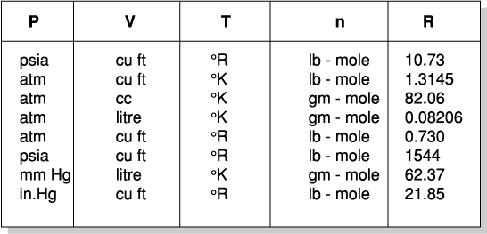
Universal Gas Constant
Ideal Gas Law
The Ideal Equation of State
$$R=10.73\frac{cu.ft.psia}{l{b}.mol.^{o}R}$$
Combining Boyle’s Law and Charles Law gives an equation relating P,T & V
$$\frac{PV}{T}=constant$$
Constant is termed R when quantity of gas is one mole
R is termed Universal Gas Constant

Slide 7
The Ideal Equation of State
Ideal Gas Law
For n moles equation becomes
PV = nRT
A useful equation to compare conditions at two conditions 1 & 2
$$\text{n}\text{=}\frac{\text{PV}}{\text{RT}}$$
$$\frac{P_{1}V_{1}}{T_{1}}=\frac{P_{2}V_{2}}{T_{2}}$$
therefore

Slide 8
Ideal Gas Law

Slide 9
Standard Conditions
Ideal Gas Law
Oil and gas occur under a whole range of temperatures and pressures
Convenient to express volumes at a reference condition.
Common practice to relate volumes to surface conditions. 14.7 psia and 60ºF
$$\frac{P_{res}V_{res}}{T_{res}}=\frac{P_{SC}V_{SC}}{T_{SC}}$$
res - reservoir conditions
SC - standard conditions
This equation assumes ideal behavior. This is NOT the case for real reservoir gases

Slide 10
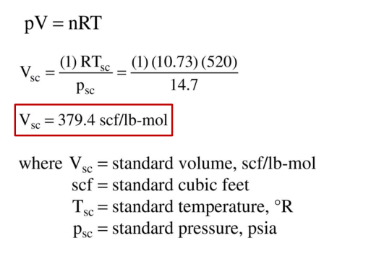
Avogadro’s Law
Ideal Gas Law
Under the same conditions of temperature and pressure equal volumes of all ideal gases contain the same number of molecules.
That is; one molecular weight of any ideal gas occupies the same volume as the molecular weight of another ideal gas.
1 lb.mole of any ideal gas at 60ºF and 14.7 psia. occupies 379.4 cu.ft.
Standard Volume:-
The standard volume, Vsc, is defined as the volume of gas occupied by 1 lb-mol of gas at standard conditions 14.7 psia and 60°F (or 520 °R )

Slide 11
Density of an Ideal Gas
$$ρ_{g}=\frac{MW.P}{RT}$$
ρ_{g} is the gas density
For 1 mole m = MW
MW= molecular weight
$$V=\frac{RT}{P}$$
$$ρ_{g}=\frac{MW.P}{RT}$$

Slide 12
Density of an Ideal Gas

Slide 13
Density of an Ideal Gas

Slide 14
Mixtures of Ideal Gases
Petroleum gases are mixtures of gases - Dalton’s Law and Amagat’s Law
Dalton’s Law of Partial Pressures
Total pressure is the sum of the partial pressures
$$P=P_{A}+P_{B}+P_{C}+P_{D}+.........$$
Therefore
$$P=n_{A}\frac{RT}{V}+n_{B}\frac{RT}{V}+n_{C}\frac{RT}{V}+.....$$
$$P=\frac{RT}{V}\sum{n_{j}}$$
i.e.
$$\frac{P_{j}}{P}=\frac{n_{j}}{n}=y_{j}$$
Therefore
y_{j} =mole fraction of j^{th} component

Slide 15
Mixtures of Ideal Gases
Amagat’s Law
States that the volume occupied by an ideal gas mixture is equal to the sum of the volumes that the pure components would occupy at the same temperature and pressure.
Law of additive volumes.
$$V=V_{A}+V_{B}+V_{C}+....$$
$$V=n_{A}\frac{RT}{P}+n_{B}\frac{RT}{P}+n_{C}\frac{RT}{P}+...$$
$$V=\frac{RT}{P}\sum{n_{j}}$$
i.e.
$$\frac{V_{j}}{V}=\frac{n_{j}}{n}=y_{j}$$
For ideal gas, volume fraction is equal to mole fraction

Slide 16
Apparent Molecular Weight
A mixture does not have a molecular weight.
It behaves as though it has a molecular weight.
Called Apparent Molecular Weight. AMW
$$AMW=\sum{y_{j}MW_{j}}$$
MWj is the molecular weight of component j.
AMW for air = 28.97 Ib/Ib-mole

Slide 17
Specific Gravity of a Gas
The specific gravity of a gas is the ratio of the density of the gas relative to that of dry air at the same conditions.
$$γ_{g}=\frac{ρ_{g}}{ρ_{air}}$$
Assuming that the gas and air are ideal
$$γ_{g}=\frac{\frac{M_{g}P}{RT}}{\frac{M_{air}P}{RT}}=\frac{M_{g}}{M_{air}}=\frac{M_{g}}{29}$$
Mg = AMW of mixture, Mair = AMW of air

Slide 18
Example
Example A gas well is producing gas with a specific gravity of 0.65 at a rate of 1.1 MMscf/day. The average reservoir pressure and temperature are 1,500 psia and 150°F.
Calculate:
Apparent molecular weight of the gas
Gas density at reservoir conditions

Slide 19
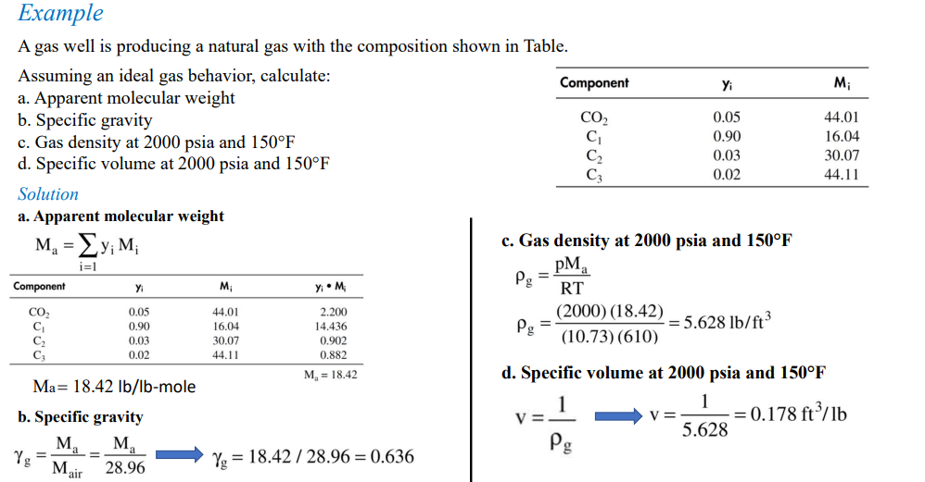

Slide 20
Correction Factor for Natural Gases
Behavior of Real Gases
At high pressures and temperatures the volume of molecules are no longer negligible and attractive forces are significant
Ideal gas law is therefore NOT applicable to real gases • for real cases, a correction factor must be introduced into EOS to account for the departure of gases from ideality
Using a correction factor in equation PV=nRT
A correction factor ‘z’ , a function of gas composition, pressure and temperature is used to modify ideal equation.
‘z’ is the gas compressibility factor , gas deviation factor, or simply the z-factor
$$PV=znRT$$
Equation known as the compressibility equation of state.

Slide 21
Compressibility factor
To compare states the equation now takes the form
$$\frac{P_{res}V_{res}}{z_{res}T_{res}}=\frac{P_{SC}V_{SC}}{z_{SC}T_{SC}}$$
Z is an expression of the actual volume to what the ideal volume would be. i.e.
Z = V actual / V ideal

Slide 22
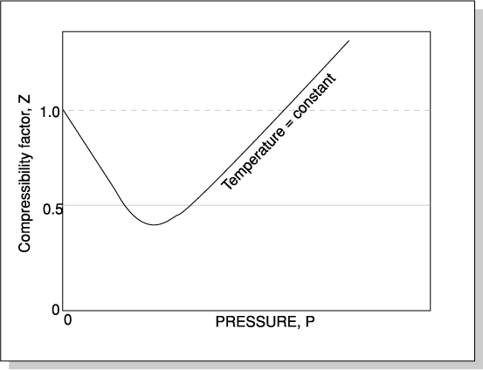
Compressibility factor
The gas compressibility factor z is a dimensionless quantity and is defined as the ratio of the actual volume of n-moles of gas at P and T to the ideal volume of the same number of moles at the same P and T
Z at standard conditions = 1.0

Slide 23
Compressibility factor
The law of corresponding states shows that the properties of many pure liquids and gases have the same value at the same reduced temperature (Tr) and pressure (Pr) where:
Where, Tc and Pc are the pure component critical temperature and pressure.
For mixtures a pseudocritical temperature and pressure, Tpc and Ppc is used such that:
Pseudo-reduced pressure, PPr
Pseudo-reduced temperature, TPr
z-Factors for Naturally Occurring Gas Mixtures
these pseudo-critical properties do not represent the actual critical properties of the gas mixture.but they are used as correlating parameters in generating
gas properties
Kay’s rule
p = system pressure, psia
ppr = pseudo-reduced pressure, dimensionless
T = system temperature, °R
Tpr = pseudo-reduced temperature, dimensionless
ppc, Tpc = pseudo-critical pressure and temperature

Slide 24
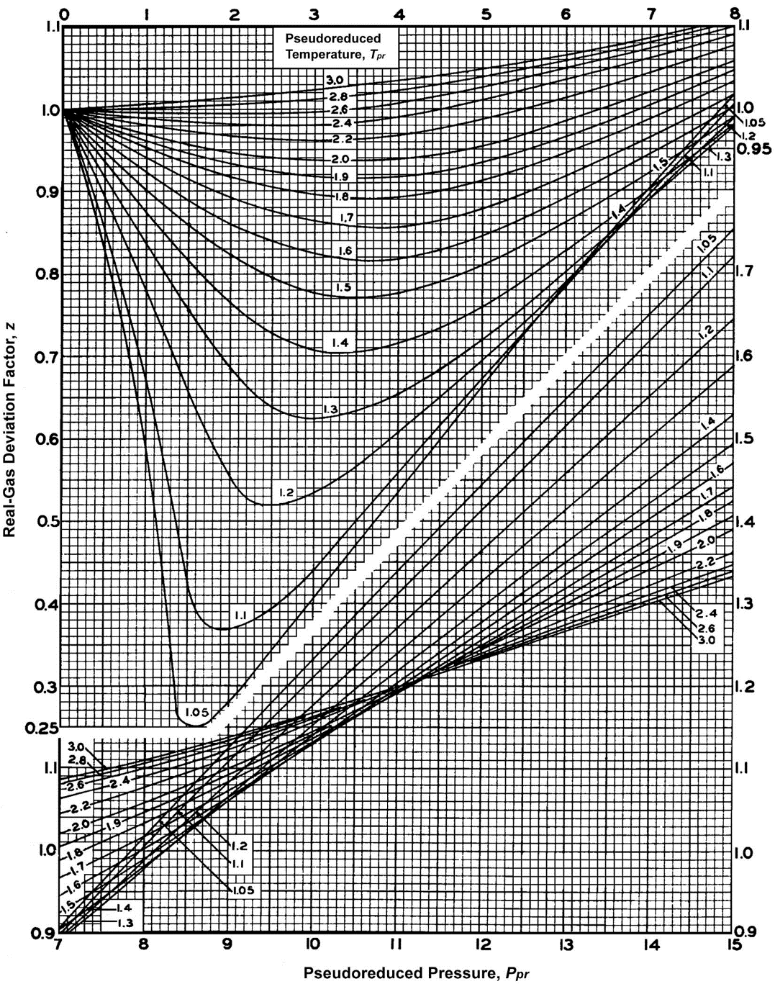
Compressibility factor
Based on the concept of pseudo-reduced properties, Standing and Katz (1942) presented a generalized gas compressibility factor chart
The chart represents compressibility factors of sweet natural gas as a function of Ppr and Tpr.
This chart is generally reliable for natural gas with minor amount of nonhydrocarbons.
It is used for mixture of gases and its one of the most widely accepted correlations in the oil and gas industry.

Slide 25
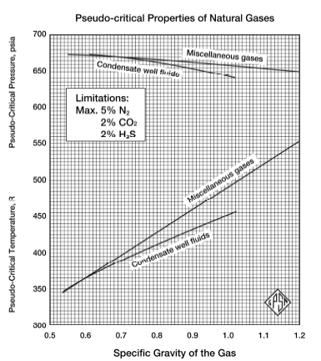
Compressibility factor
In cases where the composition of a natural gas is not available, the pseudo-critical properties, i.e., ppc and Tpc, can be predicted solely from the specific gravity of the gas.
Brown et al. (1948) presented a graphical method for a convenient approximation of the pseudo-critical pressure and pseudo-critical temperature of gases when only the specific gravity of the gas is available. The correlation is presented in the figure (Reservoir Engineering Handbook by Tarek Ahmed).
Standing (1977) expressed this graphical correlation in the following mathematical forms:

Slide 26
Compressibility factor
Effect of Nonhydrocarbon Components on the z-Factor
• Natural gases frequently contain materials other than hydrocarbon components, such as nitrogen, carbon dioxide, and hydrogen sulfide.
• Hydrocarbon gases are classified as sweet or sour depending on the hydrogen sulfide content. Natural gas is usually considered sour if there are more than 5.7 milligrams of H2S per cubic meter of natural gas, which is equivalent to approximately 4 ppm by volume under standard temperature and pressure..
• Both sweet and sour gases may contain nitrogen, carbon dioxide, or both.
• Concentrations of up to 5 percent of these nonhydrocarbon components will not seriously affect accuracy.
• Errors in compressibility factor calculations as large as 10 percent may occur in higher concentrations of
nonhydrocarbon components in gas mixtures.
• There are two methods that were developed to adjust the pseudo-critical properties of the gases to account for the presence of the nonhydrocarbon components. These two methods are the:
Wichert-Aziz correction method
Carr-Kobayashi-Burrows correction method

Slide 27
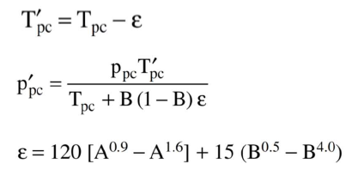
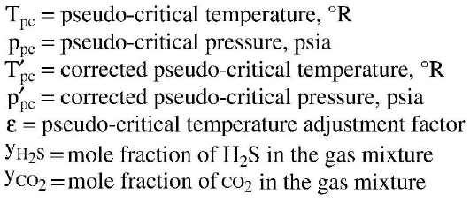
Compressibility factor
Wichert-Aziz Correction Method
• Wichert and Aziz (1972) developed a method to calculate the compressibility factor for Natural
gases that contain H2S and or CO2.
• This method permits the use of the Standing-Katz chart, i.e., Figure 2-1, by using a pseudo-critical
temperature adjustment factor.

Slide 28
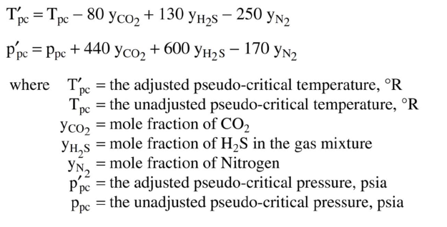
Compressibility factor
Carr-Kobayashi-Burrows Correction Method
• Carr, Kobayashi, and Burrows (1954) proposed a simplified procedure to adjust the pseudo-critical
properties of natural gases.

Slide 29
Gas formation volume factor
Gas volume formation factor (Bg) is Volume of gas at reservoir conditions required to produce one standard volume of gas at the surface
The gas formation volume factor is used to relate the volume of gas, as measured at reservoir conditions, to the volume of the gas as measured at standard conditions, i.e., 60°F and 14.7 psia.
$$B_{g}=\frac{V_{R}}{V_{sc}}$$
Bg = gas formation volume factor, ft3/scf
VR= volume of gas at reservoir conditions, ft3
Vsc = volume of gas at standard conditions, scf

Slide 30
Gas formation volume factor
Applying the real gas equation-of-state
Psc =14.7psia, Tsc= 520 R
$$B_{g}=\frac{V_{R}}{V_{sc}}=\frac{\frac{z n RT}{P}}{\frac{z_{sc }n RT_{sc}}{P_{sc}}}$$
$$B_{g}=\frac{P_{sc} Z T}{T_{sc} P}$$
$$B_{g}=0.02827\frac{ Z T}{P }$$
Bg= ft3/scf
Z factor at standard conditions = 1
$$B_{g}=0.005035\frac{Z T }{P }$$
Bg = gas formation volume factor, ft3/scf or bbl/scf
z = gas compressibility factor
T = temperature, °R
P = Pressure, Psia
Bg= bbl/scf

Slide 31
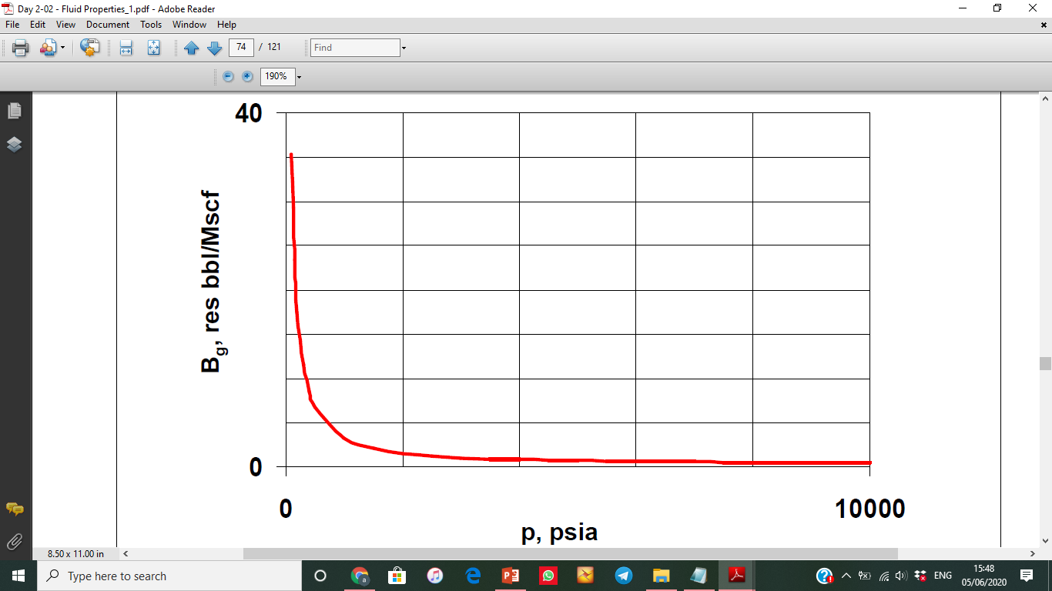
Gas formation volume factor
Bg is provided as a function of pressure to be used in reservoir engineering calculations and reservoir simulation studies

Slide 32
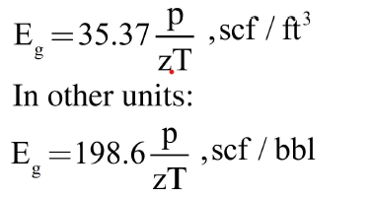
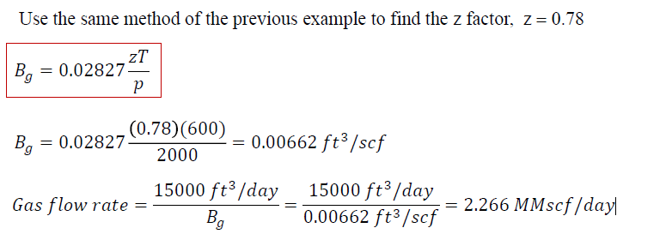
Gas Expansion factor
The reciprocal of the gas formation volume factor is called the gas expansion factor and is designated by the symbol Eg, or:
Example: A hydrocarbon gas mixture has a specific gravity of 0.72, The average pressure of 2,000 psia and a temperature of 140°F. The specific gravity is 0.72, z factor is 0.78. Calculate the Bg and Eg.
Solution:
Eg = 1/Bg = 1/2.266 = 0.44 scf/ft³

Slide 33
Coefficient of isothermal compressibility
The isothermal gas compressibility (cg) is the change in volume per unit volume for a unit change in pressure.
For ideal gas Z=1
For real gas
cg = isothermal gas compressibility, 1/psi
P= pressure, psi,
Z =z-factor.

Slide 34
Coefficient of isothermal compressibility
7000
Cg is provided as a function of pressure to be used in reservoir engineering calculations and reservoir simulation studies.
0

Slide 35
Gas viscosity
Viscosity: the resistance to flow exerted by a fluid.
Viscosity unit: poises or centipoise (cp)
The gas viscosity (μg) is not commonly measured in the laboratory because it can be estimated precisely from empirical correlations. Like all intensive properties, viscosity of a natural gas is completely described by the following function:
μg = (P, T, yi )
Correlations for estimating gas viscosity:
• Carr-Kobayashi-Burrows Correlation Method
• Lee-Gonzalez-Eakin Method

Slide 36
Gas viscosity
The Carr-Kobayashi-Burrows Correlation Method
Note: Equations have been developed by Standing (1977) and Dempsey (1965) to represent the graphical
correlations of Carr, Kobayashi, and Burrows (1954).
The Lee-Gonzalez-Eakin Method

Slide 37
Gas viscosity
0.05
Gas viscosity is provided as a function of pressure to be used in reservoir engineering calculations and reservoir simulation studies.
μg, cp
0

