Slide 1
Angina pectoris AL-AYEN UNIVERSITY COLLEGE OF HEALTH AND MEDICAL TECHNOLOGY DEPARTMENT OF ANESTHESIA By PhD Karima Aboul Fotouh Lecturer 3

Slide 2
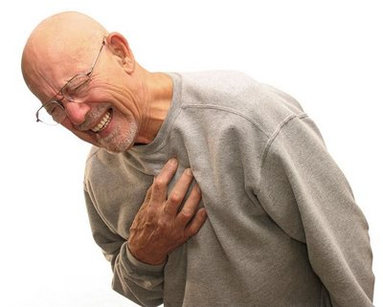
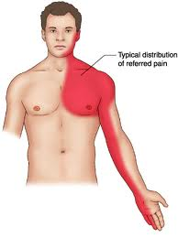
Vasodilators and management of angina pectoris
Angina usually refers to angina pectoris. It signifies chest pain and discomfort due to imbalance between myocardium oxygen requirement and oxygen supply by coronary arteries.
The pain also can occur in your shoulders, arms, neck, jaw, or back

Slide 3
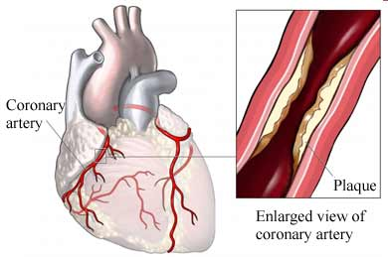
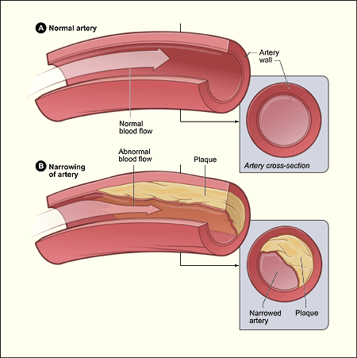
Classification of angina:
Stable (classic, effort) angina:
Chest pain brought on when the heart is working harder than usual, such as during exercise.
Occurs due to a fixed narrowing of the coronary arteries by atherosclerosis.
Symptoms are relieved by rest or medication

Slide 4
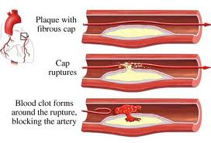
Unstable angina (preinfarction angina):
Chest pain occurs with less exertion, can occur at rest.
Occurs due to disruption of an atherosclerotic plaque with subsequent cascade of platelet activation and aggregation, and thrombosis leading to a decrease in coronary blood flow.

Slide 5
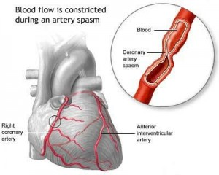
Variant ( prinzmetal's or vasospastic ) angina:
Cardiac pain that occurs exclusively at rest.
Caused by coronary artery vasospasm (vasospastic) which reduces coronary flow leading to reduction of blood flow to the myocardium.

Slide 6
Aim of Therapy
To improve the balance between myocardial oxygen demand and supply.
Supply = Demand
Coronary Blood Flow Heart rate
Contractility
Systolic Wall Tension

Slide 7
How to achieve the aim?
Increase blood flow to the myocardium by dilating the coronary arteries:
Vasodilators (nitrates) and Ca⁺² channel blockers
Decrease oxygen demand by reducing cardiac work:
β blockers and Ca⁺² channel blockers
Treat coronary artery disease:
↓cholesterol level: statins
↓plaque formation: anticoagulant, antiplatelets aggregation
Surgical procedures e.g. stents and angioplasty

Slide 8
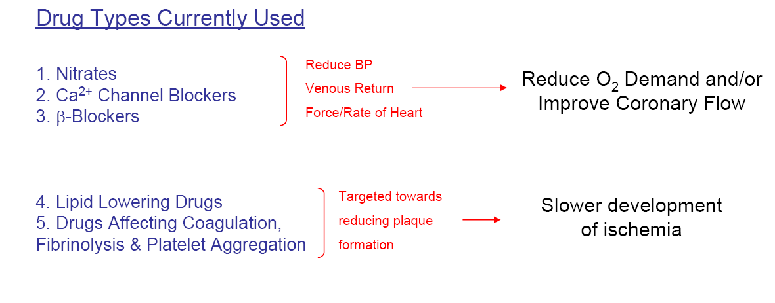

Slide 9
Organic nitrates
Nitroglycerin ( glyceryl trinitrate ),
Isosorbide dinitrate : sublingual, sustained release.
Isosorbide mononitrate : oral .

Slide 10
Mechanism of action :
to produce relaxation of smooth muscles esp. B.V.(artery and veins more than arterioles) .

Slide 11
Pharmacological actions :
V.D. of blood vessels and decreased B.P.
Reflex sympathetic stimulation → tachycardia and stimulate respiration reflexly .
Relax other smooth muscles as bronchi, gut and urinary .
It decrease platelets aggregations

Slide 12
Therapeutic uses :
1) Angina pectoris ( all types ) :
Acute attack by nitroglycerin or isosorbide dinitrate sublingual or oral spray .
Prophylaxis by long acting nitrates oral, sublingual or ointment .
IV nitroglycerin is restricted to the treatment of severe, recurrent rest angina.
2) Congestive heart failure.
3) Myocardial infarction
4) In cyanide poisoning

Slide 13
II. Slow calcium channel blockers (Calcium influx inhibitors)
Classification :
Dihydropyridines : nifedipine, amlodipine nitrendipine, nimodipine and nicardipine
Miscellaneous verapamil, diltiazem, and bepridil .
Verapamil and diltiazem affect heart more than vessels while nifedipine, nimodipine and nicardipine affect vessels more than heart .

Slide 14
Mechanism and actions :
Block the voltage sensitive calcium channel
They relax vascular smooth muscles so:
They decrease peripheral and coronary resistance ( nifedipine).
↓myocardial contractile force→↓myocardial O₂ requirements (verapamil, diltiazem ).
NB
Verapamil, diltiazem→ Bradycardia
Nifedipine → reflex tachycardia.

Slide 15
Verapamil :
It affects cardiac tissue more than vascular smooth muscles, so it decreases B.P., H.R.,COP It blocks alpha-receptors also .
Uses :
Antiarrhythmic in supraventricular arrhythmia (class IV)
Prophylactic treatment of all types of angina.
Hypertension .
Prophylaxis of migraine headache.
Adverse effects : Bradycardia, heart block, heart failure, hypotension, flushing, ankle edema and constipation .

Slide 16
III . Beta-adrenoreceptor blockers
They decrease H.R., and contractility, so decrease the myocardial work and myocardial oxygen consumption especially during exercise.
They are used for prophylaxis of angina pectoris associated with effort but not in variant angina .

Slide 17
Prophylactic treatment :
1) Variant angina :
Nitrates orally, transdermal forms or nifedipine orally .
If no response give nitrate + verapamil or diltiazem .
Nitrate + nifedipine ( in severe cases or if verapamil or diltiazem are contraindicated ) . This combination may produce hypotension and tachycardia.
2) Stable (effort) angina :
Nitrate + beta-blocker aspirin
Nitrate + verapamil or diltiazem + to inhibit
Nifedipine + ß-blocker aggregation
3) Unstable angina : I.V. heparin + antiplatelet drugs + nitrates + nifedipine + ß-blocker .

