Slide 1
CHAPTE R 1 Medical terminology

Slide 2
List of Contents
Review (What do you know about Terminology, Roots, Quiz)
Suffixes
Prefixes
Reading medical terms
Spelling of medical terms
Pronunciation of medical terms
Focus on reading
Home work
3RD Lect.
. Dr. Laith & Dr. Asaad

Slide 3
Quiz
word | Soft C | Hard C | Soft G | Hard G
1- Dermatologist
2-Cerebral
3-Encephalogram
4- Cardiac
5- Organ

Slide 4
Answers of Quiz
word | Soft C | Hard C | Soft G | Hard G
1- Dermatologist
2-Cerebral
3-Encephalogram
4- Cardiac
5- Organ

Slide 5
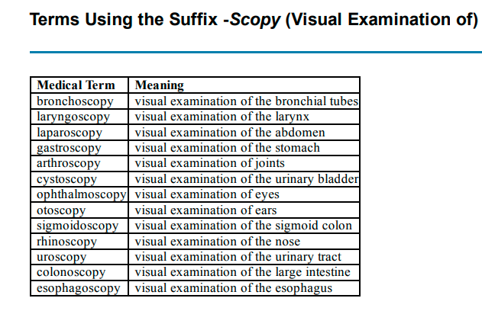

Slide 6
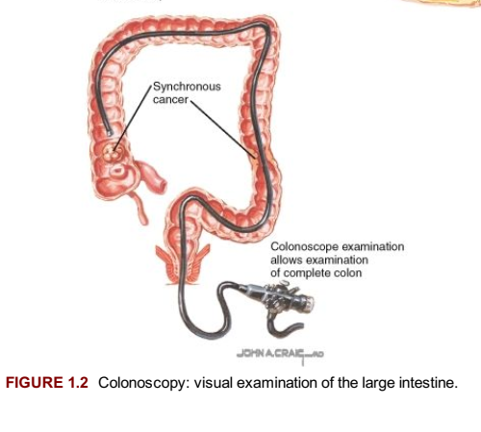

Slide 7
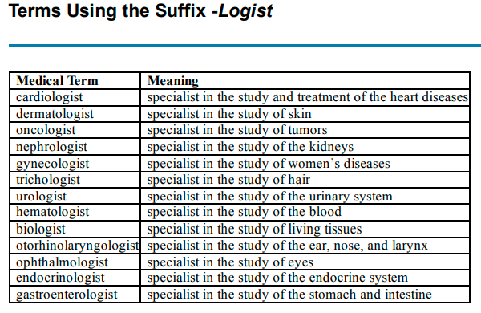

Slide 9
Prefixes
A prefix is a letter or a group of letters attached to the beginning of a root to modify its meaning.
Hyperglycemia=
an excess of glucose in the bloodstream
a prefix (hyper),
a root (glyc),
a suffix (-emia).
Cardi
Brady+ card +ia = bradycardia
(having slow heart rate)
Tachy+ card+ ia= tachycardia
(rapid heart rate).

Slide 10
When a suffix starting with a consonant is added to a root ending with a consonant, a vowel is added between the root and the suffix in order to ease the articulation of the resulting form. This vowel is referred to as the combining vowel. The root plus the combining vowel are called the combining form.
Cystoscope is an instrument to visually examine the urinary bladder.

Slide 11
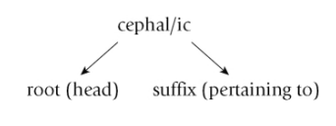
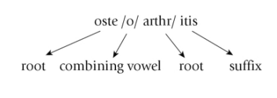

Slide 12
Practice 1.1
Form medical words from the following prefixes, combining forms, and suffixes. Delete unnecessary components.
a. electr/o/encephal/o/gram =
b. enter/o/itis =enteritis
c. nephr/o/ectomy = nephrectomy
d. ophthalm/o/scope =
e. trans/urethr/o/al =
f. retro/gastr/o/ic =
g. bi/o/opsy =
h. hyper/thyroid/o/ism =
i. arthr/o/algia =
j. cerebr/o/vascul/o/ar =

Slide 13
Practice// Write the (Medical) meaning for each of the following definitions.
specialist in study and treatment of the heart diseases _____________
specialist in study of the hair ____________________.
specialist in study of the blood _______________.
Anti is a prefix means ____________
Bio is a prefix means ___________________.
Re is a prefix means _____________________
Cardiologist
Trichologist
Hematologist
Against
Life
Again

