Slide 1
Geophysics Lecture 4

Slide 2
Seismic Methods Include:
The Elastic Theory
Hooke’s Law (Stress & Strain)
Elastic Moduli
Velocities of Seismic Wave (P-wave & S-wave)
Seismic Refraction Method
Seismic Reflection Method

Slide 3
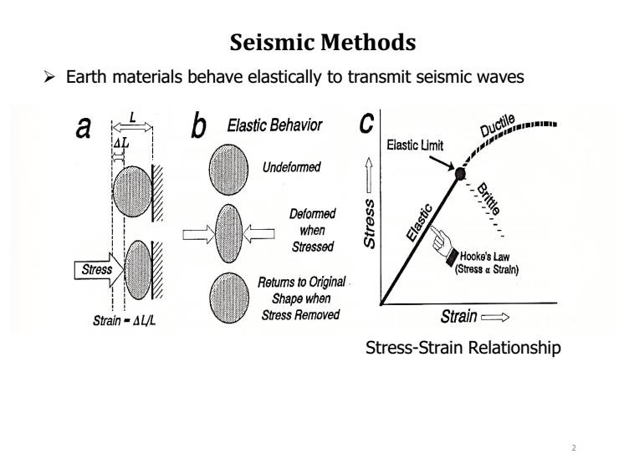
Geophy_En_2

Slide 10
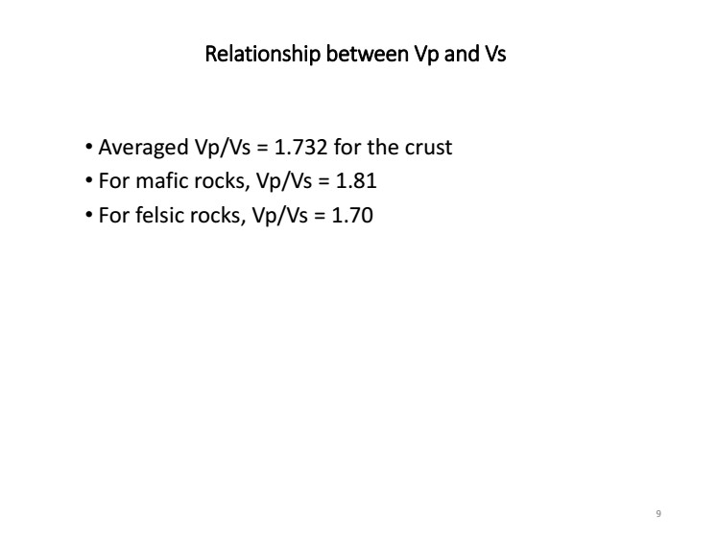

Slide 12
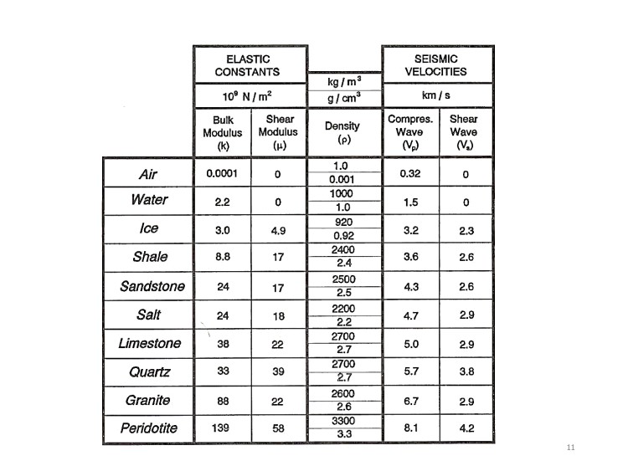

Slide 16
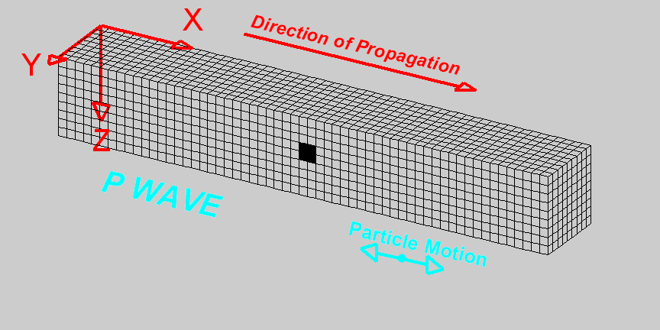
Compressional Wave (P-Wave) Animation
Deformation propagates. Particle motion consists of alternating compression and dilation. Particle motion is parallel to the direction of propagation (longitudinal). Material returns to its original shape after wave passes.

Slide 18
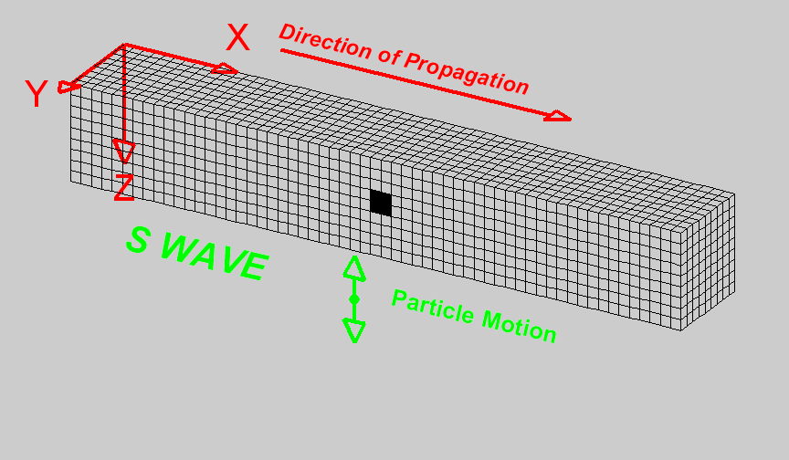
Shear Wave (S-Wave) Animation
Deformation propagates. Particle motion consists of alternating transverse motion. Particle motion is perpendicular to the direction of propagation (transverse). Transverse particle motion shown here is vertical but can be in any direction. However, Earth’s layers tend to cause mostly vertical (SV; in the vertical plane) or horizontal (SH) shear motions. Material returns to its original shape after wave passes.

Slide 22
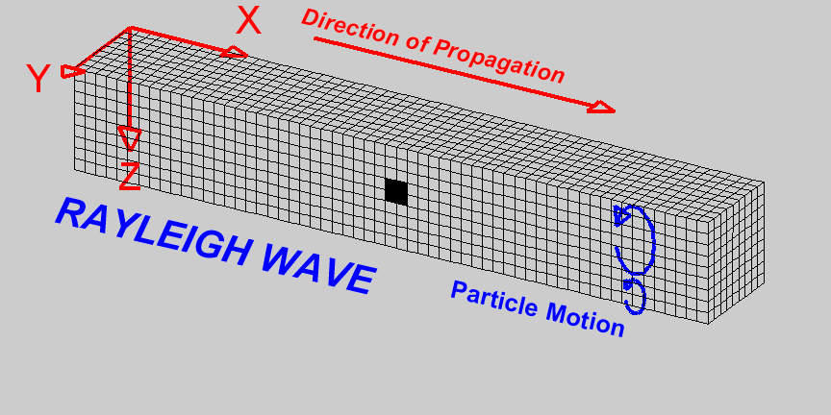
Rayleigh Wave (R-Wave) Animation
Deformation propagates. Particle motion consists of elliptical motions (generally retrograde elliptical) in the vertical plane and parallel to the direction of propagation. Material returns to its original shape after wave passes.

Slide 23
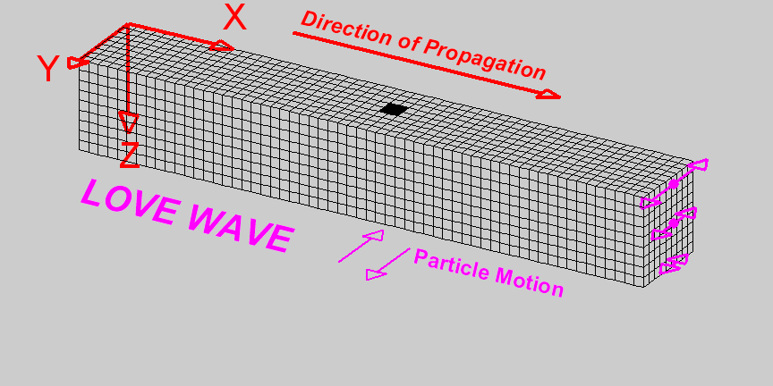
Love Wave (L-Wave) Animation
Deformation propagates. Particle motion consists of alternating transverse motions. Particle motion is horizontal and perpendicular to the direction of propagation (transverse). To aid in seeing that the particle motion is purely horizontal, focus on the Y axis (red line) as the wave propagates through it. Material returns to its original shape after wave passes.

Slide 24
Characteristics of Seismic Waves
Table 2: Seismic Waves
Type (and names) | Particle Motion | Typical Velocity | Other Characteristics
P,Compressional , Primary, Longitudinal | Alternating compressions (“pushes”) and dilations (“pulls”) which are directed in the same direction as the wave is propagating (along the raypath); and therefore, perpendicular to the wavefront | V_{P} ~ 5 – 7 km/s in typical Earth’s crust; >~ 8 km/s in Earth’s mantle and core; 1.5 km/s in water; 0.3 km/s in air | P motion travels fastest in materials, so the P-wave is the first-arriving energy on a seismogram. Generally smaller and higher frequency than the S and Surface-waves. P waves in a liquid or gas are pressure waves, including sound waves.
S, Shear, Secondary, Transverse | Alternating transverse motions (perpendicular to the direction of propagation, and the raypath); commonly polarized such that particle motion is in vertical or horizontal planes | V_{S} ~ 3 – 4 km/s in typical Earth’s crust; >~ 4.5 km/s in Earth’s mantle; ~ 2.5-3.0 km/s in (solid) inner core | S-waves do not travel through fluids, so do not exist in Earth’s outer core (inferred to be primarily liquid iron) or in air or water or molten rock (magma). S waves travel slower than P waves in a solid and, therefore, arrive after the P wave.

Slide 25
Characteristics of Seismic Waves
L, Love, Surface waves, Long waves | Transverse horizontal motion, perpendicular to the direction of propagation and generally parallel to the Earth’s surface | V_{L} ~ 2.0 - 4.5 km/s in the Earth depending on frequency of the propagating wave | Love waves exist because of the Earth’s surface. They are largest at the surface and decrease in amplitude with depth. Love waves are dispersive, that is, the wave velocity is dependent on frequency, with low frequencies normally propagating at higher velocity. Depth of penetration of the Love waves is also dependent on frequency, with lower frequencies penetrating to greater depth.
R, Rayleigh, Surface waves, Long waves, Ground roll | Motion is both in the direction of propagation and perpendicular (in a vertical plane), and “phased” so that the motion is generally elliptical – either prograde or retrograde | V_{R} ~ 2.0 - 4.5 km/s in the Earth depending on frequency of the propagating wave | Rayleigh waves are also dispersive and the amplitudes generally decrease with depth in the Earth. Appearance and particle motion are similar to water waves.

Slide 26
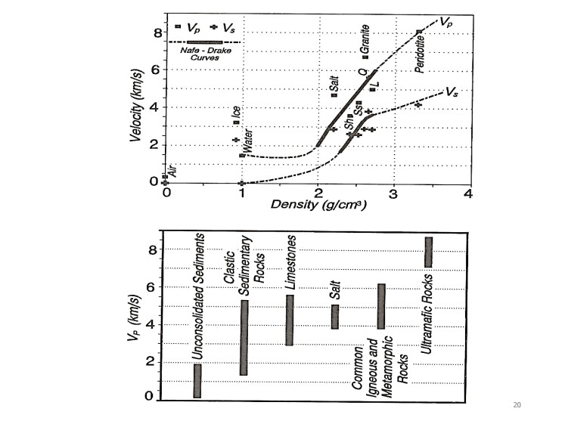

Slide 27
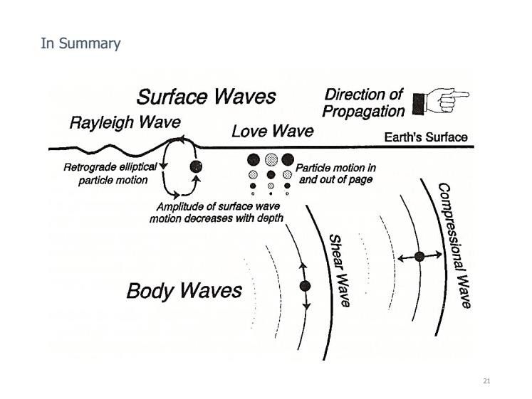

Slide 28
