Slide 1
جوائز جامعة العين العراقية للباحث الأكاديمي العراقي AUIQ - AWARDS
أ. د. شفيق شاكر شفيق المولى
رئيس جامعة العين العراقية - ذي قار

Slide 2
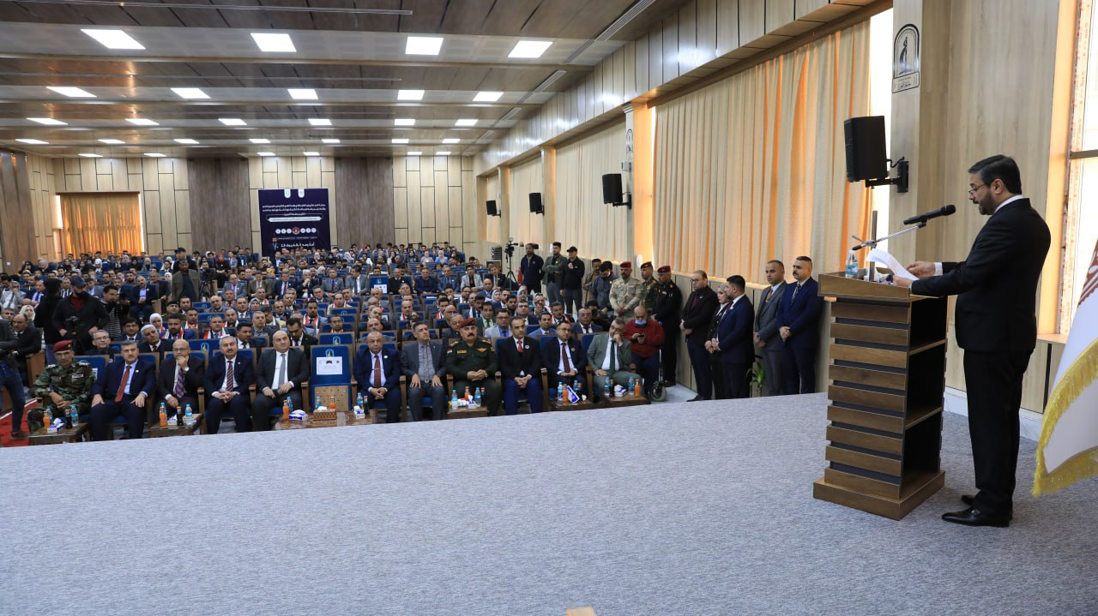
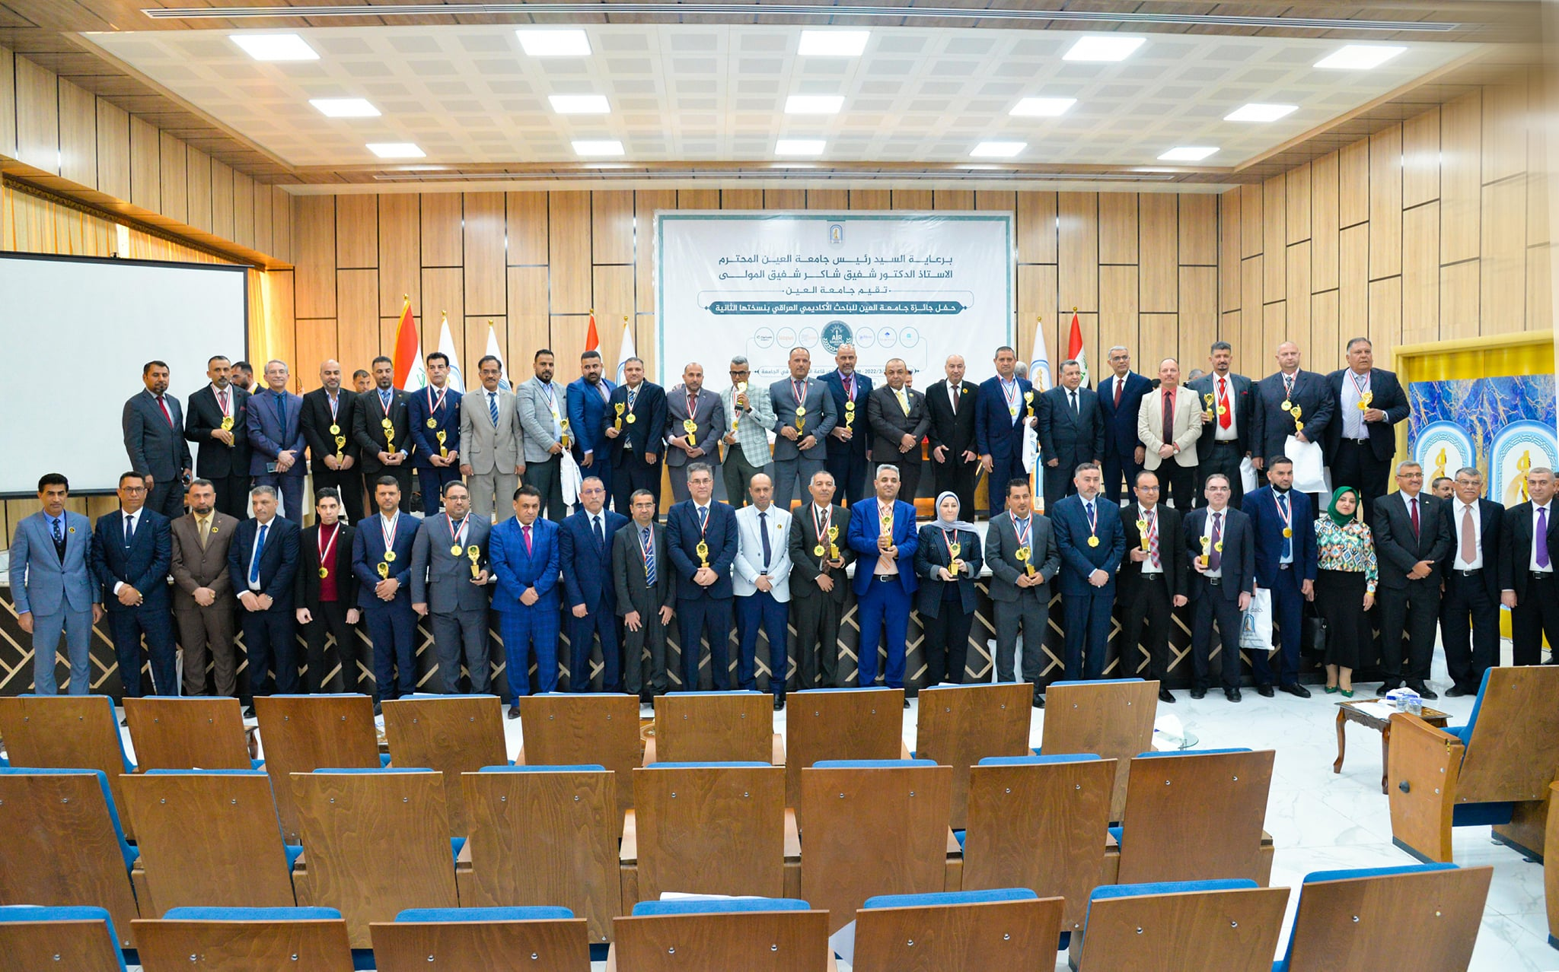
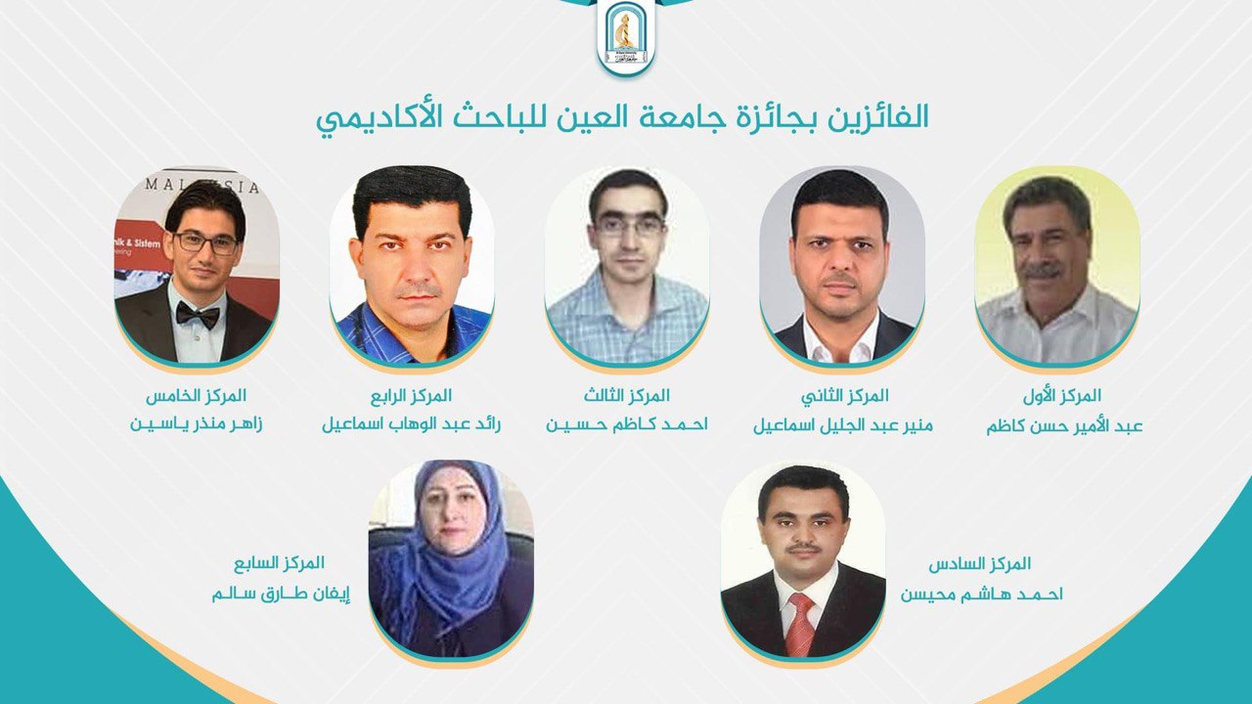
Al-Ayen Previous Awards
1st February 2023
1st March 2022
1st March 2021
Version FOUR
2024

Slide 3
مقترحات لتطوير البحث العلمي العراقي
مستخلصة من جائزة جامعة العين العراقية
بحث علمي بدون اموال, مستحيل
معهد العالي لطرائق البحث العلمي
اموال
اخلاقيات ونزاهة البحث العلمي
مختبرات مركزية
أستثمار المعرفة
بحث علمي
صندوق مالي لدعم البحث العلمي
استحداث منصة علمية الكترونية
معرفة

Slide 4
مقترحات لتطوير البحث العلمي العراقي
مستخلصة من جائزة جامعة العين العراقية
الأختصاص الدقيق : الفيزياء النووية كمثال في PACs
(Physical American Classifications) 189 اختصاص فالابداع ينتج من الاختصاص الدقيق، في العراق اغلب الدراسات العليا عامة ومن الممكن فتح دراسات عليا باختصاصات دقيقة بأساتذة من مختلف الجامعات العراقية وهذا ما ستوفره المنصة
اللغة : بدأت الوزارة بأجراء جيد ولكن
الهدف من البحث والتطبيق : وهذا يتطلب فهم كافي لمشروع البحث
ثقافة التعاون الحقيقي : التشجيع على تكوين المجاميع البحثية

Slide 5
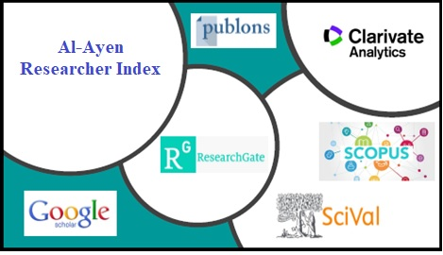
AUIQ - Awards
Conditions
The researcher must be of Iraqi nationality and currently affiliated with an institution in Iraq
Regulations of publication in the last four years
Sustainability Database Goals (SDG) from Scopus

Slide 6
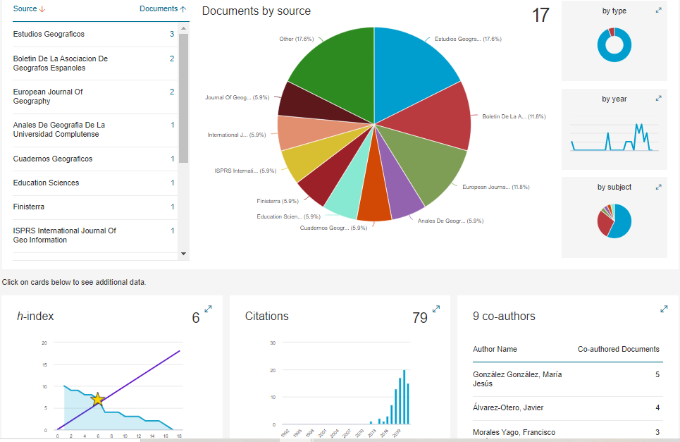
1. AUIQ – Pioneer Award
Agricultural and Biological Sciences
Arts and Humanities
Biochemistry, Genetics and Molecular Biology
Business, Management and Accounting
Chemical Engineering
Chemistry
Computer Science
Decision Sciences
Dentistry
Earth and Planetary Sciences
Economics, Econometrics and Finance
Energy
Engineering
Environmental Science
Health Professions
Immunology and Microbiology
Materials Science
Mathematics
Medicine
Multidisciplinary
Neuroscience
Nursing
Pharmacology, Toxicology and Pharmaceutics
Physics and Astronomy
Psychology
Social Sciences
Veterinary
With Field Consideration
There are 27 General Fields according to Scopus Database

Slide 7
1. AUIQ – Pioneer Award
1- Scopus based database with a total weight of 27% divided as follows:
Overall Citations, with a weight of 3 %.
Out-self Citation: 2%
H-index, with a weight of 5 %.
Total number of papers, with a weight of 4 %.
Number of papers published in 20xx, 4 %.
Author Position, 9%
Corresponding author 3%
Single Author, 3%
First Author, 3%

Slide 8
1. AUIQ – Pioneer Award
2- SciVal based database with a total weight of 23% divided as follows:
Papers in Top Journal Percentiles, 4%.
Most Citied papers, 5 %.
Field-Weighted Views Impact, 4 %.
International collaboration, 5 %.
Field-Weighted Citation Impact, 5%.
3. Sustainability Database Goals (SDG) Interested Researchers 5 %
Based on SCOPUS Sustainability Database (16 Goals).
For the year 20xx, the ratio between the number of published papers that targeted the SDG to the total published papers for the evaluation year.

Slide 9
1. AUIQ – Pioneer Award
4- Web of Science based database with a total weight of 25 % divided as follows:
Overall Citations, 3 %.
Sum of Times Cited By Patents 2%
H-index, 4 %.
Total number of papers, 3 %.
Number of papers published in 20xx, 4 %.
Author Positions: 9%
Corresponding author 3%
Single Author, 3%
First Author, 3%
5- Publons based database with a total weight of 10 % divided as follows:
Top reviewer award, 2%.
Total number of editorial contributions, 2 %.
Total number of reviews contributions, 2 %.
d) Highly-cited award, 2 %.
e) Editorial role, 2 %.

Slide 10
1. AUIQ – Pioneer Award
6- Google Scholar based database with a total weight of 6 % divided as follows:
Total number of papers, 2 %.
H-index, 2 %.
Overall Citations, 2 %.
7- ResearchGate based database with a total weight of 4 % for the ResearchGate score.

Slide 11
2. AUIQ – The First Researcher Award
Condition
In order to motivate young universities (with less than 20 years of establishment) to conduct scientific research, their H – Index must be greater than the number of years of foundation multiplied by 1.5.
1- Scopus based database with a total weight of 36% divided as follows:
$δ$H-index, with a weight of 10%.
Number of papers published in 20xx, 10%.
No. of Citations 20XX 8%
Author Position, 8%
Corresponding author 4%
First Author, 4%

Slide 12
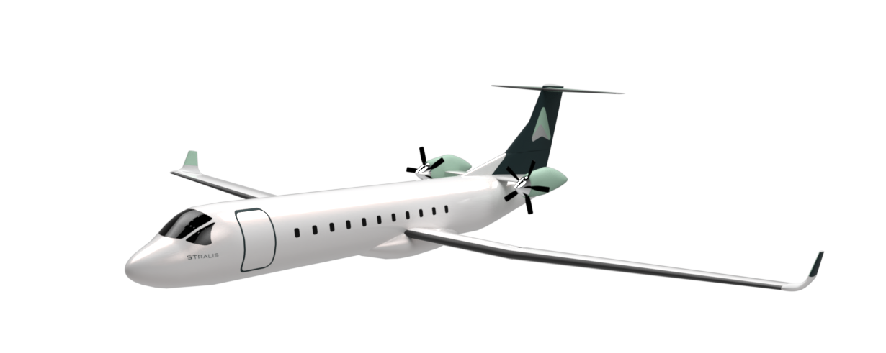
2. AUIQ – The First Researcher Award
2- SciVal based database with a total weight of 16% divided as follows:
Papers in Top Journal Percentiles, 8%.
Field-Weighted Citation Impact, 8%.
3- Web of Science based database with a total weight of 30% divided as follows:
$δ$H-index, with a weight of 8%.
Number of papers published in 20xx, 8%.
No. of Citations 20XX 6%
Author Position, 8%
Corresponding author 4%
First Author, 4%

Slide 13
2. AUIQ – The First Researcher Award
4- Google Scholar based database with a total weight of 10% divided as follows:
20xx number of papers, 3 %.
$δ$H-index, 4%.
20xx Citations, 3%.
5. Sustainability Database Goals (SDG) Interested Researchers 8 %
Based on SCOPUS Sustainability Database (16 Goals).
For the year 20xx, the ratio between the number of published papers that targeted the SDG to the total published papers for the evaluation year.

Slide 14
3. Sustainability Database Goals (SDG) Interested Institutions Awards (SDG-IIA)
For Iraqi Universities.
Based on SCOPUS Sustainability Database (16 Goals).
Highest five Publications Universities in 2023 (for Public and Private).

Slide 15
3. Sustainability Database Goals (SDG) Interested Institutions Awards (SDG-IIA)
It is advised that universities researchers follow the SDGs trend globally, as this is the major consideration for the globalization and universities ranking “e.g., QS”. See the main keywords:
https://docs.google.com/spreadsheets/d/1AaohFZNhhCEYw6YZg4CeYW0v5FdlFrBl/edit#gid=943498853

Slide 16
4. Scientific Empowered Woman Award (SEWA)
The abundance and quality of research production in international databases will be studied for Iraqi women scientific researchers.
The TOP three women researchers will be honored.
TOP THREE WOMEN in SCIENTIFIC RESEARCH
In IRAQ

Slide 17
AUIQ Amazing Team
Prof. Dr. Shafik S. Shafik
Asst. Prof. Dr. Hayder A. Marhoon
Asst. Prof. Dr. Atheer Y. Oudah
Asst. Prof. Dr. Rafid Sagban
Prof. Dr. Naser A. Hussien
Asst. Prof. Dr. Zahar M. Yaseen
Lec. Dr. Maytham T. Qasim
Asst. Prof. Raaid N. Al-Ubady
Lec. Dr. Sarah J. Shooja

Slide 18
Thanks For Listening
I love Thi qar

