Slide 1
Geophysics Introduction First Lecture

Slide 2
What is a Geophysics
Geophysics is a field of earth sciences that uses the methods of physics to investigate the physical properties of the Earth and the processes that have determined and continue to govern its evolution.
What are these Properties?

Slide 3
Geophysics

Slide 4
Using Geophysics to Characterize the Subsurface: The Principles

Slide 5
Using Geophysics to Characterize the Subsurface: The Principles

Slide 6
Sources

Slide 7
Sources

Slide 8
Sources

Slide 9
Using Geophysics to Characterize the Subsurface: The Principles

Slide 10
Physical Properties
What main physical properties do we measure?
Density
Magnetic properties
Resistivity, conductivity
Acoustic Velocity
Electromagnetic properties

Slide 11
Physical Properties
1.Density
Density ρ is defined quotient of mass m and volume V of a material.
The SI unit for density is kg m -3
Due to the heterogeneity of rocks, it is necessary to distinguish between different densities that are related to different rock components:

Slide 12
Physical Properties(Density)
ρ—bulk density: the mean density of the considered rock volume (including pores, etc.), for example, density of sandstone,
ρma—mean density of the solid matrix material (mineral or mixture of minerals), for example, density of a carbonate matrix (without pore fluid),
ρfl—mean density of the pore (or fracture) fluid, for example, density of water rw

Slide 13
Physical Properties (Density)

Slide 14
Physical Properties
Magnetic properties
Magnetic properties refer to the response of a material to an applied magnetic field. Different materials react to the application of magnetic field differently.

Slide 15
Physical Properties
3.Resisitivity vs. Conductivity
Resistance: measure of the opposition offered by the material to the flow of electricity
Resistivity R is a material invariant:
R is measured in Ohm
Conductivity is the reciprocal of resistivity (C =1/R)

Slide 16
Physical Properties
3.Acoustic Impedance
Acoustic impedance of a rock layer is the product of the density and the velocity of that layer, and strictly a reflection is generated by a contrast in acoustic impedance.

Slide 17
Physical Properties
3.Acoustic Impedance
Acoustic impedance of a rock layer is the product of the density and the velocity of that layer, and strictly a reflection is generated by a contrast in acoustic impedance.

Slide 18
Physical Properties

Slide 19
Framework for Applied Geophysics

Slide 20
Wave Theory
Seismology is the study of earthquakes and seismic waves that move through and around the Earth. A seismologist is a scientist who studies earthquakes and seismic waves.
Earthquake generate both body and surface wave.

Slide 21
What are Seismic Waves?
Seismic waves are caused by the sudden movement of materials within the Earth, such as slip along a fault during an earthquake. Volcanic eruptions, explosions, landslides, avalanches, and even rushing rivers can also cause seismic waves. Seismic waves travel through and around the Earth and can be recorded with seismometers.

Slide 22
Types of Seismic Waves
There are several different kinds of seismic waves, and they all move in different ways. The two main types of waves are body waves and surface waves. Body waves can travel through the Earth's inner layers, but surface waves can only move along the surface of the planet like ripples on water. Earthquakes send out seismic energy as both body and surface waves.

Slide 23
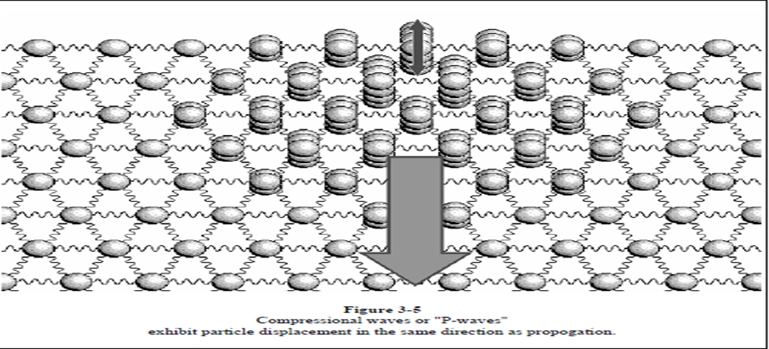
Types of Seismic waves
The compressional wave or P-wave is characterized by particles motion which is parallel to the direction of propagation.

Slide 24
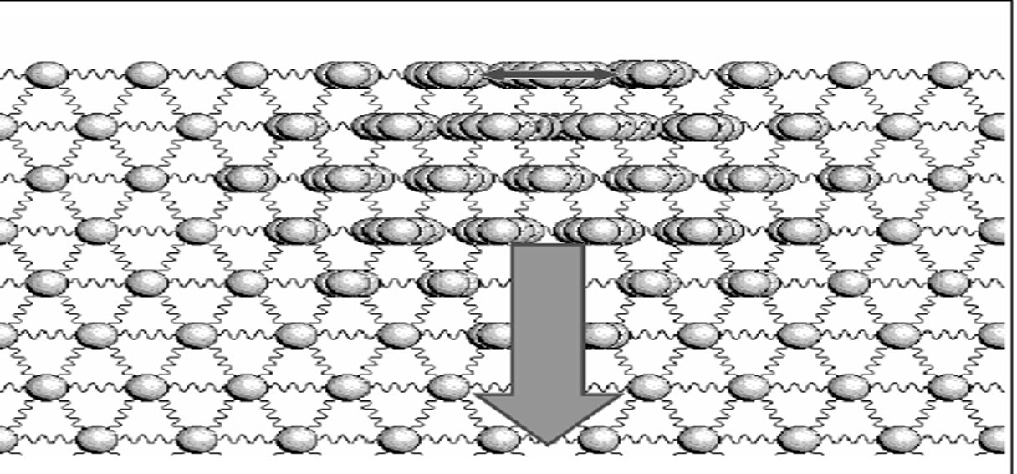
Shear Wave
The shear wave is characterized by particle motion which is transverse.

Slide 25
Summary
Geophysics is the only science can be detect the subsurface properties by indirect measurements.
There are several sources can be used to generate waves, electric current, magnetic field.
Geophysics measures the physical properties in rocks.
Seismology is the science deals with earthquake and study the wave are generated.

Slide 26
Summary
There are two types from body waves P- and S waves.
P wave are fastest waves

Slide 27
Check Point
What is the difference and similarity between geophysics and geology in general?
What types of wave are generated?
What is Seismology?
If there is any differences between P-wave and S-wave?
There are several sources are used to detect physical properties? What is the guide for each source?
There are several physical properties of the rocks?
Explain briefly these properties.

