Slide 1
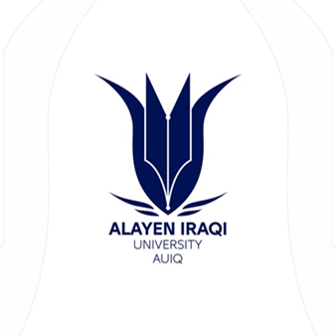
Pharmacology
AL-AYEN UNIVERSITY
COLLEGE OF HEALTH AND MEDICAL TECHNOLOGY
DEPARTMENT OF ANESTHESIA
By PhD Karima Aboul Fotouh
Lecturer 1

Slide 2
Pharmacology can be defined as the study of substances that interact with living systems through chemical processes, especially by binding to regulatory molecules and activating or inhibiting normal body processes.
Drug may be defined as any substance that brings about a change in biologic function through its chemical actions.

Slide 3
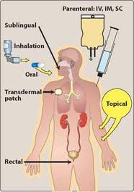
ROUTES OF DRUG ADMINISTRATION

Slide 4
Selection of route of drug administration depends on:
the nature of the agent being administered
the purpose of the administration.
Effect Of Administered Drug:
1-Systemic (General): If drug is absorbed and distributed
2-Local (Topical): If drug is not absorbed nor distributed

Slide 5
Enteral Route
1-Sublingual → Absorbed directly →Systemic circulation → Good Bioavailability.
2-Oral → Stomach & Intestine → pH changes & enzymes → Portal circulation
→ Liver metabolism → Systemic circulation → Most variable Bioavailability.
3-Rectal (Suppository) →
a-Upper rectum → Portal circulation → Liver metabolism → Systemic circulation
b-Lower rectum → Systemic circulation

Slide 6
1) Oral Route The most common method of drug administration
Advantages
Disadvantages
Safe.
Economic .
Convenient .
Some drugs are destroyed by acid e.g. insulin, penicillin
Some drugs are inactivated in the liver before it reaches the general circulation (first pass metabolism) e.g. nitroglycerine (anti-anginal)
Some drugs form complex with food e.g. tetracycline and milk
Not suitable for emergency cases

Slide 7
Sublingual administration
Drugs should be absorbed, stable, palatable and effective in small dose e.g. nitroglycerine
Advantages
Disadvantages
Rapid absorption (quick effect)
It avoid first pass effect
It avoid complexation with food
Not suitable for irritant drugs

Slide 8
Rectal route
The rectal route is used for systemic and local effect e.g. in hemorrhoids . The drug is given in the form of suppository or enema
Advantages
Disadvantages
Can be used in unconscious patients or uncooperative patient.
Can be used in case of vomiting and when the drug is irritant to the stomach e.g. indomethacin treat rheumatic pain
Usuful in large volume drugs.
Escape gut & hepatic first pass effects.
Rectal inflammation may occur with repeated use
Rectal absorption is often incomplete

Slide 9
Parenteral route
P.O.C | INTRAVENOUS( IV ) | INTRAMUSCULAR( IM) | SUBCUTANEOUS(SC)
ADV. | *Suitable for irritant drugs *Suitable for emergency cases *100% bioavailability *Suitable for large volume *Avoid first pass effect | *Suitable for oily solutions (preparations) & aqueous *Oily solutions can give a depot release | Can be used for self administartion
DISADV | *Anaphylactic shock *Not suitable for oily solutions or insoluble substances *Local venous thrombosis | *Not suitable for self administration *It is not suitable for large volume *Painful | Not suitable for large volume

Slide 10
Subcutaneous (S.C.)
Used for sustained release of the drug e.g. insulin suspension
Drugs should be:
a- Non-irritant
b- Aqueous Solution or fine suspension.
c- If irritant or oily → Inflammation
Absorption can by Enhanced by:
a- Use a solution b- Massage of injection area
c- Application of heat d- Add hyaluronidase enzyme
Absorption can be Slowed by:
a- Use a suspension
b- Application of cold
c- Add adrenaline (V.C.) to local anesthetics
d- Add gelatin to heparin

Slide 11
Other routes
Intra-thecal
Injection of the drug into spinal cord in case of spinal anesthesia
Intra-arterial
e.g. anti- cancer drugs for the treatment of localized tumor
Intra-articular
Hydrocortisone is injected into joints in rheumatoid arthritis
Intracardiac
Bone marrow injections

Slide 12
Miscellaneous routes
1- Inhalation
Advantage
its effective for patient with bronchial asthma
it is used for gases e.g. nitrous oxide
it provide rapid absorption
Disadvantage
Need special apparatus
Accuracy of the dose

Slide 13
2- Intranasal route
Calcitonin hormone is used in the treatment of osteoporosis as nasal spray
3-Transdermal
It involves application of drugs to the skin usually via (through) a transdermal patch e.g. nitroglycerin patch used in angina
4-Topical administration
Atropine is applied directly in eyes to dilated to pupil

