Slide 1
COLLAGE OF DENTISTRY
Oral and Maxillofacial Surgeryالفرع العلمي :
Oral surgery المادة:
Instruments of Local anesthesia (Armamentarium)المحاضرة:
18 رقم المحاضرة:
اسم تدريسي المادة: م.م. عامر أسامة كنج

Slide 2
The equipment necessary for the administration of local anesthesia include:
1. Dental Syringe.
2. Dental Needle.
3. Dental Cartridge.
Dental Syringe
It is the vehicle whereby the contents of the anesthetic cartridge are delivered through the needle into the tissue of the patient.
Types of the dental syringe:
1- Aspirating dental syringe
The end of the piston has a device like a harpoon. This hook will penetrate the thick rubber stopper at the end of the cartridge. The maneuver of aspiration consists of withdrawal of the stopper to create a negative pressure within the cartridge, blood will enter the lumen of the needle and is seen in the cartridge. This maneuver is employed in order to ensure that a blood vessel has not been entered by the needle tip during its insertion into the soft tissue prior to injection of the anesthetic solution.

Slide 3
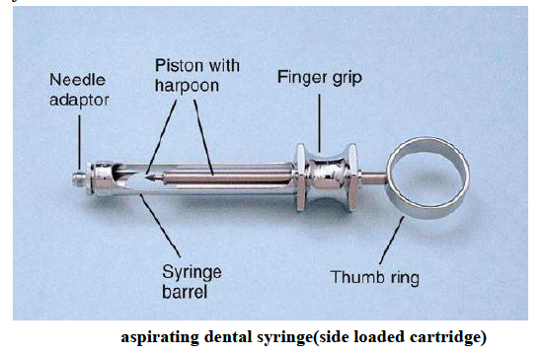
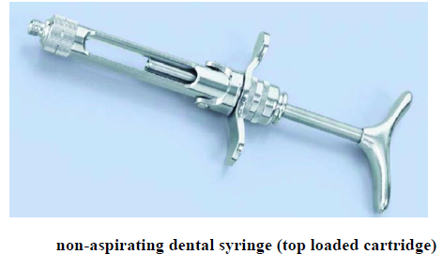
2- Non-aspirating dental syringe
The piston ends in a smooth flat end. A slight amount of aspiration may be achieved with this type by making a small initial injection of solution and then releasing the pressure on the piston, which then rebounds to produce an aspiration effect.

Slide 4
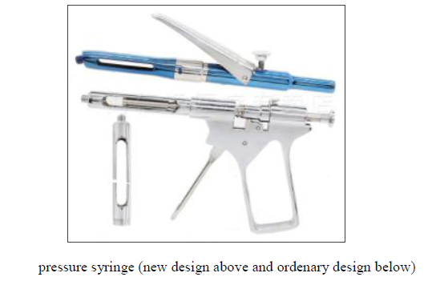
3- Pressure syringe
This type of syringe is used for intraligamentary injection, and for pulpal anesthesia.

Slide 5
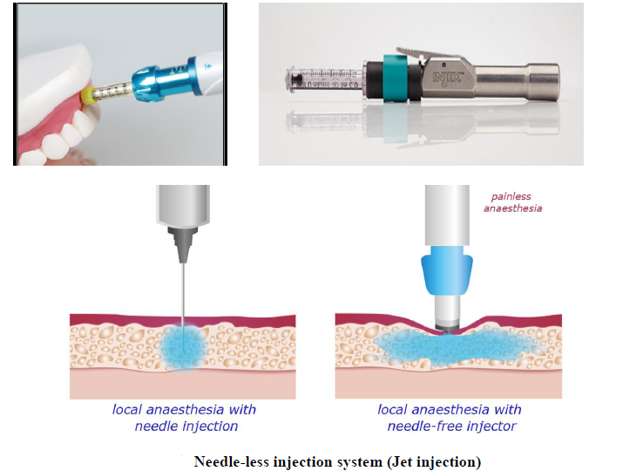
4-Needle-less injection system (Jet injection)
Jet injections can be defined as a needle-free drug delivery method in which a high-speed stream of fluids impacts the skin/mucosa and delivers a drug.

Slide 6
Dental Needle
The needle permits the local anesthetic solution to travel from the cartridge into the tissue surrounding the needle tip. Most needles used in dentistry are stainless steel. They are usually pre-sterilized and are disposable.
All needles have several components, which are:
1. The bevel: the tip of the needle (towards bone during injection).
2. The shank: from the hub to the point of the bevel.
3. The hub and syringe adapter: a plastic or metal piece through which the needle is attached to the syringe.
4. Cartridge penetrating end: it perforates the rubber diaphragm of the glass cartridge. Its tip rests within the cartridge.

Slide 7
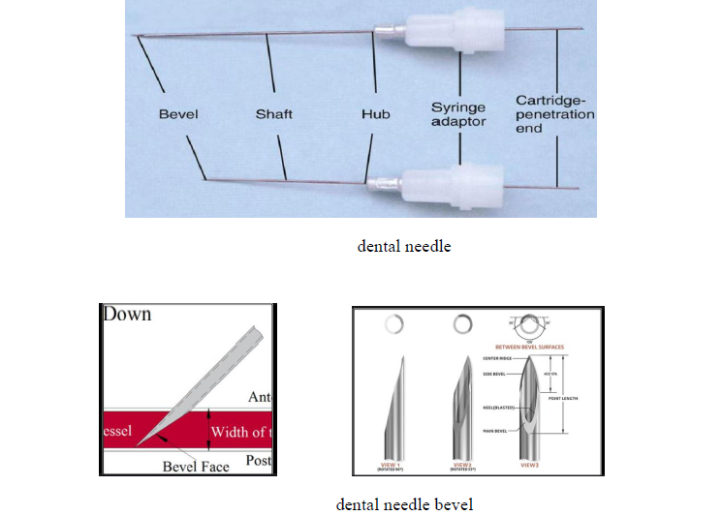

Slide 8
Two factors must be taken into consideration:
1- Gauge: gauge refers to the diameter of the lumen of the needle, the gauge of the needle is indicated by a number, the smaller the number the greater the diameter of the lumen. There is a trend toward the use of smaller diameter needle because they are less traumatic. In dentistry, the most commonly used gauges are 25, 27, and 30.
2- Length: dental needle is available in two lengths; long (average 32 mm) which are preferred for all injection techniques requiring penetration of a significant thickness of soft tissue as in the mandibular injection, and short (average 22 mm) which used in the maxillary injection. In general, the long needles are preferred for all injection techniques.

Slide 9
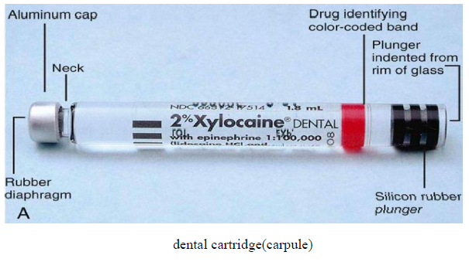
Dental Cartridge (Carpule)
The dental cartridge is a glass cylinder containing the local anesthetic solution. It consists of:
1. Cylindrical glass tube.
2. Stopper (plunger) located at the end of the cartridge that receives the hook of the aspirating syringe.
3. The aluminum cup is located at the opposite end of the cartridge from the stopper to hold the diaphragm in its position.
4. Diaphragm.

Slide 10
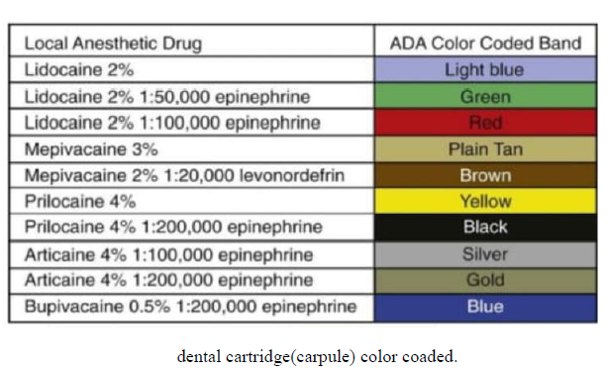

Slide 11
Care and handling of the dental cartridge
Glass dental cartridges should not be autoclaved. The seal on the cartridge cannot withstand extremes of temperature of autoclaving.
The dental cartridge should be stored as aseptically as possible; they should be stored dry in their original container and covered with a lid all the time, at room temperature and in dark place.
The dental cartridges should not be left exposed to direct sunlight because some contents may undergo accelerated deterioration.
Cartridges should not be permitted to soak either in alcohol or in other cold sterilizing solutions because the permeable rubber plunger will allow diffusion of this solution into the dental cartridge, this leads to contamination of the local anesthetic solution resulting in post-injection pain, edema and trismus.

Slide 12
Clinical problems associated with the equipment used in local anesthesia
A- Clinical problems related to the dental syringes
1- Leakage of the solution during injection:
The leakage of the anesthetic solution into the patient's mouth during injection will occur if the cartridge and the needle are improperly mounted into the syringe. When the needle is properly placed on the syringe after the cartridge is inserted; the needle produces a centric perforation of the diaphragm that tightly seals itself around the needle. When pressure is applied to the plunger during injection, all of the solution will be directed into the lumen of the needle.
When reloading a syringe with a second cartridge and the needle already, in place an eccentric ovoid perforation may occur in the diaphragm and with pressure on the plunger some solution will be directed into the lumen of the needle and some may leak out of the cartridge between the needle and the diaphragm and runs into the patient’s mouth.
2- Broken cartridge
The breaking of the cartridge may result from a bent needle at its proximal (cartridge penetrating) end, which may not perforate the diaphragm of the cartridge, positive pressure on the thumb ring increases intracartridge pressure leading to its breakage. A broken cartridge may also result from a bent hook (harpoon) of an aspirating syringe.

Slide 13
B- Clinical problems related to the dental needle
1- Pain on insertion: This may be avoided by using sharp, new disposable needles and the application of topical anesthetic at the penetrating site.
2 - Pain on withdrawal: Pain on withdrawal of the needle from the tissue can be produced by fishhook barbs on the tip, these barbs may be produced during the manufacturing process but it is more likely that they occur when the needle tip forcefully contact a bone, therefore, needle should NOT be forced against resistance.
3 - Breakage of the needle: In general, bending of the needle during insertion weaken the needle and making them more likely to break on subsequent contact with the hard tissue such as bone.
4 - Injury to the patient or the administrator: Major cause of injury is carelessness by the operator, although sudden unexpected movement by the patient (this may also cause needle breakage when the needle is present in deep tissues) is also a frequent cause, therefore the needle should be capped until its use and should be recapped immediately after withdrawal from the patient's mouth.

Slide 14
C- Clinical problems related to dental cartridge
1 – Bubbles in the cartridge
A small bubble approximately 2 mm in diameter will frequently be found in the dental cartridge. It is composed of nitrogen gas which was bubbled into the local anesthetic solution during its manufacture to prevent oxygen from being trapped in the cartridge and potentially destroying the vasopressor.
2 – Extruded stopper
The stopper can be extruded when a cartridge is frozen and the liquid inside expands; in this case, the solution can no longer be considered sterile and should not be used for injection. Also, an extruded stopper may be due to prolonged storage in a chemical disinfecting solution and diffusion of the solution through the rubber diaphragm into the cartridge.

Slide 15
3 – Burning on injection
A burning sensation on injection of the anesthetic solution may be the result of one of the following:
a. Normal response to the PH of the drug: The PH of the dental cartridge containing vasopressor is (3.5) which is lower than that without vasopressor (5.5 – 6.5) because of this, plain anesthesia has somewhat more rapid onset of clinical action and more comfortable (less burning on injection).
b. Cartridge containing sterilizing solution: This occurs when the cartridges are stored in a disinfectant solution for a long period so we get diffusion of the disinfecting solution into the cartridge upon injecting, it will cause a burning sensation.
c. Overheated cartridge or cold cartridge placed in the refrigerator: Local anesthetic solution injected at room temperature is well tolerated by the patients, overheated or cold cartridge produces burning on injection.

Slide 16
Additional Notes:
Topical antiseptic may be used to prepare the tissue at the site of injection before the initial needle penetration, to minimize the risk of post-injection infection. Antiseptic like betadine is applied on an applicator stick and placed at the site of injection for 15 – 30 seconds. If a topical antiseptic is not available, a sterile gauze wipe serves to prepare the tissue adequately.
A topical anesthetic could be used to reduce the discomfort during injection.
Applicator sticks: they are wooden sticks with a cotton swab at one end. They can be used to apply topical antiseptic or topical anesthetic to the mucous membrane.
Hemostat will be helpful to remove the needle from the soft tissue; in the event of needle breakage.
Finally, proper care and handling of the local anesthetic equipment can prevent or at least minimize the development of complications associated with needle, syringe and the cartridge.

Slide 17
Thank You

