Slide 1
LECTURE 4 – RESERVOIR ROCK AND FLUID PROPERTIES – PART 1

Slide 2
Reservoir Rock Properties
Rock properties are essential for reservoir engineer calculation as they directly effect both the quantity and the distribution of HC.
Petrophysics is the study of rock properties and rock-fluid properties. These properties, include: porosity, rock compressibility, permeability, fluid saturation, electrical properties of reservoir rocks, wettability, capillary pressure, and relative permeability.
An understanding of petrophysical properties helps us in:
Estimating the quantity of hydrocarbons present in the reservoirs (e.g. porosity and fluid saturation).
Understanding how the hydrocarbons will flow from the reservoir to the well during production (e.g.
permeability, wettability, and relative permeability).
Petrophysics source can be divided into
core analysis
wireline (well log) analysis .
Core analysis (core petrophysics) that requires conducting laboratory experiments on core samples brought
from the reservoir to the surface.
Wireline analysis (wireline petrophysics), which involves using logs to determine properties.

Slide 3
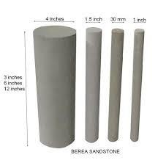
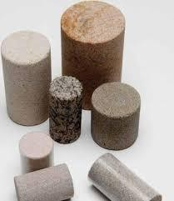
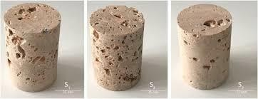
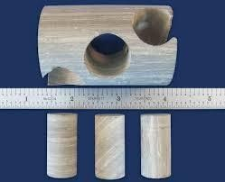
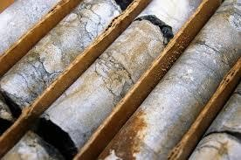

Slide 4
Note: Rock samples are extracted from the reservoir through coring and can be subjected to two
categories of laboratory analysis: routine core analysis (RCAL) and special core analysis (SCAL).
Routine core analysis (RCAL) attempts to find the basic properties of the reservoir rock such as porosity, grain density, permeability, and fluid saturation, as shown below:
Special core analysis (SCAL) is an extension of RCAL, and attempts to measure data that is more representative of the reservoir conditions. These measurements include electrical properties of reservoir rocks, wettability, capillary pressure, and relative permeability, as shown below:

Slide 5
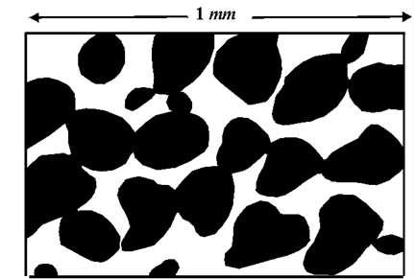
Porosity
Petroleum is not found in underground rivers or caverns, but in pore spaces between the grains of porous sedimentary rocks.
A piece of porous sedimentary rock. The pore spaces are the white areas between the dark grains. It is within such pore spaces that fluids such as oil, natural gas, or water can be found in the subsurface.
Porosity is important Especially because it allows us to make estimations of the amount of fluid that can be contained in a rock (water, oil, spilled contaminants, etc.).
Rock matrix Water
Oil and/or gas

Slide 6
Basically, Porosity (φ) means storage capacity that can indicate the amount of fluid that the porous medium can store. Quantitatively, Porosity (φ) is defined as a percentage or fraction of pore volume (void volume) to the bulk volume of a material. The general formula for porosity is:
𝑃𝑜𝑟𝑒 𝑣𝑜𝑙𝑢𝑚𝑒 𝑉_{𝑝}
∅ =
=
𝐵𝑢𝑙𝑘 𝑣𝑜𝑙𝑢𝑚𝑒 𝑉_{𝑏}
Also, we can express the porosity as:
𝑉_{𝑏} − 𝑉_{𝑔}
𝑉_{𝑔}
𝑉_{𝑏}
∅ =
or ∅ = 1 −
𝑉_{𝑏}
Overall, we can say that:
𝑉_{𝑝}
∅ = =
𝑉_{𝑏} − 𝑉_{𝑔}
𝑉_{𝑏} 𝑉_{𝑏}
where: ф = porosity [fraction or %], Vp = pore or void volume [cm³] , Vb = bulk volume of rock [cm³], Vb=
bulk or matrix volume [cm³] which equal to (Vb = Vp +Vg) , Vg = grain volume [cm³]
Note: if we know any two of the volumes, we can calculate the porosity.

Slide 7
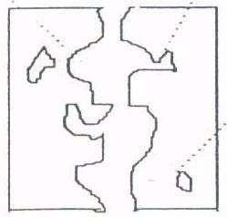
Note: fractional porosity value is often multiplied by 100 to make it a percentage; however, it should always be a fraction when used in calculations
Classification of Porosity:
A. Depending on measurement
Many of the void spaces are interconnected while some of the pore spaces are completely isolated by excessive cementation. This leads to two distinct type of porosity:
1- Total porosity (∅_{𝒕}) or ( Absolute porosity (∅_{𝑎})) is defined as the ratio of the volume of all pores (i.e. total pore space) to the bulk volume of a material, regardless of whether or not all of the pores are interconnected. 2- Effective porosity (∅_{𝒆}) is defined as the ratio of the interconnected pore volume to the bulk volume
Isolated pores

Slide 8
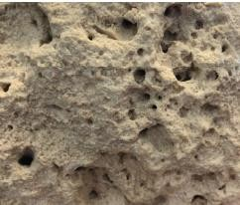
Note : As petroleum engineers, we mostly care about the effective porosity which represent the interconnected pore space that contains the recoverable HC fluid .
For homogeneous intergranular , slight consolidate then ∅_{𝒕} = ∅_{𝒆} .
For hetrogenous strongly cemented limestone ∅_{𝒕} > ∅_{𝒆} .
B. Depending on origin :
Porosity may be classified according to the time of formation as :
Primary porosity (or original porosity) – developed during the burial
of the rock (i.e. formed at the time the sediment was deposited):
Secondary porosity (or Induced) – developed after deposition due to external factors (i.e. developed by some geological process subsequent to depositional rock). e.g.
Compaction due to stress
Fractures and re-crystallization
Dissolutions (Vugs) , leaching
Micro
Note: Rock media having both fracture and intergranular pores are called Double – porous (Double porosity or Dual porosity)

Slide 9
Note: The total Porosity can be calculated using three values of density, which are bulk density (𝜌_{𝑏} ), grain density (𝜌_{𝑔}) and the fluid density (𝜌_{𝑓} ) as ;
𝜌_{𝑔} − 𝜌_{𝑏}
𝜌_{𝑔} − 𝜌_{𝑓}
∅ =
∗ 100%
Porosity of commercial reservoirs usually ranges from about 5% to about 47%. Table #1 shows typical porosity values for different reservoir rocks. The porosity of rocks within a reservoir indicates how much oil and/or gas is stored in that reservoir. Therefore, finding the porosity of the reservoir beforehand is important
Rock Type | Ranges
Sandstone | 10 - 40% depending on the nature of the cement and the style (i.e. nature of consolidation)
Limestone and Dolomite | 5 – 25 %
Clay | 20 – 45% depending upon the origin and depth
for engineers because it helps them
that
estimate how economically viable
reservoir is and how
many
resources
should be invested in it.

Slide 10
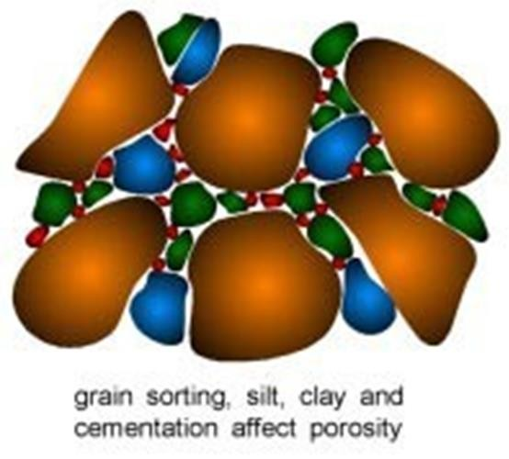
In general :
Porosity is negligible if Ø ˂ 5%
Porosity is low if 5% ˂ Ø ˂ 10%
Porosity is good if 10% ˂ Ø ˂ 20%
Porosity is very good if Ø >20%
Note: theoretically, φ varies from 0% - 47.6%. In practice, φ varies between 3% and 37%
Factors Affecting Porosity
Grain size: as the grain decrease the porosity of the
rock will decrease.
Degree of cementation: Deposition of cementation material such as (silt, clay) around grains will reduced porosity
Grain shape: Irregularly shaped particles tend not to pack as neatly as rounded particles, resulting in higher proportions of void space.
Packing of grains.

Slide 11
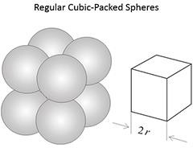
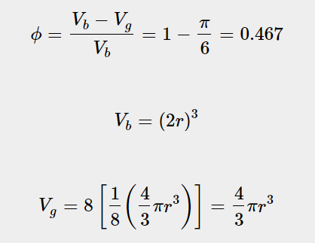
Packing Bed
The porosity can be determined for various packing arrangement of spheres:
Regular or uniform (ordered)which has an unique position of each grain.
Irregular or Random location of any grain only expressed as probabilities distribution.
Sphere packs as uniform packing beds
1. Cubic packed sphere (or wide packed): in least-compact arrangement with a
porosity of 47.64%

Slide 12
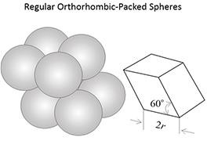
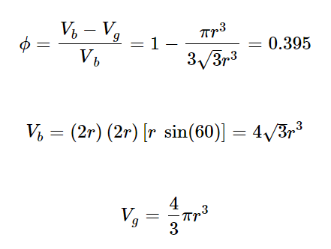
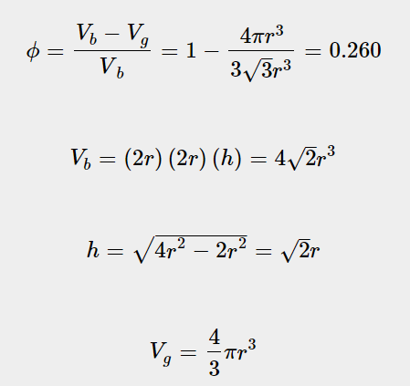
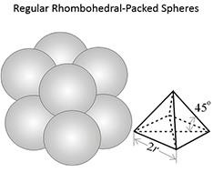
2. Hexagonal (orthorhombic packed sphere)
3. Rhombohedral (or close packing) : a most- compact arrangement with a porosity of 26% or 25.9%

Slide 13
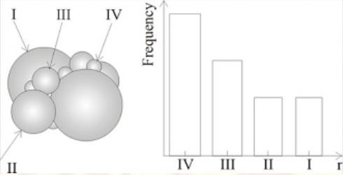
Irregular or Random spheres with different Radii
Spherical size variation influences
type & volume of solid porosity
Real reservoir rock exhibits a complex
structure and substantial variation in grain
size and their packing which result in variation of porosity and other important reservoir properties, often associated with the heterogeneity medium
The figure shows a example of an idealized porous medium represented by four population of spheres (sorted by radii).
The histogram shows the hypothetical grain – size distribution.

