Slide 1

AL-AYEN UNIVRSITY
COLLEGE OF ENGINEERING
RESERVOIR ENGINEERING I
Volumetric calculations for Oil and Gas Reserve
2022-2023
NASIR ATALLAH
ASMAA ALGHAZI

Slide 2
Outline
Volumetric Method
Reserves
Recovery Factor
Oil and Gas Resources and Reserves
Deterministic and Probabilistic Representation of Reserves
Volume in-Place Calculations
Volumetric Method (Deterministic method)
Probabilistic Representation of Reserves

Slide 3

Volumetric Methods
Stock-tank Oil Initially in Place (STOIIP): The total amount of crude oil present in a hydrocarbon reservoir before the commencement of any production. It is also known as Stock Tank Original Oil in Place (STOOIP).
The assessment of Volume of oil and/gas in-place, V, is difficult due to :
The complexity of the porous medium.
Uncertainty as to the exact shape of the reservoir.
Little sampling for petro-physical data (porosity/saturation).

Slide 4
Gross and Net Pay
Different using to NTG:
Net pay to Gross pay = 2/4
Net pay to Gross reservoir = 2/5
Net Res. to Gross Res. = 3/5
So hₙ using in the equation = NTG x Gross pay
Reservoir engineering for Geologists-part 4, Etris and Stewart, 2003

Slide 5


Reserves
Reserves are estimated volumes of crude oil, condensate, natural gas, natural gas liquids, and associated substances anticipated to be commercially recoverable from known accumulations from a given date forward, under existing economic conditions, by established operating practices, and under current government regulations.
Reserve estimates are based on geologic and/or engineering data available at the time of estimate.
Where R_{F} is the recovery factor

Slide 6
Recovery Factor
Proportion of hydrocarbons recovered called recovery factor. It is influenced by a range of properties:
Rock and fluid properties.
Drive mechanisms.
Formation characteristics & heterogeneity
Development process
Geometry and location of wells

Slide 7
Oil and Gas Resources and Reserves
Total Oil and Gas Resources
Discovered
Undiscovered
Nonrecoverable Resources
Recoverable Resources
Reserves
Cumulative Production
Proved Reserves
Unproved Reserves
Probable Reserves
Possible Reserves

Slide 8
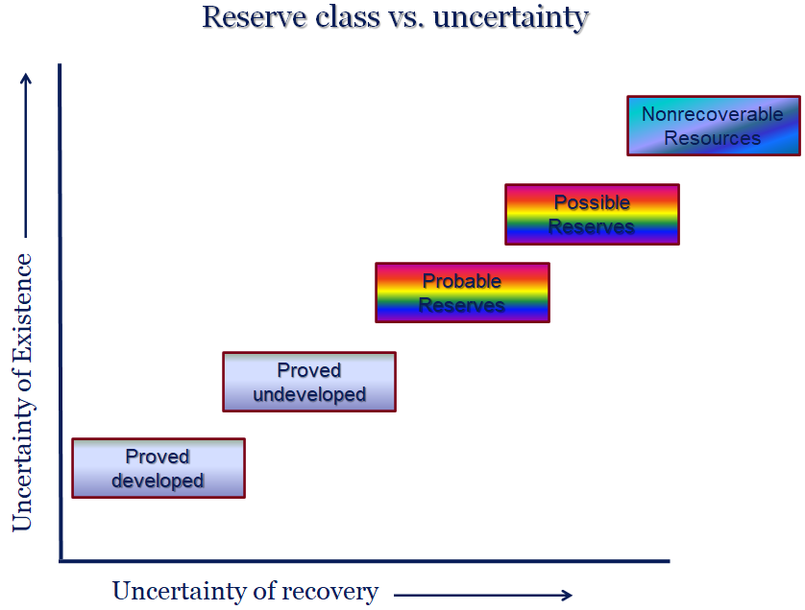

Slide 9
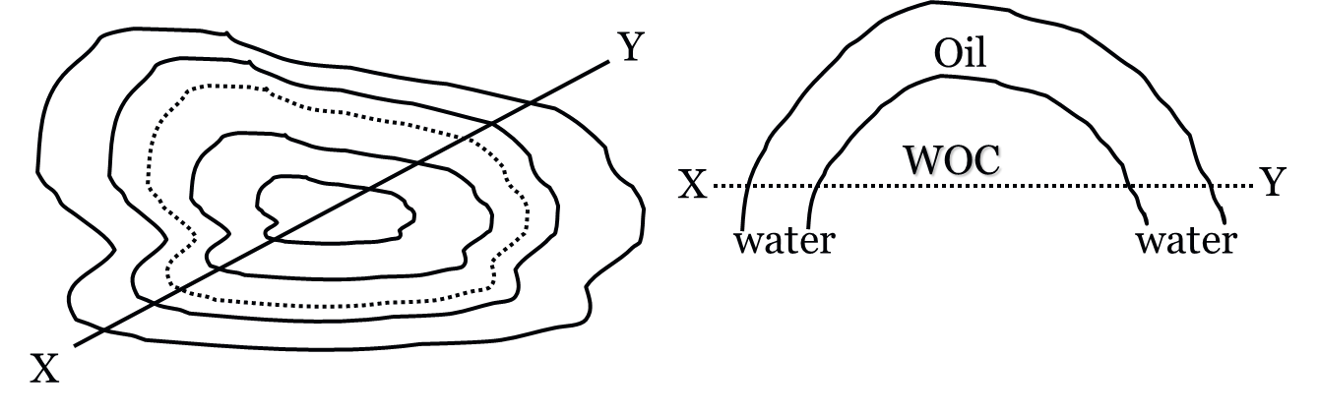
Volume in-Place Calculations
The net bulk volume V_{B} is generally obtained from the geological and fluid pressure analysis.
The geologist provides contour map of the top and base of the reservoir as shown below. Such maps have contour lines drawn for a constant contour intervals.
Measurements of the enclosed reservoir rock volume above the level at which the OWC is to be located will then give the net bulk volume V_{B}.
Contour map
Water oil contact (WOC)

Slide 10
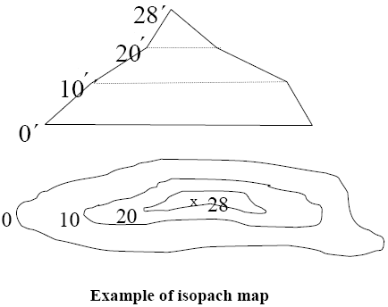
Volumetric Method (Deterministic method)
Deterministic and Probabilistic Representation of Reserves
The deterministic methods are based on certain values for the various parameters.
With the probabilistic methods statistical analysis is used. e.g. Monte Carlo methods
• Geologic maps are usually derived from log and core data.
• Then an isopach map (a map contoured on reservoir thickness) is prepared
• The bulk volume of the reservoir is Calculated
• Initial amount of oil and gas are determined.

Slide 11



Estimation of Initial Oil in Place
For undersaturated crude, the reservoir contains only connate water and oil with their respective solution gas contents. The initial or original oil in place can be estimated from the volumetric equation:
or
STOIIP = $\frac{7758 A hₙ Φ (1−Swi)}{ B_{oi}}$
Vb = A . ht
Where:
OOIP = original oil in place, STB
7,758 = factor converting acre-feet to barrels
A = reservoir area, acres
Vb = the reservoir bulk volume, acre-ft
hₙ = net pay thickness of reservoir, feet
Φ = average reservoir porosity.
Swi = average water saturation.
Boi = oil formation volume factor, RB/STB

Slide 12


Estimation of Gas in Place
We will estimate two cases (Initial gas, in solution, in place and free gas in place). For an undersaturated oil (no free gas), the gas in solution with the oil is:
Initial gas (in solution) in place
Vb = the reservoir bulk volume, acre-ft
R_{s} is gas solubility in the oil or solution gas-oil ratio = V_{g} (std)/V_{o} (std)
Free Gas in Place
V_{g} is the bulk volume assigned to the gas-saturated portion of the reservoir in acre-ft, B_{gi} is the initial gas formation volume factor in RB/scf.
(Note: If the formation volume factor is expressed in ft³/scf, 7,758 should be replaced with 43,560 ft³/acre-ft).

Slide 13
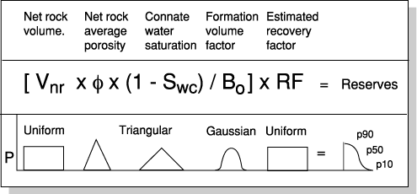
Probabilistic Representation of Reserves
For each element there is a probability function.

Slide 14
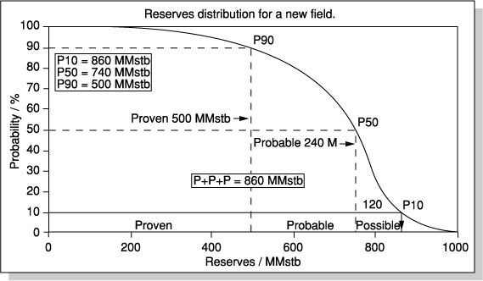
Probabilistic Representation of Reserves
Proven = 500MMstb,
Probable =740-500=240MMstb
Possible =860-740=120MMstb

Slide 15
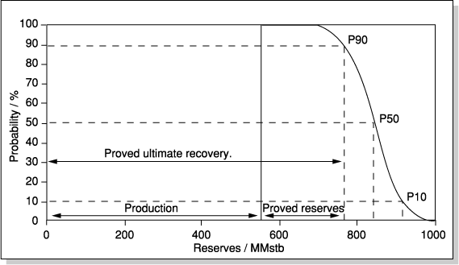
Probabilistic Representation of Reserves
As field is produced the shape of the curve changes. Probability converted to recovery leaving less uncertainty in reserves.

Slide 16
Exercises
Ex.1
Calculate the volume of oil in a reservoir having the following parameters:
Reservoir area = 40.0 acres
Average reservoir thickness = 25 feet
Average reservoir porosity = 22%
Average water saturation = 30%
Oil formation volume factor = 1.32 RB/STB
Solution
OIIP = 7758 𝐴 ℎ 𝛷 (1−𝑆𝑤) / 𝐵𝑜
OIIP = 7758 𝑥 40 𝑥 25 𝑥 0.22 (1−0.3) / 1.32
OIIP= 905100 STB

Slide 17
Exercises
Ex.2
A core sample of 2 cm in radius, 4 cm long and 10 cm3 pore volume was taken from a reservoir. Assuming the reservoir is homogenous, calculate the oil initially in place in bbls in the reservoir. The following data of the reservoir are available:
Reservoir area= 27788400 ft2
Average thickness= 10 ft
Average connate water saturation=0.25
Solution
First, convert area from ft2 to acres in order to use the equation with 7758 conversion factor
1 acre = 43 560 ft2
Area = 27788400/43560= 640 acre
𝑉𝑏 = 𝜋 𝑟²𝐿
𝑉𝑏 = 𝜋 𝑥 2 ²𝑥4 = 50 cm3
∅ = 𝑉𝑝 / 𝑉𝑏 = 10 / 50 = 0.2 = 20 %
OIIP = 7758 𝐴 ℎ 𝛷 (1 − 𝑆𝑤)
OIIP = 7758 𝑋 640 𝑥 10 𝑥 0.2 (1 − 0.25)
OIIP =7.5 MMbbls

