Slide 1
COLLAGE OF DENTISTRY
الفرع: امراض الفم
Oral pathologyالمادة:
Bone Neoplasmsالمحاضرة:
9 رقم المحاضرة:
اسم تدريسي المادة: د. محمد طالب

Slide 2
امراض الفم
محاضرة ( 9 )
Oral Pathology
Bone Neoplasms
Lec 9 & Lab 9`

Slide 3
Osteoma
امراض الفم
محاضرة ( 9 )

Slide 4
امراض الفم
محاضرة ( 9 )
Benign tumors composed of mature compact or cancellous bone.
The frequency, demographic distribution and incidence is unknown. (many osteomas are small and asymptomatic).
Involve the craniofacial skeleton and rarely, in other bones.
The arising forms,
- Periosteal, peripheral, or exophytic osteomas
Endosteal or central osteomas
Osteoma cutis (Rarely…in muscle or skin)
The pathogenesis is unclear, several suggestions
- It as a true neoplasm,
Developmental anomaly.
Caused by trauma .

Slide 5
امراض الفم
محاضرة ( 9 )
Clinical
Adult, Male > female
Solitary ((Excepting Gardner syndrome ))
Periosteal osteomas appear as
Polypoid or sessile masses on the bone surface,
Endosteal osteomas may not be evident clinically unless they are large enough to cause expansion and facial deformity
- Osteama occur commonly in paranasal sinus, gnathic bone and intracranial site.

Slide 6
Paranasal sinus osteoma
امراض الفم
محاضرة ( 9 )
Clinical
- Paranasal sinus osteomas are even more common than gnathic lesions.
The frontal sinus is most often involved, followed by the ethmoid and maxillary sinuses.
Asymptomatic, although pain, swelling, sinusitis, and nasal discharge are possible.
Intracranial osteoma
- Infrequently

Slide 7
Gnathic osteoma
امراض الفم
محاضرة ( 9 )
Clinical
- Mandibular body frequently
Found on the lingual surface of the premolars or molars zones, the inferior border of angle, coronoid & condyle processes, and ramus
Mostly are solitary and asymptomatic with very slow growth, although Pain, tooth displacement, and tooth impaction have been reported.
The involving of the mandibular condyle may limit mouth opening or cause malocclusion, with deviation toward the unaffected side.
Condylar osteomas may designate as hyperostoses or hyperplasia (hyperplastic
condyle usually retains its original shape)

Slide 8
Radiographically
امراض الفم
محاضرة ( 9 )
Osteomas appear as circumscribed sclerotic masses.
Periosteal osteomas may show a uniformly sclerotic pattern or may demonstrate a sclerotic periphery with central trabeculation
Smaller endosteal osteomas are difficult, if not impossible, to differentiate radiographically from condensing osteitisfocal, chronic sclerosing, osteomyelitis, or idiopathic osteosclerosis
The true nature of these osteomas can be confirmed only by documentation of continued growth.

Slide 9
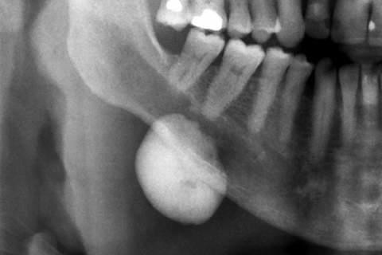
امراض الفم
محاضرة ( 9 )
Panoramic radiograph showing a uniformly sclerotic mass arising from the surface of the posterior mandible
8

Slide 10
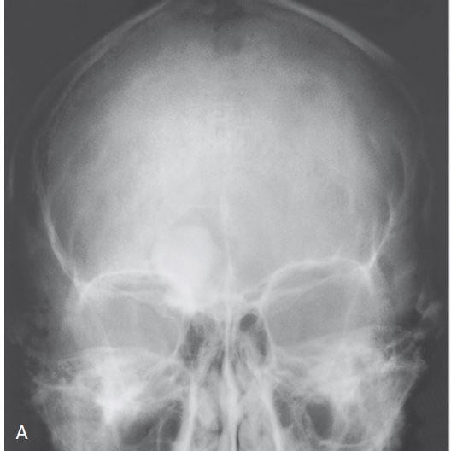
امراض الفم
محاضرة ( 9 )
Radiograph of the skull shows a well circumscribed, diffusely dense, ovoid ivory osteoma in the right frontal sinus
9

Slide 11
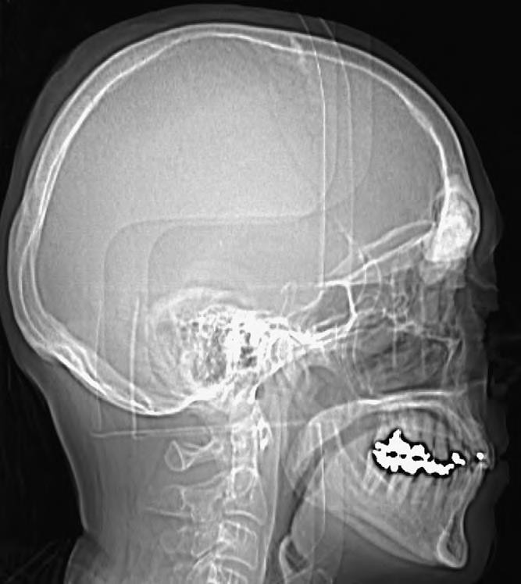
امراض الفم
محاضرة ( 9 )
Osteoma arising on the surface and filling the frontal sinus on lateral radiograph.
10

Slide 12
Histopathologic Features
امراض الفم
محاضرة ( 9 )
Osteoma classified histolocially as compact osteoma or cancellous osteoma
Compact osteomas (ivory) are composed of normal-appearing, dense bone with minimal marrow.
Cancellous osteomas are composed of bony trabeculae and fibro-fatty marrow.
11

Slide 13
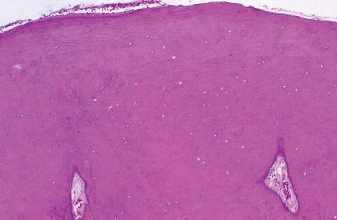
امراض الفم
محاضرة ( 9 )
This compact osteoma is composed of dense bone, with only minimal marrow elements
12

Slide 14
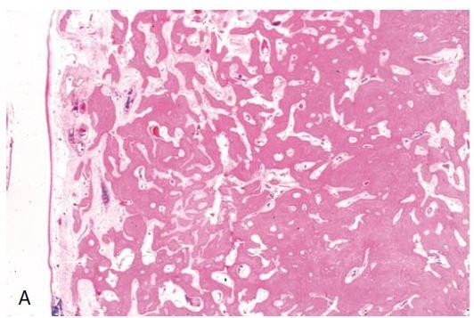
امراض الفم
محاضرة ( 9 )
Osteoma of frontal sinus. Compact and trabecular bone is present beneath intact mucosa at the left of the field

Slide 15
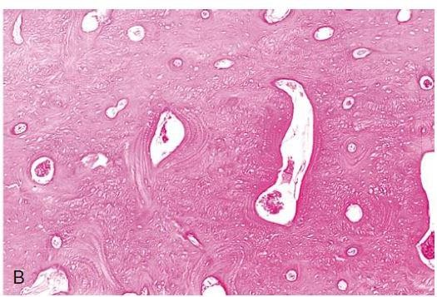
امراض الفم
محاضرة ( 9 )
Compact cortical-type bone of the osteoma

Slide 16
Treatment and Prognosis
امراض الفم
محاضرة ( 9 )
Small, asymptomatic osteomas may not require treatment but should be observed periodically.
Large or symptomatic osteomas of the mandibular body appropriate for conservative excision.
Condylar osteomas, because they are frequently symptomatic, usually are removed by local resection or condylectomy.
Symptomatic paranasal sinus osteomas may be removed endoscopically or via an open surgical approach.
Recurrence after excision is extremely rare.
No reports of malignant transformation.

Slide 17
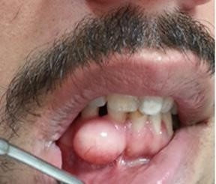
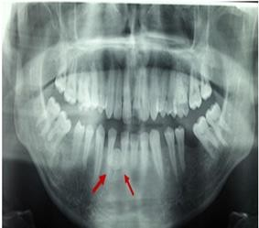
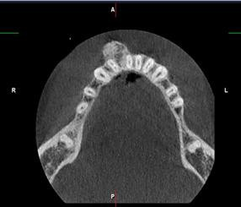
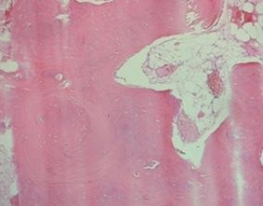
امراض الفم
محاضرة ( 9 )

Slide 18
GARDNER SYNDROME
امراض الفم
محاضرة ( 9 )

Slide 19
Gardner syndrome, a rare autosomal dominant disorder, represents a variant of familial adenomatous polyposis ,characterized by intestinal polyps as well as various abnormalities of bone, teeth, skin, soft tissue, and other sites.
Caused by mutations in the adenomatous polyposis coli (APC) tumor suppressor gene on chromosome 5q21
family history of the disease associated with most cases, although approximately 30% of cases appear to represent new mutations
The estimated frequency of Gardner syndrome ranges from about 1 : 8,300 to 1 : 16,000 live births.

Slide 20
Clinical
امراض الفم
محاضرة ( 9 )
Colorectal polyps | Typically develop by the second decade of life. Asymptomatic but may cause diarrhea, constipation, rectal bleeding, anemia, and abdominal pain. Transform into adenocarcinoma if not treated Small intestine or stomach polyps often arise with small percentage of carcinomatous transformation
Skeletal defects | Osteomas are the most skeletal abnormalities, noted around puberty. Often become evident before the intestinal polyps; indeed, the presence of multiple osteomas may lead to an early diagnosis of Gardner syndrome. skull, paranasal sinuses, and mandible are most involvement with osteoma.
Skin lesion | Most patients show one or several epidermoid cysts of the skin Other cutaneous findings may include lipomas, fibromas, neurofibromas, and leiomyomas.
Extra- intestinal neoplasms | - Extra-intestinal neoplasms have been reported in Gardner syndrome, including thyroid carcinoma, adrenal adenoma or adenocarcinoma, hepatoblastoma, pancreatic adenocarcinoma, nasopharyngeal angiofibroma, and brain tumors.
19

Slide 21
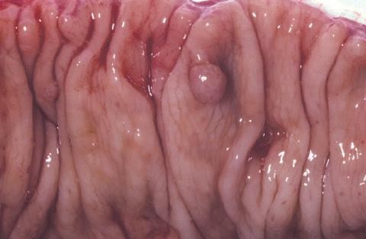
امراض الفم
محاضرة ( 9 )
Gardner Syndrome. A segment of resected large bowel showing polyp formation

Slide 22
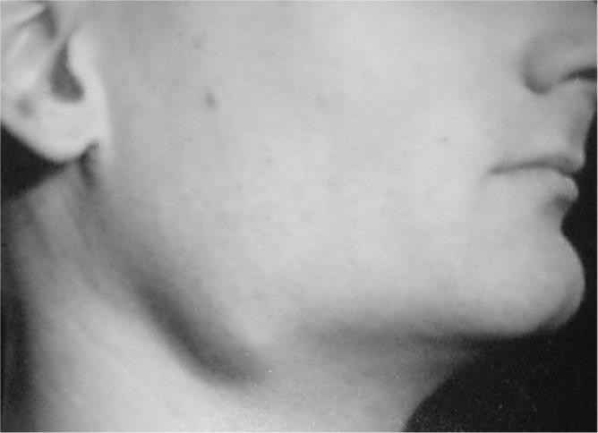
امراض الفم
محاضرة ( 9 )

Slide 23
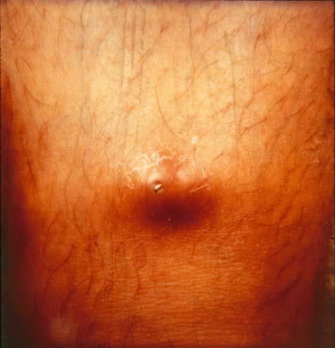
امراض الفم
محاضرة ( 9 )
Epidermoid cyst

Slide 24
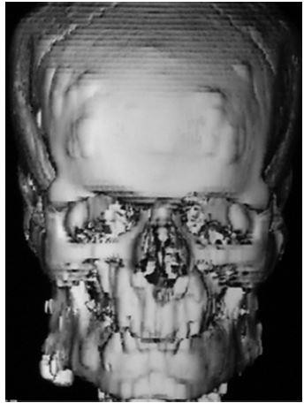
امراض الفم
محاضرة ( 9 )
Three-dimensional reconstruction CT scan demonstrating the osteomas of the skull in the areas of the frontal bone, mandible, maxillae, and to some degree the orbit. Note the large osteoma on the right angle of the mandible.

Slide 25
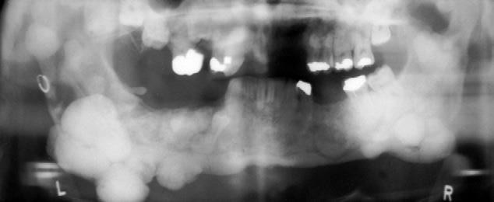
Osteomas of Gardner’s syndrome

Slide 26
The osteomas are generally of the compact type. An individual lesion
امراض الفم
محاضرة ( 9 )
Histopathologic Features
cannot be differentiated microscopically from a solitary osteoma.

Slide 27
امراض الفم
محاضرة ( 9 )
Treatment and Prognosis
- Prophylactic colectomy because of the high risk for transformation of colorectal polyps into adenocarcinoma. Since ,without treatment, approximately 50% of patients by 30 years of age, and 100% by the fifth decade develop colorectal cancer
- Patients also
should be monitored for development of extracolonic
malignancies or desmoid tumors.
Osteomas and epidermoid cysts may be removed if they cause functional or cosmetic problems.
Dental management typically involves surgical extraction of impacted teeth, removal of odontomas, and prosthodontic treatment. Orthodontic tooth movement may be difficult due to increased bone density from the osteomas.

Slide 28
OSTEOBLASTOMA
& OSTEOID OSTEOMA
امراض الفم
محاضرة ( 9 )

Slide 29
امراض الفم
محاضرة ( 9 )
Osteoblastoma and osteoid osteoma
Closely related benign bone tumors that arise from osteoblasts.
Most authorities currently recognize them as two distinct clinicopathologic entities, although some authors regard them as variants of the same lesion due to very similar histopathologic features.
Although some have proposed that the limited growth of osteoid osteoma suggests an inflammatory or unusual healing process, the cytogenetic studies support the neoplastic nature because the iditicfication of alterations on the long arm of chromosome 22 in some osteoid osteomas and aggressive osteoblastomas

Slide 30
Clinical Features
امراض الفم
محاضرة ( 9 )

Slide 31
OSTEOBLASTOMA
OSTEOID OSTEOMA
1% of all primary bone tumors -
The lesion occurs most often in vertebral column, -
3% of all primary bone tumors
The lesion occurs most often in the femur and tibia but is very rare in the jaws
long bones, pelvis, talus, facial bones, and small bones of the hands and feet
- Mandibular predilection, mostly involving the -
A slight mandibular predominance
Mostly with (mean age 25 years).
Jaw lesions exhibit no significant
posterior regions.
85% of gnathic osteoblastomas occur before 30y
Jaw lesions have slight female predominance.
gender
predilection
- Dull pain, tenderness, and swelling are common -
Often among extragnathic lesions than jaw lesions, the pain that is most severe at night and alleviated by NSAIDs.
presenting features. Unlike the pain associated with osteoid osteoma, the pain not relieved by NSAIDs.
Painful jaw lesions may be misinterpreted as
odontogenic infections
Gnathic tumors also may cause tooth mobility, root resorption, or tooth displacement
- Most osteoblastomas are between 2 and 4 cm, but - Osteoid osteomas measuring less than a threshold
of 1.5 cm or 2 cm in diameter
they may be as large as 10 cm
30

Slide 32
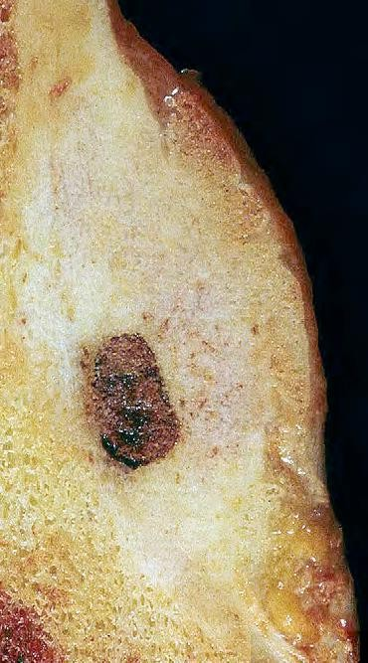
امراض الفم
محاضرة ( 9 )
Gross image of osteoid osteoma. The small ovoid red–tan tumor is surrounded by dense reactive bone.

Slide 33
Radiographic Features
امراض الفم
محاضرة ( 9 )
well-circumscribed radiolucent defect, usually less than 1 cm in diameter, with a surrounding zone of reactive sclerosis of varying thickness.
A small radiopaque nidus may be present

Slide 34
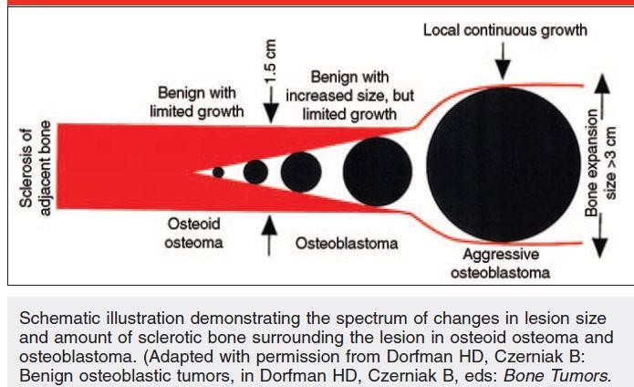

Slide 35
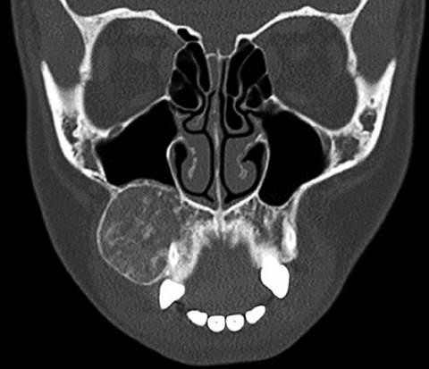
امراض الفم
محاضرة ( 9 )
Osteoblastoma. Computed tomography (CT) image showing an expansile, mixed radiolucent and radiopaque lesion of
the maxilla.

Slide 36
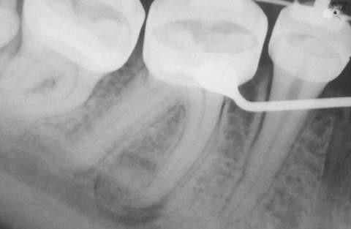
امراض الفم
محاضرة ( 9 )
Osteoid Osteoma. A circumscribed, mixed radiolucent and radiopaque lesion near the apex of mesial root of mandibular first molar. The patient had dull, nocturnal pain that was relieved by aspirin

Slide 37
Histopathologic Features
امراض الفم
محاضرة ( 9 )

Slide 38
امراض الفم
محاضرة ( 9 )
Microscopically, both osteoid osteoma and osteoblastoma centrally exhibit irregular trabeculae of osteoid or woven bone, which are surrounded by numerous osteoblasts and scattered osteoclasts.
The vascularity tends to be more prominent in osteoblastoma than osteoid osteoma.
At the periphery, there is typically a more prominent zone of dense, sclerotic bone in osteoid osteoma than osteoblastoma.
The supporting stroma, consists of loose fibrous connective tissue that contains
scattered dilated vascular channels.

Slide 39
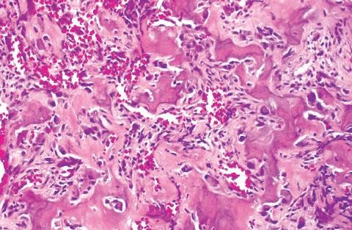
امراض الفم
محاضرة ( 9 )
Osteoblastoma. High-power photomicrograph showing irregular bony trabeculae with prominent osteoblastic rimming and osteoclasts.
38

Slide 40
Nidus of osteoid osteoma abuts thickened mature bone. B, Osteoid trabeculae, some partially calcified, within the nidus of an osteoid osteoma. The trabeculae are rimmed with plump osteoblasts with occasional osteoclasts. The stroma is hemorrhagic.

Slide 41
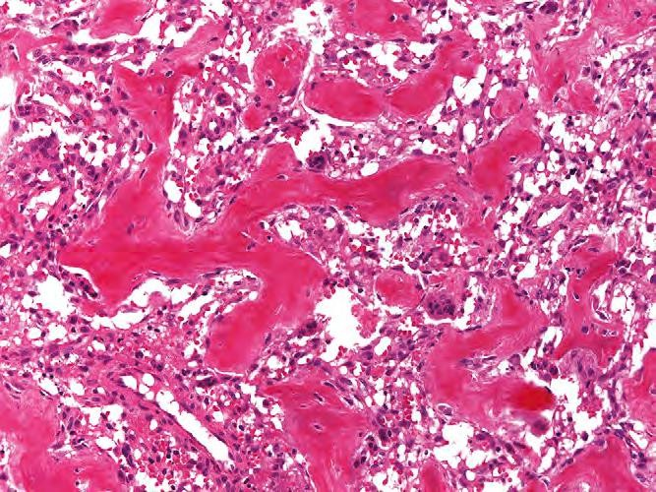
امراض الفم
محاضرة ( 9 )
Osteoid osteoma composed of haphazardly interconnecting trabeculae of woven bone that are lined prominently by osteoblasts. The intervening loose connective tissue is vascular

Slide 42
Treatment and Prognosis
امراض الفم
محاضرة ( 9 )

Slide 43
Mostly the both lesions of the jaws are treated by local excision or curettage.
Some osteoid osteomas may regress spontaneously; however, most clinicians prefer surgical removal over long-term observation and pain management with NSAIDs.
For extragnathic lesions, minimally invasive techniques (e.g., computed tomography [CT]-guided
excision and radiofrequency ablation) have gained popularity recently.
Recurrence after complete removal is uncommon; many reported recurrences may be attributed to incomplete excision.
Osteoid osteoma exhibits no potential for malignant transformation, and osteoblastoma only rarely transforms into osteosarcoma.
Whether aggressive osteoblastoma exhibits a greater recurrence potential than conventional osteoblastoma is controversial, although metastasis or death from aggressive osteoblastoma has not been reported

