Slide 1
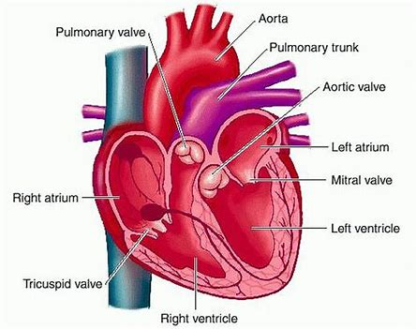
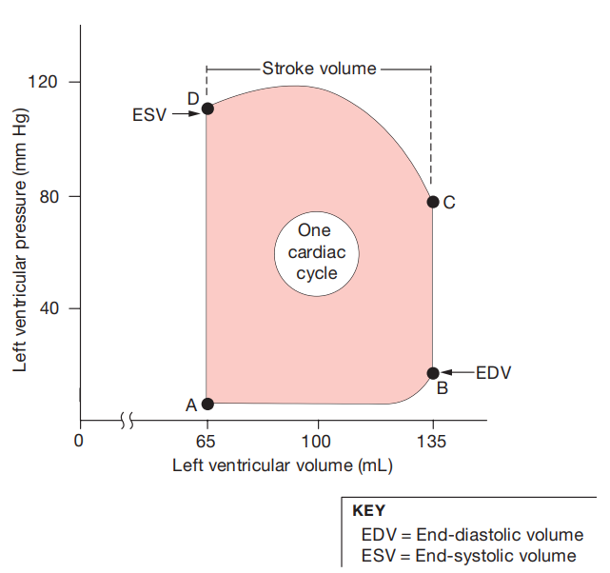
Chapter: 7
The left ventricle pressure-volume loop
Dr. Abbass HAYDAR

Slide 2
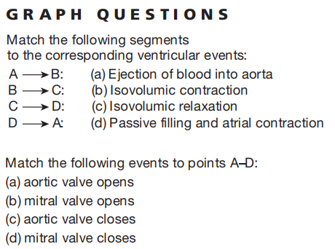
Dr. Abbass HAYDAR

Slide 3
represents the pressure (y-axis) and volume (x-axis) changes in the left ventricle, that occur during one cardiac cycle.
The flow of blood through the heart is governed by the same principle that governs the flow of all liquids and gases:
flow proceeds from areas of higher pressure to areas of lower pressure.
When the heart contracts, the pressure increases and blood flows out of the heart into areas of lower pressure.
The left side of the heart creates higher pressures than the right side, which sends blood through the shorter pulmonary circuit.
Dr. Abbass HAYDAR

Slide 4
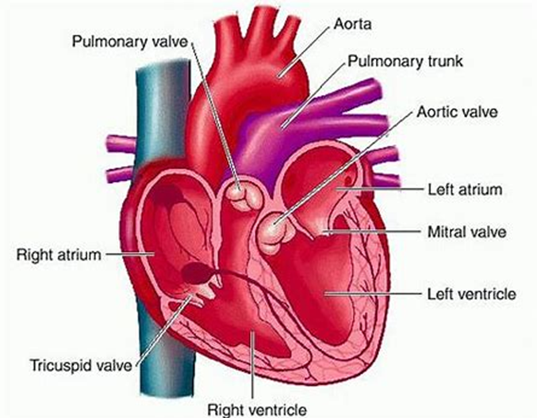
A-B segment: ventricular filling
The cycle begins at point A.
The ventricle has completed a contraction and contains the minimum amount of blood that it will hold during the cycle. It has relaxed, and its pressure is also at its minimum value.
Blood is flowing into the atrium from the pulmonary veins. Once pressure in the atrium exceeds pressure in the ventricle, the mitral valve between the atrium and ventricle opens (point A).
Atrial blood now flows into the ventricle, increasing its volume (point A to point B).
As blood flows in, the relaxing ventricle expands to accommodate the entering blood. Consequently, the volume of the ventricle increases, but the pressure in the ventricle goes up very little.
mitral valve open
Ventricle volume is increasing
Dr. Abbass HAYDAR

Slide 5
A-B segment: ventricular filling
The last portion of ventricular filling is completed by atrial contraction.
The ventricle now contains the maximum volume of blood that it will hold during this cardiac cycle (point B).
Because maximum filling occurs at the end of ventricular relaxation (diastole), this volume is called the end-diastolic volume (EDV).
In a 70-kg man at rest, end-diastolic volume is about 135 mL, but this value varies under different conditions.
During periods of very high heart rate, for instance, when the ventricle does not have time to fill completely between beats, the end-diastolic value may be less than 135 ml.
atrial contraction.
Dr. Abbass HAYDAR

Slide 6
B-C segment: ventricular isovolumic contraction – closed valve
isovolumic contraction
When ventricular contraction begins, the mitral valve closes (point B).
With both the AV valve and the semilunar valve closed, blood in the ventricle has nowhere to go.
Nevertheless, the ventricle continues to contract, causing the pressure in this chamber to increase rapidly during isovolumic contraction (B-C).
Once ventricular pressure exceeds the pressure in the aorta, the aortic valve opens (point C).
aortic valve opens
mitral valve closes
Dr. Abbass HAYDAR

Slide 7
C-D segment: ventricular contraction- opened valve
Once ventricular pressure exceeds the pressure in the aorta, the aortic valve opens (point C).
Pressure continues to increase as the ventricle contracts further, but ventricular volume decreases as blood is pushed out into the aorta (C→D).
The heart does not empty itself completely of blood each time the ventricle contracts.
The amount of blood left in the ventricle at the end of contraction is known as the end-systolic volume (ESV).
The ESV (point D) is the minimum amount of blood the ventricle contains during one cycle.
Dr. Abbass HAYDAR

Slide 8
C-D segment: isovolumic ventricular relaxation
semilunar valve closes
An average ESV value in a person at rest is 65 ml., meaning that nearly half of the 135 mL that was in the ventricle at the start of the contraction is still there at the end of the contraction.
At the end of each ventricular contraction, the ventricle begins to relax. As it does so, ventricular pressure decreases.
Once pressure in the ventricle falls below aortic pressure, the semilunar valve closes, and the ventricle again becomes a sealed chamber.
The remainder of relaxation occurs without a change in blood volume, and so this phase is called isovolumic relaxation (DA).
When ventricular pressure finally falls to the point at which atrial pressure exceeds ventricular pressure, the mitral valve opens and the cycle begins again.
Dr. Abbass HAYDAR

Slide 9
Stroke Volume Is the Volume of Blood Pumped per Contraction
Stroke volume is the amount of blood pumped by one ventricle during a contraction.
It is measured in milliliters per beat and can be calculated as follows:
For the average contraction in a person at rest: 135 ml- 65 mL = 70 ml, the normal stroke volume
Stroke volume is not constant and can increase to as much as 100 ml. during exercise.
Volume of blood before contraction volume (EDV) - volume of blood after contraction stroke (ESV) = stroke volume

Slide 10
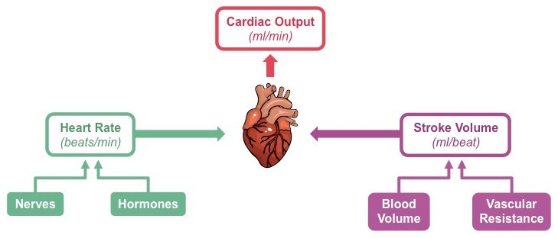
Cardiac Output is a Measure of Cardiac Performance
How can we assess the effectiveness of the heart as a pump?
One way is to measure cardiac output (CO), the volume of blood pumped by one ventricle in a given period of time.
Because all blood that leaves the heart flows through the tissues, cardiac output is an indicator of total blood flow through the body.
However, cardiac output does not tell us how blood is distributed to various tissues. That aspect of blood flow is regulated at the tissue level.
Dr. Abbass HAYDAR

Slide 11
Cardiac Output is a Measure of Cardiac Performance
Cardiac output (CO) can be calculated by multiplying heart rate (beats per minute) by stroke volume (ml. per beat, or per contraction):
Cardiac output = heart rate x stroke volume
For an average resting heart rate of 72 beats per minute and a stroke volume of 70 ml. per beat, we have
CO = 72 beats/min x 70 ml/beat = 5040 mL/min (or approx. 5/L min)
Dr. Abbass HAYDAR

Slide 12
Cardiac Output is a Measure of Cardiac Performance
Average total blood volume is about 5 liters. This means that, at rest, one side of the heart pumps all the blood in the body through it in only one minute!
Normally, cardiac output is the same for both ventricles. However, if one side of the heart begins to fail for some reason and is unable to pump efficiently, cardiac output becomes mismatched. In that situation, blood pools in the circulation behind the weaker side of the heart.
During exercise, cardiac output may increase to 30-35 L/min. Homeostatic changes in cardiac output are accomplished by varying the heart rate, the stroke volume, or both. Both local and reflex mechanisms can alter cardiac output.
Dr. Abbass HAYDAR

Slide 13
Dr. Abbass HAYDAR

Slide 14
Dr. Abbass HAYDAR

Slide 15
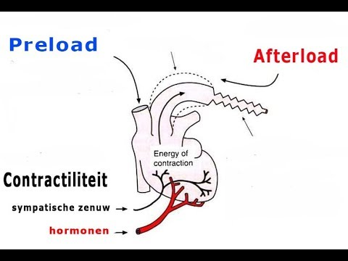
Regulation of Stroke Volume
A healthy heart will pump out the blood that entered its chambers during the previous diastole. In other words, if more blood returns to the heart during diastole, then more blood is ejected during the next systole.
At rest, the stroke volume is 50–60% of the end-diastolic volume because 40–50% of the blood remains in the ventricles after each contraction (end-systolic volume).
Three factors regulate stroke volume and ensure that the left and right ventricles pump equal volumes of blood:
(1) preload, the degree of stretch on the heart before it contracts;
(2) contractility, the forcefulness of contraction of individual ventricular muscle fibers; and
(3) afterload, the pressure that must be exceeded before ejection of blood from the ventricles can occur.

Slide 16
Preload: Effect of Stretching
A greater preload (stretch) on cardiac muscle fibers prior to contraction increases their force of contraction.
Preload can be compared to the stretching of a rubber band. The more the rubber band is stretched, the more forcefully it will snap back.
Within limits, the more the heart fills with blood during diastole, the greater the force of contraction during systole.
This relationship is known as the Frank–Starling law of the heart.

Slide 17
Preload: Effect of Stretching
The preload is proportional to the end-diastolic volume (EDV) (the volume of blood that fills the ventricles at the end of diastole).
Normally, the greater the EDV, the more forceful the next contraction.
Two key factors determine EDV: (1) the duration of ventricular diastole and (2) venous return, the volume of blood returning to the right ventricle.
When heart rate increases, the duration of diastole is shorter. Less filling time means a smaller EDV, and the ventricles may contract before they are adequately filled.
By contrast, when venous return increases, a greater volume of blood flows into the ventricles, and the EDV is increased.
When heart rate exceeds about 160 beats/min, stroke volume usually declines due to the short filling time.
At such rapid heart rates, EDV is less, and the preload is lower.

Slide 18
Contractility
The second factor that influences stroke volume is myocardial contractility, the strength of contraction at any given preload.
Substances that increase contractility are positive inotropic agents those that decrease contractility are negative inotropic agents.
Thus, for a constant preload, the stroke volume increases when a positive inotropic substance is present.
Positive inotropic agents often promote Ca2+ inflow during cardiac action potentials, which strengthens the force of the next contraction.
Stimulation of the sympathetic division of the autonomic nervous system (ANS), hormones such as epinephrine and norepinephrine, increased Ca2+ level in the interstitial fluid, and the drug digitalis all have positive inotropic effects.
In contrast, inhibition of the sympathetic division of the ANS, anoxia, acidosis, some anesthetics, and increased K+ level in the interstitial fluid have negative inotropic effects.
Calcium channel blockers are drugs that can have a negative inotropic effect by reducing Ca2+ inflow, thereby decreasing the strength of the heartbeat.

Slide 19
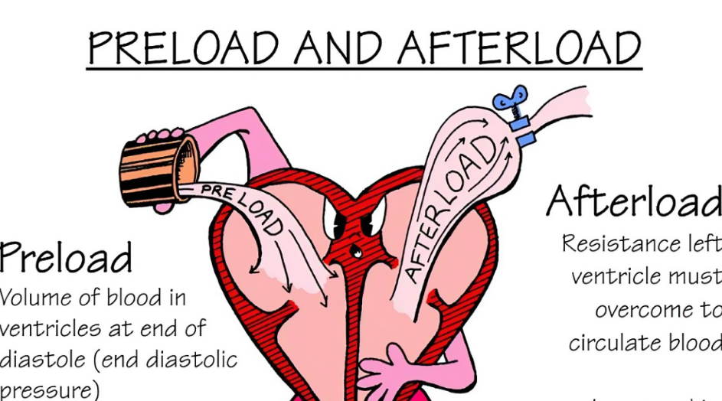
Afterload
Ejection of blood from the heart begins when pressure in the right ventricle exceeds the pressure in the pulmonary trunk (about 20 mmHg), and when the pressure in the left ventricle exceeds the pressure in the aorta (about 80 mmHg).
At that point, the higher pressure in the ventricles causes blood to push the semilunar valves open.
The pressure that must be overcome before a semilunar valve can open is termed the afterload.
An increase in afterload causes stroke volume to decrease, so that more blood remains in the ventricles at the end of systole.
Conditions that can increase afterload include hypertension (elevated blood pressure) and narrowin

Slide 20
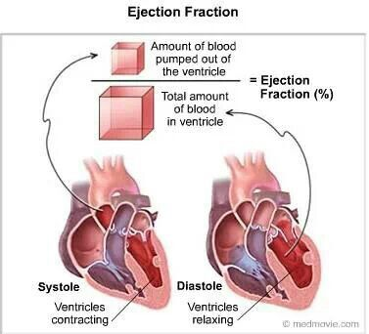
Ejection fraction
Ejection fraction (EF) is defined as the fraction of end-diastolic volume that is ejected out of the ventricle during each contraction.
Healthy ventricles typically have ejection fractions greater than 0.55.
However, EF is also dependent on loading conditions and inferior to hemodynamic parameters defined by the PV plane.

Slide 22
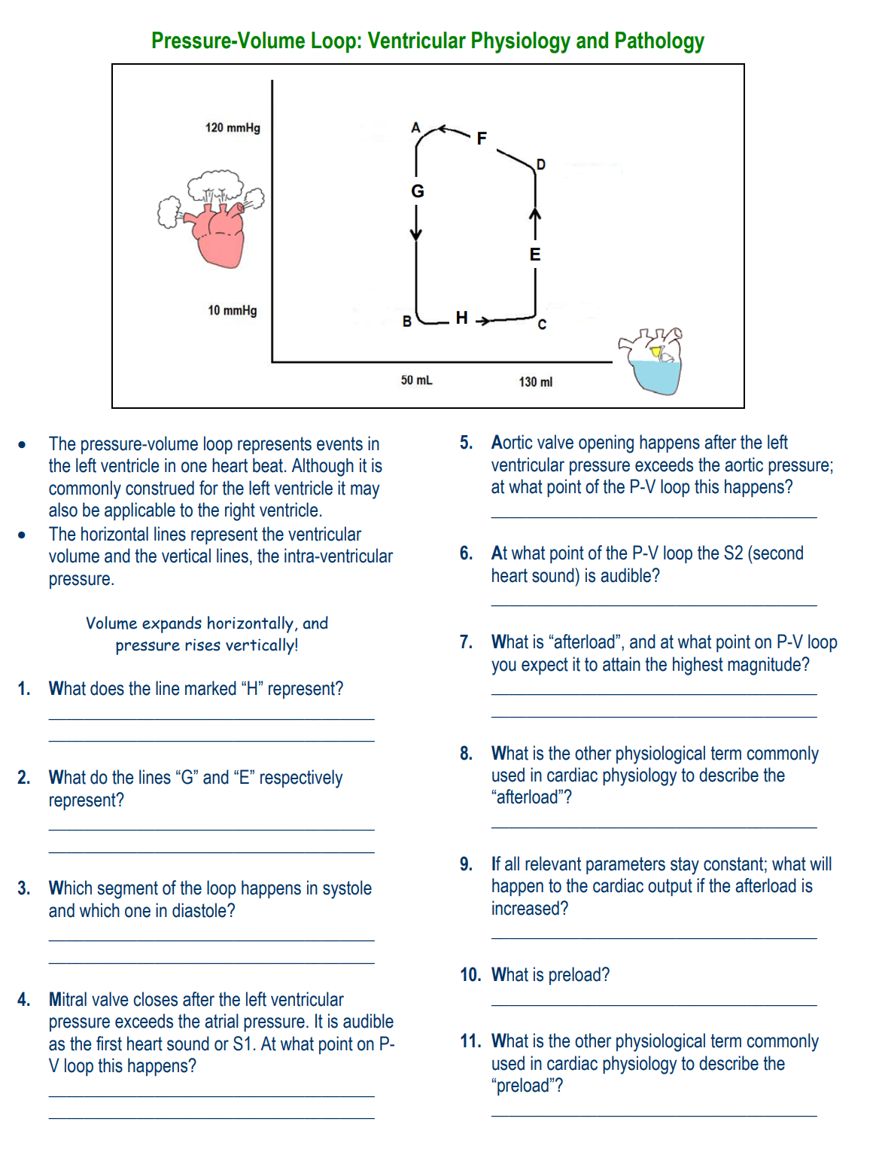

Slide 23
RVF
Negative ionotropic anesthesia drug

