Slide 1
CHAPTE R 1 Medical terminology

Slide 2
List of Contents
Review (What do you know about Terminology, Roots, Quiz)
Answer the practice 1.1
Reading medical terms
Spelling of medical terms
Pronunciation of medical terms
Home work (basic medical terms)
Lect.4
Dr. Laith & Asaad

Slide 3
Practice 1.1
Form medical words from the following prefixes, combining forms, and suffixes. Delete unnecessary components.
a. electr/o/encephal/o/gram =electroencephalogram
b. enter/o/itis =enteritis
c. nephr/o/ectomy = nephrectomy
d. ophthalm/o/scope = ophthalmoscope
e. trans/urethr/o/al =transurethral
f. retro/gastr/o/ic =retrogastric
g. bi/o/opsy =biopsy
h. hyper/thyroid/o/ism =hyperthyroidism
i. arthr/o/algia =arthralgia
j. cerebr/o/vascul/o/ar =cerebrovascular

Slide 4
Reading medical terms
Reading a medical term in order to get its meaning is quite easy.
You should always start from the end, then move to the beginning, and across the term.
A word such as electr/o/encephal/o/graphy consists of two roots, two combining vowels and a suffix.
1 (-graphy), which means act of recording;
2-(electr/o), which means electricity;
3- finally (encephal/o), which means brain.
The entire word means the act of recording the electrical activity in the brain
Encephalogram

Slide 5
Rea the following Medical terms
esophag/o/gastr/o/duoden/o/jejun/o/stomy
Otorhinolaryngology
Ophthalmoscopy
Gastroenterologist
otorhinolaryngologist
2
3
4
5
6

Slide 6
In conclusion
1. Root: the part of the term that conveys its basic meaning.
2. Prefix: a letter or a group of letters attached to the beginning of a term to modify its meaning.
3. Suffix: a letter or a group of letters attached to the end of a term to produce a new word form in general or to modify the meaning of the root.
4. Combining form: a root with a combining vowel.
5. Combining vowel: a vowel inserted between a root and a suffix that starts with a consonant or a root and another root to ease pronunciation.

Slide 7
Practice 1.2 Write the medical term for each of the following definitions.
a. The study of women’s diseases is called _________________.
b. Record of electricity in the brain is called _________________.
c. Low level of hormone from a gland in the neck is called ______.
d. An instrument that examines the patient’s eye is called_______.
e. Pertaining to behind the stomach ________________.

Slide 8
The Answers
A-gynecology
B- electroencephalography
C-hypothyroidism
D-ophthalmoscope
E- gastric

Slide 9
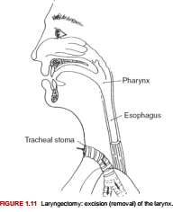
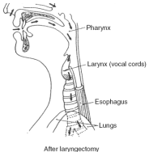

Slide 10
Words ending in “is”: change “is” to “es”
Singular | Plural | Meaning
diagnosis | diagnoses | determination of the cause of the disease (condition of complete knowledge)
analysis | analyses | separation of substances into their component parts
metastasis | metastases | spreading of the cancer
psychosis | psychoses | abnormal condition of the mind
prosthesis | prostheses | artificial part attached to the body

Slide 11
Spelling of medical terms
Root | Suffix | Term | Meaning
men | -rhea | Menorrhea | Normal menstrual flow or discharge
hem | -rhage | Hemorrhage | Excessive bleeding
hemat | -rhagia | hematorrhagia | Bursting forth of blood
arteri | -rhaphy | arteriorrhaphy | Suture of an artery
my | -rhexis | myorrhexis | Rupture of a muscle

Slide 12
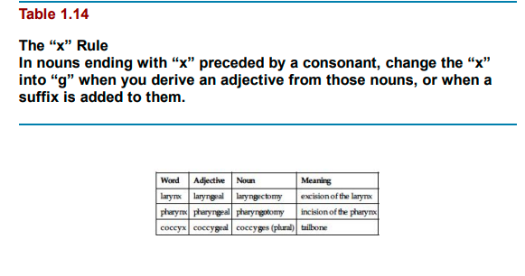
Word | Adjective | Noun | Meaning
larynx | laryngeal | Laryngectomy | excision of the larynx
pharynx | Pharyngeal | pharyngotomy | incision of the pharynx
coccyx | Coccygeal | coccyges (plural) | tailbone

Slide 13
Pronunciation of medical terms
Pronouncing medical terms is rather difficult because many terms are multisyllabic and some of them have silent letters have unusual pronunciation.
Some differences between spelling and pronunciation are shown in

Slide 14
Pronunciation of medical terms
Spelling | Pronunciation | Example | Meaning
dys | dis | dyspnea | difficulty in breathing
ph | f | pharmacy | a place for dispensing medicine
x | z | xiphoid | cartilage attached to the sternum
ch | k | chronic | pertaining to time( a disease that remains for long period of time

