Slide 1
COLLAGE OF DENTISTRY
الفرع العلمي:طب الاسنان
المادة: Dental Radiology
المحاضرة: RADIATION PROTECTION
رقم المحاضرة:12
اسم تدريسي المادة: م.م. مسار عبد الخالق

Slide 2
RADIATION PROTECTION

Slide 3
Reducing Dental Exposure
There are three guiding principles in radiation protection;
The first is the principle of justification, the dentist must do more good than harm.
- In radiology this means the dentist should identify those situations where the benefit to a patient from the diagnostic exposure exceeds the low risk of harm.

Slide 4
-The second guiding rule is the principle of optimization.
This principle holds that dentists should use every means to reduce unnecessary exposure to their patient and themselves.
This philosophy of radiation protection is often referred to as the principle of ALARA
(As Low As Reasonably Achievable)
Recentely the philosophy of radiation protection is often referred to as the principle of ALADA
(As Low As Diagnostically Acceptable )

Slide 5
. ALARA holds that exposures to ionizing radiation should be kept as low as reasonably achievable, economic and social factors being taken into account.
The third principle is that of dose limitation.
Dose limits are used for occupational and public exposures to ensure that no individuals are exposed to unacceptably high doses.

Slide 6
PATIENT SELECTION CRITERIA
According to (ADA, 2006)
-Dentists should not prescribe routine dental radiographs at preset intervals for all patients.
Instead, they should prescribe radiographs after an evaluation of the patient ’ s needs that includes a(1) health history review, a (2)clinical dental history assessment, a (3) clinical examination, and an (4) evaluation of susceptibility to dental diseases

Slide 7
RADIATION PROTECTION
The radiation protection can be divided into: choice of equipment, choice of technique,
operation of equipment,
and processing and interpreting the radiographic image.

Slide 8
1-Film and Digital Imaging
High speed films or digital sensors may be used.
Currently, intraoral dental x-ray film is available in three speed groups: D, E, and F.
Clinically, film of speed group E is almost twice as fast (sensitive) as film of group D.
The current F-speed films require about 75% the exposure of E-speed film and only about 40% that of D-speed.
Notes:
Slow ABC
Fast DEF

Slide 9
2- Source-to-Skin Distance
Two standard focal source-to-skin distances have evolved over the years for use in intraoral radiography,
one 20 cm (8 inches) and the other 41 cm (16 inches).
Use of the distance results in a 32% reduction in exposed tissue volume because the x-ray beam is less divergent .

Slide 10
Source-to-Skin Distance

Slide 11
3- Rectangular Collimation
According to (ADA, 2006) since a rectangular collimator decreases the radiation dose by up to fivefold as compared with a circular one,
radiographic equipment should provide rectangular collimation for exposure of periapical and bitewing radiographs.
.

Slide 12
This results in not only decreased patient exposure
but also increased image quality because the amount of radiation scatter generated is proportional to the area exposed.

Slide 13
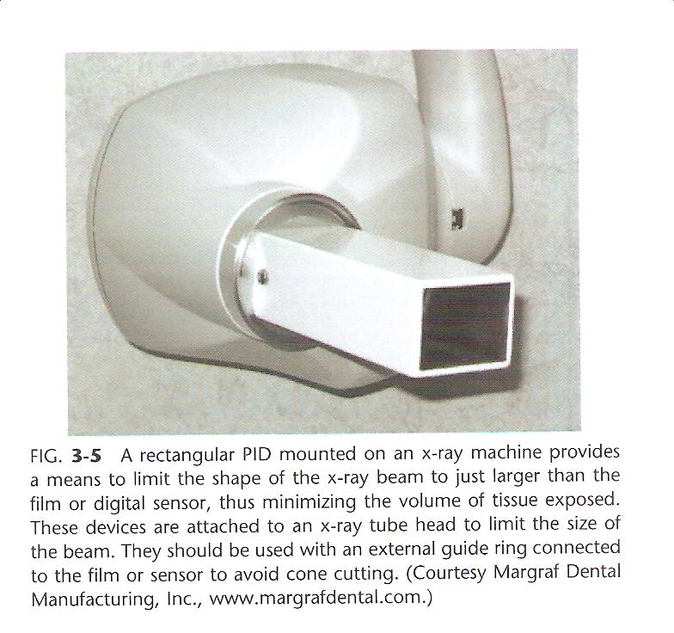
There are several means to limit of the size of the x-ray beam. First, a rectangular position-indicating device (PID) may be attached to the radiographic tube housing.

Slide 14
4- Filtration
The x-ray beam emitted from the radiographic tube consists of not only high-energy x-ray photons, but also many photons with relatively lower energy.
The purpose of filtration is to remove these low-energy x-ray photons selectively from the x-ray beam.
When an x-ray beam is filtered with 3 mm of aluminum, the surface exposure is reduced to about 20% of that with no filtration.

Slide 15
5- Leaded Aprons and Collars
The function of leaded aprons and thyroid collars is to reduce radiation exposure of the gonads and thyroid gland.
Thyroid shielding with a leaded thyroid shield or collar is strongly recommended for children and pregnant women,
as these patients may be especially susceptible to radiation effects.

Slide 17
6-Film and Sensor Holders
Film or digital sensor holders should be used when intraoral radiographs are made because they improve the alignment of the film, or digital sensor, with teeth and x-ray machine.
Their use results in a significant reduction in unacceptable images.
This is especially important when the paralleling technique and digital imaging are used.

Slide 19
7- Kilovoltage
The operating potential of dental X-ray machines must range between 50 and 100 kilovolt peak but should range between 60 and 80 kVp.
8- Milliampere-Seconds
The operator should set the amperage and time settings for exposure of dental radiographs of optimal quality.
In terms of exposure, optimal image quality means
that the radiograph is of diagnostic density, neither overexposed (too dark) nor underexposed (too light).

Slide 20
9- Film Processing
Radiographs should not be overexposed and then underdeveloped, because this practice results in greater exposure to the patient and dental health care worker and can produce images of poor diagnostic quality.
Dental radiographs should not be processed by sight, and manufacturers ’ instructions regarding time, temperature and chemistry should be followed.
Approximately 30% of all films retaken because of incorrect film density were directly related to processor variability.

Slide 21
PROTECTING PERSONNEL
In addition to those mentioned, several other steps can be taken to reduce the chance of occupational exposure.
First the operator should leave the room or take a position behind a suitable barrier or wall during exposure of the image.

Slide 22
If leaving the room or making use of some other barrier is impossible,
strict adherence to what has been termed the position-and distance rule is required:
The operator should stand at least 6 feet (2 m) from the patient, at an angle of 90 to 135 degrees to the central ray of the x-ray beam

Slide 24
When applied, this rule not only takes advantage of the inverse square law to reduce x-ray exposure to the operator but also take advantage of the fact that in this position the patient’s head absorbs most scatter radiation.
Second, the operator should never hold films or sensors in place.
Third, neither the operator nor patient should hold the radiographic tube housing during the exposure.

Slide 25
Film badges
The best way to ensure that personnel are following office safety rules such as those described previously is with personnel-monitoring devices.
Commonly referred to as film badges, these devices provide a useful record of occupational exposure.
Film badges contain either a piece of sensitive film or a radiosensitive crystal (thermoluminescent dosimeter) and a printed report of accumulated exposure at regular intervals

Slide 26
Thank you

