Slide 1
Al-ayen Iraqi university
College of Heaith &Medical Technology
Department of Anasthesia
Chapter 6
Heart sound generated during cardiac cycle
By: MSC Khitam AL-mohammed

Slide 2
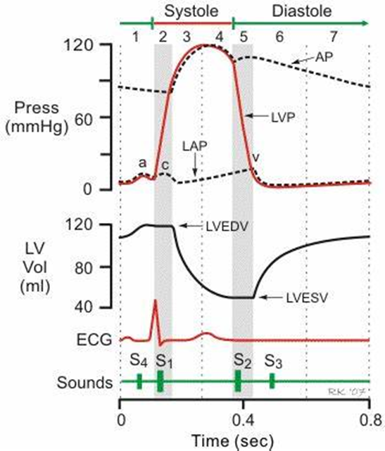

Slide 3
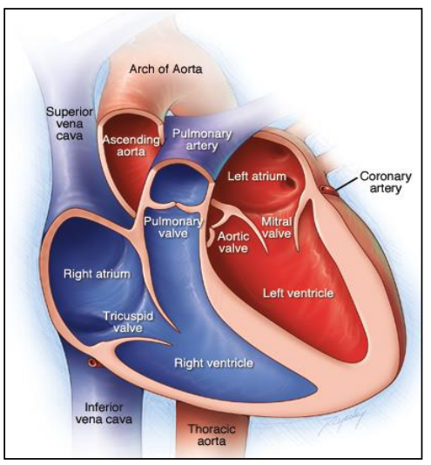

Slide 4
Introduction:
Each side of the heart consists of two chambers, the atrium and the ventricle
Between atria and ventricles, there are mitral and tricuspid valves
and between ventricles and aorta and pulmonary artery, there are aortic and pulmonary valves respectively
Heart sounds originates from the vibration associated with the closure of heart valves.

Slide 5
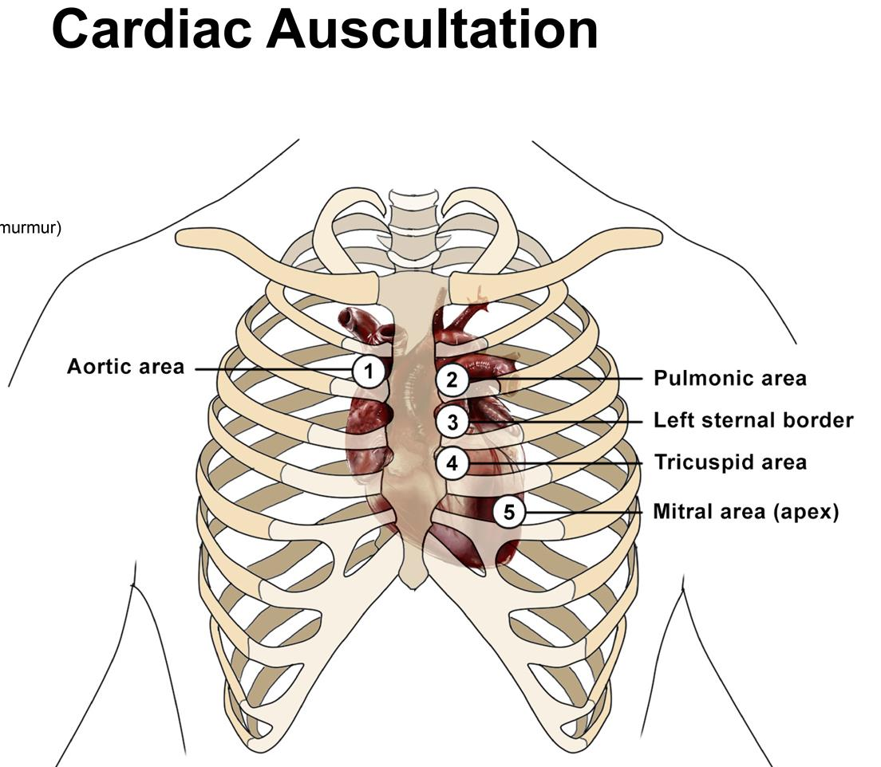
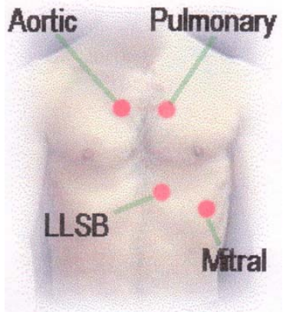
Location of the valves:
Mitral valve → 5 ICS (apex).
Tricuspid valve → LLSB (left lower sternal border).
Aortic valve → 2ICS (right).
Pulmonic valve → 2 ICS (left).

Slide 6
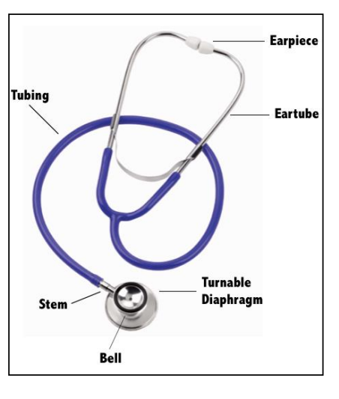
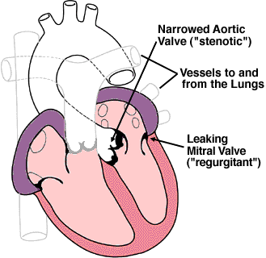
stethoscope
Auscultation of the heart requires a stethoscope with a bell and diaphragm
The bell is best for listening to low-pitched sounds such as the murmur of mitral stenosis.
The diaphragm filters out such sounds and helps to identify high-pitched sounds such as normal heart sounds.
The most important features of stethoscope are the extraneous noises must be excluded as far as possible and that the condition of sound from the chest pieces should be as complete as possible.
In order to achieve these, the ear pieces should be well fitting and there should be no leaks elsewhere.
The tube should be of small diameter, relatively short, and with polished inner surface to reduce loss of conduction by friction.
Plastic tubing is much more efficient in this capacity than rubber.

Slide 7
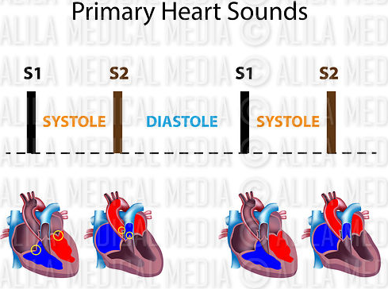
heart sound
The characteristic heart sound is lup-dup-pause-lup-dup-pause rhythm.
Two heart sounds (S1, S2) are normally heard during cardiac cycle by stethoscope with or without additional heart sounds (S3,S4).
Low frequency sounds are detected by phonocardiogram.

Slide 8
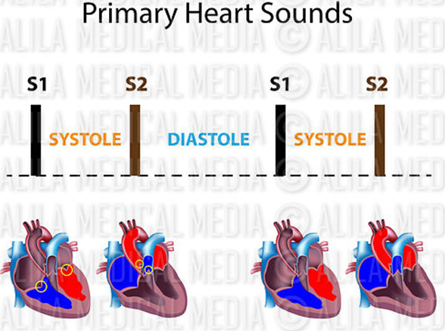
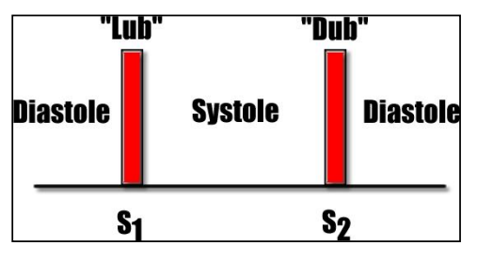
1-The first heart sound (S1)
is low pitch (25 – 45 Hz), slightly prolonged (0.14 - 0.15 second)
caused by vibration associated with the closure of the mitral and tricuspid valves at the start of ventricle systole.
It is normally loudest at the apex area.
Quiet S1 is heard in low cardiac output, poor left ventricular function and long PR interval.
Loud S1 is heard in increased cardiac output, mitral valve stenosis and short PR interval

Slide 9
2-The second heart sound (S2)
is shorter (0.12 second), high pitch (50 Hz), caused by vibration associated with the closure of the aortic and pulmonary valves just after the end of ventricular systole
It is best heard at left sternal edge.
The interval between the aortic and pulmonary valve closure during deep inspiration is long enough for the second sound to be reduplicated (physiological splitting). This is because left ventricular contraction slightly precedes right ventricular contraction and further delay is due to increased venous return and increased right ventricle filling.
The aortic component of S2 is well heard in the aortic area while pulmonic component of S2 is usually heard in pulmonary area.
Quiet S2 is heard in low cardiac output and aortic regurgitation.
Loud S2 is heard in systemic and pulmonary hypertension.

Slide 10
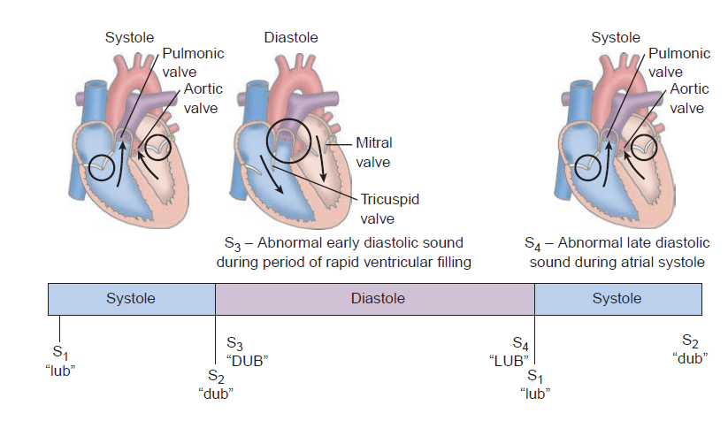
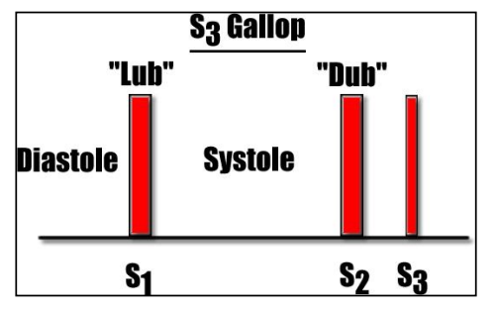
3-A soft (0.1 second), low pitched third heart sound (S3)
Is heard about one-third of way through diastole, It coincides with the period of rapid ventricular filling and due to vibration set up by inrush of blood.
It is best heard at the apex.
It can be physiological or pathological.
Physiological causes include healthy young adult, athletes, pregnancy and fever.
S3 is usually pathological after the age of 40 and is associated with heart failure.
S3 accompanied by tachycardia in heart failure result in ‘triple rhythm’ or gallop rhythm resembling the sound of galloping horse.
Normally S3 disappears completely when the patient sits or stands

Slide 11
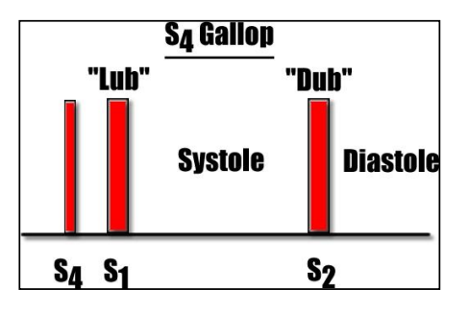
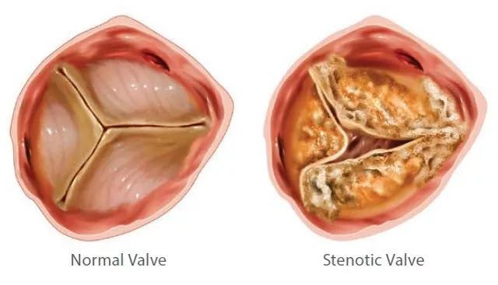
4- A fourth heart sound (S4)
is a very soft, low-pitched sound that occurs just before the first sound (late diastole) when atrial pressure is high
It is pathological and caused by forceful atrial contraction.
It is best heard with the bell of stethoscope at the apex.
S4 is heard in conditions associated with left ventricular hypertrophy such as hypertension and aortic stenosis.

Slide 12
Murmurs or bruits:
They are abnormal sounds heard in vascular system due to turbulent blood flow in the heart.
Normally blood flow is laminar and non-turbulent so it is silent.
Murmurs are caused either by abnormal heart valve function or arise from increased volume, or velocity of blood flowing through normal valve.
Murmurs may occur in healthy heart when stroke volume is increased like e.g. during pregnancy and in athletes.
Murmurs can be classified according to timing into systolic, diastolic or continuous murmurs.

Slide 13
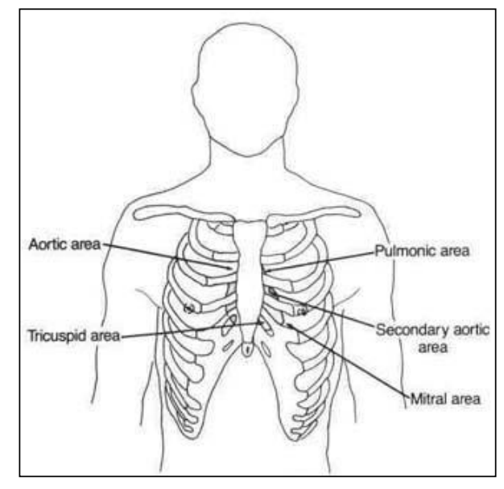
Murmurs or bruits:
There are four sites at which sound of murmurs arising from the four valves are best heard.
1-The apex area (mitral area): It is at 5th intercostal space, at mid-clavicular line, below left mammary.
2- The tricuspid area: It is at left lower end of sternum.
3- The aortic area: It is at right to sternum in 2nd intercostal space.
4- The pulmonary area: It is at left to sternum in 2nd intercostal space.
Most clinicians first auscultate at the apex then proceed to tricuspid, pulmonary and aortic area.

Slide 14
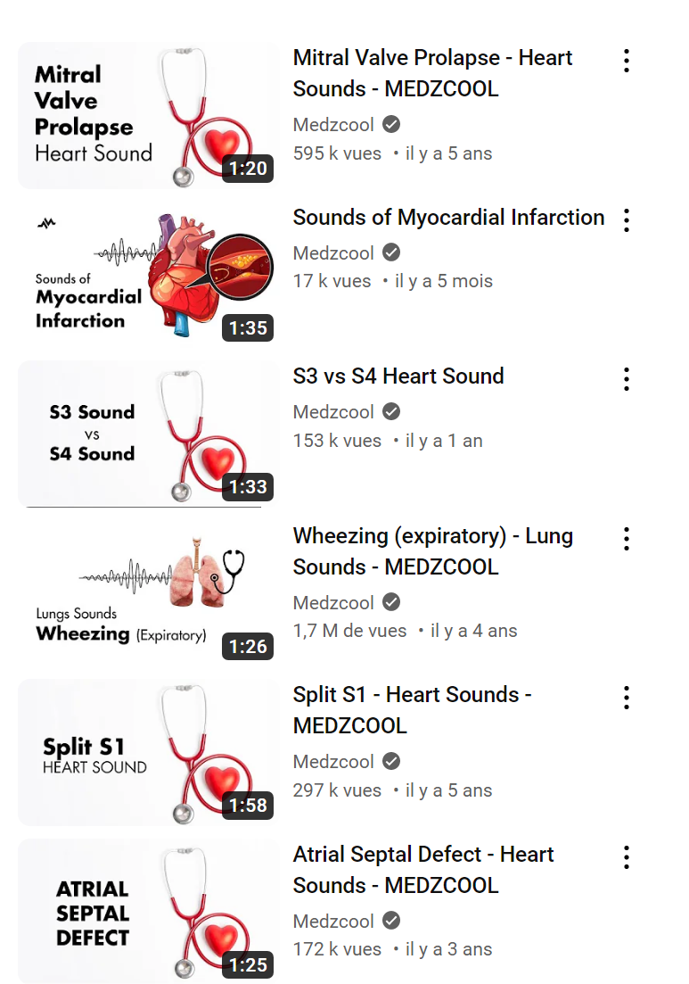

Slide 15
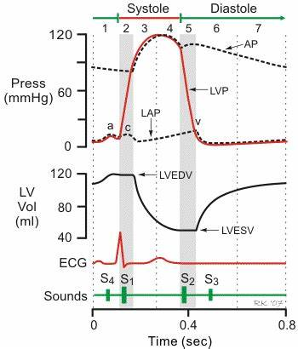
Youtube:
S1 Heart Sound - MEDZCOOL
S3 Heart Sound - MEDZCOOL

