Slide 1
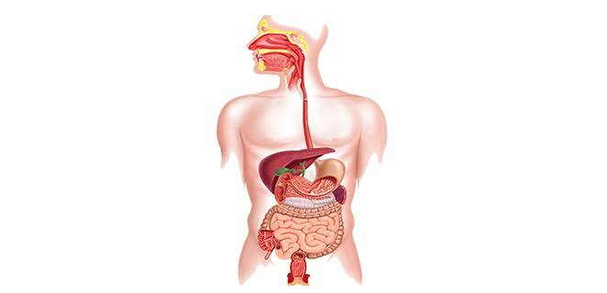
Theoretical Physiology
Al Ayen University
College of medical and Health
Department of Anesthesia
lecture.1 M.Sc. Awham Kareem
First Stage

Slide 2
Introduction
Physiology
Is the scientific study of functions and mechanisms in a living system.
It is branch of biology , physiology focuses on organ systems , individual organs , cells , and biomolecules carry out the chemical and physical functions in a living system.

Slide 3
Levels of Organization of The Human body.
Chemical (Atoms)
Cellular ( Cells)
Tissue
Organs
System
Organism

Slide 4
Cell Physiology
Cell is the Basic unit of the life so that it is
Defined as the structural and functional unit of the living body .
All living Organisms are composed of one or more cells .
There are about 200 different kinds specialized cells in the human body .

Slide 5
General Characteristics of Cell.
*Needs Nutrition and Oxygen .
*Produces tis own energy necessary for its growth.
*Eliminates CO2 and other metabolic wastes .
*Maintains the environment for its survival cell.
* Its has immediate response when any foreign body enters.
*Reproduces by division.
There are some exceptions like neuron

Slide 6
Structure of The Cells
The cell as seen by light microscope , consist
Three basic components
1.Cell Membrane ( Plasma membrane )
is a thin , elastic structure that envelops the cell .
It separates the contents of the cell from the external environment and controls exchange of materials between the fluid outside the cell ( extracellular fluid ) and the fluid inside the cell ( intracellular fluid ) . The cell membrane is composed of Proteins ( 55 % ) Lipids ( 40 % ) Like Phospholipids , Cholesterol and Other lipids and Carbohydrates ( 5 %)

Slide 7
Structure of The Cell Membrane
1.Lipids consist two type
A. Cholesterol
B. Phospholipid …two type
*Hydrophilic (Head )
*Hydrophobic (Tail )
2.Proteins
A. Trans membrane
B. Integral
C. Peripheral
3.Carbohydrate

Slide 9
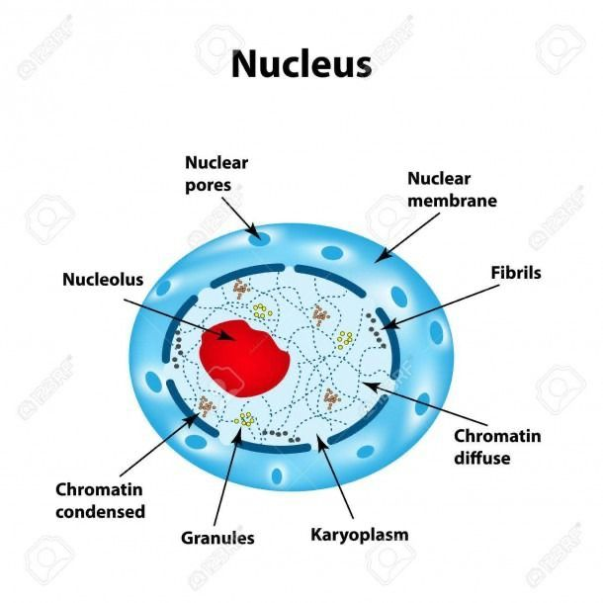
2.Nucleus
Is the largest of the cells organelles . Cells can have more than one nucleus or lack a nucleus all together Skeletal muscle cells contain more than one nucleus whereas red blood cells dont contain a nucleus at all .

Slide 10
The nucleus is bounded by the nuclear membrane envelope . The nucleus contains the genetic material
( DNA ) is the Genetic information in the cell
The DNA is spread out within the nucleus as a threadlike matrix called chromatin .
When the cell begins to divide , the chromatin condenses into rod - shaped bodies called chromosomes.

Slide 11
3.Cytoplasm
Is consists of all the cellular contents between the plasma membrane and the nucleus This. compartment has two components: cytosol and organelles
*Cytosol :means the fluid portion of cytoplasm . Contains : ( water , dissolved solutes , and suspended particles ) . Surrounded by cytosol are several different types of organelles.
*Organelles :are the permanent components of the cells that are bounded by a limiting membrane and contain enzymes , hence participating in cellular metabolic activity These include

Slide 12
1.Mitochondria
Are major sites for aerobic respiration (powerhouse)
2.Lysosomes
Are sac that contain a number of powerful degradative enzymes , they break down harmful cell products and waste materials.
3. Golgi apparatus
Its continuous with the endoplasmic reticulum .its the functions synthesis Carbohydrate and proteins.
4.Ribosoms There are two types rough and smooth , its the functions synthesis proteins.

Slide 13
Function of the cell membrane
The cell employs a number of transport mechanisms that involve biological membranes
Such as Transport its consist of two types
1.Passive Transport
A. Simple Diffusion
B. Facilitated Diffusion
2.Active Transport

Slide 14
Active Transport
1.Require energy or ATP
2.Move material from low to high concentration
3.Pumping
Potassium ions and sodium
There are two type
*Endocytosis
* Exocytosis
Passive Transport Facilitated Diffusion
1.Dosent require Energy
2.Used transport protein to move high to low concentration
3.Ex.Glucose or Amino Acids moving from blood into the cell
Passive Transport
Simple Diffusion
1.Doesn't require energy
2.Moves high to low concentration
3.Ex. O2 and water diffusing into a cell and CO2 diffusing out

Slide 15
*Endocytosis
defined as a transport mechanism by which the macromolecules enter the cell .
Macromolecules ( substances with larger molecules ) cannot pass through the cell membrane either by active or by passive transport mechanism . This substances are transported into the cell by endocytosis
Pinocytosis , Phagocytosis , Receptor mediated

Slide 16
Exocytosis
Is the process by which the substances are expelled from the cell , where the substances made within the cells are packed into vesicles , which then fuse with the cell membrane . This is the reverse of endocytosis

Slide 17
Answer Questions
Q. Define the cell and what is the essential or basic components?
Q. What is the level of organization ?
Q. Enumerate the cellular organelles and the function of each?

Slide 18
Thank you

