Slide 1
AL-AYEN UNIVRSITY COLLEGE OF ENGINEERING
RESERVOIR ENGINEERING I
Reservoir Rock Properties
Permeability
Rock compressibility
Fluid saturation
2022-2023
NASIR ATALLAH
ASMAA AHMED

Slide 2
Reservoir Rock Properties
Permeability
Outline
Permeability definition
Importance of permeability
Permeability types
Darcy law
Assumptions of Darcy law
Permeability unit
Permeability measurements
Rock compressibility
Saturation

Slide 3
Permeability: Definition
Permeability definition
Ability of the formation to transmit fluids
The ease with which fluid can pass through the pore structure
Symbol, K
K is defined mathematically by Henry Darcy in 1856
Importance of permeability
K is very important rock property because:
It Controls the directional movement of fluids
It Control the flow rate of fluids in the reservoir

Slide 4
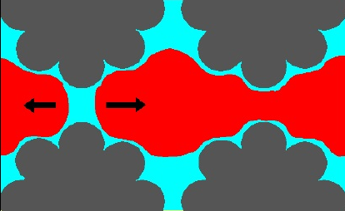
Permeability: Types
Effective Permeability, Ke
Absolute Permeability, K
Relative Permeability, Kr
When one phase is flowing in the reservoir
When two fluids or more are flowing in the reservoir
K=Ke
Ko< K
oil
oil
Kw< K
water

Slide 5
Darcy law
Darcy developed a fluid flow equation (Darcy Law) for flow of water through filter beds
Darcy law represents the basis of the study of fluid flow through porous rock
Varies directly with
1-Pressure difference
2-Area open to flow
Q $∝A, ∆P, \frac{1}{μ L}$
The rate of flow through a given rock
Varies Inversely with
1-Fluid viscosity
2-Length of rock
$$Q=\frac{K ∆p A}{μ L}$$
the constant of proportionality in the equation is the permeability

Slide 6
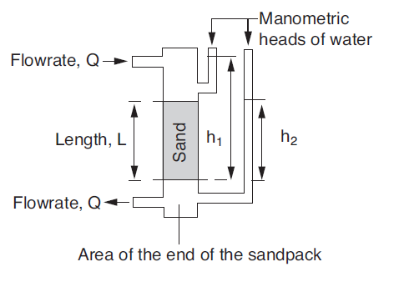
Darcy’s Law
Assumptions of Darcys Law
Steady state flow
Laminar flow
One phase present at 100% pore space saturation
No reaction between fluid and rock
Rock is homogenous
Darcy’s Law experiment
Water flows through a sandpack at a constant rate
The flowrate was directly proportional to the area open to flow and the difference in pressure and inversely proportional to the length of the sandpack.
When another fluid is used, results were different to those of Darcy due to the effect of fluid viscosity. Thus, the equation becomes:

Slide 7
Permeability: Units
Unit of Permeability
$$Q=\frac{K ∆p A}{μ L}$$
The unit of permeability is the Darcy
Darcy is defined as the permeability which will permit a fluid of one centipoise viscosity (= viscosity of water at 68°F) to flow at a linear velocity of one centimetre per second under a pressure gradient of one atmosphere per centimetre
Darcy is too big unit, Milli Darcy (mD) unit is used for permeability
mD$={10}^{−3}$ Darcy
Formation permeabilities Vary from a fraction (e.g 0.0002 mD ) to more than 10000 mD
Clays & shales have permeabilities of ${10}^{−2}$ to ${10}^{−6}$mD
They are considered as seals between permeable layers due to their low permeabilities
Reservoir quality:
K< 1 md Poor
1 < K < 10 md Fair
10 < K < 50 md Moderate
50 < K < 250 md Good
250 md < K Very good

Slide 8
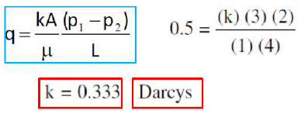
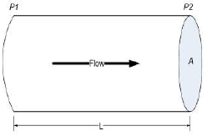
Example
A brine is used to measure the absolute permeability of a core plug. The rock sample is 4 cm long and 3 cm2 in cross section. The brine has a viscosity of 1 cp and is flowing at a constant rate of 0.5 cm3/sec under 2 atm pressure differential. Calculate the absolute permeability.
L= 4 cm
A= 3 cm2
µ= 1 cp
Q= 0.5 cm3/sec
∆p= 2 atm

Slide 9
Dimensions of permeability
Length= L, Mass=m, Time=t
Unit conversion:
dyne = gm cm/sec2 = a unit of force
Poise=gm/cm sec
atm = 1.0133 x 10^6 dyne/cm2
ρgh = dyne/cm2 = a unit of pressure
Parameter |  | Dimensions
Q | Volume/ time | L³/t
μ | Poise=(gm/cm. sec) | m/(L.t)
L | length | L
A | Length x length | L²
$$∆p$$ | Dyne/cm² =(gm cm/sec2)/cm2 | (m.L/t²)/L²= m/(t².L)
$$Q=\frac{K ∆p A}{μ L}$$
$k=\frac{qμ L}{A∆p}$=$\frac{\frac{L^{3}}{t}x \left[\frac{m}{L t}\right] x L}{L^{2}\left[\frac{m}{L t^{2}}\right]}$= L²
Unit of cross-sectional area

Slide 10
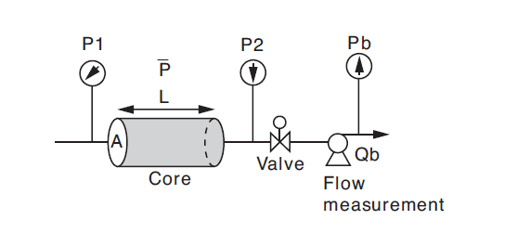
Permeability measurements: Lab. measurement
Dry gas is usually used (air, N2, He) in permeability determination???
Due to its convenience, availability, and to minimize fluid-rock reaction.
Darcy law for gas phase flow:
k = absolute permeability, Darcy
μg = gas viscosity, cp
pb = base pressure (atmosporic pressure), atm
p1 = inlet (upstream) pressure, atm
p2 = outlet (downstream) pressure, atm
L = length of the core, cm
A = cross-sectional area, cm2
Qgsc = gas flow rate at standard conditions, cm3/sec
Gas
The gas flow rate is proportional to the difference in the pressure squared
The liquid flowrate is proportional to the difference in the pressure.
Liquid

Slide 11
Permeability measurements: Lab. measurement
Derivation of Gas flow equation
In using dry gas in measuring the permeability, q varies with pressure because the gas is a highly compressible fluid.
The value of q at the average pressure in the core must be use
with the mean pressure pm expressed as:

Slide 12
Permeability measurements: Lab. measurement
Derivation of Gas flow equation
The gas flow rate is usually measured at base (atmospheric) pressure pb ,therefore, the term Qgsc is used
Substituting Darcy’s Law in the above expression gives
Permeability Measurements made With gas give higher permeabilities than the liquid.
This phenomenon is attributed to Klinkenberg who observed this in 1941.
Klinkenberg Effect ??

Slide 13
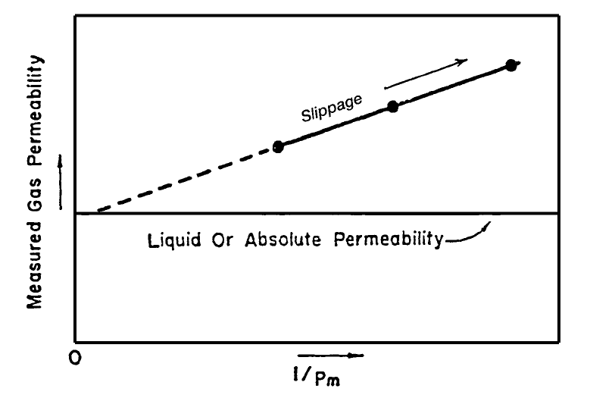
Permeability measurements: The Klingenberg Effect
liquids had a zero velocity at the sand grain surface, while gases exhibited some finite velocity at the sand grain surface.
The gases exhibited slippage at the sand grain surface.
This slippage resulted in a higher flow rate for the gas at a given pressure differential
Klinkenberg found that as the mean pressure increased the calculated permeability decreased.
Plot measured permeability versus 1/pm
Extrapolated to the point where 1/pm = 0
This permeability equals to the liquid permeability
KL

Slide 14
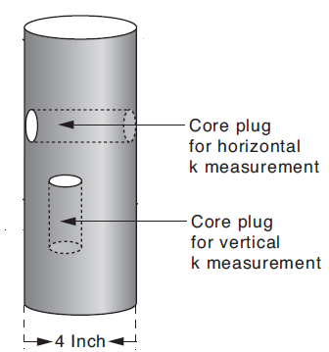
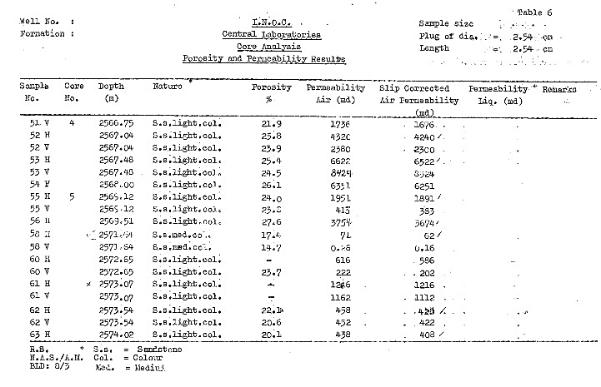
Permeability measurements
Horizontal (KH) & Vertical Permeability (Kv)
Plugs in both vertical and horizontal directions are taken
Kv is smaller than KH
Routine core analysis example

Slide 15
Reservoir Rock Properties
Rock compressibility
Outline
Compressibility definition
Rock compressibility
Overburden pressure
Reservoir pressure
Types of compressibility
Lab. Measurement of compressibility

Slide 16
Compressibility definition
Compressibility, C: the fractional change in volume per unit change in pressure
It is always positive value, So the negative is in the equation to force the compressibility coefficient to positive
Volume is a function of pressure only at constant temperature ( Isothermal condition)
C$=−\frac{1}{V} \frac{∆V}{∆p}$
Where;
C = Coefficient of isothermal comp, 1/psi
V = volume, ft
P= pressure, psi
Dv= change in volume
Dp= change in pressure

Slide 17
Rock compressibility
Fov
Reservoir rock grains are subjected to:
1- External pressure due to overburden
2- Internal pressure due to fluid pressure.
As fluid is produced from a reservoir , Pf decreases and pov is constant, then:
a. The force on the matrix increases
b. causing a decrease in bulk volume
c. and a decrease in pore volume
Fm
Ff
As reservoir fluids are produced, the rock grains
may expand causing a reduction in porosity which
causes fluid to be expelled (expansion of rock
grains). At the same time, the overburden may cause a decrease in the bulk volume causing fluid to be expelled (rock compaction).

Slide 18
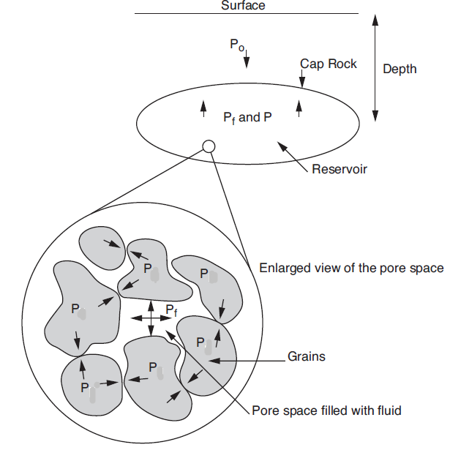
Overburden pressure
Within the pores, fluid pressure acts on the surface of the grains and reduces the grain-to-grain (or compacting) stress. Therefore in a real reservoir there is a balance between the effect of the overburden pressure and the pore pressure. This can be described by the relationship:
m
Pov = Pm + Pf
Where,
Pf = Fluids column pressure
Pm = Matrix or Grain column pressure
Overburden pressure: The total pressure at any reservoir depth, due to the weight of overlying fluid saturated rock column.
A typical value of Pov/dZ is approximately 1 psi/ft
m
m
m
m
m
Note: Psi= Ib/in2 (field unit)
Psia= absolute pressure Psig= Gauge pressure

Slide 19
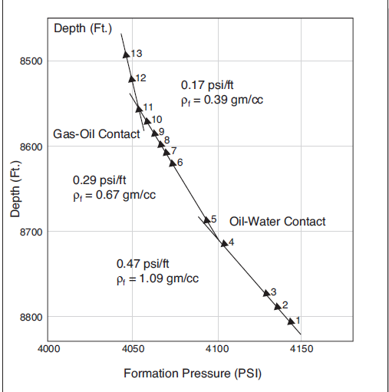
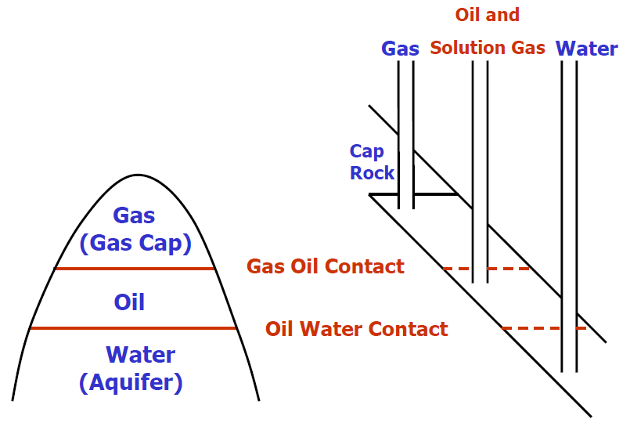
Reservoir pressure, Pf

Slide 20
Rock compressibility
Types of compressibilities
1- Matrix compressibility: relative change in volume of rock
material (grain volume) per unit pressure change (usually Cm ≅ 0
2- Bulk compressibility: relative change in bulk volume per unit pressure change ( usually ΔVb ≅ ΔVp)
3- Pore volume compressibility: relative change in pore volume
per unit pressure change
$c_{m}=−\frac{1}{V_{m}} \frac{∆V_{m}}{∆p}$
$$c_{b}=−\frac{1}{V_{b}} \frac{∆V_{b}}{∆p}$$
$$c_{p}=−\frac{1}{V_{p}} \frac{∆V_{p}}{∆p}$$
$$C_{b}=\left(1−∅\right)C_{m}+∅C_{p}$$
For most petroleum reservoirs
The bulk and matrix compressibility are considered small compared to formation compressibility
Therefore, the pore compressibility is used to describe the total compressibility of the formation
The value of formation compressibility ranges from 3x10-6 to 6x10-6 psi -1
$$c_{f}= c_{p}=\frac{1}{V_{p}} \frac{∆V_{p}}{∆p}$$
$∆Vp=C_{f}V_{p}$ $∆$p

Slide 21
Rock compressibility
It should be pointed out that the total reservoir compressibility ct is extensively used in the transient flow equation and the material balance equation as defined by the following expression
Ct = SoCo + SwCw + SgCg + Cf
Where:
So, Sw, Sg = oil, water, and gas saturation
Co = oil compressibility, psi−1
Cw = water compressibility, psi−1
Cg = gas compressibility, psi−1
Ct = total reservoir compressibility

Slide 22
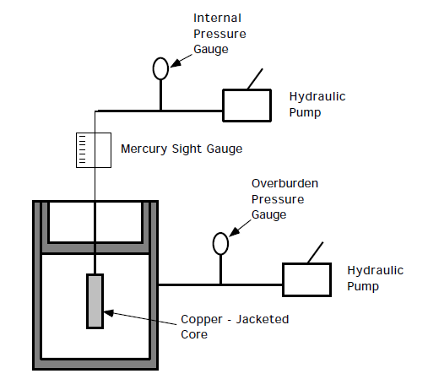
Lab. Measurement of compressibility
In reservoirs, overburden pressure is constant and the pressure of fluid in pores changes, resulting in pore volume change
In Lab, we change the confining pressure on the core plug (overburden) while holding the pore pressure constant
Measurement procedure
Core plug is 100% saturated with brine
Core plug is placed in rubber or soft copper
sleeve
As pressure outside sleeve is increased,
pore volume decreases and the volume of
expelled brine is measured

Slide 23
Reservoir Rock Properties
Saturation
Outline
Saturation
Types of saturation
Average saturation

Slide 24
Saturation
Saturation, S: fraction of the pore volume occupied by a particular fluid (oil, gas, or water)
$$Fluid saturation=\frac{Fluid volume}{Pore volume}$$
Three types of fluids are presents in the pore; oil, gas and water
Water
Vp =Vo +Vg+Vw
Water saturation, Sw: Fraction of the pore volume occupied by water
$$Sw=\frac{V_{w}}{V_{p}}$$
oil saturation, So: Fraction of the pore volume occupied by oil
$$So=\frac{V_{o}}{V_{p}}$$
Grain
Oil
Gas saturation, Sg: Fraction of the pore volume occupied by gas
$$Sg=\frac{V_{g}}{V_{p}}$$
24

Slide 25
Saturation
Saturation of each phase ranges from zero to 1 (100%)
Summation of the saturations is 100%
So + Sg + Sw=100% or 1
For an undersaturated reservoir: Hydrocarbon saturation (So) = 1- Sw Sg=0
For a reservoir with a gas cap: Hydrocarbon saturation (So + Sg) = 1- Sw
For the fluid to flow, the saturation of the fluid must exceed a certain value which is termed critical oil saturation
Critical Water saturation, Swi or Swc
Critical oil saturation, Soc
Critical gas saturation, Sgc
Residual oil saturation, Sor
During the displacing process of the crude oil system from the porous media by water or gas injection there will be some remaining oil left that is quantitatively characterized by a saturation value that is larger than the critical oil saturation
Movable oil saturation, Som
Movable oil saturation Som is another saturation of interest and is defined as the fraction of pore volume occupied by movable oil as expressed by the following equation:
Som = 1 - Swc - Soc

Slide 26
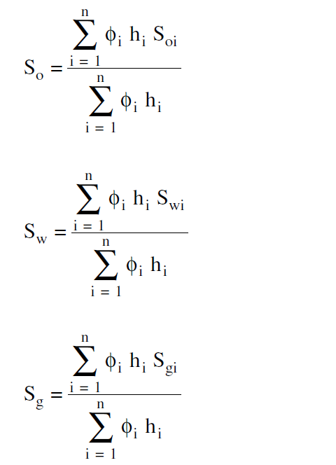
Average Saturation
Proper averaging of saturation data requires that the saturation values be weighted by both the interval thickness hi and interval porosity ɸ. The average saturation of each reservoir fluid is calculated from the following
equations:

