Slide 1
COLLAGE OF DENTISTRY
الفرع العلمي : امراض وجراحة اللثة
Periodonticsالمادة:
Classification of periodontitis المحاضرة:
11 رقم المحاضرة:
اسم تدريسي المادة: د. حسام سامي إسماعيل

Slide 2
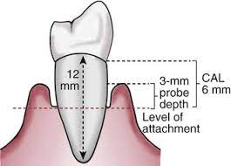

Slide 3
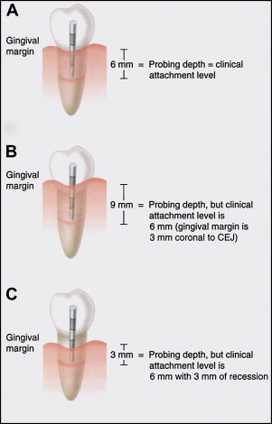

Slide 4
Periodontitis :
is a chronic multifactorial inflammatory disease associated with dysbiotic dental plaque biofilms.
Periodontitis is characterized by progressive destruction of the tooth-supporting apparatus. Its primary features include the loss of periodontal tissue support manifest through clinical attachment loss (CAL) and radiographically assessed alveolar bone loss, presence of periodontal pocketing and gingival bleeding
Recently, based on pathophysiology, three different forms of periodontitis have been identified according to a new classification system proposed by the American Academy of Periodontology (AAP) and the European Federation of Periodontology (EFP) in 2017:
1. Periodontitis.
2. Periodontitis as a direct manifestation of systemic diseases
3. Necrotizing periodontitis

Slide 5
Periodontitis:
was classified according to different form of staging and grading. Staging relies on the standard dimensions of severity and extent of periodontitis at presentation. Periodontitis groups are defined as (Tonetti et al., 2018):
Interdental CAL is detectable at ≥2 non-adjacent teeth, or
(2) Buccal or lingual CAL ≥3 mm
(3) pocketing >3mm is detectable at ≥ 2teeth
The extent
The extent and distribution for each stage described as molar/ incisor pattern or localized if the involved sites < 30% or generalized if the involved site ≥30%

Slide 6
Staging:
Stage I periodontitis: is the borderline between gingivitis and periodontitis and represents the early stages of attachment loss, the severity of this stage associated with clinical attachment loss about 1-2mm and radiographic bone loss less than 15% in the coronal third.
Stage II periodontitis: represents established periodontitis. The severity of this stage associated with clinical attachment loss about 3-4mm and radiographic bone loss more than 15% and less than 33%in the coronal third.
Stage III periodontitis: This stage associated with clinical attachment loss ≥5mm and radiographic bone loss extending to the middle third of the roots.
Advanced stage IV periodontitis: This stage is characterized by the presence of deep periodontal lesions that extend to the apical portion of the root. This stage associated with clinical attachment loss ≥5mm and radiographic bone loss extending to apical third of the roots.

Slide 7
Grading
Irrespective of the stage at diagnosis, periodontitis may progress with different rates in individuals, may respond less predictably to treatment in some patients, and may or may not influence general health or systemic disease.
Grading or rate of progression is assigned by dividing the maximum amount of radiographic bone loss in percentage terms on the patient’s age in years
Grade A periodontitis: if the result was less than 0.5 so the grade is A (for example, bone loss 25% in a 60-year-old or less than 30% in an 80-year-old)
Grade C periodontitis: if the result was more than 1 (for example, bone loss more than 30% in a 28-year-old or more than 50% in a 49-year-old)
Grade B periodontitis: all other situations (the result between 0.5-1)

Slide 8
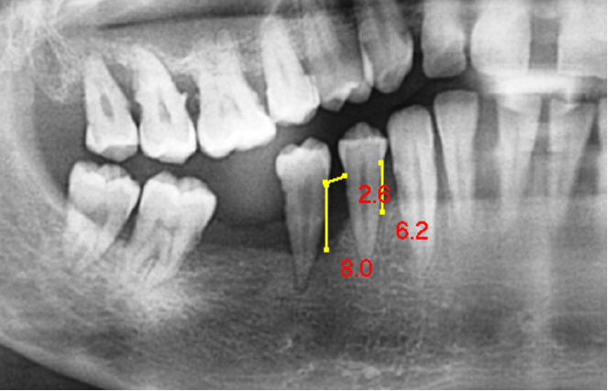

Slide 9
Important note :
clinically the radiographic bone loss in percentage can be calculated (in case there is no radiograph) if we have clinical attachment loss by measuring (recession ₊ pocket depth) using the worse tooth with the interproximal recession, adding the biological width (~2 mm) to give an estimate of the distance that the bone crest is from the CEJ, If an average root length assumed 15 mm, the percentage of bone loss calculated by using the following formula. Percentage of bone loss = (clinical attachment loss +2)*100/ root length by doubling the length of the clinical crown, the result can be used to estimate percentage bone loss for grading. $bone loss \%=\frac{CAL+2}{total length of root}×100$

Slide 10
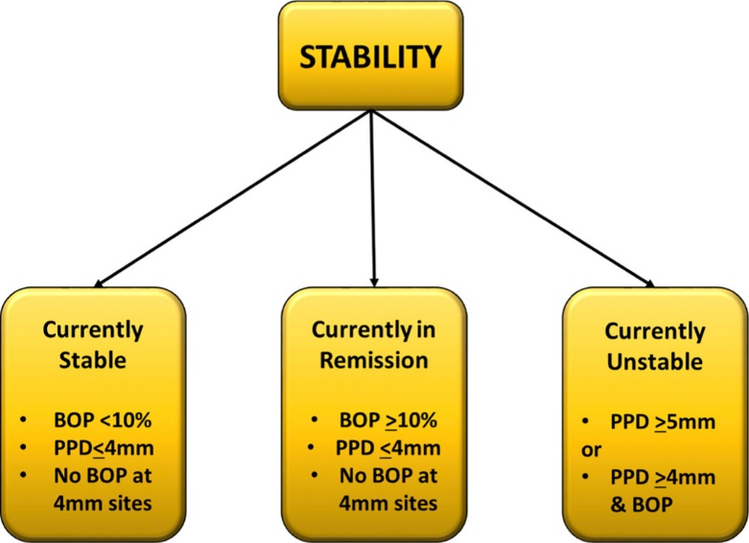
Status of periodontitis

Slide 11
Risk factors:
Diabetes mellitus
Smoking
Family history
So the final diagnostic statement for periodontitis should include the following terms:
Extent, Periodontitis , Stage, Grade, Status, Risk factor

Slide 12
II. Periodontitis as a manifestation of systemic diseases
A variety of systemic diseases and conditions can affect the course of periodontitis or have a negative impact on the periodontal attachment apparatus.
Systemic disorders that have a major impact on the loss of periodontal tissues by influencing periodontal inflammation
I. Genetic disorders:
Diseases associated with immunologic disorders: like Down syndrome, Leukocyte adhesion deficiency syndromes, Papillon‐Lefèvre syndrome
b. Diseases affecting the oral mucosa and gingival tissue: like Plasminogen deficiency
c. Diseases affecting the connective tissues: Ehlers‐Danlos syndromes (types IV, VIII)
d. Metabolic and endocrine disorders: like Glycogen storage disease and Hypophosphatasia
II. Acquired immunodeficiency diseases: including Acquired neutropenia and HIV infection
III. Inflammatory diseases: Inflammatory bowel disease

Slide 13
2. Other systemic disorders that influence the pathogenesis of periodontal diseases
Diabetes mellitus , Obesity ,Osteoporosis ,Arthritis (rheumatoid arthritis, osteoarthritis), Emotional stress and depression , Smoking (nicotine dependence)
3. Systemic disorders that can result in loss of periodontal tissues independent of periodontitis
Neoplasms: -Primary neoplastic diseases of the periodontal tissues like Oral squamous cell carcinoma
-Secondary metastatic neoplasms of the periodontal tissues
b. Other disorders that may affect the periodontal tissues
like Langerhans cell histiocytosis, Giant cell granulomas - Hyperparathyroidism

Slide 14
III. Necrotizing periodontal diseases:
A. Necrotizing ulcerative gingivitis
B. Necrotizing ulcerative periodontitis
C. Necrotizing stomatitis
Necrotizing ulcerative gingivitis:
This is an infection characterized by gingival necrosis presenting as 'punched-out' papillae, with gingival bleeding, and pain. Fetid breath and pseudomembrane formation may be secondary diagnostic features. Fusiform bacteria, prevotella intermedia, and spirochetes have been associated with gingival lesions. Predisposing factors may include: emotional stress, poor diet, cigarette smoking, and HIV infection.`

Slide 15
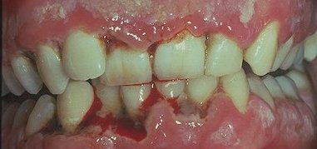
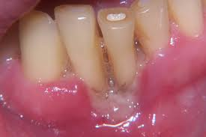

Slide 16
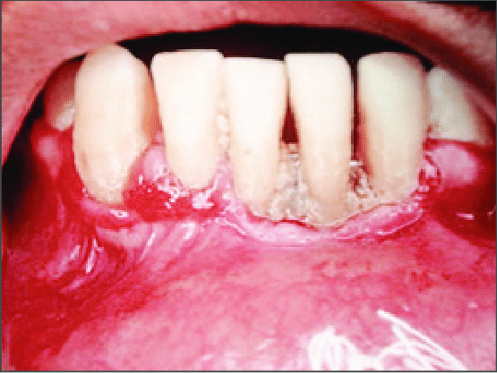
Necrotizing ulcerative periodontitis:
This is an infection characterized by necrosis of gingival tissues, periodontal ligament, and alveolar bone. These lesions are most commonly observed in individual with systemic conditions including HIV infection, severe malnutrition, and immunosuppression

Slide 17
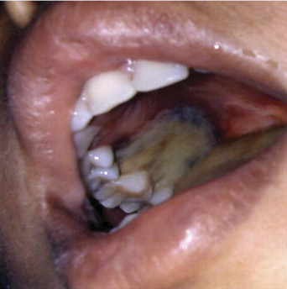
Necrotizing stomatitis
is a very severe and aggressive form of necrotizing periodontal disease showing extensive oral cavity tissue and bone destruction. In necrotizing stomatitis, after the oral mucosal membranes are destroyed, the entire mouth is involved due to spread of deep infection.

Slide 18
Other condition affecting the periodontium:
PERIODONTAL ABSCESSES (PA)
Clinical presentation: Different etiological factors may explain the occurrence of abscesses in the periodontal tissues, such as pulp necrosis (endodontic, periapical or dentoalveolar abscesses), periodontal infections (gingival or periodontal abscess ), pericoronitis (pericoronal abscess), trauma, surgery, or foreign body impaction. Together, they are referred to as odontogenic or dental abscesses, and when they are associated with endo perio lession, they could also be considered odontogenic abscesses. PA can specifically be defined as a localized accumulation of pus located within the gingival wall of the periodontal pocket, with an expressed periodontal breakdown occurring during a limited period of time, and with easily detectable clinical symptoms.

Slide 19
Periodontal abscess in periodontitis patients:
In periodontitis patients, a PA could represent a period of disease exacerbation, favored by the existence of tortuous pockets, the presence of furcation involvement or a vertical defect, in which the marginal closure of the pocket could lead to an extension of the infection into the surrounding periodontal tissues. In addition, changes in the composition of the subgingival microbiota, with an increase in bacterial virulence, or a decrease in the host defense, could also result in an inefficient capacity to drain the increased suppuration

Slide 20
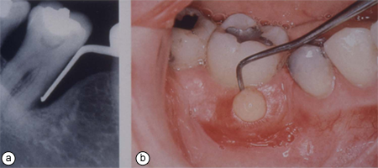

Slide 21
Different subgroups could be distinguished:
Acute exacerbation:
○ In untreated periodontitis.
○ In “refractory” periodontitis.
○ during maintenance phase after periodontal therapy.
b. After different treatments:
○ Scaling and root planing or professional prophylaxis: dislodged calculus fragments could be pushed into the tissues, or inadequate scaling could allow calculus to remain in deep pocket areas, whereas the coronal part would occlude the normal drainage.
○ Surgical periodontal therapy: associated with the presence of foreign bodies such as membranes for regeneration or sutures.
○ Systemic antimicrobial intake, without subgingival debridement, in patients with severe periodontitis could also cause abscess formation, probably related to an overgrowth of opportunistic bacteria.
○ Use of other drugs: e.g., nifedipine.

Slide 22
Periodontal abscess in non‐ periodontitis patients
PA can also occur in previously healthy sites, because of :
• Impaction of foreign bodies: dental floss, orthodontic elastic, toothpick, rubber dam, or popcorn hulls.
• Harmful habits (biting wire, nail biting, clenching) could favor abscess formation because of subgingival impaction of foreign bodies or to coronal closure of the pocket
• Orthodontic factors, such as inadequate orthodontic forces or a cross‐bite, have been reported to favor PA development.
• Gingival enlargement.
• Alterations of the root surface, including:
Severe anatomic alterations, such as invaginated tooth, dens evaginatus (grooves) or odontodysplasia.
Minor anatomic alterations, such as cemental tears, enamel pearls or developmental grooves.
Iatrogenic conditions, such as perforations.
Severe root damage: vertical root fracture or cracked tooth syndrome extending through the root.
External root resorption.

Slide 23
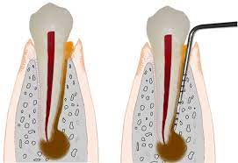
2. ENDO‐PERIODONTAL LESIONS (EPL)
Clinical presentation

Slide 24
Etiology and risk factors
The primary etiology an established EPL is always associated with varying degrees of microbial contamination of the dental pulp and the supporting periodontal tissues. Nonetheless, the primary etiology of these lesions might be associated with
A. endodontic and/or periodontal infections ,they might be triggered:
by a carious lesion that affects the pulp and, secondarily, affects the periodontium
periodontal destruction that secondarily affects the root canal;
(3) or by both events concomitantly. The latter type occurs less frequently and is usually referred to as a “true‐combined” or “combined” lesion. These lesions may develop in subjects with periodontal health or disease.

Slide 25
B) Trauma and/or iatrogenic factors.
These conditions usually have a poor prognosis as they affect the tooth structure. The most common lesions in this category were:
(1) root/pulp chamber/furcation perforation (e.g. because of root canal instrumentation or to tooth preparation for post retained restorations
(2) external root resorption (e.g., because of trauma)
(3) pulp necrosis (e.g., because of trauma) draining through the periodontium
The periodontal condition has an important impact in the prognosis of the EPL because of the striking changes in the oral ecology of subjects with periodontal diseases. Converting this ecology back into a healthy state is challenging, especially in patients with severe periodontitis and in teeth with deep pockets

Slide 26
Mucogingival deformities or conditions around teeth:
gingival biotype
Thin scalloped b. Thick scalloped c. Thick flat
2. Gingival/soft tissue recession
Facial or lingual surfaces b. Interproximal (papillary) c. Severity of recession d. Gingival thickness e. Gingival width
3. Lack of keratinized gingiva
4. Decreased vestibular depth
5. Aberrant frenum/muscle position
6. Gingival excess
Pseudopocket b. Inconsistent gingival margin c. Excessive gingival display d. Gingival enlargement
7. Abnormal color

Slide 27
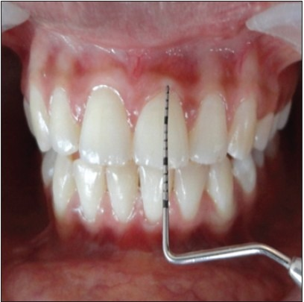
Gingival biotype, which includes in its definition gingival thickness (GT) and keratinized tissue width (KTW);. A recent systematic review using the parameters reported previously, classified the “biotypes” in three categories:
• Thin scalloped biotype in which there is a greater association with slender triangular crown, subtle cervical convexity, interproximal contacts close to the incisal edge and a narrow zone of KT, clear thin delicate gingiva, and a relatively thin alveolar bone.

Slide 28
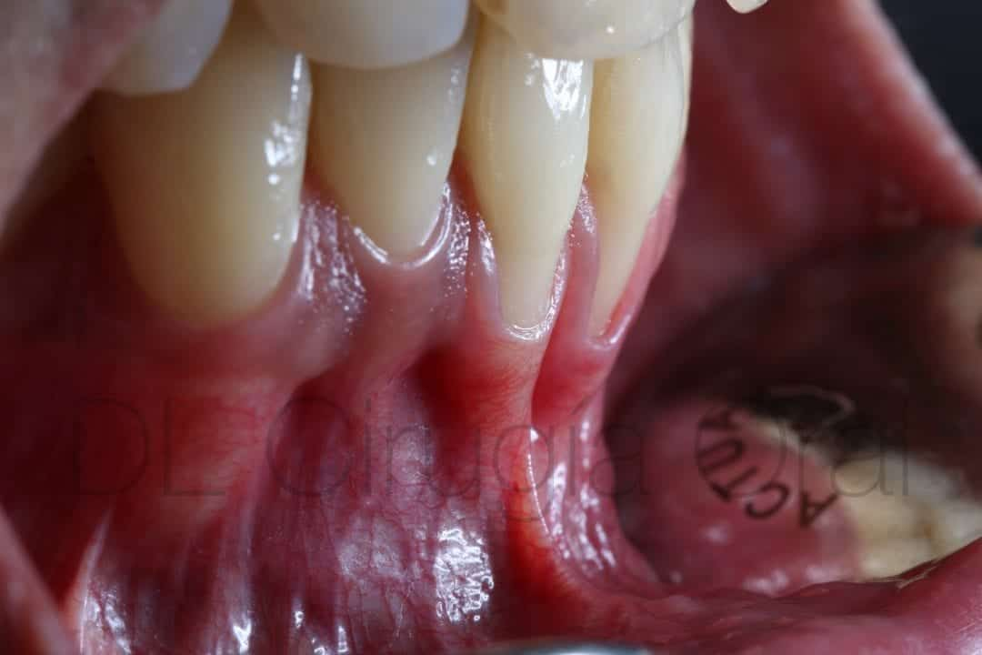

Slide 29
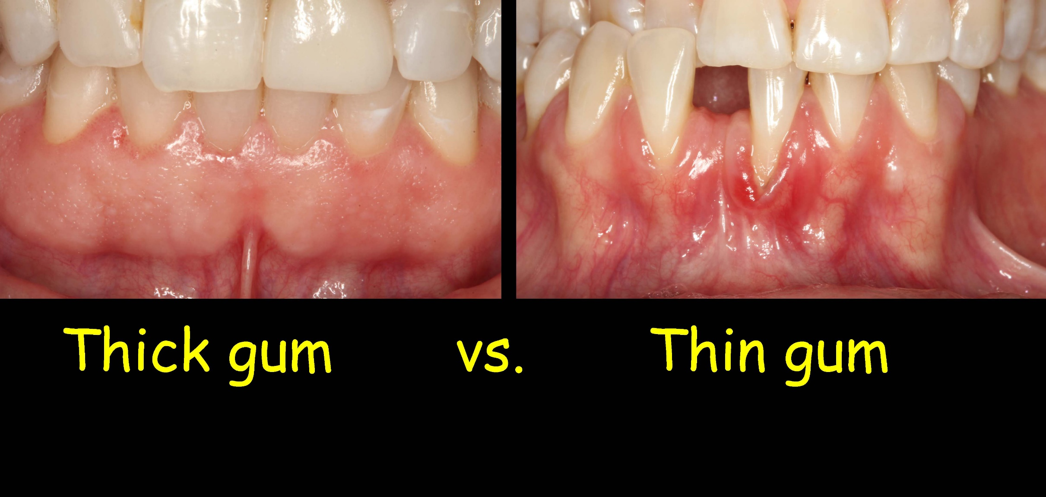
• Thick flat biotype showing more square‐shaped tooth crowns, pronounced cervical convexity, large interproximal contact located more apically, a broad zone of KT, thick, fibrotic gingiva, and a comparatively thick alveolar bone.

Slide 30
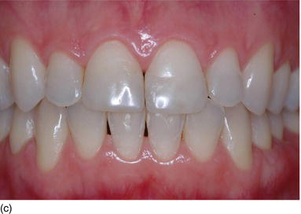
Thick scalloped biotype
showing a thick fibrotic gingiva, slender teeth, narrow zone of KT, and a pronounced gingival scalloping.

Slide 31
Gingival recession: Is location of the gingival margin apical to the cemento-enamel junction.
The causes of gingival recession:
• Plaque accumulation will cause destruction of the junctional epithelia as a result of the inflammatory process.
• Traumatic gingival recession:
Fault tooth brushing
Tooth malposition
High frenal attachment
Overhanging fillings
Prosthetic appliances
Habits as nail biting.

Slide 32
Tooth and prosthetic related factors :
A. Localized tooth‐related factors that modify or predispose to plaque‐induced gingival diseases/periodontitis
Tooth anatomic factors
Root fractures
Cervical root resorption, cemental tears
Root proximity
Altered passive eruption
B. Localized dental prosthesis‐related factors
Restoration margins placed within the supracrestal attached tissues
Clinical procedures related to the fabrication of indirect restorations
Hypersensitivity/toxicity reactions to dental materials

Slide 33
Traumatic occlusal force
Primary occlusal trauma
Secondary occlusal trauma
Orthodontic force
Occlusal trauma: Injury resulting in tissue changes within the attachment apparatus as a result of occlusal force(s).
Primary occlusal trauma: Injury resulting in tissue changes from traumatic occlusal forces applied to tooth or teeth with normal support. It occurs in the presence of:
Normal bone levels,
Normal attachment levels, and
Excessive occlusal force(s).
Secondary occlusal trauma: Injury resulting in tissue changes from normal or traumatic occlusal forces applied to a tooth or teeth with reduced support. It occurs in the presence of: 1) Bone loss, 2) Attachment loss, And 3) "Normal"/excessive occlusal force(s).

Slide 34
Peri-implant diseases and conditions:
Peri-implant health
In health, the peri-implant site is characterized by the absence of erythema, bleeding on probing, swelling and suppuration
2. Peri-implant mucositis: the diagnosis of peri-implant mucositis requires: Visual inspection demonstrating the presence of peri-implant signs of inflammation: red as opposed to pink, swollen tissues as opposed to no swelling. Presence of profuse bleeding and/or suppuration on probing, an increase in probing depths compared to baseline; and absence of bone loss beyond crestal bone level changes resulting from the initial remodeling.

Slide 35
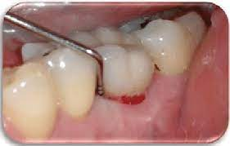
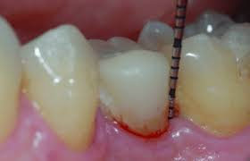

Slide 36
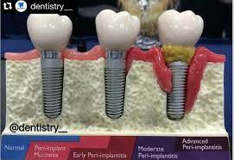
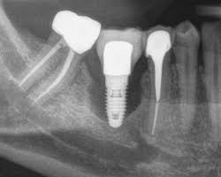
3. Peri-implantitis:
the diagnosis of peri-implantitis will involve radiographic bone loss associated with gingival recession or increased probing depth in addition to signs associated with peri-implant mucositis

Slide 37
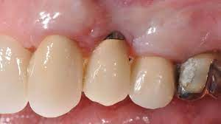
4 .Peri implant soft tissues and hard tissues deficiency

Slide 38
Thank You

