Slide 1
PERMEABILITY

Slide 2
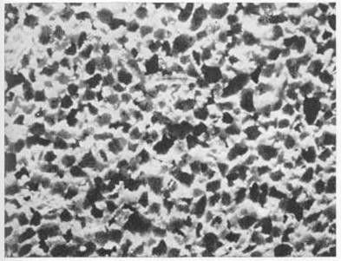
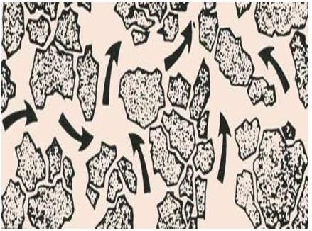
Permeability
Permeability is a property of the porous medium that measures the ability of the formation to transmit fluids. It’s the measure of the ease with which the rock will permit the passage of fluids. This depends on how well the pore spaces within that rock are interconnected.
The rock permeability, k, is a very important rock property because it controls the directional movement and the flow rate of the reservoir fluids in the formation
Unlike porosity, permeability cannot be defined apart from fluid flow. For a rock to be Permeable, it must contain inter- connected pores
Permeability is an INTENSIVE property of a porous medium
(e.g. reservoir rock)
Reservoir permeability is usually quoted in millidarcies, (md).

Slide 3
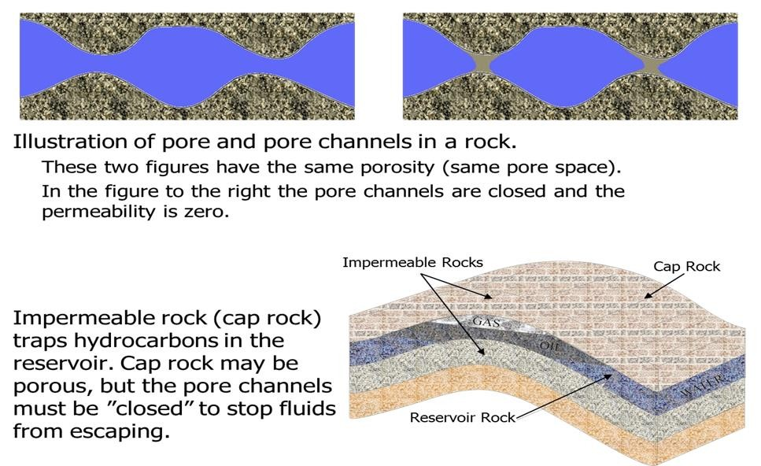

Slide 4
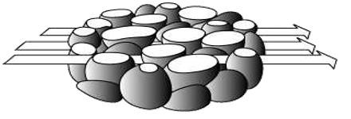
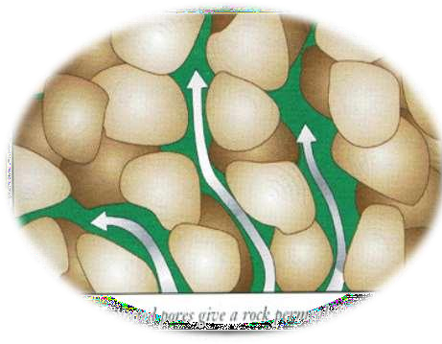
Permeability Classification
Three types of permeability
Absolute permeability - the permeability of a porous medium with only one fluid present (single-phase flow).
When two or more fluids are present permeability of the rock to a flowing fluid is called effective permeability (ko, kg, kw). [i.e. Effective permeability is the permeability of a flowing phase which does not saturate 100% of the rock]
Relative permeability is the ratio of absolute and effective
permeabilities kro=ko/k, krg=kg/k, krw=kw/k. Note: The effective permeability is always less than the
absolute value of k for the rock.

Slide 5
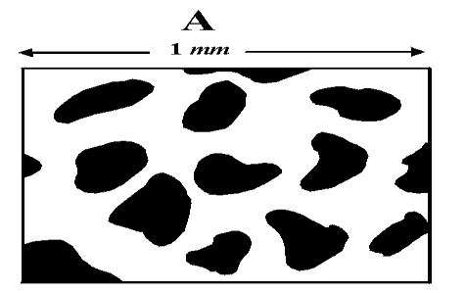
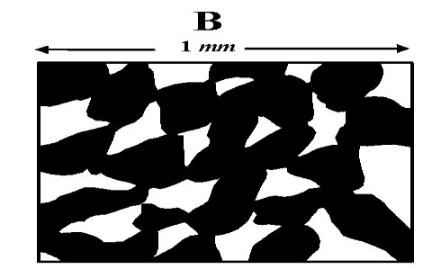
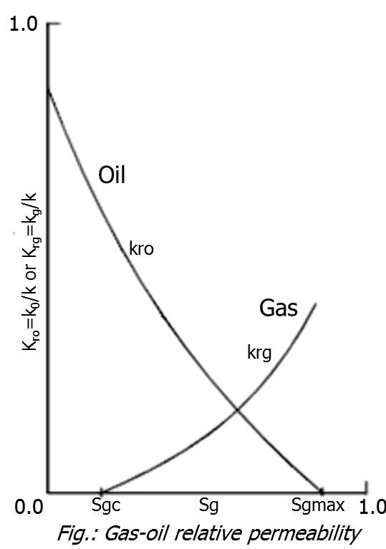
Permeability Scale
Generally the permeability is termed as :
Poor if; k<1,
Fair if; 1<k<10,
Moderate if; 10<k<50,
Good if; 50<k<250,
Very good if; k>250.
Good Permeability
Poor Permeability
Note: This scale changes with time, for example 30
years ago k< 50 was considered poor.
Note:
If a single fluid is present in a rock, its relative
permeability is 1.
The relative permeability of a fluid is a function
of its saturation.

Slide 6
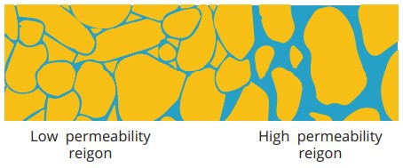
Permeability
The factors affecting the magnitude of Permeability are:
Shape and size of grain sizes (pore system),
Cementation
Sorting
Lithology or rock type
fracturing and Dissolution
The Source of Permeability is determined by:
Core analysis
Well test analysis (flow testing)
RFT (repeat formation tester) provides small
well tests
Production data
production logging measures fluid flow into
well
Log data
MRI (magnetic resonance imaging) logs calibrated via core analysis

Slide 7
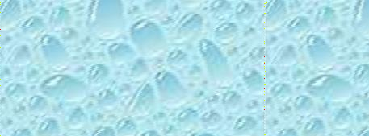
Darcy’s law helps us to measure the degree of permeability.
Assumptions Used in Darcy Equation:
Steady state flow, under laminar
regime i.e. Q_{in} = Q_{out}
Viscous flow - rate of flow
directly proportional to pressure
gradient
The flowing fluid is
incompressible.
Porous media 100% saturated
with fluid which flowed
Fluid and porous media not reacting(i.e. no chemical exchange or reactions between them)
𝐾 𝐴 𝑑𝑃
𝑄 = −
𝜇 𝑑𝐿
QQ == ^{KK AA} (( pp
−− pp ))
μL
11
22
Darcy’s “K” was determined to be a combination of
k, permeability of the sand pack (porous medium, e.g. reservoir rock), Darcy.
A = cross sectional area [cm²] µ = viscosity of the liquid [cp] Q = volumetric flow [cm³/s]
dp/dL, Pressure gradient (atm/cm)
◦
◦
◦
◦
Note that P1>P2

Slide 8
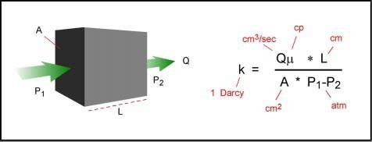
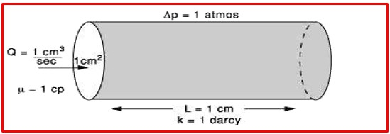
What is Darcy ?
A practical definition of a Darcy is as follows;
A porous medium has a permeability of one Darcy, when a single-phase fluid of one centipoises viscosity (1 cp ) , that completely fills the voids of the medium will flow through it at a rate of one cubic centimeter cross sectional area (1 cc/sec/cm2 ), and under a pressure or equivalent hydraulic gradient of one atmosphere per centimeter (1 atm/cm ).

Slide 9
Units of Permeability
Two sets of units are generally used in reservoir engineering: Darcy units and Oil-field units
For the purpose of the mathematical derivations, a system of units commonly referred to as
Darcy units are used. These units are:
K = Darcy; g = cm/sec²; dp/ds = atm/cm
For application to field data of the various mathematical expressions, the second system of
units called the practical oil-field units are used.
From dimensional analysis, the dimension for K is [L]². We could use ft², ins², or cm² for
measure of permeability, but these units are all too large to be applied in porous media.
So Darcy unit is used and recommended ,but in many cases the millidarcy (mD) are used.
1 Darcy = 1000 miliDarcy
1 Darcy = 0.987 x 10⁻¹²
_{m}2
Required :
prove k = L²
permeability conversion factor
1 Darcy = 1.062 x 10⁻¹¹ ft²
1 miliDarcy ~ 10⁻⁹ mm²

Slide 10
Common Oil Field Units
Quantity | Symbol | Dimension | Oilfield Units | SI Units
Mass | m | m | Ibm | Kg
Moles | n | n | Ibmol | Kmol
Force | F | ML/ ² t | Ibf | N
Length | L | L | ft | m
Area | A | _{L}2 | acres | _{m}2
Volume-liquids | v | _{L}3 | bbl | _{m}3
Volume-gases | v | _{L}3 | ft³ | _{m}3
Pressure | p | m/L ² t | psi | kPa
Temperature | T | T | R | K
Flow rate-liquids | q | L³/t | bbl/d | m³/d
Flow rate -gases | q | L³/t | Ft³/d | m³/d
Viscosity | μ | m/Lt | cP | mpa.s
Permeability | k | _{L}2 | md | _{m}2

Slide 11
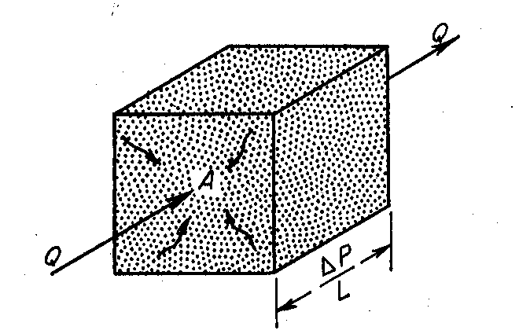
Linear Flow System
Darcy’s Law for one dimensional linear horizontal flow (incompressible fluid) Field Units
Darcy’s Law for one dimensional linear horizontal flow (compressible fluid) Field Units
kA Δp
q = −1.127x10⁻³
μB_{o} Δl
k = absolute permeability, Darcys
μg = gas viscosity, cp
T = temperature, ̊R
Z = gas compressional factor.
p1 = inlet (upstream) pressure, psia
p2 = outlet (downstream) pressure, psia
L = length of the core, ft
A = cross-sectional area, ft²
Qgsc = gas flow rate at standard conditions,
q = production rate stb/d k = permeability mD
A = cross sectional area to flow ft²
^{Δp} = pressure gradient psi/ft
Δl
μ = fluid viscosity cp
B_{o} = oil formation volume factor rb/stb
Field units of permeability are Darcy, D and milliDarcy, mD
STB/day
11

Slide 12
Radial Flow System
2𝜋ℎ𝑘 (𝑃_{𝑒}
𝑄 =
− 𝑃_{𝑤} )
Fluid not compressed
Steady flow (stream mass was constant)
𝜇
ln( ^{𝑟𝑒} )
𝑟_{𝑤}
Where :
Q = flow rate, m³/sec
K = permeability,
_{m}2
r
e
h = thickness, m
r_{w}
P_{e} = pressure drainage radius, N/m²
P_{wf} = flowing pressure, N/m²
μ = fluid viscosity, N/m²
^{P}wf
P_{e}
re = drainage radius, m
r
r_{w} = the well-bore radius, m
In field unit the above equation becomes as:
h
7.08 ∗ 10⁻³ℎ𝑘 (𝑃_{𝑒}
− 𝑃_{𝑤})
𝑄 =
𝜇
ln( ^{𝑟𝑒} )
𝑟_{𝑤}

Slide 13
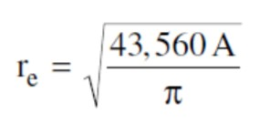
The External (Drainage) Radius
The external (drainage) radius re is usually determined from the well spacing by equating the area of the well spacing with that of a circle, i.e
Where A is the well spacing in acres.

Slide 14
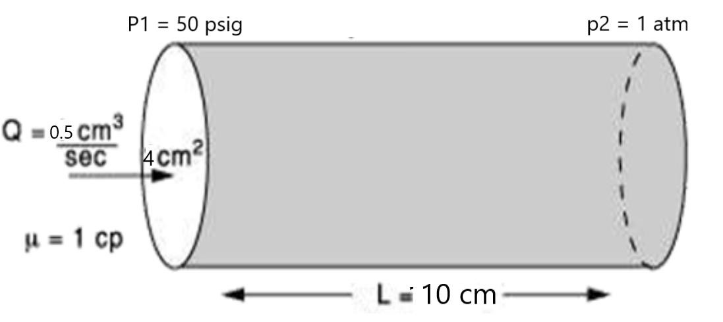
Examples
Example - 1:
Calculate the k of cylindrical core sample subjected to linear flow using water if
the following data are available :
𝜇_{𝑤} = 1 cp., core diameter = 4 cm, core length = 10 cm, flow rate = 0.5 cc/sec.,
p1 = 50 psig and p2 = 1 atm.
Solution:
𝐾 𝐴 𝑑𝑃
𝜇 𝑑𝐿
= 4.40
𝑄 = −
𝑃1 =
50+14.7
and 𝑃2 = 1
14.7
𝑄 𝜇 𝐿
𝐾 =
𝐴 𝑑𝑃
1 atm = 14.7 Psia Psia = Psig +14.7
K= 0.117 Darcy

Slide 15
Example – 2:
What is the flow rate of a horizontal rectangular system when the conditions are as follows:
permeability = k = 1 Darcy Area = A = 6 ft²
viscosity = μ= 1.0 cp length = L = 6 ft
inlet pressure = P1 = 5.0 atm.
outlet pressure = P2 = 2.0 atm
Solution:
We must insure all the variables are in the correct units.
k = 1 darcy ,
A = 6 ft² (144 in² /1 ft² ) (6.45 cm²/1 in² ) = 5572.8 cm² L = 6 ft (12 in/1 ft) (2.54 cm/1 in) = 182.88 cm
P1 = 5.0 atm and P2 = 2.0 atm
𝐾 𝐴
(𝑃2 − 𝑃1)
(1) (5572.8)
(2 − 5)
𝑄 = −
𝑄 = −
𝜇
𝐿
(182.88)
1
𝑄 = 91.42 𝑐𝑚³/𝑠𝑒𝑐

Slide 16
Horizontal Permeability
Permeability in the direction parallel to the bedding plane is of greatest interest in vertical
wells traversing perpendicular, horizontal hydrocarbon-bearing reservoirs
Vertical Permeability
Permeability in the direction perpendicular to the bedding plane controls flow caused by
gravitational forces. This is the permeability of interest in long, horizontal wells.

Slide 17
Averaging Permeability
It is necessary to determine an average value of permeability.
Three common types of computed averages are as follows:
Arithmetic average permeability(Weighted-average permeability)
Harmonic average permeability
ii) Geometric average permeability
Selection of the averaging technique should be based primarily on the
geometry of the flow system.

Slide 18
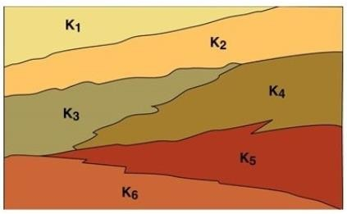
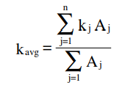
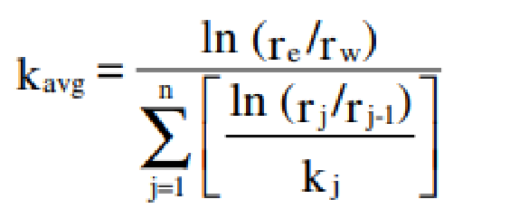
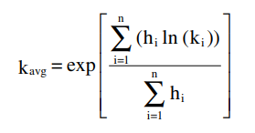
Parallel Flow
Series Flow
Random Flow
Arithmetic Average
Harmonic Average
Geometric Average
h₁
k₁
h₂
Q
k₁ k₂ k₃
h₃
Q
k
2
k₃
L₁ L₂ L₃
₌ ∑ ^{k}i ^{h}i
∑ ^{L}i
k
∑h_{i}
(All permeabilities must represent
layers of the same thickness)
A
k_{H} =
∑
L / k
i i
For variable layers width then the permeability calculated from the below eq.
For different thickness then the permeability calculated from the below eq.
Radial, Series Flow

