Slide 1
COLLAGE OF DENTISTRY
الفرع العلمي : امراض وجراحة اللثة
Periodonticsالمادة:
Risk Factors for periodontal disease المحاضرة:
12 رقم المحاضرة:
اسم تدريسي المادة: د. حسام سامي إسماعيل

Slide 2
Introduction
Risk: is the probability that an individual will develop a specific disease in a given period of time.
Risk factors: can be defined as characteristics or factors that when present increases the risk that an individual will get the disease.
It is important to make the distinction that risk factors are associated with a disease but do not necessarily cause the disease.
Systemic risk factors: may be modifiable or non-modifiable:
1. Modifiable risk factors: are usually environmental or behavioral in nature.
2. Non modifiable risk factors: are usually intrinsic to the individual and therefore not easily changed. They are also known as determinants.

Slide 3
Modifiable risk factors:
Tobacco Smoking :
Is a well-established risk factor for periodontitis, a direct relationship exists between smoking and the prevalence of periodontal disease.
Many studies comparing the response to periodontal therapy in smokers, previous smokers, and nonsmokers have shown that smoking has a negative impact on the response to therapy. However, former smokers respond similarly to nonsmokers.

Slide 4
Diabetes mellitus:
-Diabetes is a modifiable factor in the sense that though it cannot be cured, it can be controlled.
-Uncontrolled diabetes is associated with many problems as reduction in the defense mechanism (neutrophil dysfunction, Impairment of chemotaxis & phagocytosis), atherosclerosis & reduce normal gingival blood flow, increased susceptibility to infections including periodontitis & poor wound healing.
-The mechanism responsible for increasing the risk of sever periodontal destruction in uncontrolled diabetic patients unclear but it is likely to be related an increased susceptibility to infection, an impaired immune response, poor wound healing &increase collagenase activity.

Slide 5
Psychological factors :
Studies have demonstrated that individuals under psychological stress are more likely to develop clinical attachment loss and loss of alveolar bone.
One possible link in this regard may be:
increased glucocorticoid secretion that can depress immune function increased insulin resistance, increases in the production of IL-6 in response to increased psychological stress and potentially increased risk of periodontitis.
Another study suggests that host response to P. gingivalis infection may be compromised in psychologically stressed individuals
individuals under stress are less likely to perform regular good oral hygiene and prophylaxis.

Slide 6
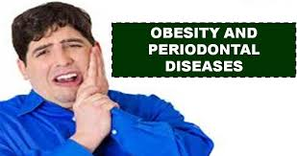
Obesity :
Obesity is one of the most significant health risks of modern society, and is now recognized as a major health concern in both developed and developing countries.
Conditions associated with obesity, e.g. ‘‘the metabolic syndrome’’, a clustering of dyslipidemia and insulin resistance may exacerbate periodontitis. Obesity has been postulated to reduce blood flow to the periodontal tissues & promoting the development of periodontal disease.
Furthermore, obesity may enhance immunological or inflammatory disorders, which might be the reason, also obese subjects tend to exhibit escalating poor periodontal status relative to non-obese individuals

Slide 7
Socioeconomic status (SES) :
Multitudes of disease conditions are associated with socioeconomic status, and cause/effect is plausible. Generally, those who are better educated, wealthier, and live in more desirable circumstances enjoy better health status than the less educated and poorer segments of society, periodontal diseases are not different and have been related to lower SES.
The ill effects of living in deprived circumstances can start early in life. Gingivitis and poor oral hygiene are clearly related to lower SES, this can be attributed to decreased dental awareness and decreased frequency of dental visits compared with more educated individuals of higher SES, but the relationship between periodontitis and SES is indirect.

Slide 8
Pregnancy, puberty:
Pregnancy associated gingivitis is an inflammation of the gingival tissues associated with pregnancy . This condition is accompanied by increase in steroid hormones in crevicular fluid & increase in levels of ( Prevotella intermedia microorganism ) which use the steroids as growth factors . The increase in sex hormones may exaggerate the inflammatory response to dental plaque which means small amount of plaque may lead to gingivitis.
Puberty is also accompanied by an exaggerated response of the gingiva to local irritation. As adulthood is approached, the severity of the gingival inflammation diminishes even when local factors persist.

Slide 9
Medications :
In general the overgrowth of the gingiva start as painless enlargement of the interdental papilla & extend to the marginal gingiva , then as the condition progresses, the marginal & papillary enlargements unite together & may cover the clinical crown & may interfere with the occlusion.
The first drug induced gingival enlargement is Phenytoin (Dilantin Na) :(50-65%) of patients receiving the drug.
The other drug is (Cyclosporine A) which is immunosuppressive agent used to prevent organ transplant rejection, the enlargement occurs in 30% of patients receiving this drug.
Ca-channel blockers also are drug used for treatment of cardio-vascular conditions such as hypertension & angina pectoris, some of these drugs can induce gingival enlargement such as (Nifedipine) which is one of the most commonly used drug that induced the enlargement in about 20% of the patients.

Slide 10
Non-modifiable risk factors :
- Hematological Disorders :
Hemorrhagic gingival overgrowth with or without necrosis is a common early manifestation of acute leukemia. Patients with chronic leukemia may experience similar but less severe periodontal changes. Chemotherapy or therapy associated with bone marrow transplantation may also adversely affect the gingival health.
- Genetic factors :
There is evidence that genetic differences between individuals may explain why some patients develop periodontal disease & other do not. Genetic factors may play an important role in determining the nature of the host response & may affect the function of phagocytic immune cells or the structure of the epithelia or connective tissue. One of these diseases is Papillon - Lefevre syndrome which is a rare hereditary disease characterized by hyperkeratotic skin lesion in the palms, soles , knees & elbows and sever destruction to the periodontium with early loss of primary & permanent teeth . Many studies have been done to demonstrate that periodontal disease was linked to genetics and they found the following:
1- A specific inteukin-1 (IL-1) genotype has been associated with severe periodontitis.
2. Neutrophil abnormalities are under genetic control.
3. Genetics play a role in regulating the titer of protective IgG2 antibody response to A. actinomycetemcomitans in patients with severe periodontitis.

Slide 11
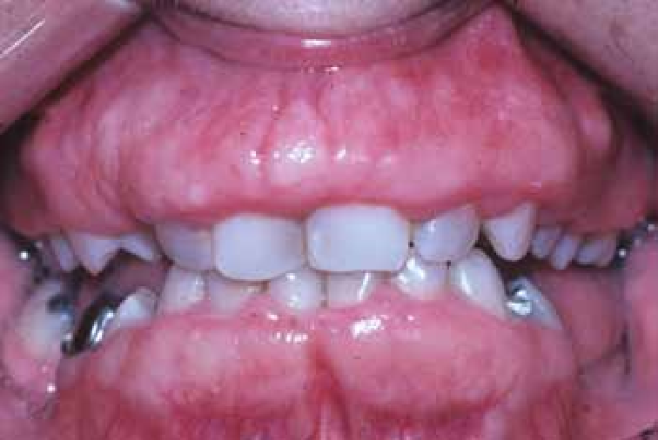
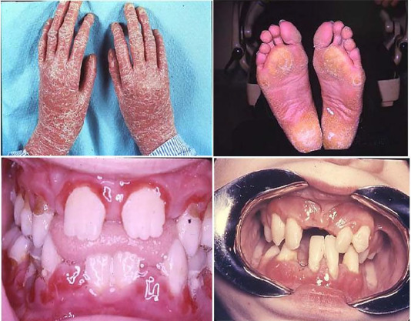
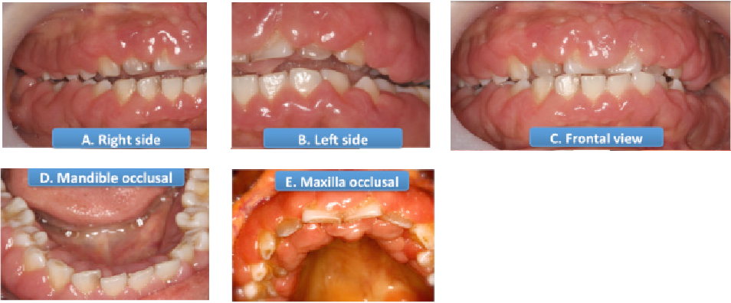

Slide 12
- Aging
With aging a number of changes take place in the periodontal tissues as the following:
Arteriosclerosis (reduction in arterial blood supply).
The gingiva become more fibrotic &less keratinized.
The periodontal fiber bundles become thicker with decrease in cellularity.
Osteoporosis of alveolar bone.

Slide 13
Epidemiological studies had shown that the prevalence & severity of periodontal disease increase with age & a high incidence of periodontal disease was found after the age of 40 years . Age by itself has no influence on the periodontal tissues, but the older the age , the longer the time interval & the more the chance of periodontal tissues to be exposed to factor (accumulative effect of age) , also there is declined host defense mechanism & high incidence of systemic diseases & drug intake which may adversely affect the periodontal health.
It has been demonstrated that the mean annual rate of bone loss among the initially 70 years old subjects was 0.28 mm compared to 0.07 on the 25 years old individual.

Slide 14
-Gender :
Numerous studies reported higher periodontal destruction among males compared to the female population .The reasons for these sex differences are not clear, but they are thought to be related to the ignorance of oral hygiene, which is usually observed among males. However, the relationship observed between sex and the disease is not apparent and is not considered as strong and consistent.

Slide 15
-Ethnicity :
The level of attachment loss is also influenced by race/ethnicity, although the exact role of this factor is not fully understood. Certain racial/ethnic groups, particularly subjects of African and Latin American background, have a higher risk of developing periodontal tissue loss than other groups.

Slide 16
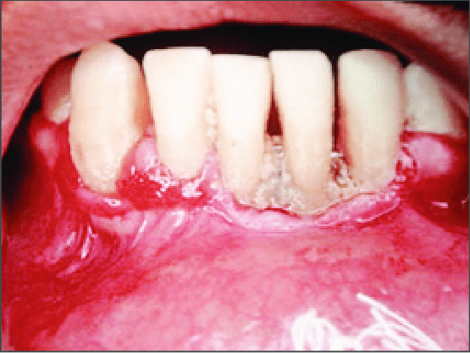
-Human Immunodeficiency Virus (HIV) /Aquired Immunodeficiency Syndrome (AIDS):
. Those patients often had severe periodontal destruction characterized by necrotizing ulcerative periodontitis .

Slide 17
-Osteoporosis :
Many of the studies conducted to date suggest that there is a relationship between skeletal osteoporosis and bone loss to the extent that postmenopausal osteoporosis may result in dental osteopenia involving the jaws, and particularly the mandible. Osteoporosis was significantly associated with severe alveolar crestal bone loss and the prevalence of periodontitis cases in postmenopausal women. During menopause, estrogen deficiency will reduce bone mineral density, some women may develop menopausal gingivostomatitis.

Slide 18
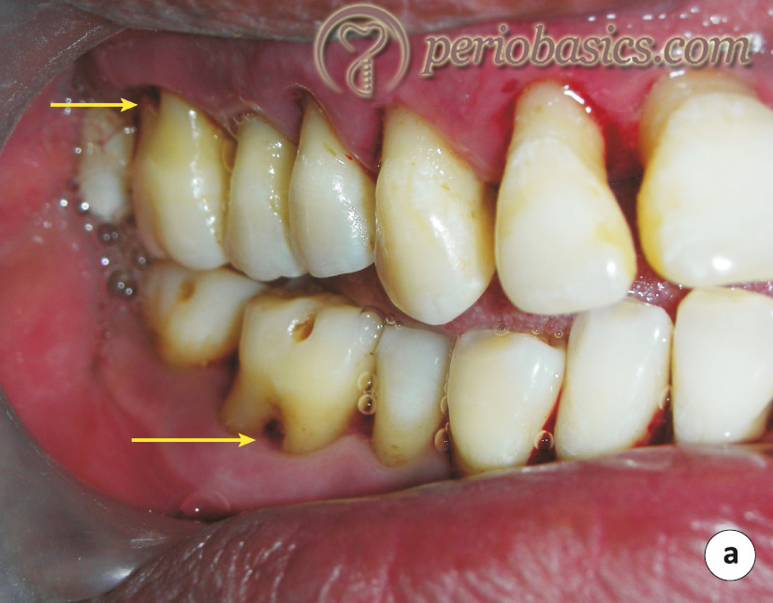
The local anatomic risk factors:
(Anatomic &Iatrogenic) factors.
1-Furcation anatomy:

Slide 19
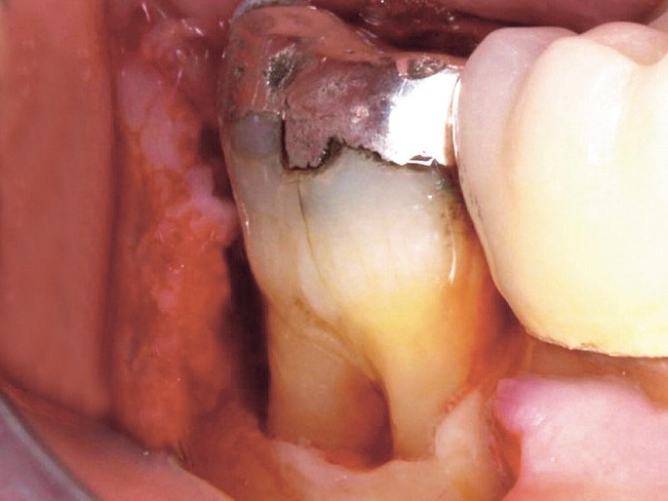
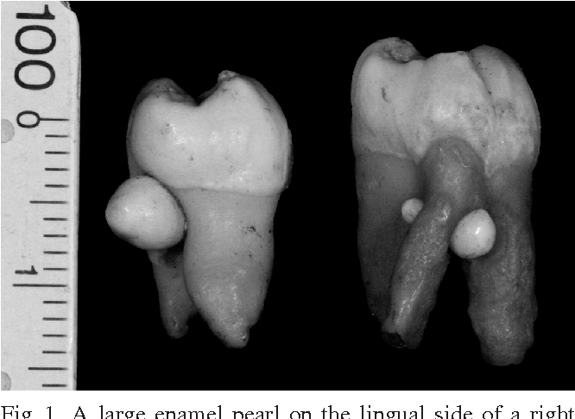
2-Cervical enamel projections (CEP):

Slide 20
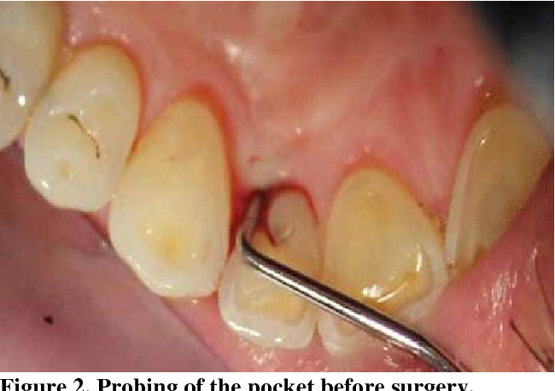
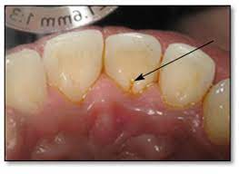
3-Palatogingival grooves (PGG):

Slide 21
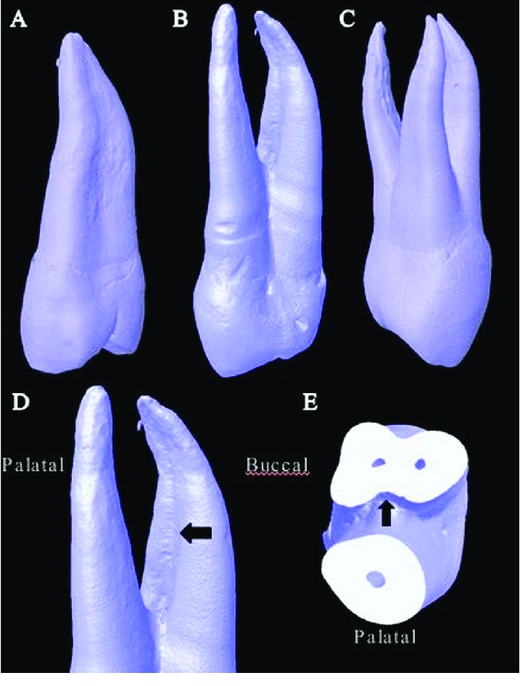
4- Root Morphology:

Slide 22
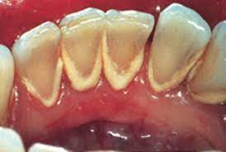
Local predisposing factors :
Biofilm and Calculus :

Slide 23
Iatrogenic Factors :
Inadequate dental procedures that contribute to the deterioration of the periodontal tissues are referred to as iatrogenic factors.
Iatrogenic endodontic complications that can adversely affect the periodontium include root perforations, vertical root fractures and endodontic failures that may necessitate tooth extraction.
Characteristics of dental restorations and removable partial dentures that are important to the maintenance of periodontal health include the location of the gingival margin for the restoration, the space between the margin of the restoration and the unprepared tooth, the contour of the restorations, the occlusion, materials used in the restoration, the restorative procedure itself and the design of the removable partial denture.

Slide 24
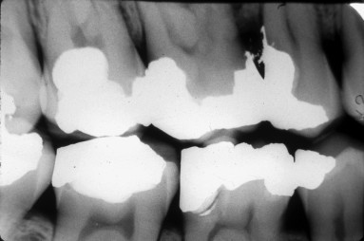
Margins of restorations (overhanging margins of dental restorations) :

Slide 25
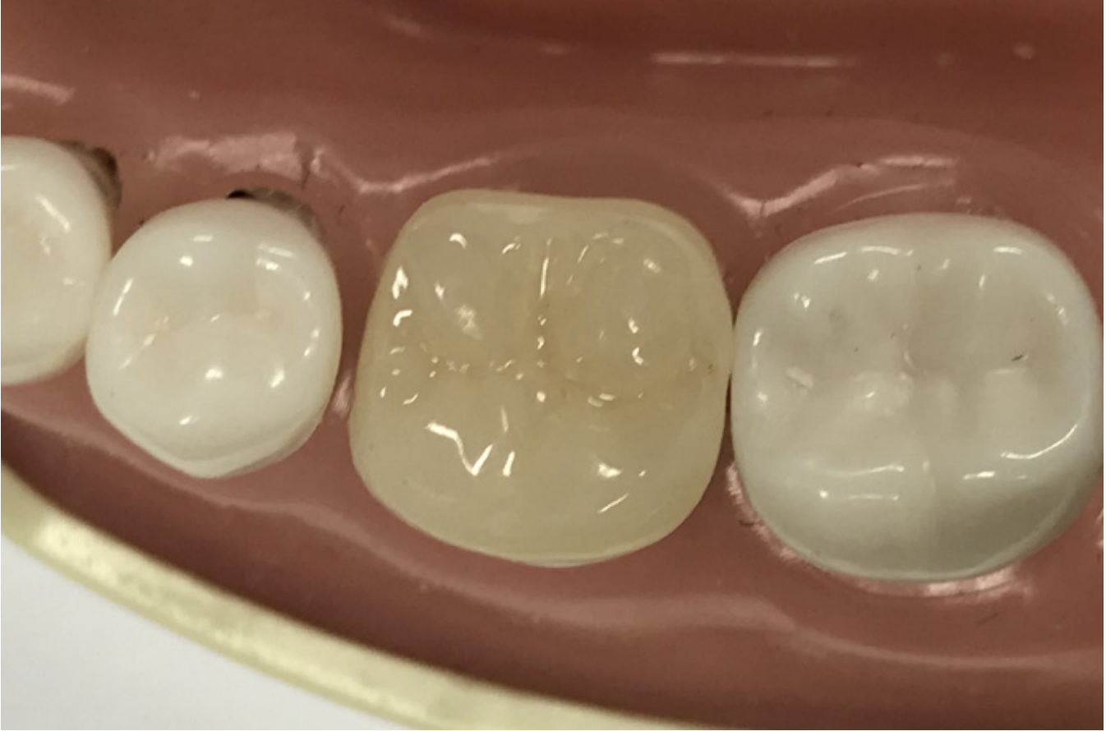

Slide 26
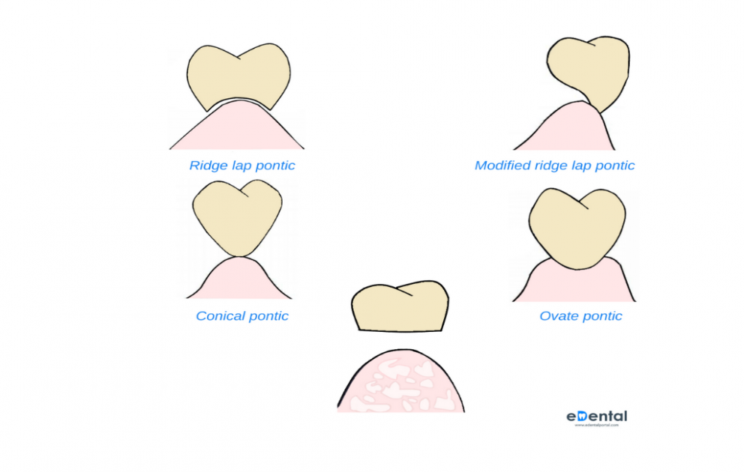

Slide 27
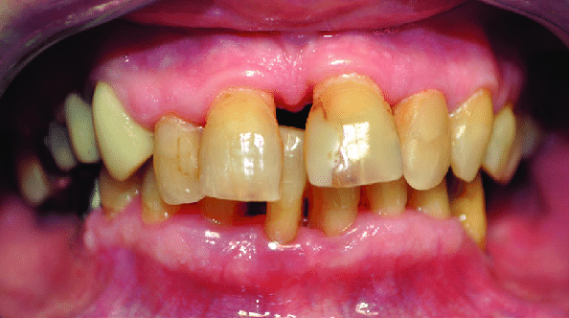
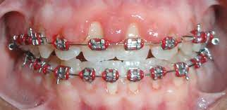
Malocclusion:

Slide 28
Orthodontic appliances tend to retain bacterial plaque and food debris, thereby resulting in gingivitis and they are also capable of modifying the gingival ecosystem. An increase in Prevotella melaninogenica, Prevotella intermedia, and Actinomyces odontolyticus and a decrease in the proportion of facultative microorganisms was detected in the gingival sulcus after the placement of orthodontic bands.

Slide 29
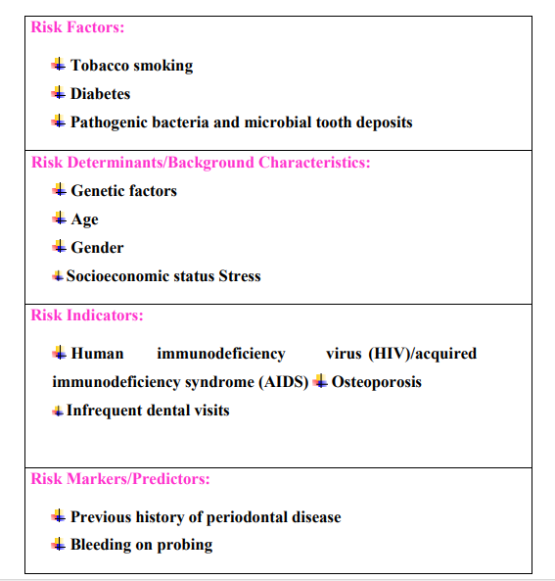

Slide 30
Thank You

