Slide 1
AL-AYEN UNIVRSITY COLLEGE OF ENGINEERING
RESERVOIR ENGINEERING I
Introduction
2022-2023
NASIR ATALLAH
ASMAA AHMED

Slide 2
Introduction
Outline
Petroleum system (PS)
Elements & processes of PS
Reservoir rocks
Significance of rock properties
Methods of rock properties measurements
Summary

Slide 3
Petroleum system (PS)
The petroleum system (PS) is a core concept in Petroleum geology
PS encompasses all the key elements & processes in the formation of hydrocarbons.
Key elements
Source rock
Cap rock
Processes
Trap formation
Generation
Reservoir rock
Migration
Accumulation

Slide 4
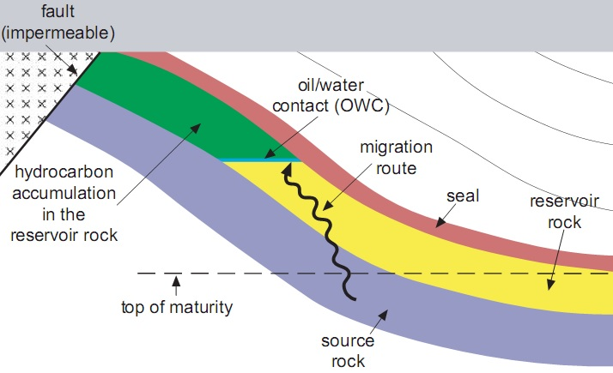
Elements & processes of PS
1- Source rock
2- Reservoir rock
3- Cap rock or seal
4- Trap
5- Migration

Slide 5
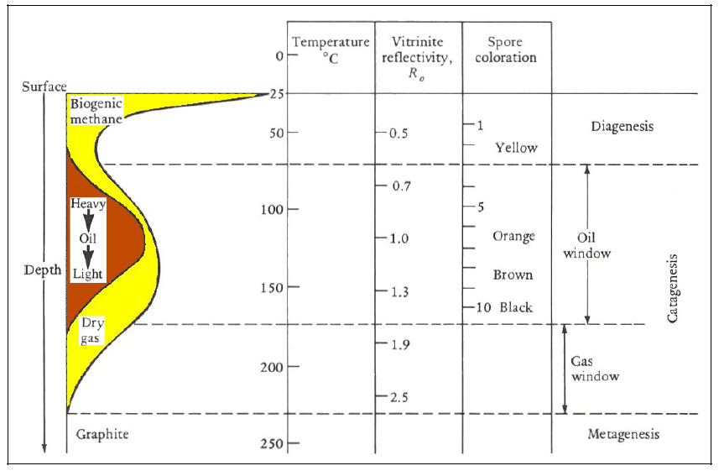
Elements & processes of PS: Source rock
Sedimentary rock made of shale or limestone.
Contains the precursors of hydrocarbon formation & organic matters.
Organic matter subjected to high temperature for a long time to convert into hydrocarbon.
Hydrocarbon can be generated depending on temperature/depth limit
The limit is called the oil window or oil kitchen

Slide 6
Elements & processes of PS: Cap rock
Low permeability rock
Restricts hydrocarbons to escape from the reservoir
Made of chalks, shale or evaporates

Slide 7
Elements & processes of PS: Trap
The trap is structural or stratigraphic feature
Ensures a fixed and firm position of seal and reservoir which avoids the escape of hydrocarbons
Three types of traps: Structural, Stratigraphic and combination

Slide 8
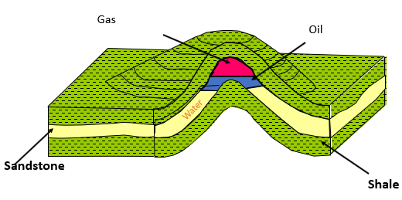
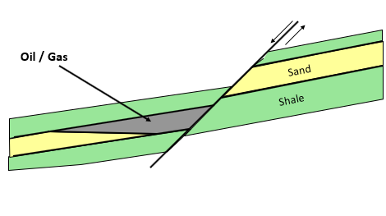
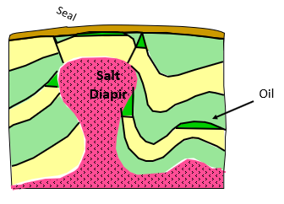
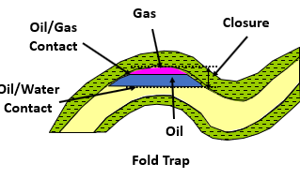
Structural Hydrocarbon Traps
Dome-Shaped and Anticline:
Fault Trap
Salt-Dome
Notes:
The dome above shows gravity separation of fluids. Shale comprises the upper and lower confining beds.

Slide 9
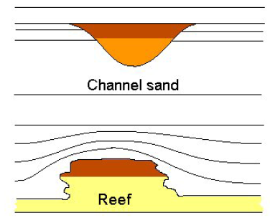
Stratigraphic Hydrocarbon Traps
Unconformity
Uncomformity
Oil/Gas
Pinch out
Oil/Gas
Notes:
Stratigraphic hydrocarbon traps occur where reservoir facies pinch into impervious rock such as shale, or where they have been truncated by erosion and capped by impervious layers above an unconformity.

Slide 10
Elements & processes of PS: Migration
Process of moving oil and gas from the source rock to the reservoir rock
The main factors of the oil and gas migration:
Compression
Buoyancy
Thermal expansion
Maturation (increase in volume with time)
Gravitational separation of hydrocarbons & water from each other

Slide 11
Reservoir rocks
The reservoir is the portion of rock containing the pool of petroleum
Composed of sedimentary rocks, such as sandstones, limestones and dolomites
Must be a large enough capacity to store economically viable amounts of hydrocarbon
The hydrocarbon must flow at economical rates when penetrated by a well

Slide 12
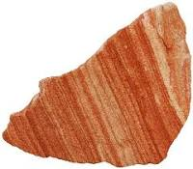
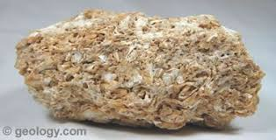
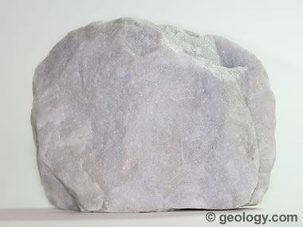
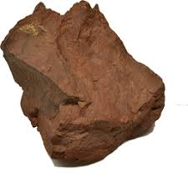
Reservoir rocks
Reservoir lithology
The term lithology is used as a gross identification for a rock layer in the subsurface and uses familiar names such as:
Sandstone, Limestone, Dolomite, Claystone (or clay)
Lithology identification is fundamental to all reservoir characterization.
Understanding reservoir lithology is the foundation from which all other petrophysical calculations are made.

Slide 13
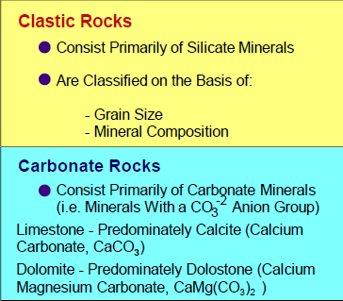
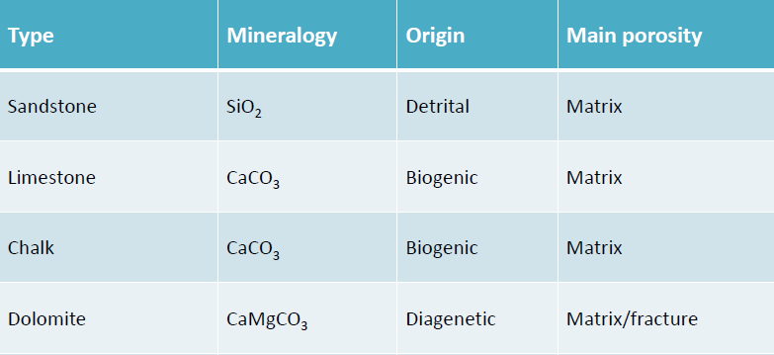
Reservoir rocks
Reservoir lithology: Clastic & Carbonates

Slide 14
Reservoir rocks
Major reservoir rock properties:
1- Porosity, Φ
2- Permeability, K
3- Rock compressibility, Cf
4- Rock resistivity, Rt
5- Saturation, Sw, So, Sg
6- Wettability
7- Capillary pressure, Pc
8- Relative permeabilities, Kro, Krw, Krg

Slide 15
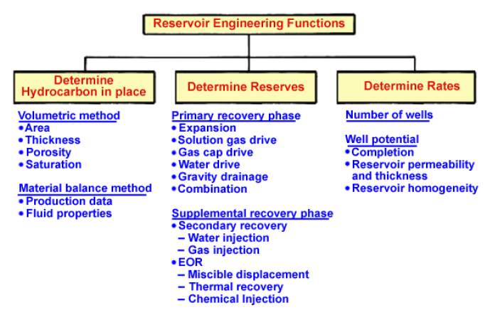
Significance of rock properties
Rock properties in conjunction with fluid properties are very important for
Reservoir engineers

Slide 16
Significance of rock properties
Why are reservoir rock properties so important?
1-How much oil? Φ, Swc
2-How much oil can be recovered? Φ, Sor, Co, Cf, Cg, Cw
3-How fluids flow in the reservoir? K, Ke, Ko, Krw, Krg
4-To predict production profile Kro, Krw, Krg, Sw, So, Sg
5-Predict change in reservoir pressure Co, Cf, Cg, Cw

Slide 17
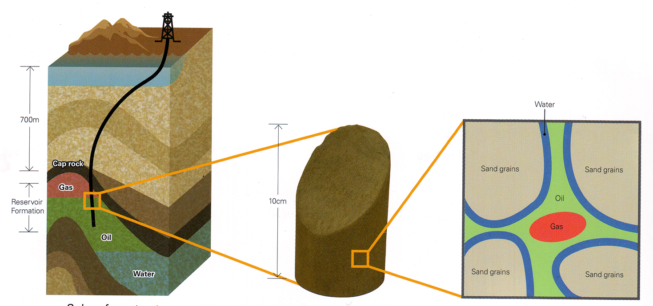
Measurement of rock properties: Coring
Two ways can be used to determine rock properties:
1- Coring
2- Well logging
Coring
Coring is a process of taking samples (Cores) from a reservoir.
Cores can be taken during drilling operations as a continuous section or as sidewell plugs from the wellbore wall

Slide 18
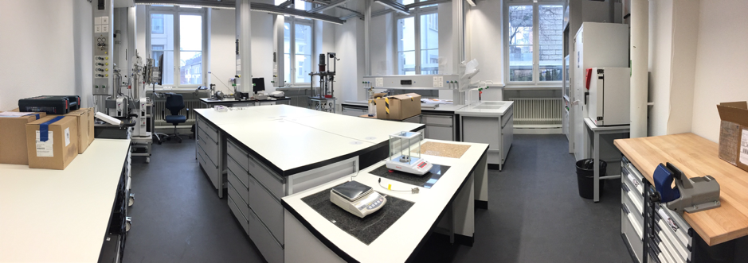
Measurement of rock properties: Coring
Samples are cleaned & subjected to many laboratory measurements
Samples are then analysed to determine the reservoir properties.
Two distinct methods for core analysis: Routine core analysis and Special core analysis (SCAL)

Slide 19
Measurement of rock properties: Coring
Routine & SCAL
Routine
SCAL
Porosity
Horizontal & vertical perm.
Grain density
Lithology
Relative permeability
Capillary pressure
Saturation exponent, n
Cementation exponent, m

Slide 20
Measurement of rock properties: Coring
Two types of coring:
Conventional coring (Whole coring)
Sidewell coring

Slide 21
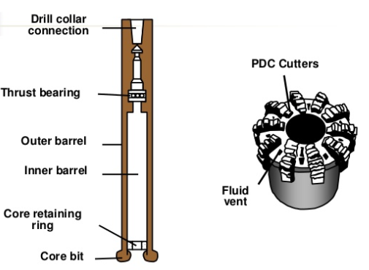
Measurement of rock properties: Coring
Whole coring
Continues section of rocks extracted from a well during drilling operations
Coring assembly & bit are used
The core bit is a hollow cylinder with cutters on the outside

Slide 22
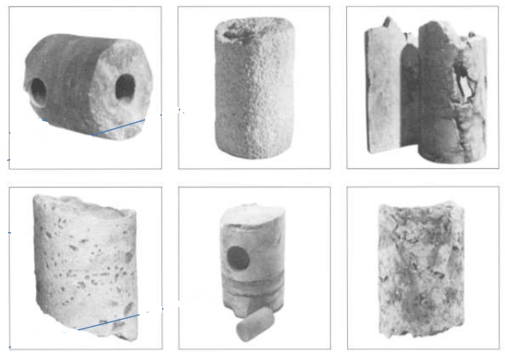
Measurement of rock properties: Coring
Whole coring
The cylindrical core is retain in the core barrel
Core diameter is typically from 1.75 to 5.25 inches and about 1m long
These core barrels are then cut into small pieces called plugs

Slide 23
Measurement of rock properties: Coring
depth | lithology | porosity | Horizontal perm. | Vertical perm
3320 | S.St | 0.2 | 1000 | 100
3321 | S.St | 0.18 | 950 | 80
3322 | S.St | 0.25 | 1500 | 150
3323 | shale | 0.01 | 0.02 | 0.02
3324 | shale | 0.02 | 0.02 | 0.02
3325 | S.St | 0.25 | 1450 | 160
3326 | S.St | 0.23 | 1320 | 120
3327 | S.St | 0.27 | 2000 | 200
Whole coring
3319.5
3328

Slide 24
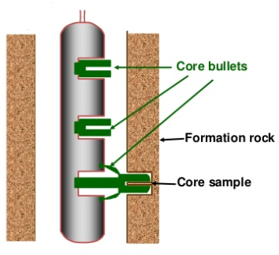
Measurement of rock properties: Coring
Sidewell coring
Plugs of rock cut from the wellbore wall
Acquired by wireline-conveyed tools

Slide 25
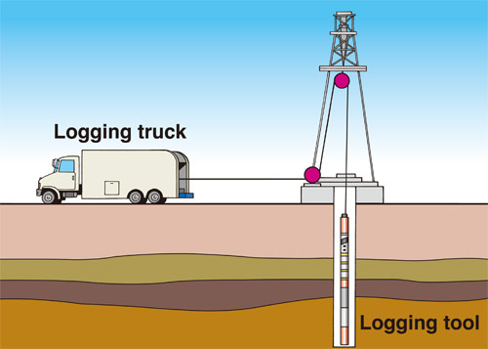
Measurement of rock properties: Well logging
Logging are a special tools lowered into the well
To examine the formation rocks
Obtain measurements about rock properties
Several tools are run at the same time as a logging string

Slide 26
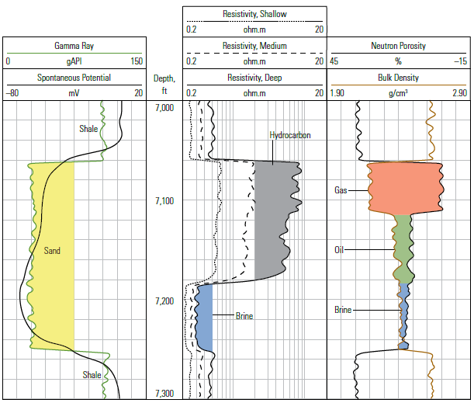
Measurement of rock properties: Well logs
Track 1
Track2
Track 3
Track 4
Data are displaced as a series of measurements covering a depth range in a display called well logs
Data of each tool or many tools togother are shown in distinct tracks

Slide 27
Measurement of rock properties: Well logs
Logging tools designed for formation evaluation are based on:
1- Electrical measurements
Resistivity, Induction
2- Nuclear & radioactive measurements
Neutron, Density & Gamma ray
3- Acoustic measurements
Sonic

