Slide 1
CHAPTER 7 Medical terminology

Slide 2
Content
Word and its relation the term
Word &adjective
Correct spelling
Term and meaning
medical term
Definitions
Lect.7
Dr. Laith & Asaad

Slide 3
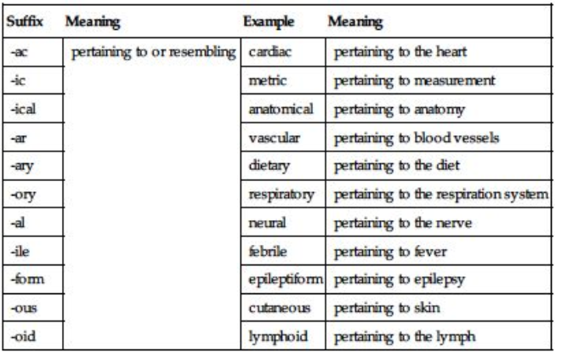

Slide 4
Noun | Adjective
psychosis | Psyches
abdomen | abdominal
epilepsy | Epilept/ic/iform
anatomy | anatomical
biology | biologic
cancer | cancerous

Slide 5
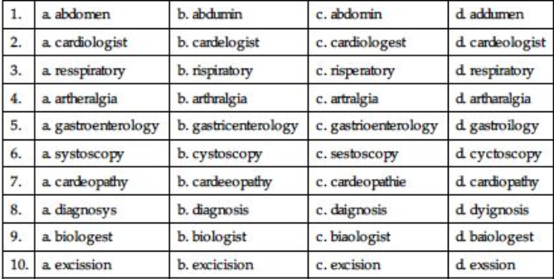

Slide 6
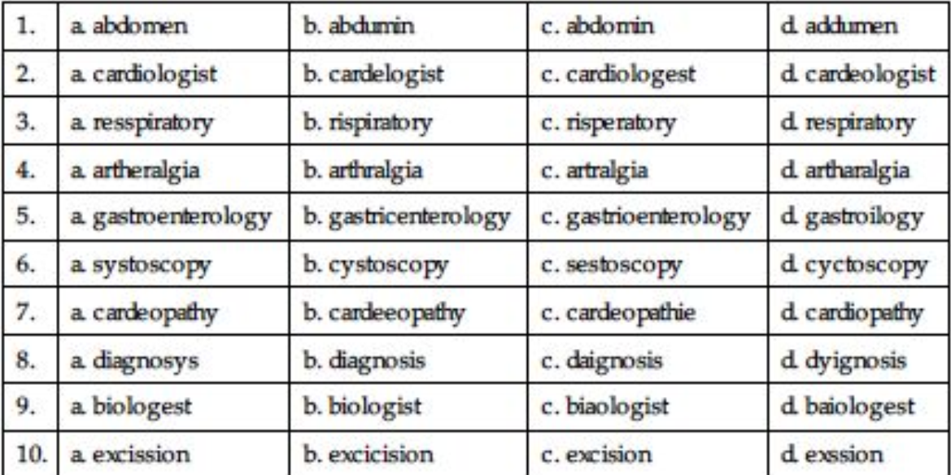
Spelling: Circle the correctly spelled term

Slide 7
Identify the suffix in each of the following medical terms and provide its meaning.
Suffix | Suffix | Meaning
1. thrombosis | sis | Thickening (blood)
2. gastrectomy | ectomy | excision of the stomach
3. cerebral | al | Pertaining of the head
4. osteitis | itis | Bone inflammation
5. Retrogastric | ic | Pertaining of stomach-reverse
6. Carcinoma: | ma | Cancerous disease

Slide 8
Identify the prefix and give its meaning in each the following terms.
No | Medical term | Prefix | Meaning
1 | hyperthyroidisim | Hyper | Exessive activity of gland
2 | transhepatic | Trans | Across the liver
3 | prognosis | pro | Prior / before determination
4 | retrogastric | retro | behind of stomach
5 | tachycardia | tachy | High heart rate
6 | hypoglycemia | hypo | sugar lack in blood stream
7 | eupnea | eu | Normal breathing
8 | pericardium | Peri | conical sac contain the heart

Slide 9
Choose the most appropriate choice to the given medical TERMS
Joint pain is: a. neural b. arthralgia c. nueralgia d. neuralgia | 10. The suffix that means record is a. -graph b. -ia c. -scopy d. -gram | 5. A gastrectomy is a/an a. gastric resection b. incision of a gland c. gastroscopy d. examination of the stomach
2. The suffix that means visual examination is a. -dys b. -dia c. -scopy d. -ia | The root that means kidney is a. pharyngo b. rhin c. rino d. nephr | 6. A combining form meaning cells is a. cyst/o b. cyt/o c. cis/o d. cyts

Slide 10
Joint pain is: a. neural b. arthralgia c. nueralgia d. neuralgia | 10. The suffix that means record is a. -graph b. -ia c. -scopy d. -gram | 5. A gastrectomy is a/an a. Gastric resection b. incision of a gland c. gastroscopy d. examination of the stomach
2. The suffix that means visual examination is A. -dys b. -dia c. -scopy d. -ia | 4. The root that means kidney is a. pharyngo b. rhin c. rino d. nephr | 6. A combining form meaning cells is a. cyst/o b. cyt/o c. cis/o d. cyts

Slide 11
Tumor of a liver a. arthrosis b. arthroscope c. adenoma d. hepatoma | 12. Prediction about the outcome of treatment is a. prolapse b. prognosis c. diagnosis d. psychosis | 13. Which term relates to the neck? a. thrombosis b. cervical c. cephalic d. cerebral
14. A white blood cell is a/an] a. leukocyte b. resection c. platelet d. erythrocyte | 15. Subhepatic means a. over the liver b. below the liver c. beside the liver d. in the liver | 16. An instrument to visually examine the urinary bladder is called a/an a. cystoscope b. arthroscope c. cholecystoscope d. gastroscope

Slide 12
Tumor of a liver a. arthrosis b. arthroscope c. adenoma d. hepatoma | 12. Prediction about the outcome of treatment is a. prolapse b. prognosis c. diagnosis d. psychosis | 13. Which term relates to the neck? a. thrombosis b. cervical c. cephalic d. cerebral
14. A white blood cell is a/an] a. leukocyte b. resection c. platelet d. erythrocyte | 15. Subhepatic means a. over the liver b. below the liver c. beside the liver d. in the liver | 16. An instrument to visually examine the urinary bladder is called a/an a. cystoscope b. arthroscope c. cholecystoscope d. gastroscope

Slide 13
17. Low (less than normal) amount of sugar in the bloodis called a. hyperacidity b. hyperthyroidism c. hyperglycemia d. hypoglycemia | 18. Glands that secrete substances are a. exocrine b. endocrine c. adenomas d. enteral
19. Cancerous condition of white blood cells with high numbers of immature cells a. osteoma b. adenosis c. leukemia d. anemia | 20. Excision of the kidney is a. nephrectomy b. adenectomy c. gastrectomy d. mastectomy

Slide 14
17. Low (less than normal) amount of sugar in the blood is called a. hyperacidity b. hyperthyroidism c. hyperglycemia d. hypoglycemia | 18. Glands that secrete substances are a. exocrine b. endocrine c. adenomas d. enteral
19. Cancerous condition of white blood cells with high numbers of immature cells a. osteoma b. adenosis c. leukemia d. anemia | 20. Excision of the kidney is a. nephrectomy b. adenectomy c. gastrectomy d. mastectomy

Slide 15
Practice 2.2
Match each term in column A with its definition in column B.
A Term | B definition
1. microscope | a. instrument for recording many physiologic responses simultaneously
2. calorimeter | b. visual examination of the abdominal cavity
3. audiometry | c. instrument for examining very small objects
4. polygraph | d. measurement of hearing
5. celioscopy | e. instrument for measuring the caloric energy of food
Electro-encephalogram | f. record of the brain’s electrical activity
7. echography | g. recording data obtained by ultrasound

Slide 16
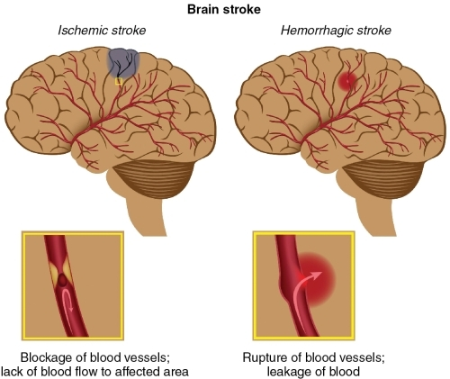

Slide 17
Terms Using the Suffix -Ectomy (Removal, Excision) Table 2.15
Medical Term | Medical Term Meaning
appendectomy | excision of the appendix
adenectomy | excision of a gland
hepatectomy | excision of the liver
cholecystectomy | excision of the gallbladder
laryngectomy | excision of the larynx
nephrectomy | excision of a kidney
colectomy | excision of the large intestine
tonsillectomy | excision of tonsils

Slide 18
Terms Using the Suffix -itis (Inflammation)
Medical Term | Medical Term Meaning
arthritis | inflammation of a joint
neuritis | inflammation of a nerve
esophagitis | inflammation of the esophagus
encephalitis | inflammation of the brain
osteitis | inflammation of bones
dermatitis | inflammation of skin
otitis | inflammation of ears
rhinitis | inflammation of the nose
bronchitis | inflammation of the bronchial tubes
myositis | inflammation of a muscle

