Slide 1
COLLAGE OF DENTISTRY
Oral and Maxillofacial Surgeryالفرع العلمي :
Oral surgery المادة:
Complications of exodontia المحاضرة:
9 رقم المحاضرة:
اسم تدريسي المادة: م.م. عامر أسامة كنج

Slide 2
Complications can arise during the procedure of extraction (per operative) or may manifest themselves sometime following the extraction (post operative).
All these complications arise from error in judgment, misuse of instruments, exertion of extensive force or from anatomic causes or factors.
By careful diagnosis and planning of the procedures many complications can be avoided but some of these complications may occur even when utmost, care is exercised, so that the dentist or the oral surgeon should be qualified to deal with each complication successfully.

Slide 3
1- Failure to secure anesthesia.
Failure to secure profound or good anesthesia may be due to:
a- Faulty technique, or Insufficient dosage of anesthesia.
b- Expired anesthesia.
c- The presence of acute infection.
2- Failure to remove the tooth with either forceps or elevator????!!!
Failure to remove the tooth after applying a reasonable amount of force without movement or yielding of the accused tooth need further clinical and radiological evaluation, because the tooth may be need surgical extraction. The tooth may be ankylosed or hypercementosed.

Slide 4
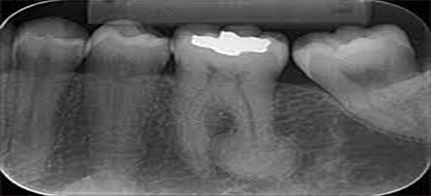

Slide 5
3- Fracture of:
A. Crowns and roots.
B. Alveolar bone.
C. Maxillary tuberosity.
D. Adjacent or opposing tooth.
E. Mandible.
A-Fracture of crowns and roots:
The most common complication during tooth extraction is fracture of the tooth crown or roots.
The factors that may lead to fracture of crown or roots may be classified into three groups:
I.Factors related to the tooth itself.
II.Factors related to the bone investing that tooth.
III.Factors related to the operator (dentist).

Slide 6
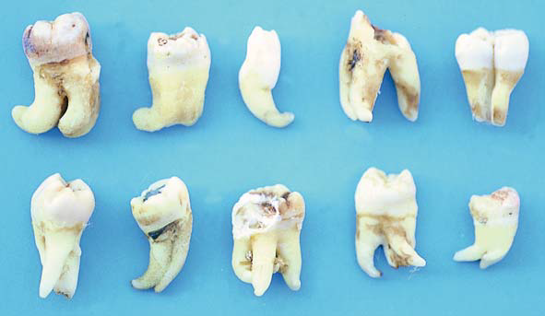
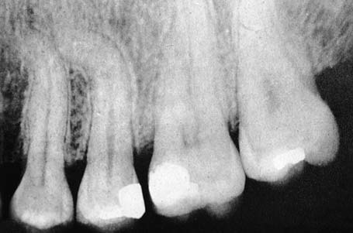
I-Factors related to the tooth itself
Means that the tooth may be badly carious, or heavily filled, brittleness of the tooth due to age, or non-vitality, root canal filled tooth. Also peculiar root or crown formation like dilacerated tooth, geminated tooth, severely curved root, divergent roots, convergent roots, hyper-cementosis, accessory root and complex root shape, malposed tooth, insufficient space for the application of the extraction instrument, internal & external resorption.

Slide 7
II-Factors related to the investing bone
Means the surrounding bone might be excessively dense or sclerotic due to localized or systemic causes.
III-factors related to the operators
Includes improper application of the beaks of the dental forceps or elevator on the tooth to be extracted; like the placement of the beaks of the dental forceps on the crown instead of the root or below the cemento-enamel junction, also the beaks are not parallel to the long axis of the tooth, also the use of wrong type of forceps.
Incorrect application of force during extraction by wrong direction in addition to that the use of twisting or rotational movement when not indicated like the use of twisting movement in extraction of upper 1st premolar or upper 1st and 2nd molar for example.

Slide 8
B- Alveolar bone fracture:
Fracture of alveolar bone frequently occurs when extraction is difficult.
The fractured bone may be removed with tooth to which it is firmly attached or it may be remain attached to the periosteum or it may be completely detached in the socket or wound.
It is a common complication that especially occurs on labial(buccal) area during extraction of upper canine and upper and lower molar teeth.
This complication might be due to:
1.The alveolar bone is very thin.
2. Accidental inclusion of the alveolar bone within forceps blades.
3. Configuration of the roots.
4. The shape of the alveolus.
5.Pathological or physiological changes in the bone itself like Ankylosis (bony connection between the tooth and bone), the presence of destruction in the alveolar bone due to the presence of discharging sinus.

Slide 9
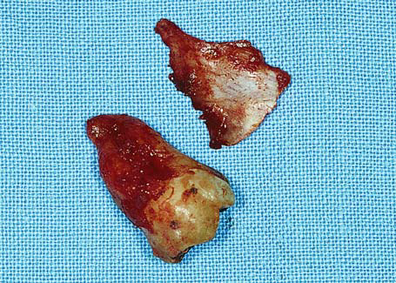
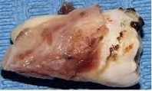
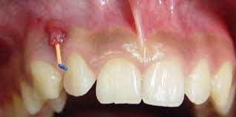
Treatment
When the broken part of the alveolar process and has been reflected from the periosteum, then it is removed and the sharp edges are smoothened and the wound is sutured. If the broken part of the alveolar process is still attached to the overlying periosteum, then it’ll be left in place and suturing of the mucoperiosteum is undergone.

Slide 10
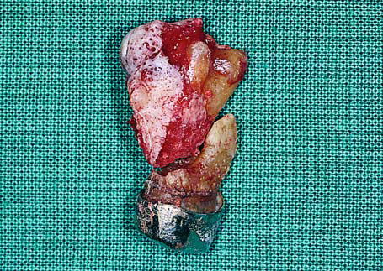
C- Maxillary tuberosity fracture:
Sometime the tuberosity is completely fractured when we try to remove maxillary 3rd or 2nd molar.
Fracture of maxillary tuberosity may lead to a wide opening into the antrum called Oro-antrum communication with irregular tearing in the covering soft tissue lead to profuse bleeding and post- operatively may lead to difficulties in the retention of upper denture.
This complication might occur if the molar tooth to be extracted is isolated and subjected to full force of bite leading to sclerosis of the surrounding bone, or due to downward extension of the maxillary sinus to the nearby edentulous alveolar bone or due to large abnormal size of the maxillary sinus extended to involve the tuberosity; in addition to that, the use of excessive force or wrong positioning of the elevator in the extraction of upper 3rd molars .

Slide 11
Treatment
When the fracture occurs and the fractured segment has not been reflected from the periosteum, it is repositioned and the mucoperiosteum is sutured., the tooth should be splinted to an adjacent tooth and be placed out of occlusion. In this case, the scheduled extraction of the tooth is postponed, if possible, for approximately 2 months, whereupon the fracture will have healed and the extraction may be performed with the surgical technique.
If the bone segment has been completely reflected from the tissues or an oroantral communication occurs, the bone is then smoothened and the wound is tightly sutured. Antibiotics and nasal decongestants are then prescribed.

Slide 12
D-Fracture of the adjacent and opposing tooth:
Adjacent teeth occasionally may be damaged during extraction procedures, this may include loosening or dislocation or fracture of the adjacent teeth.
This misshapes occur mostly due to careless use of the dental forceps or elevator by wrongfully using the adjacent tooth as a fulcrum during the use of elevator or the application of the beaks of dental forceps, also fracture of the crown of adjacent tooth or fracture and dislodgment of its filling.
When an adjacent tooth is inadvertently luxated or partially avulsed, the tooth is stabilized for approximately 45–60 days. If there is still pain during percussion even after this period, then the tooth must be endodontically treated.
In addition to that opposing teeth may be chipped or fractured if the tooth being extracted yield suddenly to uncontrolled force of the forceps striking the opposing tooth leads to this complication.

Slide 13
E-Mandible fracture:
This is a rare complication, but it might occur almost exclusively with the surgical removal of impacted lower third molar tooth.
A mandibular fracture is usually the result of the application of a force exceeding that needed to remove a tooth and often occurs during the use of dental elevators (winters elevator), but sometimes pathological or physiological changes may lead to weakened mandible like:
1.Senile atrophy and osteoporosis of the bone.
2.Osteomyelitis e.g. osteoradionecrosis.
3.Cystic lesion.
4. Impacted teeth.
5.Tumour, benign or malignant..
So, preoperative clinical and radiographic evaluation is very important to avoid such complication or preventing it.

Slide 14
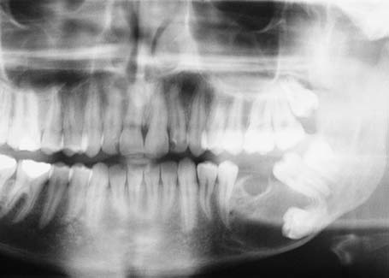
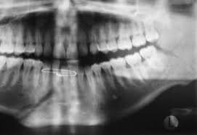

Slide 15
4-Dislocation of the tempro-mandibular joint (T.M.J.):
Exertion of high amount of force during extraction of lower teeth especially posterior teeth may lead to dislocation of the condyle of the mandible and the patient becomes unable to close his/her mouth, especially in patient who had a history of recurrent dislocations in TMJ.
If this dislocation occur it should be reduced immediately by the operator by standing in front of the patient and his thumbs placed intra-orally on the external oblique ridge lateral to the molar (or on the occlusal surface of the molars)teeth and other fingers outside the mouth under the lower border of the mandible, downward pressure with the thumbs and upward (backward) pressure with the other fingers may reduce the dislocation.
If reduction is delayed it become difficult to reduce it because of muscle spasm.
The patient may complain of pain in the TMJ region post-operatively due to high pressure applied to the joint during extraction, so supporting the mandible during extraction prevents such complication.

Slide 16
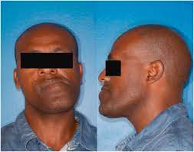
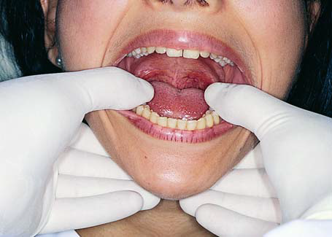
In unilateral dislocation, the mandible deviates towards the healthy side, while in bilateral dislocation, the mandible slides forward in a gaping prognathic position.

Slide 17
5- Displacement of a root into the soft tissue and tissue spaces and the maxillary antrum:
During extraction especially on use of elevator, a root or piece of root may be dislodged into the soft tissue through a very thin bony plate overlying the socket and disappear buccally or lingually into the soft tissue between periosteum and bone in the vestibule, but sometimes a root or even a tooth may be displaced into the tissue spaces surrounding the jaws e.g. a retained root in the lower molar teeth may be displaced into the sublingual or submandibular space or e.g. upper third molar may displaced into the infratemporal space.
So the extraction with high force without direct vision on the retained root may lead to such complications, also retained root may be displaced into the maxillary antrum during the extraction of upper molar or sometimes premolar teeth especially palatal root of upper molar teeth.
The presence of large antrum or the use of excessive force during extraction or due to pathological conditions like periapical pathology. All these factors may assist or predispose to such complication, so pre-operative radiograph and clinical evaluation may assist in the prevention of such complication.

Slide 18
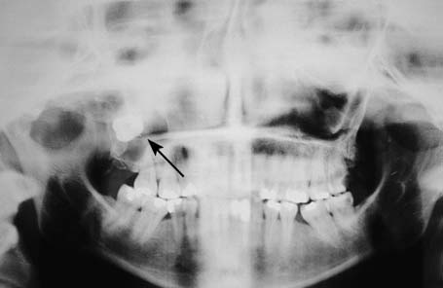
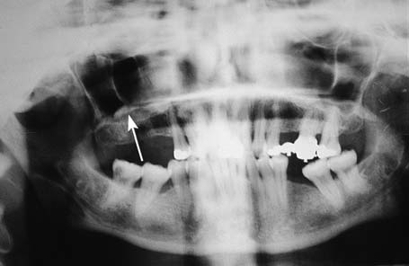

Slide 19
6- Excessive bleeding (after or during extraction):
At the beginning one must understand that some slight oozing of blood for several hours following tooth extraction is considered normal. But sometime excessive or abnormal bleeding may occur following tooth extraction.
The causes of excessive bleeding may be due to:
I-Local factors
The local causes which are the commonest causes for prolonged bleeding as in usual, due to gross tissue damage, when there is severe bone injury and tearing of the periosteum many vessels are opened also severe gingival lacerations, also damage to large arteries like inferior dental vessel or greater palatine vessels may lead to profuse bleeding.
Also the presence of Hemangioma (central) and other vascular abnormalities may lead to such complication.
Also post-operative infection of the extraction wound causing erosion of the blood vessel leading to secondary haemorrhage (delayed postoperative bleeding), also the working in acutely inflamed area may assist in the prolonged bleeding.

Slide 20
II-Systemic factors
For the systemic causes like systemic haematological disorders like thrombocytopenia, reduction in the clotting factors, anticoagulant drugs, hereditary blood disease like haemophilia, all these factors may lead to severe bleeding; so good history and clinical examination and blood investigation is very important and essential before any extraction especially if the patient gives you a history of bleeding on previous extractions or trauma.

Slide 21
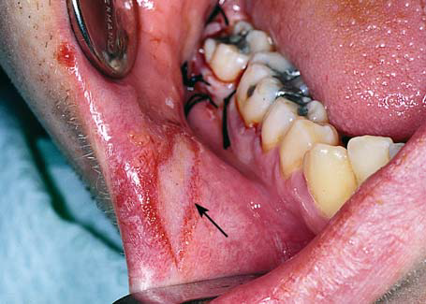
7-Damage to the surrounding soft tissues.
A- Damage to the gum or lip.
Like laceration of the gum during extraction occurs if the gingival tissue not reflected before extraction so gum adhere to the tooth to be extracted from its socket should be carefully dissected before any further attempts to deliver the tooth are made, also the inclusion of the gum by forceps beaks or by blind application of the forceps may lead to crushing of the soft tissue, also the lower lip may be pressed or crushed between the handles of the forceps and the lower lip on extraction of upper teeth if sufficient care is not taken .

Slide 22
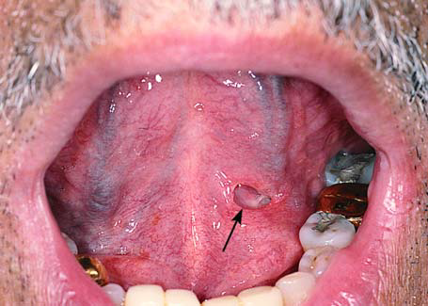
B-Damage to the tongue and floor of the mouth
Also slipping of elevator during extraction may lead to damage or wounds in the floor of the oral cavity, there are many vital structures in the floor of the oral cavity which might be damage like [sublingual gland , submandibular duct, lingual nerve & tongue]. So the operator should always keep in his mind that supporting of elevator during extraction is very important.

Slide 23
C-Damage to nerves
Occur mostly on surgical extraction of teeth rather than simple extraction but one must always be aware of the risk when operating in the region of the (inferior dental nerve, lingual nerve & mental nerve).
Inferior alveolar nerve injury is an uncommon occurrence in extraction of erupted mandibular teeth.
In rare cases third molar roots may encircle the nerve so that extraction of the tooth will cause nerve injury.
Curration or improper use of elevators to remove root apices may cause tearing or displace bone fragments so that will be impinging or pressing the nerve in the canal "inferior dental canal" result in Paraesthesia or anesthesia of half of lower lip.

Slide 24
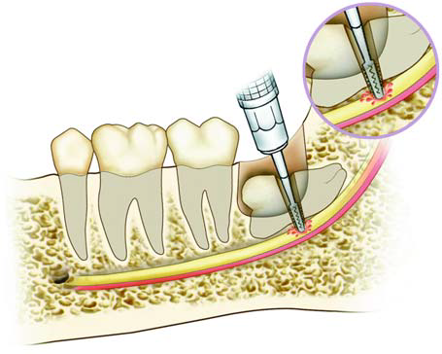
The mental branch of the alveolar nerve also may be injured during surgical procedures in the premolar region.
The lingual nerve may be damaged during exodontias of the lower molar teeth especially the lower wisdom tooth by trapping the lingual soft tissue in the forceps beaks or by direct trauma from misusing of elevator or by using surgical extraction to remove impacted wisdom tooth.

Slide 25
There are three types of nerve damage:
A. Neurapraxia:
This type of damage has the most favorable prognosis and may occur even after simple contact with the nerve. Nerve conduction failure is usually temporary and there is complete recovery, without permanent defects. Recovery is quite rapid and occurs gradually within few days to weeks.
Axonotmesis
This is a serious injury of the nerve resulting in degeneration of the nerve axons. Regeneration and recovery of sensation is slower than in neurapraxia and usually begins as paresthesia 6–8 weeks after injury. Regeneration of the nerve may be exceptionally favorable, but there is a chance of a certain degree of sensory disturbance of the area remaining.
C. Neurotmesis
This is the gravest type of nerve injury, resulting in discontinuation of conduction due to severance of the nerve or due to the formation of scar tissue at the area of trauma. This type of injury may cause permanent damage to nerve function.

Slide 26
8- Post -operative pain
Post-operative pain and discomfort after extraction due to traumatized soft or hard tissue may be from bruising of bone during instrumentation or from using burs for removal of bone also damage and rough handling of soft tissue during extraction is another cause for postoperative pain.
The most common cause for the moderate to severe continuous pain after extraction is related to a well-known cause called dry socket or acute localized alveolar Osteitis.
The patient presented with continuous moderate to severe pain after 24-72 hours after extraction which may last for 7 to 10 days clinically the patient may presented with empty socket (there is no clot in the socket) , exposed bone or empty socket with some evidence of broken-down blood clot and food debris within it with intense bad odour. The etiology of this condition is incompletely understood but many predisposing factors exist like infection, trauma, blood supply, site, smoking, sex, vasoconstrictors or systemic factors.

Slide 27
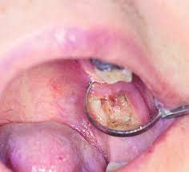
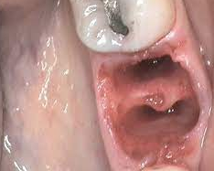

Slide 28
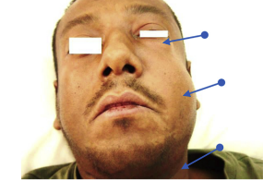
9-Per operative or postoperative swelling
I-Peroperative swelling
Emphysema
This complication may occur as a result of air entering the loose connective tissue, when an air motor is used in the surgical procedure for the removal of bone or for sectioning the impacted tooth.
Clinically, the region swells, with a characteristic crackling sound during palpation (crepitus). It subsides spontaneously after 2–4 days.

Slide 29
After extensive surgical interference and exodontias some time may be associated with post-operative swelling, this swelling may be related to one or more of the following causes: ( 1-Oedema, 2-Infection, 3-Hematoma.)
II-Postoperative swelling
A-Oedema:
Oedema occurs after surgery as a result of tissue injury (it is normal response) when there is great damage to the tissue by using blunt instrument. And rough handling of tissue may increase the chance of production large oedema.
So laceration of tissue during extraction, trauma to the bone or periosteum are some of the most common causes of oedema and in other words post-operative swelling.
Persistent post-extraction swelling or the development of swelling several days after surgery is usually due to infection.

Slide 30
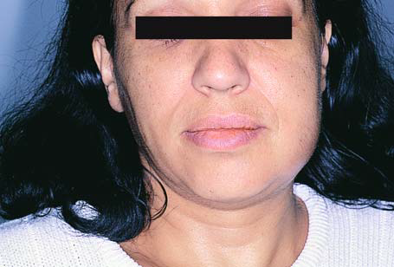
B-Infection
Swelling due to infection can be distinguished from postoperative oedema by the increased skin temperature, greater redness of the overlying tissues, the usual presence of fever and sometime fluctuation is present due to presence of pus.
The infection should be always considered a serious complication and need urgent management.

Slide 31
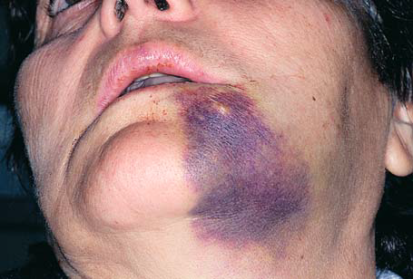
C-Hematoma
Means a collection of blood in the extra-vascular spaces of the tissues.
Treatment
If a hematoma is formed during the first few hours after the surgical procedure, therapeutic management consists of placing cold packs extraorally during the first 24 hours, and then heat therapy to help it to subside more rapidly. In addition of administration of antibiotics to avoid suppuration of the hematoma, and analgesics for pain relief.

Slide 32
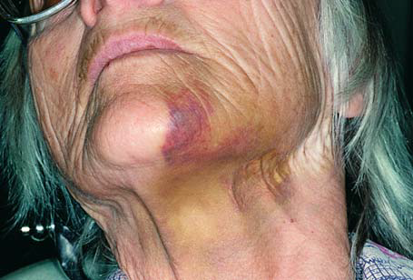
10-Ecchymosis
Occurs in case of presence of friable capillaries and decreased tissue tone where there is generalized trauma of the area (damage during traumatic flap retraction). In order to avoid such a complication, retractors must be handled gently.
Treatment
No particular treatment is required. The patient should be informed that it is not a serious situation and that ecchymosis gradually subside within few days.

Slide 33
11-The creation of an oroantral communication
On extraction of upper molar teeth and sometimes upper premolars a communication between the oral cavity and maxillary antrum may be created.
This communication if not healed or closed after few days a chronic condition occurs called Oro- antrum fistula.
Close proximity of the maxillary cheek teeth to the maxillary antrum which are separated only by little amount of bone and sometime even the soft-tissue lining of the maxillary sinus, the presence of periapical infection, the antrum itself may be abnormal in size, misjudgement of the amount of force and its direction used in extraction or the presence of pathological lesions.
All these factors may assist in the production of this complication.

Slide 34
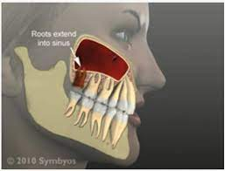
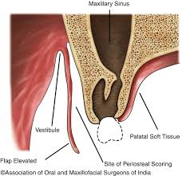
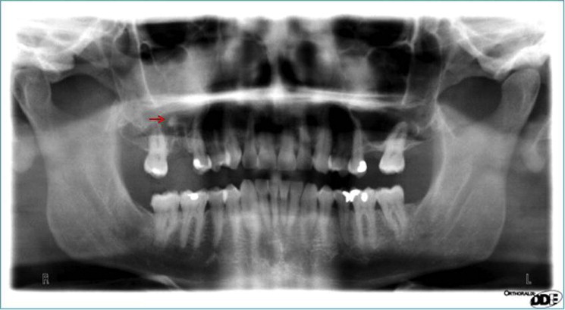
To confirm the presence of this complication, the patient is asked to pinch or close the nostrils together and blow air gently into the nose, the operator may see blood bubbling, or shooting of air through the communication is heard or a piece of cotton on tweezer may be defected (we may see fogging on the dental mirror).
The presence of this complication needs surgical correction by well-trained oral surgeon and surgical unit in which all instruments and qualified staff present.

Slide 35
12-Trismus:
Means inability to open the mouth (limitation of mouth opening), trismus is one of common complication following extraction of teeth especially the surgical removal of wisdom teeth.
Trismus may be caused by post-operative oedema, hematoma, inflammation of the soft tissue, trauma and arthritis of the temporomandibular joint.
It may be related to the use of inferior dental block local anesthesia (trauma to the medial pterygoid muscle) so the management of the trismus depend on diagnosis of the cause of this complication.
Treatment
When acute inflammation or hematoma is the cause, then antibiotics are administered.
-Hot compresses are placed extraorally for approximately 20 minutes every hour.
-Gentle massage of the TMJ area

Slide 36
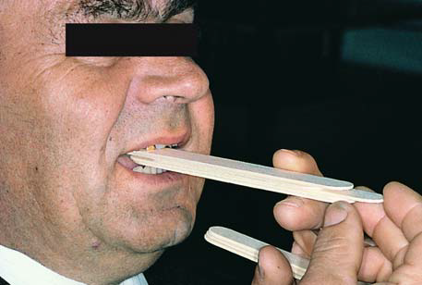
-Physiotherapy lasting 5 minutes every 3–4 hours, which includes movements of opening and closing the mouth, as well as lateral movements, aimed at increasing the extent of mouth opening.
-Administration of analgesics, anti-inflammatory and muscle relaxant medication.

Slide 37
13-Syncope(fainting)
Collapse on the dental chair is a common complication during extraction.
The patient may often complain of feeling dizzy, weak & nauseated, and the skin is seen to be pale, cold and sweating, these complains may be accompanied by loss of consciousness, and the patient if not noticed at the beginning of the fainting may shows episode of convulsion.
The primary pathophysiological component of this situation is cerebral ischemia secondary to an inability of the heart to supply the brain with an adequate volume of oxygenated blood.
In the presence of anxiety, blood flow is increasingly directed toward the skeletal muscles at the expense of other organ systems such as the gastrointestinal tract, in the absence of muscular movement, the increased volume of blood in the skeletal muscle remains there, decreasing venous return to the heart and decreasing the volume of blood available to be pumped by the heart (uphill) to the brain.

Slide 38
A slight decreased in cerebral blood flow is evidenced by the signs and symptoms of vasodepressor syncope (i.e., light headedness, dizziness, tachycardia, palpitation) if this situation continues cerebral blood flow declines still further and the patient loses consciousness.
When the operator notices these signs and symptoms a first aids treatment should be started by lowering the head of the patient by putting him in supine position by lowering the back of the dental chair.
Care should be taken to maintain the airway and you have to notice the condition of the patient.
If consciousness is not returned within 1-2 minutes otherwise one should consider that something serious like respiratory arrest or cardiac arrest may happen and the patient need medical emergency.

Slide 39
Thank You

