Slide 1
AL-AYEN UNIVRSITY COLLEGE OF
PETROLEUM ENGINEERING
TECHNICAL ENGLISH
Lecture #3: Oil Companies
2022-2023
NASIR ALSHMLH
ASMAA ALGHAZI

Slide 2
Оil Industry Sectors
Оil Industry Sectors
The entire oil industry is often divided into three major sectors: upstream, midstream and downstream.
Downstream (oil industry)
The downstream oil sector is a term commonly used to refer to the refining of crude oil, and the selling and distribution of natural gas and products derived from crude oil. The downstream sector includes oil refineries, petrochemical plants, petroleum product distribution, retail outlets and natural gas distribution companies. The downstream industry touches consumers through thousands of products such as gasoline, diesel, jet fuel, heating oil, asphalt, lubricants, synthetic rubber, plastics, fertilizers, antifreeze, pesticides, pharmaceuticals, natural gas and propane.
Upstream (oil industry)
The upstream oil sector is a term commonly used to refer to the searching for and the drilling and production of crude oil and petroleum natural gas. The upstream oil sector is also known as the exploration and production (E&P) sector. The upstream sector includes the searching for potential underground or underwater oil and gas fields, drilling of exploratory wells, and subsequently operating the wells that recover and bring the crude oil and/or raw natural gas to the surface.
Midstream (oil industry)
However, midstream operations are usually simply included in the downstream category. The midstream sector processes, stores, markets and transports commodities such as crude oil, natural gas and natural gas liquids (NLG) such as ethane, propane and butane.
The process of oil production, transportation, refinery and sale is managed by oil companies (producers), but there are also service companies that work as contractors to the oil companies. They are deeply involved in the oil business providing services that help oil companies to carry out their operations.

Slide 3
Terms and Vocabulary
Midstream
Refining
Refinery
Crude oil
Natural gas
Retail outlets
Commodities
Natural gas liquids (NLG)
Headquarters/head office/central office
Revenue
Procurement
Listing
Processing
Subsidiary
Core business
Trading
Shipping
High gravity
Open joint stock company
Seismic acquisition
Seismic processing
Formation evaluation
Well testing
Directional drilling
Report to smb.(v)
Asset Based Organisation
Asset
Functional approach
Allocate budget
Set targets

Slide 4
Exercises
1. State whether the sentences are true (T) or false (F). If true, add the information on the statement. If false, correct the sentence.
1. Oil industry is divided into three sectors.
2. Downstream begins from refinery to product distribution.
3. Upstream sector includes only drilling and exploration.
4. Midstream is part of the upstream sector.
5. Midstream transports such products as crude oil, natural gas and NGL.
6. Service companies help oil companies in different operations.
7. Oil companies can also be contractors.

Slide 5
Exercises
2. Classify the words into Business terms and Petroleum Engineering terms.
Crude oil
Retail outlet
Refinery
Joint venture
Market value
Profit
Pipelines
Formation evaluation
Share
Artificial lift
Headquarters
Vendor
Seismic acquisition
Well completion
Offshore location
Consumer
Raw natural gas
Revenue

Slide 6
Exercises
3. Fill in the gaps with necessary prepositions.
The oil industry is often divided __________ three major sectors.
The downstream oil sector is a term commonly used to refer ________ the refining_________crude oil, and the selling and distribution of natural gas and products derived _________ crude oil.
The upstream sector includes the searching _________ potential underground or underwater oil and gas fields.
Midstream operations are usually simply included __________the downstream category.
The process of oil production, transportation, refinery and sale is managed _______oil companies.
These are deeply involved _______ the oil business providing services that help oil companies to carry ________ their operations.
The company's main business is the exploration _________and the production, processing, transportation and marketing of hydrocarbons.
Shell is incorporated in the UK with its corporate headquarters in The Hague, its tax residence is _______ the Netherlands, and its primary listings _______ the London Stock Exchange.

Slide 7
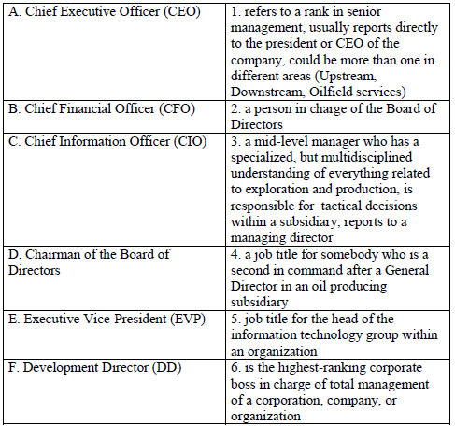
Exercises
4. Match the job title with the definition.

Slide 8
Useful abbreviation
Abbreviation | Definition
ABO | Asset Based Organisation
HR | Human Resources
GD | General Director
CE | Chief Engineer
CG | Chief Geologist
CFO | Chief Financial Officer
CEO | Chief Executive Officer
EVP | Executive Vice-President
PE | Petroleum Engineer

