Slide 1
AL-AYEN UNIVRSITY COLLEGE OF ENGINEERING
RESERVOIR ENGINEERING I
Material Balance Equation (MBE)
2022-2023
NASIR ATALLAH
ASMAA ALGHAZI

Slide 2
Outline
INTRODUCTION
ASSUMPTIONS OF MBE
DRY GAS EXPANSION
Example
GENERAL OIL RESERVOIRS
GENERAL DRIVE INDICES
Example
The MBE as an Equation of a Straight Line
Undersaturated-Oil Reservoirs
Example
Undersaturated-Oil Reservoirs
Gas cap reservoir

Slide 3
Introduction

Slide 4
Assumptions of MBE

Slide 5
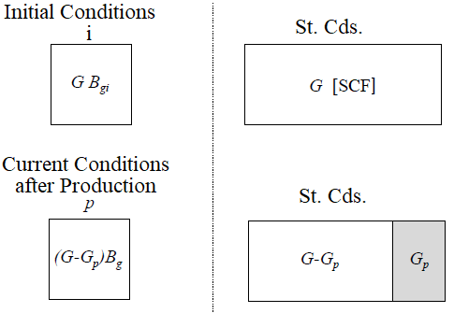
Dry Gas Expansion
Let us consider a dry gas reservoir where the production is modelled using material balance calculations.
The hydrocarbon pore volume (HCPV) is constant in absence of water influx. The production of gas at surface conditions is Gp.
……………………… (1)
Volume transformation using volume formation factors

Slide 6
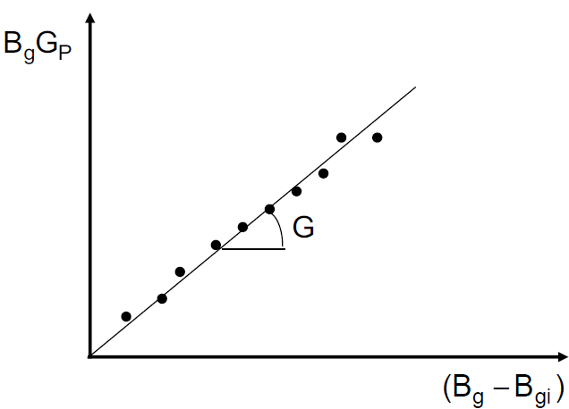
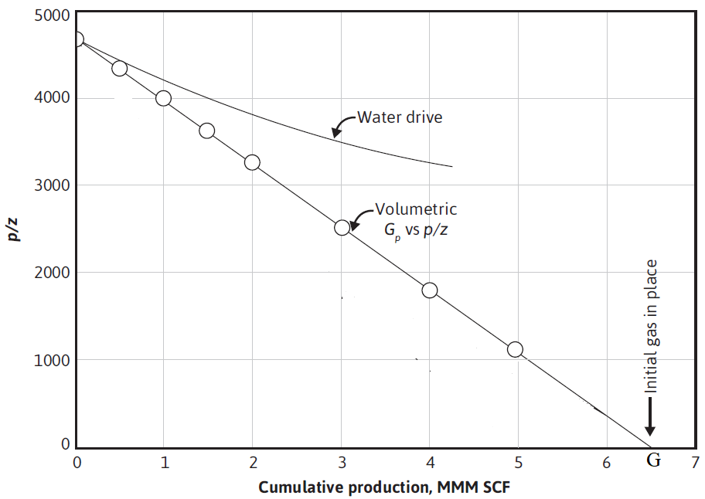
Dry Gas Expansion
Method #1:
Method #2:
Material Balance Equation linearization method:
Eq.(1) can be written as follows:
Eq.(1) can be written as follows:
…… (3)
…… (2)
Thus, for isothermal flow in gas reservoirs, , Eq. (2) becomes as follows:
or
……… (4)
Recovery factor:
From Eq.(3), plot of p/z vs. Gp (cumulative gas production) gives a straight line.
Two important characteristics from this straight line:
This is a proof for the assumption of no or negligible water influx during gas production and that the main driving force behind the production is gas expansion.
The intersection point with the x-axis gives an estimate for initial gas in place, G.

Slide 7
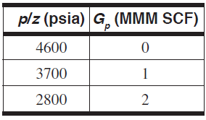
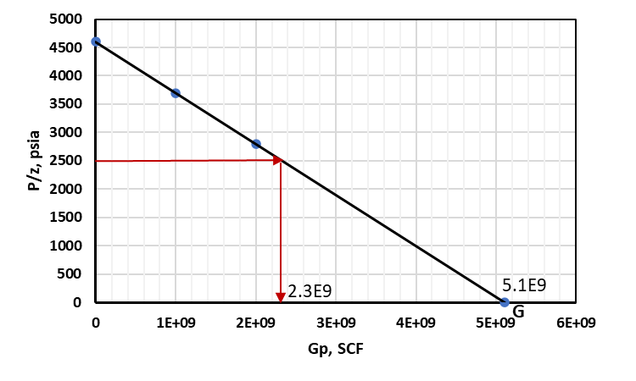
Dry Gas Expansion
Example
A dry gas reservoir with an initial reservoir pressure of 4200 psia and temperature of 180°F. The reservoir has been producing for some time. Two pressure surveys have been made at different times as shown in the Table. Calculate the initial gas in place and the cumulative gas produced when the reservoir pressure becomes 2000 psia. Given z = 0.8 at 2000 psia and 180 °F.
Solution
Plot P/z vs. Gp, as shown in the figure and extend the line to intersect with x-axis.
Read from the Graph, $G=5.1×{10}^{9}$ SCF
At P = 2000 psia, P/z = 2000/0.8 = 2500 psia
From the Graph at P/z = 2500 psia, $G_{p}=2.3 ×{10}^{9} SCF$

Slide 8
General Oil Reservoir

Slide 9
General Oil Reservoir

Slide 10
General Oil Reservoir

Slide 11
General Oil Reservoir

Slide 12
General Oil Reservoir

Slide 13
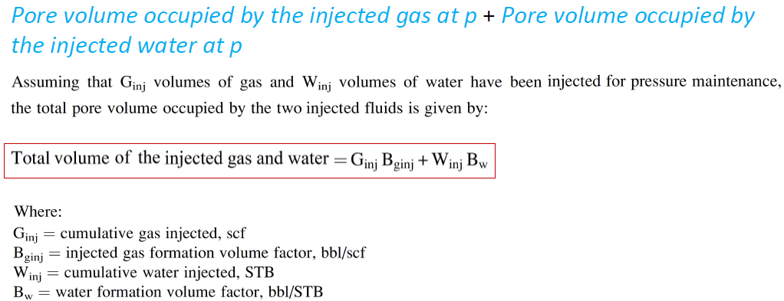
General Oil Reservoir

Slide 14
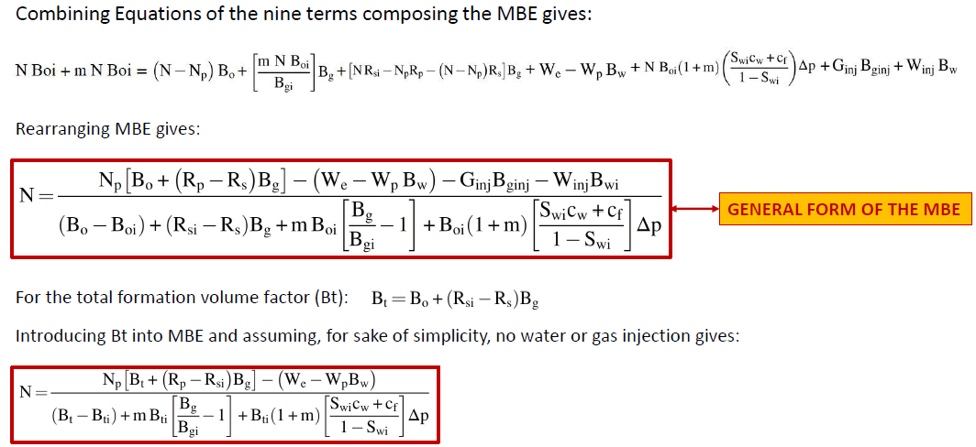
General Oil Reservoir

Slide 15
Reservoirs Drive Indices

Slide 16
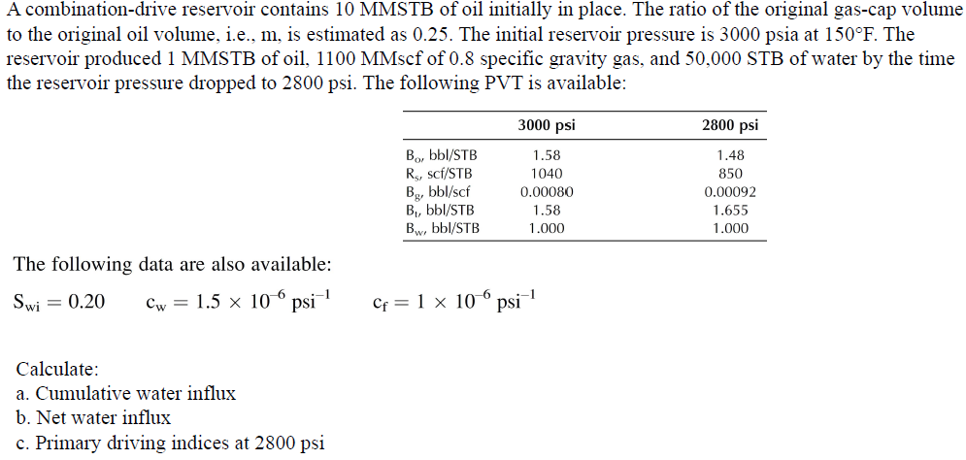
Reservoirs Drive Indices
Example

Slide 17
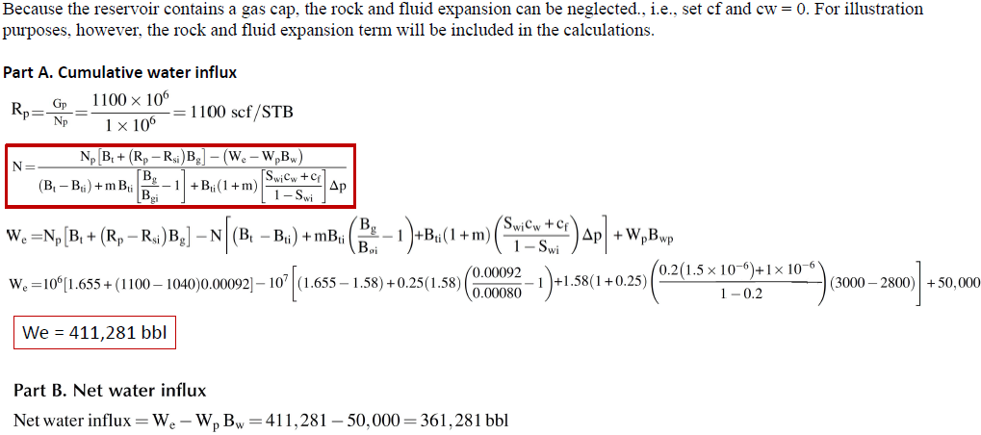
Reservoirs Drive Indices
Solution

Slide 18
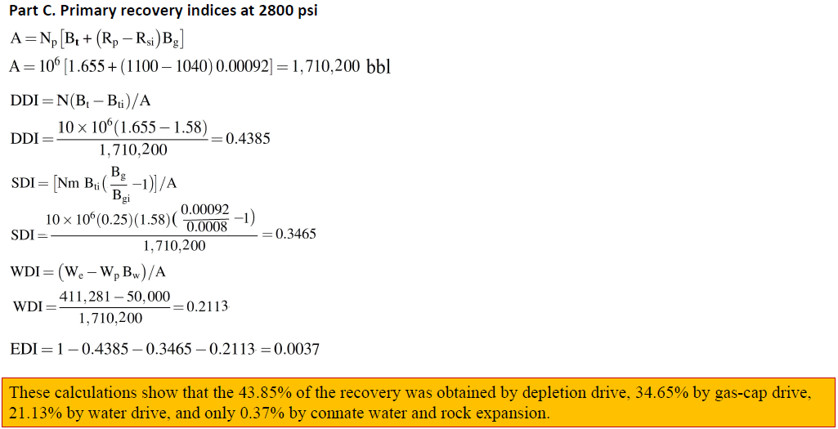
Reservoirs Drive Indices

Slide 19
The MBE as an Equation of a Straight Line
Havlena and Odeh Equation:
F represents the underground withdrawal and given by:
Eo describes the expansion of oil and its originally dissolved gas:
Eg is the term describing the expansion of the gas-cap gas:
Ef,w represents the expansion of the initial water and the reduction in the pore volume:

Slide 20
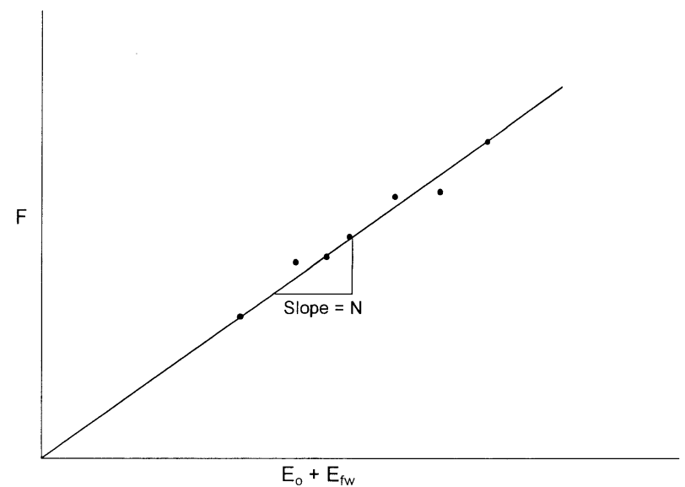
The MBE as an Equation of a Straight Line
1. Undersaturated-Oil Reservoirs
F = N [Eo + m Eg + Ef,w] + We
We = 0, since the reservoir is volumetric
m = 0, since the reservoir is undersaturated
Rs = Rsi = Rp, since all produced gas is dissolved in the oil
Applying the above conditions, the equation become:
F = N (Eo + Ef,w)
where N = initial oil in place, STB
F = Np Bo + Wp Bw
Eo = Bo − Boi

Slide 21
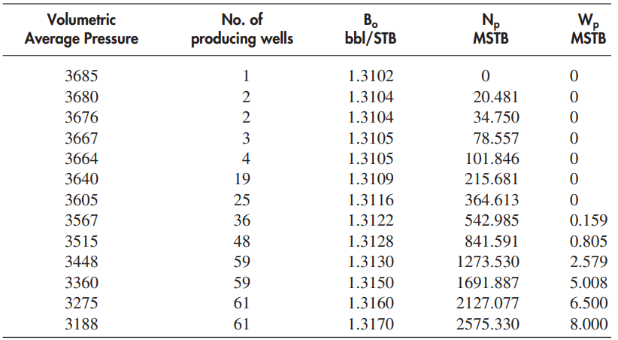
The MBE as an Equation of a Straight Line
Example
The Virginia Hills Beaverhill Lake field is a volumetric undersaturated reservoir. Volumetric calculations indicate the reservoir contains 270.6 MMSTB of oil initially in place. The initial reservoir pressure is 3685 psi. The following additional data is available:
Swi = 24%, cw = 3.62 × 10−6 psi−1, cf = 4.95 × 10−6 psi−1, Bw = 1.0 bbl/STB, pb = 1500 psi
The field production and PVT data are summarized below:
Calculate the initial oil in place by using the MBE and compare with the volumetric estimate of N.

Slide 22
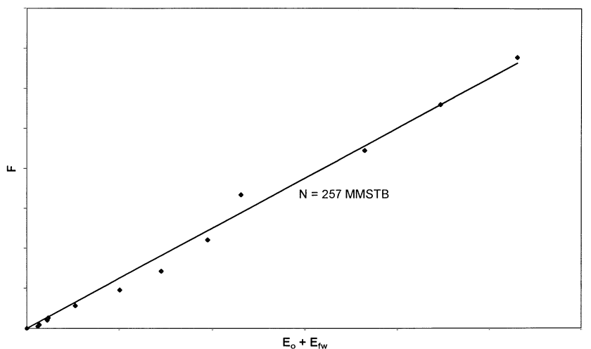
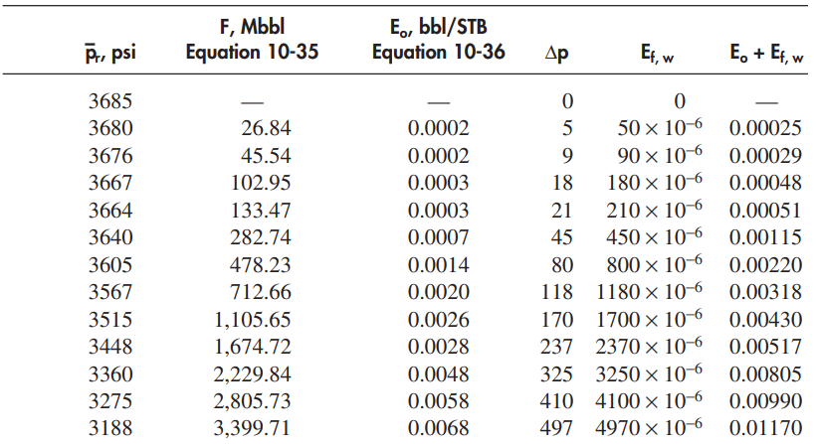
The MBE as an Equation of a Straight Line
Solution:
Step 1. Calculate the initial water and rock expansion term Ef,w
Step 2. Construct the following table:
Step 4. Draw the best straight line through the points and determine the slope of the line and the volume of the active initial oil in place as: N = 257 MMSTB
Step 3. Plot the underground withdrawal term F against the expansion term (Eo + Ef,w) on a Cartesian scale

Slide 23
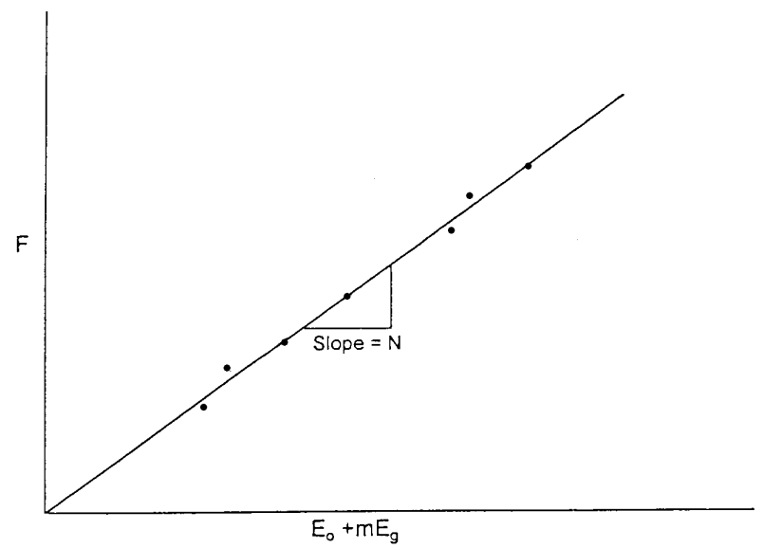
The MBE as an Equation of a Straight Line
2. Saturated-Oil Reservoirs
The main driving mechanism in this type of reservoir results from the liberation and expansion of the solution gas as the pressure drops below the bubble-point pressure. Assuming that the water and rock expansion term Ef,w is negligible in comparison with the expansion of solution gas, Equation can be simplified as:
Eo
3. Gas-Cap-Drive Reservoirs
For a reservoir in which the expansion of the gas-cap gas is the predominant driving mechanism and assuming that the natural water influx is negligible (We = 0), the effect of water and pore compressibility can be considered negligible. Under these conditions, the Havlena-Odeh material balance can be expressed as:

Slide 24
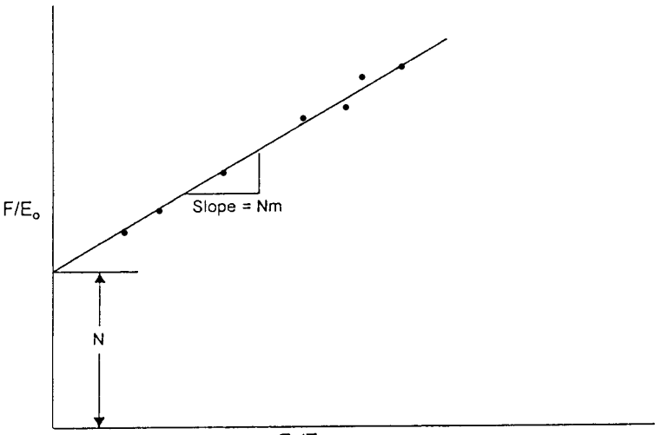
The MBE as an Equation of a Straight Line
3. Gas-Cap-Drive Reservoirs cont`d
In case m is unknown, the equation can be rearranged as an equation of straight line, to give:
A plot of F/Eo versus Eg/Eo should then be linear with intercept N and slope mN.
N = intercept
mN = slope
m = slope/intercept

