Slide 1
Pharmacology
AL-AYEN UNIVERSITY
COLLEGE OF HEALTH AND MEDICAL TECHNOLOGY
DEPARTMENT OF ANESTHESIA
By PhD Karima Aboul Fotouh
Lecturer 2

Slide 2
Pharmacology
It is divided into:
1-Pharmacotheraputic deals with the use of the drug for treatment of certain disease
2- Pharmacokinetic: what the body does to the drug (ADME).
3- Pharmacodynamics what the drug does to the body
4- Toxicology branch of pharmacology deals with the undesirable effects of chemicals
and drugs on living system.

Slide 3
Drugs can be useful in diagnosis, prevent, suppress (Treatment) or cure diseases
Source of drugs:
1- Natural Source .
a- Plant source: Digoxin, morphine, atropine, pilocarpine
b- Animal source: insulin and heparin
c- Minerals: magnesium sulphate and iodine,
d- Microorganisms: fungi and as penicillin.
2- Semisynthetic: drugs can be extensions of plant or animal sources as heroin (from morphine), ampicillin (from penicillin)
3- Synthetic:
a- Chemically: barbiturate, sulpha, aspirin
b- Genetic engineering: e.g. Human insulin, interferon

Slide 4
Pharmacology specific area:
The interactions between a drug and the body are conveniently divided into two
classes:
Pharmacokinetic processes (What the body does to drug); this includes absorption, distribution, metabolism and excretion of drug
Pharmacodynamics processes (What the drug does to body). It deals with the biochemical and physiological effects of drugs and their mechanisms of action.

Slide 5
Pharmacokinetics
Absorption
Distribution;
Metabolism
excretion

Slide 6
I- Absorption of Drugs
Absorption is defined as the passage of a drug from its site of administration into the plasma.
Factors influencing absorption
1.Drug solubility (polarity-Lipid/ water Partition coefficient)
2.Effect of pH on drug absorption (Acid –Base Nature)
3.Route of administration
4.Blood flow to the absorption site
5.Total surface area available for absorption
6.Contact time at the absorption surface
7.Gastric emptying time
8.Presence of other drugs and Specific factors

Slide 7
Bioavailability is defined as the percentage of drug that reaches the systemic circulation in an unchanged form and becomes available for biological effect
extent of the absorption. e.g. if 100 mg of a drug is administered orally & 70 mg of
this drug is absorbed unchanged, the bioavailability is 70%

Slide 8
Factors that influence Bioavailability
1- First pass hepatic metabolism
2- Solubility of the drug
3- Chemical instability
4- Nature of the drug formulation

Slide 9
2- Distribution of Drug
Distribution of a drug from systemic circulation to tissues is dependent on lipid solubility, ionization, molecular size, binding to plasma protein, rate of blood flow and special barriers.

Slide 10
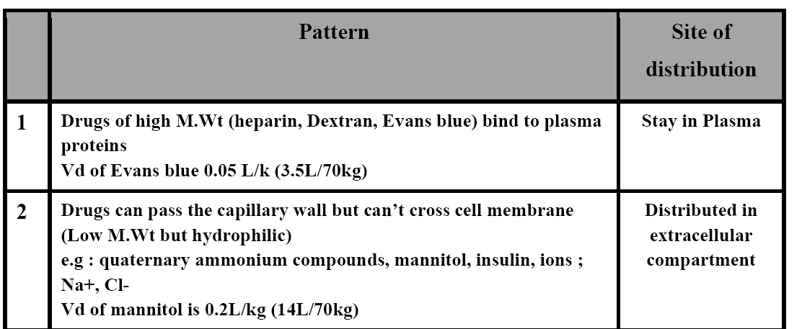
There are 4 Basic Patterns of Distribution

Slide 11
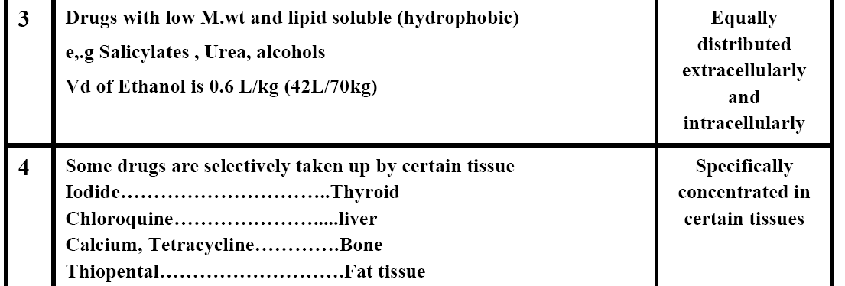

Slide 12
III- Drug Metabolism(Biotransformation)
conversion of drug molecules to more water soluble metabolites that are more readily excreted.
The lipophilic properties of drugs that allow them to pass through cell membrane hinder their elimination. Therefore, drugs are modified to become more polar so that elimination can occur more quickly.
Liver is the principle organ of drug metabolism.
Other tissues: GIT (drugs may metabolized by gastric acid e.g. penicillin), lungs, skin, and kidneys

Slide 13
Hepatic Microsomal Enzymes:
✓ Responsible for oxidation (by cytochrome p450), glucuronide conjugation, reduction and hydrolysis.
✓ The drug should be lipid to be metabolized by Hepatic Microsomal Enzymes
✓ Activity is low in new born (esp. premature), in elderly and starvation.
✓ They can be induced and inhibited by drugs.
Non -Microsomal Enzymes:
✓ Present in liver, gut, plasma, kidney, lungs.
✓ Responsible for other conjugation, oxidation, reduction and hydrolysis
✓ Activity is stable and are not induced or inhibited.
✓ e.g: Xanthine oxidase (converts xanthin to uric acid) and monoamine oxidase (MAO) (oxidizes adrenaline, dopamine, serotonin)

Slide 14
Biotransformation reactions: are classified into:
A- Non synthetic reaction (Phase I metabolism)
Include oxidation, reduction and hydrolysis.
1- Conversion of active compound to inactive: Acetylcholine converted to choline+ acetic acid
2- Conversion of active drug into active metabolites: Codeine is metabolized to morphine (long duration)
3- Conversion of inactive compound (Prodrugs)
to active metabolites
4- Conversion to toxic compound

Slide 15
B- Synthetic (Phase ΙΙ Metabolism): Conjugation of drug or its metabolite with
glucuronic acid (microsomal enzymes) or acetic acid, glycine, sulphate or methyl group (non- microsomal). They usually result in drug inactivation but morphine-6-glucuronide is active.

Slide 16
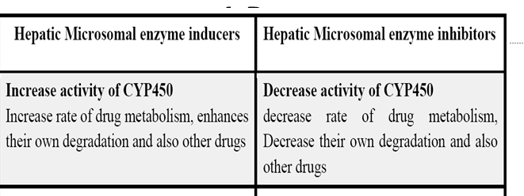
Factors affecting drug metabolism

Slide 17
Factors affecting drug metabolism
1-Drugs
2-Age
3-Disease state:

Slide 18
4 Excretion of drugs
It is the process by which a drug or metabolite is eliminated from the body
Routes of excretion
1- Renal Excretion
2- Other Routes of drug excretion
Lung: Gases and volatile anesthetics, sweat
(Rifampicin), saliva (iodide – morphine), tears, GIT: through bile

