Slide 1
CHAPTE R 1 Medical terminology

Slide 2
List of Contents
Review (What do you know about Terminology, Roots)
Suffixes
Spelling of medical terms
Pronunciation of medical terms
Test
Home work (quiz with all suffixes and their examples)
2ND LECT.
Lect. Dr. Laith & Dr. Asaad

Slide 3
Suffixes
A suffix is a letter or group of letters added to the end of a word to change its meaning or to produce a new word (part of speech).
Gastr(Noun) +O +scopy (Suff.)= gastroscopy (visualizing the stomach)
Gastr(Noun) +O +tomy (Suff.)= gastrotomy (incision the stomach)
dent (N.)+ al = dental (adjective).( relating to the teeth )
Neur+ algia= neuralgia (having pain in the nerve)
Neur+ itis = neuritis (inflammation of the nerve)
Neuro+plasty =neuroplasty (plastic repair of the nerve)
although the three words above have the same root Neur, they have different meaning because of the different suffixes.

Slide 4
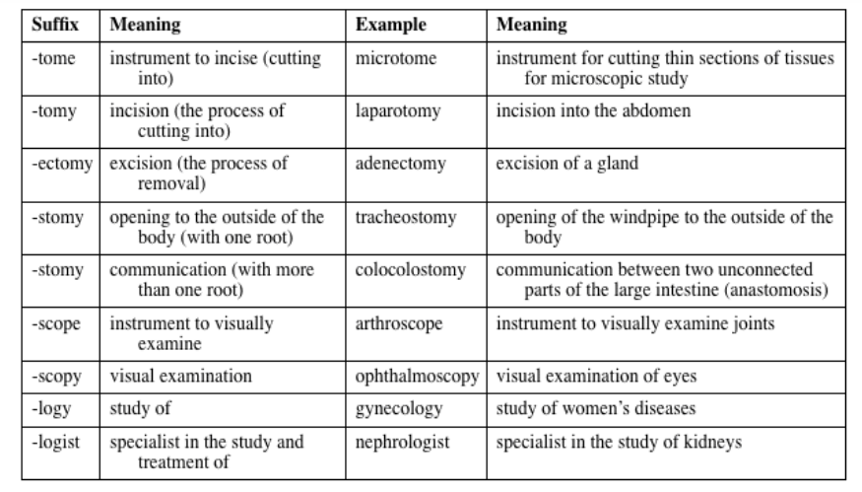

Slide 5
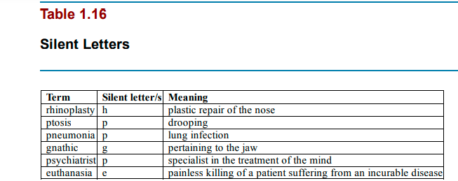
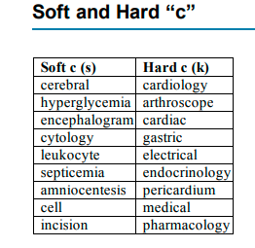

Slide 6
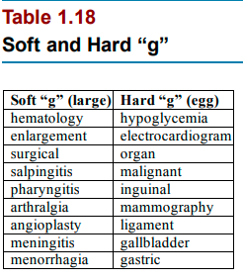

Slide 7
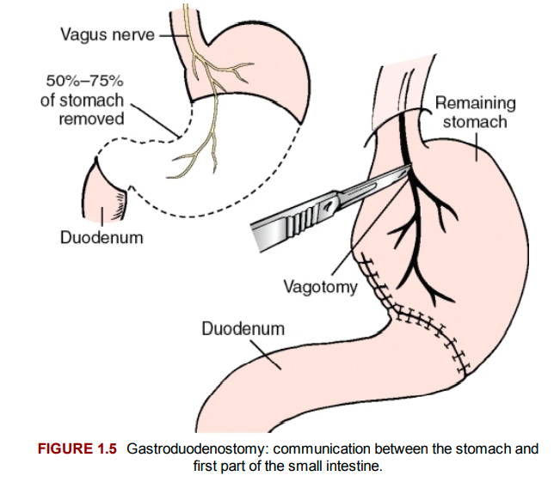

Slide 8
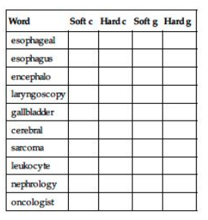
Practice 1.1 Identify whether each of the following words has A soft or hard “C” or “G.”
Word
esophageal
esophagus
encephalo
Laryngoscopy
gallbladder
cerebral
Sarcoma
leukocyte
nephrology
oncologist

Slide 9
Answers
1- soft g 6- soft c
2- hard g 7- hard c
3- soft c 8-soft c
4- hard (g –c) 9- soft g
5- hard g 10- hard c soft g

