Slide 1
Lec.3 Petroleum Origin
Dr. Murtadha Al zaidi

Slide 2
Chemical Composition of Petroleum ▪ Substances present in petroleum fall into four major groups: ▪ Paraffins ▪ Naphthenes ▪ Aromatics ▪ Non-hydrocarbon ▪ The relative proportions of these compounds determine the physical properties (density, viscosity, pour point, etc) of petroleum.

Slide 6
Fractional Distillation
▪ Fractional distillation splits the crude oil into simpler mixtures called fractions. The different fractions are taken out of the still at different levels. ▪ This happens in a distillation tower (which we shorten to still). ▪ The crude oil is heated in a furnace to about 370°C and is pumped into the bottom of a distillation tower. Most of the hydrocarbons are gaseous, though the very thick ones are still a liquid even at this temperature.

Slide 7
The tower is like a giant heat exchanger - it removes heat from the gases as they rise up it. The temperature falls to 20°C by the time the vapours reach the top. ▪ The vapours condense as they rise up the tower. The heavier ones (with higher boiling points) condense first. The thinner, runny ones get further up the tower before they condense. And the gases pass out of the top.

Slide 8
Where do Product come out of a Still? ▪ A distillation tower splits crude oil into separate fractions. ▪ Each fraction is a mix of hydrocarbons. Each fraction has its own range of boiling points and comes off at a different level in the tower. ▪ In reality, a single tower could not cover the full range of temperatures needed to split up the heavier fractions.

Slide 10
Source Rocks
Generally, finer-grained sediments contain more organic matter than coarser-grained ones because of the restricted diffusion and thus the lower amount of oxygen that can get in contact with organic matter (OM). TOC can reach 20% or more. Coals and oil shales are rich in OM but are called source rocks. Most source rocks are black shales.

Slide 11
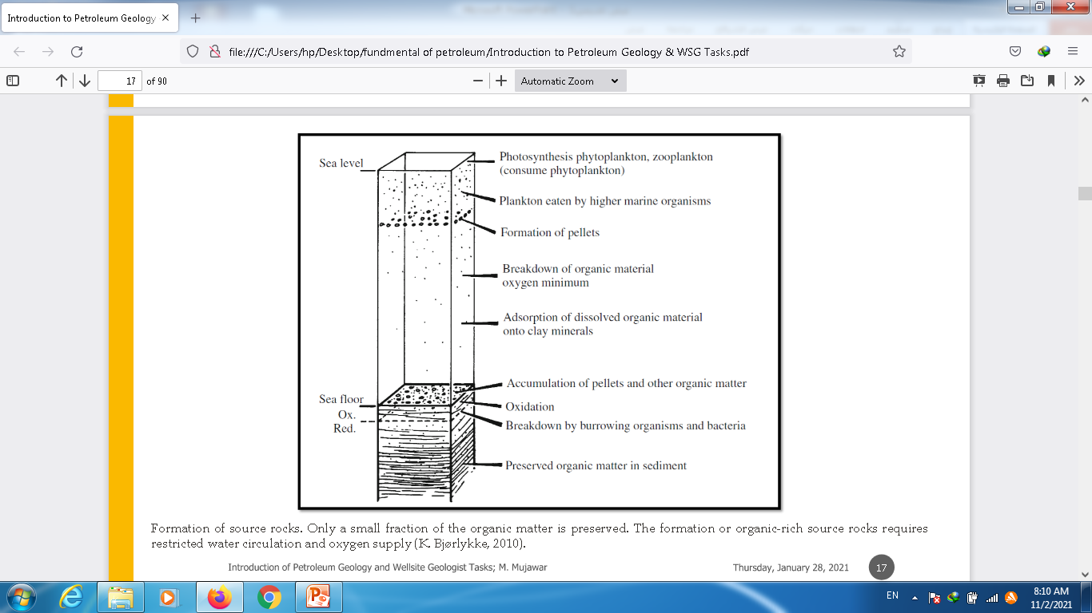

Slide 12
Total Organic Carbon (TOC)
If a rock contains significant amounts of organic carbon, it is a possible source rock for petroleum or gas. The TOC content is a measure of the source rock potential and is measured with total pyrolysis. The table below shows how TOC (in weight percent) relates to the source rock quality.

Slide 14
TOC Types
TOC in sedimentary rocks can be divided into two types: • Bitumen, the fraction that is soluble in organic solvents such as chloroform. • Kerogen, (wax) the insoluble, non-extractable residue that forms in the transformation from OM Kerogen is an intermediate product formed during diagenesis and is the principal source of hydrocarbon generation. It is a complex mixture of high-weight organic molecules.

Slide 15
Conversion of OM to HC
The principal condition is that this conversion take place in an essentially oxygen-free environment from the very beginning of the process. Anaerobic bacteria may help extract sulfur to form H2S and N, in addition to the earlier formation of CO2 and H2O. This explains the low sulfate content of many formation waters. On burial, kerogen is first formed. This is then gradually cracked to form smaller HC, with formation of CO2 and H2O. At higher temperatures, methane is formed and HCs from C13 to C30. Consequently, the carbon content of kerogen increases with increasing temperatures. Simultaneously, fluid products high in hydrogen are formed and oxygen is eliminated.

Slide 16
With increasing temperature, the chemical bonds in these large molecules (kerogen) are broken and kerogen is transformed into smaller molecules which make up oil and gas. This requires that the temperature must be 80–150° C over long geological time (typically 1–100 million years). The conversion of kerogen to oil and gas is thus a process which requires both higher temperatures than one finds at the surface of the earth and a long period of geological time. Only when temperatures of about 80–90° C are reached, i.e. at 2–3 km depth, does the conversion of organic plant and animal matter to hydrocarbons very slowly begin to take place. About 100–150°C is the ideal temperature range for this conversion of kerogen to oil, which is called maturation. This corresponds to a depth of 3–4 km with a normal geothermal gradient (about 30–40° C/km).

Slide 17
In general, we can say that petroleum can not be generated near the surface except locally through the influence of hydrothermal and igneous activity. Shallow deposits of oil and gas which we find today were actually formed at great depths and either the overburden has been removed by erosion or the hydrocarbons have migrated upwards considerable distances.

Slide 21
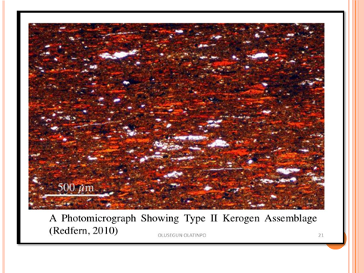

Slide 24
I appreciate your Attention

