Slide 1
COLLAGE OF DENTISTRY
الفرع العلمي : امراض وجراحة اللثة
Periodonticsالمادة:
Dental Stain المحاضرة:
6 رقم المحاضرة:
اسم تدريسي المادة: د. حسام سامي إسماعيل

Slide 2
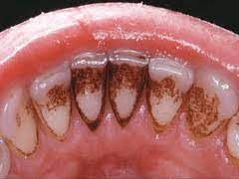
Dental Stain

Slide 3
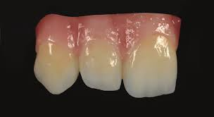
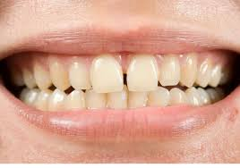
Color and color perception

Slide 4
Classification of tooth discoloration
Any changes in hard tissue component of tooth, cause alteration in the outward appearance of the tooth caused by its light transmission and reflecting properties
According to location
Intrinsic, extrinsic and internalized stain

Slide 5
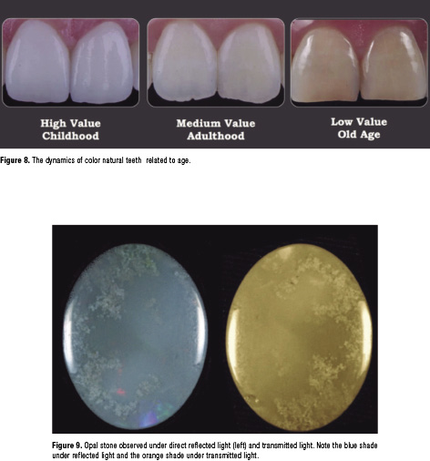
Intrinsic Discoloration
Intrinsic discoloration occur during development as a result in changes in composition or thickness in enamel, dentin and pulp
Normal color of tooth is determined by blue, green, pink tints of the enamel, reinforced by the yellow shades of dentine beneath

Slide 6
Mechanism of tooth discoloration
Intrinsic tooth Discoloration:
1- Alkaptonuria:
Incomplete oxidation of tyrosine and phenylalanine, leads to increase level of homogentisic acid, this effect the permanent dentation by causing brown discoloration.

Slide 7
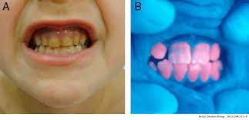
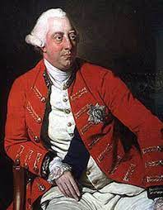
2- congenital erythropoietic porphyria
Rare , recessive, autosomal , metabolic disease caused by error in porphyrin metabolism, leading to accumulation of porphyrin in bone marrow, red blood cells, urine, feces.
Red-brown discoloration of the teeth ….with red fluorescence under ultra-violet light.

Slide 8
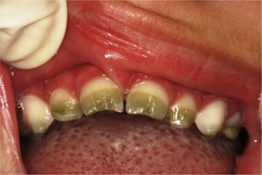
3-Congenital Hyperbilirubinemia
-Yellow- green discoloration occur as a result of hemolysis
-rhesus incompatibility hemolysis lead to deposition of bile pigment in the calcifying dental hard tissue , particularly in neonatal teeth.

Slide 9
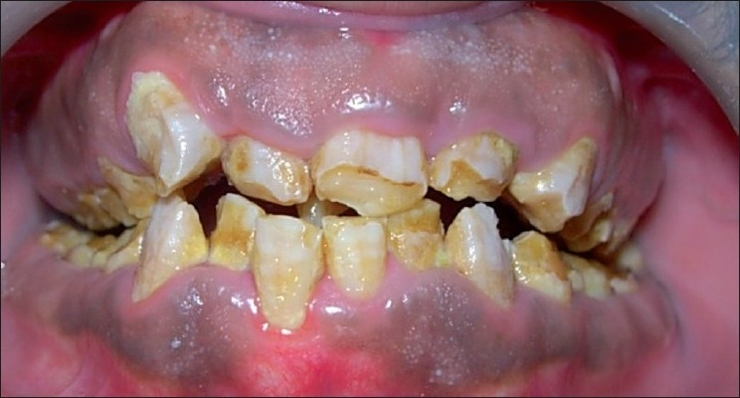
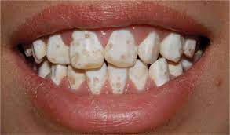
4- Amelogenesis imperfecta
Autosomal dominant X-linked trait resulted from disturbed formation of enamel either in mineralization or in matrix formation.
There are 14 different subtypes according to severity which may vary from mild hypomature (snow-capped) enamel to more sever hypoplasia which has yellow to yellow brown appearance.

Slide 10
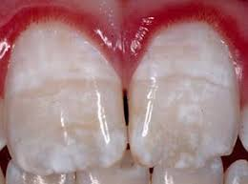
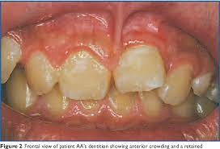
5- systemic syndrome
Number of sysytemic disease cause disruption of enamel formation include: vit D dependent rickets, epidermolysis bullosa and pseudohypoparathyrodisim..
Ehler-Danlos syndrome causing irrigularities in the region of amelo-dentinal and cemento-dentinal junctions.
Epidermolysis bullosa causing pitting of the enamel caused by vesiculation of the ameloblast layer

Slide 11
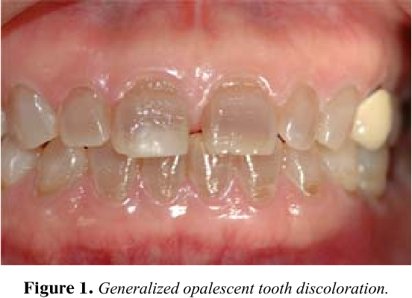
6-Dentinogenesis imperfecta
Three types of dentininogensis imperfect:
Type l: associated with osteogensis imperfect , show bone fragility, blue sclera, lax joints and opalescent dentine , the teeth often show opalescent color.
The enamel is much less prone to fracture , the pulp , the pulp chamber is seldom occluded by dentine

Slide 12
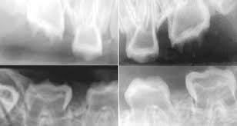
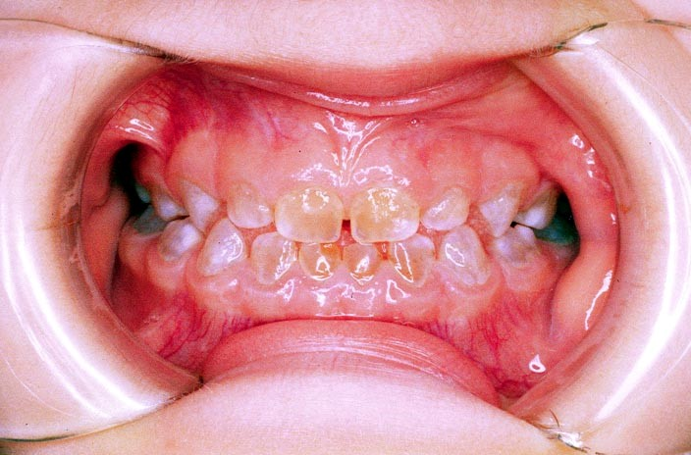
6-Dentinogenesis imperfecta
Type ll : associated with dentine alone , the teeth are usually brown or bluish in color.
The enamel is more prone to fracture to expose the amelo-dentinal junction and pulp chamber become obliterated
Type lll: resembling type l and ll however multiple pulpal exposures occur in the primary dentitions ..
Radiographically : teeth appear like shell appearance

Slide 13
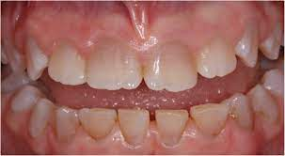
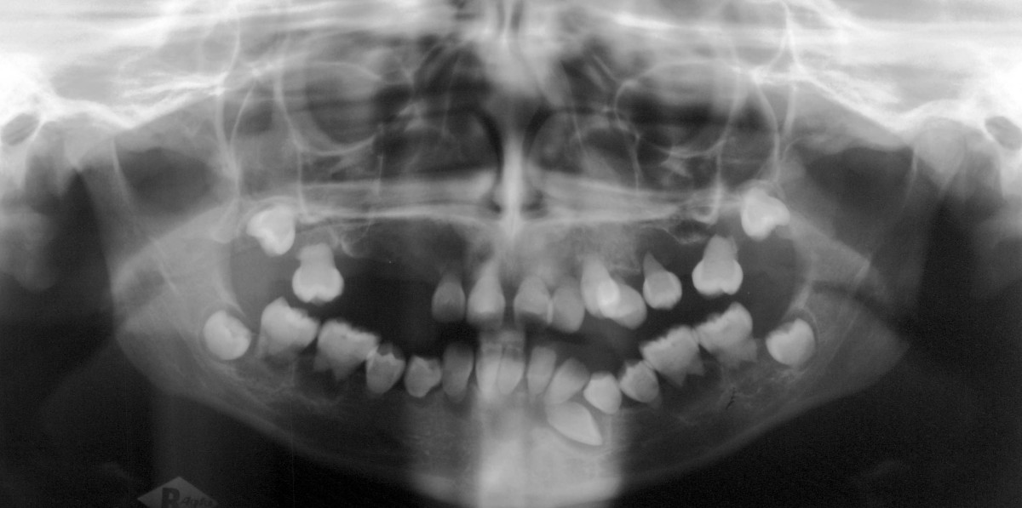
7- Dentinal dysplasia
Type l : the teeth have short roots with conical apical constrictions. Only crescent pulpal remnants are found in permanent dentation.
There are characteristic periapical radiolucency's in many disease free teeth.
Type ll : the main characteristic is that of a thistle-shaped pulp chamber with numerous pulp stones.
Teeth have brown discoloration …

Slide 14
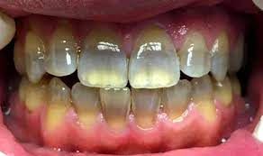
8- Tetracycline staining
-Tetracycline has the ability to form complexes with calcium ions on the surface of hydroxyapatite crystals within bone and dental hard tissue.
-tetracycline has the ability to cross the placental barrier and should be avoided from 29 weeks of uterus until 12 years of age.
-teeth affected by tetracycline have yellowish to brown– grey appearance, when exposed to light it become bright yellow to brown color.

Slide 15
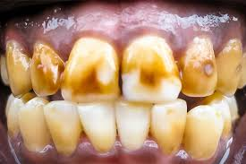
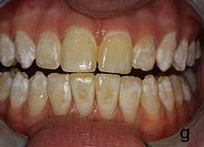
9- Fluorosis
-Dependent on the age and dose ,Mild fluorosis resulted in chalky white appearance , brown-black discoloration occur in sever condition as a result from internalized extrinsic stain into porous enamel surfaces.
-These features mimic with hypomaturation type of amelogenesis imperfecta…

Slide 16
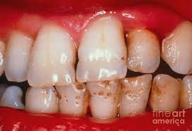
10- Enamel Hypoplasia
Localized enamel hypoplasia occur following trauma or infection in the primary dentition.
Generalized enamel hypoplasia occur in large number of fetal or maternal conditions (maternal vit D deficiency, Rubella infection, drug intake during pregnancy and in pediatric hypocalcemic conditions)
There may be pitting or grooving wich predisposing to extrinsic stain..

Slide 17
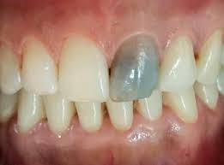
11- Pulpal hemorrhagic products
- Sever trauma to the teeth caused hemolysis of red blood cells with releasing of hem group to combined with pulpal tissue to form black iron sulphide.
It has been shown that the pinkish hue seen initially after trauma may disappear in 2-3 months if the tooth become revasculrized.

Slide 18
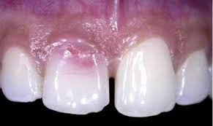
12- Root resorption
Root resorption is asymptomatic.
Occur either from pulpal or periodontal aspects.
- Initial presenting feature is a pink appearance at the amelo-cemental junction.

Slide 19
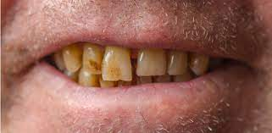
13- Aging
The natural laying down of secondary dentine affects the light –transmitting properties of teeth resulting in a gradual darkening of teeth with age.

Slide 20
Extrinsic Discoloration
1- Non metallic stain ( direct staining):
- Chromgenes attached directly by enamel pellicle and dental plaque (dietary compounds , beverages, tobacco, mouth rinses and other medicament).
- Chromogenic bacteria have been cited in children (green stain caused by Penicillium and Aspergillus species , orange stain associated with children with poor oral hygiene infected by Actinomyces species , black stain associated with good oral hygiene infected by same bacteria

Slide 21
2- Metallic stains ( indirect staining)
Associated with occupational exposure to metallic salts and with number of medicines contains metal salts.
Iron supplements and iron foundry workers resulted in black staining of teeth.
Copper and mouth rinses containing copper causes green stain.
silver nitrate salts used in dentistry cause grey color whereas stannous fluoride cause golden brown discoloration.
Iron sulfate found in tea produce black discoloration.

Slide 22
Internalized discoloration
Dental defects that permit the entry of chromogenic material can be classified into:
1- Developmental defects: either defect in enamel such as ( dental fluorosis , enamel hypoplasia ) or defect in dentin such as dentiogenesis imperfect, witch promote the entry of extrinsic stain into dentinal tubules.

Slide 23
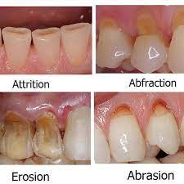
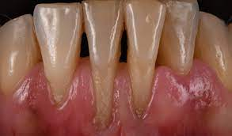
2- Acquired defects
A- Tooth wear and gingival recession :

Slide 24
B- Dental caries
The initial lesion characterized by an opaque, white spot , air drying removes water from the pores and leaving air makes a white spot lesion.
Enamel has a Refractive index pf 1.62 compared with 1.33 for water and 1.0 for air.
The arrested lesion have a black color picked up from exogenous sources.
Changes in color resulted from releasing of amino acids during proteolysis as a result of cavity formation…

Slide 25
C- Restorative material including amalgam
Eugenol and phenolic compounds used during root canal therapy contain pigments which may stain dentine.
Some of poly antibiotic pastes used in endo therapy may cause darkening of root dentine.
Dark grey appearance resulted from removal of long standing amalgam filling, it has been thought that mercury was penetrating the dentinal tubules and reacted with sulphide ions. Electron microscopy have shown that tin migrate to dentinal tubule.

Slide 26
Treatment options:
1- diet and habits.
2- tooth brushing.
3- professional tooth cleaning.
4- enamel microabrasion by using mixture of hydrochloric acid and silicon carbide particles in a water soluble paste.
5- Bleaching.

Slide 27
Thank You

