Slide 1
AL-AYEN UNIVRSITY COLLEGE OF ENGINEERING
RESERVOIR ENGINEERING I
Reservoir Fluid Properties
Properties of Oil
2022-2023
NASIR ATALLAH
ASMAA AHMED

Slide 2
Reservoir Fluid Properties
Outline
Oil properties
Crude oil density
Oil specific gravity
API gravity
Solution gas gravity
Bubble-Point Pressure
Oil formation volume factor
Solution gas oil ratio
Total formation volume factor
Isothermal compressibility coefficient
Oil viscosity
Other oil properties (production data)

Slide 3
Oil Properties
Crude oil is a complex mixture consisting predominantly of hydrocarbons and impurities such as sulphur, nitrogen, oxygen, and helium as minor constituents.
The physical and chemical properties of crude oils depend on the concentration of the various types of hydrocarbons and minor constituents present
Oil Properties include:
Oil density
Specific gravity.
API gravity
Oil formation volume factor.
Gas solubility.
Isothermal compressibility coefficient
Oil viscosity.

Slide 4
Crude Oil Density
The crude oil density is defined as the mass of a unit volume of the crude at a specified pressure and temperature.
Oil density usually is expressed in pounds per cubic foot.
Oil density varies from 30 lb/ft3 for light volatile oil to 60 lb/ft3 for heavy crude oil
Oil density is measured in the laboratory as part of routine PVT tests.
$$ρ_{o}=\frac{m}{V}$$

Slide 5
Crude Oil Density
The crude oil density is defined as the mass of a unit volume of the crude at a specified pressure and temperature.
Density of Saturated Oils (P ≤ Pb)
Depending on the available data, density of saturated oils (P ≤ Pb) can be calculated from one of the following equations:
……………………………(1)
……………………………(2)
5

Slide 6
Crude Oil Density
Density of Undersaturated Oils (P > Pb)
Density of the oil at pressures above the bubble-point pressure can be calculated with:
Note: The isothermal compressibility coefficient (Co) can be calculated by any of the methods that can be used for undersaturated oils.
6

Slide 7
Oil specific gravity
The specific gravity of a crude oil is the ratio of the density of the oil to that of water at 60°F and atmospheric pressure.
$$γ_{o}=\frac{ρ_{o}}{ρ_{w}}$$
$γ_{o}$= specific gravity of the oil
$ρ_{o}$ = density of the crude oil, lb/cubic ft
$ρ_{w}$= density of the water, lb/cubic ft
Density of pure water at 60°F and atmospheric pressure is 62.4 lb/ft3 = 1 gm/cc

Slide 8
API gravity
API gravity is a commonly used index of the density of a crude oil.
API stands for the American Petroleum Institute (The industry organization that created this measure.
API$=\frac{141.5}{γ_{o}}−131.5$
API is calculated from a hydrocarbon's specific gravity:
The API gravities of crude oils usually range from 47° API for the lighter crude oils to 10°API for the heavier asphaltic crude oils.
Lighter (high API) crudes are more valuable because they yield more high-value light products when run through a refinery.

Slide 9
API gravity
Light crude is typically in the 35-45 API range,
A medium crude is in the 25-35 API range
Heavy crude is in the 15-25 API range
Crudes lighter than 45 are typically considered extra-light crude or condensates and are valued lower than light crude because they contain a lot of light ends such as propane and butane
Anything below 15 API would be considered an extra-heavy crude.

Slide 10
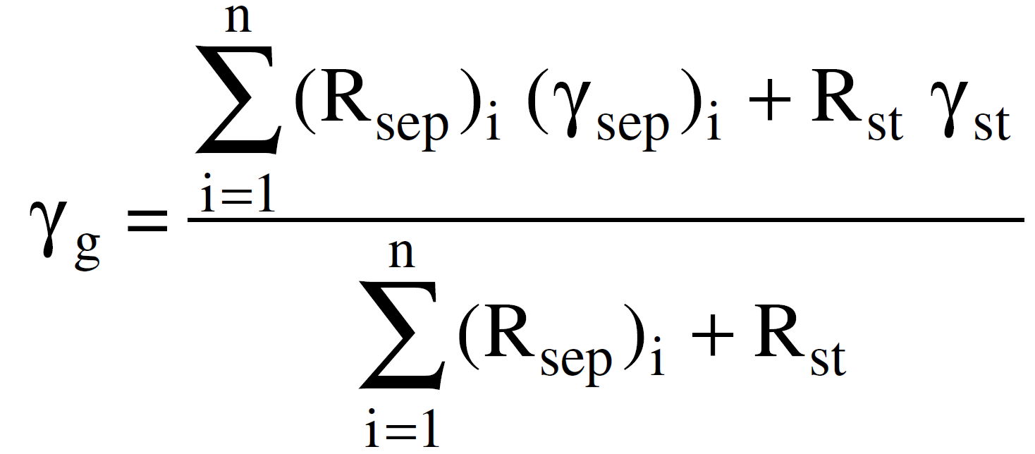
Specific Gravity of the Solution Gas
The specific gravity of the solution gas is described by the weighted average of the specific gravities of the separated gas from each separator.
This weighted-average approach is based on the separator gas-oil ratio, or:

Slide 11
Specific Gravity of the Solution Gas
Example
Separator tests were conducted on a crude oil sample. Results of the test in terms of the separator gas-oil ration and specific gravity of the separated gas are given below:
Calculate the specific gravity of the separated gas.
Solution
11

Slide 12
Bubble-Point Pressure
The bubble-point pressure Pb of a hydrocarbon system is defined as the highest pressure at which a bubble of gas is first liberated from the oil.
This important property can be measured experimentally.
In the absence of the experimentally measured bubble-point pressure, it is necessary for the engineer to estimate this crude oil property using one of empirical or mathematical correlations with available measured producing parameters.
The correlations are essentially based on the assumption that the bubble-point pressure is a strong function of gas solubility Rs, gas specific gravity, oil gravity API, and temperature T, or:

Slide 13
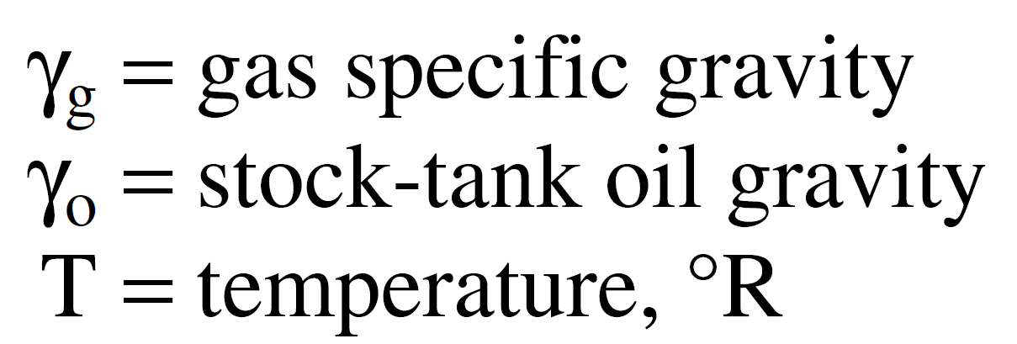
Empirical correlations for estimating the bubble-point pressure:
Bubble-Point Pressure
Standing’s Correlation
Standing (1981) presented the following correlation:
Standing’s correlation should be used with caution if nonhydrocarbon components are known to be present in the system.
Marhoun’s Correlation
Marhoun (1988) developed the following expression:
The reported average absolute relative error for the correlation is 3.66% when compared with the experimental data used to develop the correlation.
13

Slide 14
Oil Formation Volume Factor
Volume of reservoir oil at reservoir conditions required to produce one standard volume of stock tank oil. Symbol: Bo
$$B_{o}=\frac{Oil volume at reservor conditions, bbl}{Oil volume at standards conditions, STB}$$
Bo converts surface volumes to downhole volumes
Bo is always greater than or equal to unity.
STB are considered to be at 60°F and atmospheric pressure regardless of the actual temperature of the stock tank

Slide 15
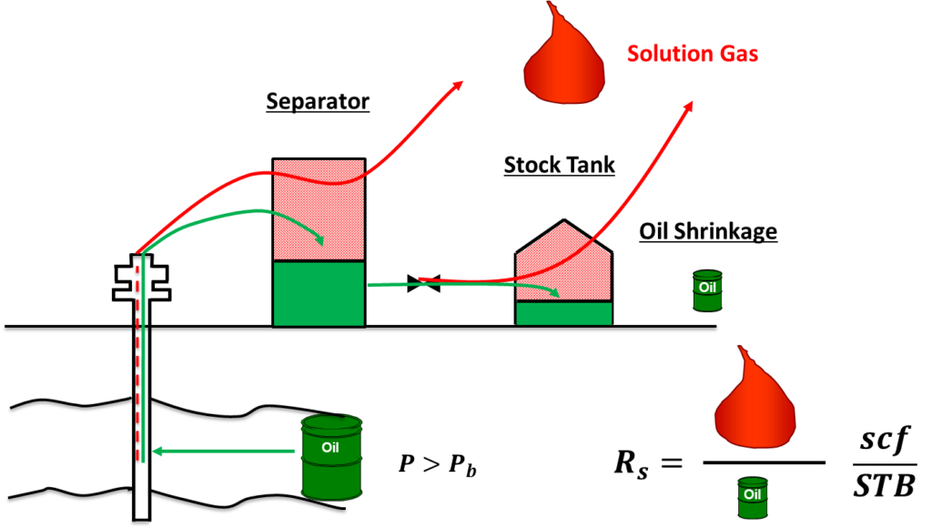
Oil Formation Volume Factor
When oil is transported to the surface, it shrinks.
Oil shrinks because gas evolves out of the oil as the pressure decreases. The gas that evolves from oil as it is transported from reservoir to surface conditions is called solution gas.

Slide 16
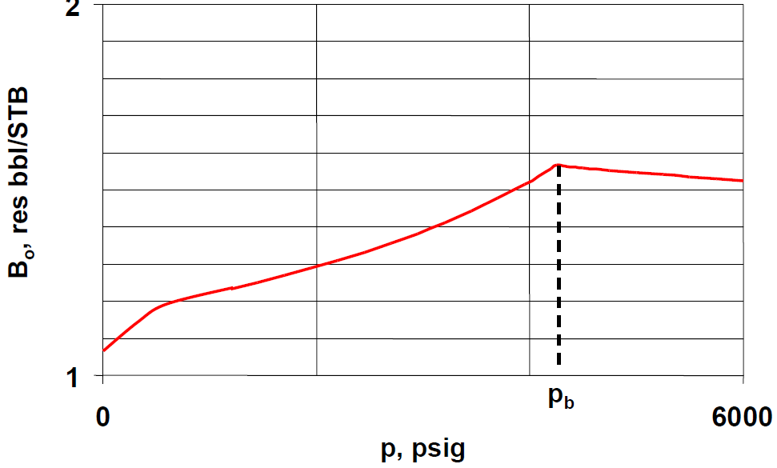
Oil Formation Volume Factor
As the pressure is reduced below the initial reservoir pressure pi, the oil volume increases due to the oil expansion.
This behaviour results in an increase in the oil formation volume factor and will continue until the bubble-point pressure is reached.

Slide 17
Oil Formation Volume Factor
At pb, the oil reaches its maximum expansion and consequently
attains a maximum value of Bo (Bob).
As the pressure is reduced below pb, volume of the oil and Bo are decreased as the solution gas is liberated.
When the pressure is reduced to atmospheric pressure and the temperature to 60°F, the value of Bo is equal to one.

Slide 18
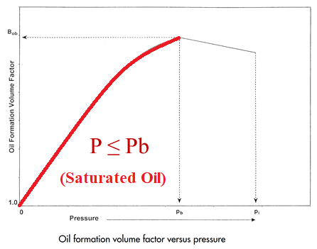
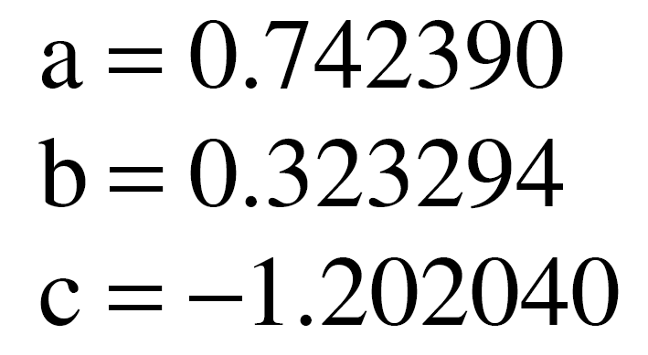
Oil Formation Volume Factor for Saturated Oils (P ≤ Pb)
Oil Formation Volume Factor
Standing’s Correlation
Standing (1981) showed that the oil formation volume factor can be expressed in a mathematical form by the following equation:
Marhoun’s Correlation
Marhoun (1988) developed a correlation for determining the oil formation volume factor as a function of the gas solubility, stock-tank oil gravity, gas gravity, and temperature.
18

Slide 19
Oil Formation Volume Factor
T. Ahmed (2006) suggested that the oil formation volume factor can be calculated from the following equation:

Slide 20
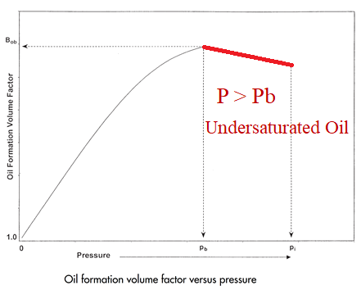
Oil Formation Volume Factor
Oil Formation Volume Factor for Undersaturated Oils (P > Pb)
The oil formation volume factor of undersaturated oil can be calculated from the following equation:
where
Bo = oil formation volume factor at the pressure of interest, bbl/STB
Bob = oil formation volume factor at the bubble-point pressure which can be calculated using any of the methods previously described for saturated oil, bbl/STB
p = pressure of interest, psia
pb = bubble-point pressure, psia
Co = isothermal compressibility coefficient of the oil at the arithmetic average pressure, 1/psi
20

Slide 21
Solution gas oil ratio
The gas solubility, Rs, is defined as the number of standard cubic feet of gas that dissolve in one stock-tank barrel of crude oil at certain pressure and temperature, (Unit: Scf/STB).
Volume of gas which comes out of the oil as it moves from reservoir temperature and pressure to standard temperature and pressure.
It is important to realize that solution gas does not include free gas. If the reservoir was saturated (reservoir pressure below the bubble point), a free gas phase would exist. We do not include free gas in the determination of solution gas because under reservoir conditions, the free gas is not dissolved in the oil.

Slide 22
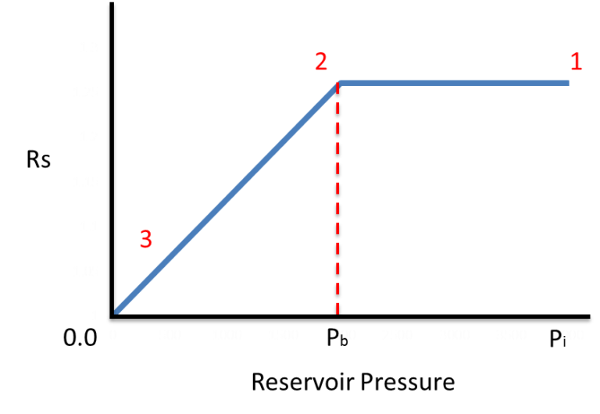
Solution gas oil ratio
The solution gas oil ratio changes as a function of pressure at constant reservoir temperature
As the reservoir pressure is decreased from initial reservoir pressure ( Pi ) to bubble point pressure ( Pb ), the dissolved gas oil ratio is constant. This is because, above the bubble point there is no free gas in the reservoir. So the amount of gas that comes out at the surface will be dissolved gas only and the solution gas oil ratio will remain constant.
As the reservoir pressure falls below bubble point pressure, free gas will continuously evolve in the reservoir. This leaves less gas dissolved in the oil, therefore the solution gas oil ratio steadily declines below the bubble point pressure.

Slide 23
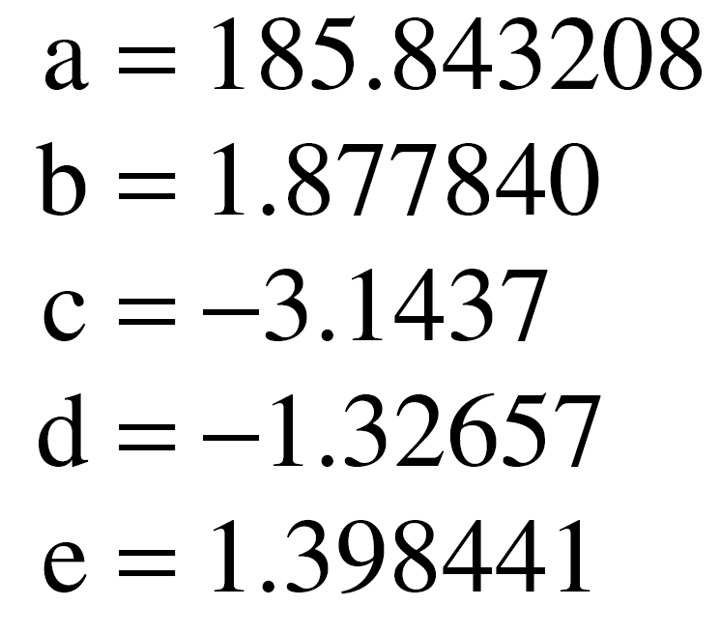
Empirical correlations for estimating the gas solubility
Solution gas oil ratio
Standing’s Correlation
Standing (1981) expressed his proposed graphical correlation in the following more convenient mathematical form:
Marhoun’s Correlation
23

Slide 24
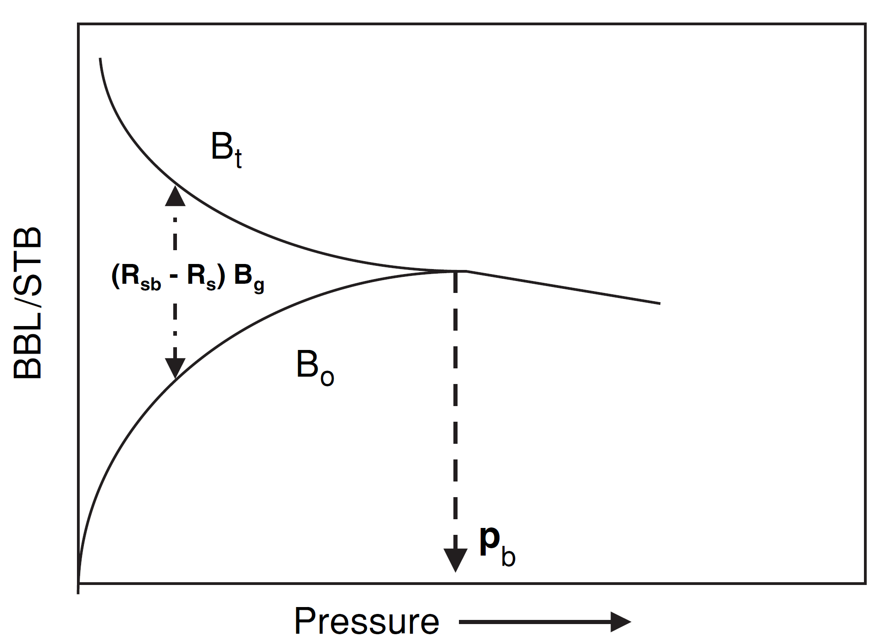
Total Formation Volume Factor
The total formation volume factor, denoted Bt, is defined as the ratio of the total volume of the hydrocarbon mixture (i.e., oil and gas, if present), at the prevailing pressure and temperature per unit volume of the stock-tank oil. Mathematically, Bt is defined by the following relationship:
At P ≥ Pb no free gas exists, thus Bt = Bo as shown below:
At P < Pb, Bt can be calculated as below:
Bt and Bo vs. Pressure

Slide 25
Isothermal compressibility coefficient
The isothermal compressibility of a substance is defined mathematically by the following expression:
For pressure above the bubble point pressure
For pressure below the bubble point pressure
where
co = isothermal compressibility (Oil compressibility), ${Psi}^{−1}$
Bo = oil formation volume factor, bbl/STB
Rs=Solution oil ratio, scf/STB
Bg = Gas formation volume factor, bbl/scf

Slide 26
Crude Oil Viscosity
Crude oil viscosity is an important physical property that controls and influences the flow of oil through porous media and pipes Units: centipoise.
The oil viscosity is a strong function of the temperature, pressure, oil gravity, gas gravity, and gas solubility.
Oil viscosity determination:
Laboratory measurements at reservoir T & P.
Correlations
μo = (P, T, API, gas gravity, Rs )

Slide 27
Other oil properties (production data)
Instantaneous Gas-Oil Ratio
The produced gas-oil ratio (GOR) at any particular time is the ratio of the standard cubic feet of total gas being produced at any time to the stock-tank barrels of oil being produced at that same instant. Hence, the name instantaneous gas-oil ratio. Equation describes the GOR mathematically by the following expression:
where GOR = instantaneous gas-oil ratio, scf/STB
Rs = gas solubility, scf/STB
krg = relative permeability to gas
kro = relative permeability to oil
Bo = oil formation volume factor, bbl/STB
Bg = gas formation volume factor, bbl/scf
µo = oil viscosity, cp
µg = gas viscosity, cp

Slide 28
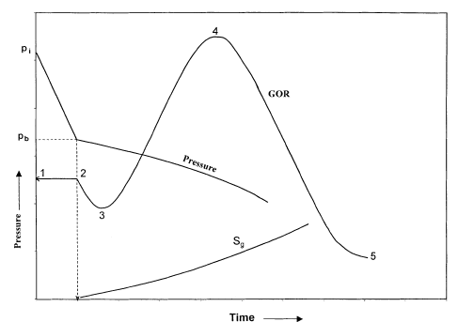
Instantaneous Gas-Oil Ratio
The instantaneous GOR equation is of fundamental importance in reservoir analysis
These illustrations show the history of the gas-oil ratio of a hypothetical depletion-drive reservoir that is typically characterized by the following points:
Point 1. When the reservoir pressure p is above the bubble-point pressure pb, there is no free gas in the formation, i.e., krg = 0, and therefore: GOR = Rsi = Rsb
The gas-oil ratio remains constant at Rsi until the pressure reaches the bubble-point pressure at Point 2.
Point 2. As the reservoir pressure declines below pb, the gas begins to evolve from solution and its saturation increases. This free gas, however, cannot flow until the gas saturation Sg reaches the critical gas saturation Sgc at Point 3. From Point 2 to Point 3, the instantaneous GOR is described by a decreasing gas solubility as: GOR = Rs

Slide 29
Instantaneous Gas-Oil Ratio
Point 3. At Point 3, the free gas begins to flow with the oil and the values of GOR are progressively increasing with the declining reservoir pressure to Point 4. During this pressure decline period, the GOR is described by the following equation, or:
Point 4. At Point 4, the maximum GOR is reached due to the fact that the supply of gas has reached a maximum and marks the beginning of the blow-down period to Point 5.
Point 5. This point indicates that all the producible free gas has been produced and the GOR is essentially equal to the gas solubility and continues to Point 6.

Slide 30
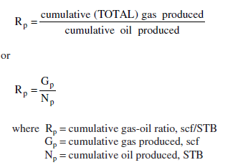
The cumulative gas-oil ratio
The cumulative gas-oil ratio Rp, as defined previously in the material balance equation, should be clearly distinguished from the producing (instantaneous) gas-oil ratio (GOR). The cumulative gas-oil ratio is defined as:
The cumulative gas produced Gp is related to the instantaneous GOR and cumulative oil production by the expression:

