Slide 1
AL-AYEN UNIVRSITY COLLEGE OF
PETROLEUM ENGINEERING
TECHNICAL ENGLISH
Lecture#11_ Drilling
2022-2023
NASIR ALSHMLH
ASMAA ALGHAZI

Slide 2
Drilling
Prepare to Drill
Once the site has been selected, it must be surveyed to determine its boundaries and environmental impact studies may be done. Lease agreements, titles and right-of-way accesses for the land must be obtained and evaluated legally. Once the legal issues have been settled, the crew goes about preparing the land:
1. the land is cleared and levelled and access roads may be built;
2. because water is used in drilling, there must be a source of water nearby. If there is no natural source, they drill a water well;
3. they dig a reserve pit, which is used to dispose rock cuttings and drilling mud during the drilling process, and line it with plastic to protect the environment. If the site is an ecologically sensitive area, such as a marsh or wilderness, then the cuttings and mud must be disposed offsite –trucked away instead of placed in a pit.
Once the land has been prepared, several holes must be dug to make way for the rig and the main hole. A rectangular pit, called a cellar, is dug around the location of the actual drilling hole. The cellar provides a work space around the hole, for the workers and drilling accessories. The crew then begins drilling the main hole, often with a small drill truck rather than the main rig. The first part of the hole is larger and shallower than the main portion and is lined with a large-diameter conductor pipe. Additional holes are dug off to the side to temporarily store equipment – when these holes are finished, the rig equipment can be brought in and setup.

Slide 3
Drilling Rig Components
Once the equipment is at the site, the rig is set up. Here are the major systems of a land rig:
1. Power system
• Large diesel engines – burn diesel fuel oil to provide the main source power;
• Electrical generators – powered by the diesel engines to provide electrical power;
2. Mechanical system
• Hoisting system – used for lifting heavy loads; consists of a mechanical winch (drawworks) with a large steel cable spool, a block-and-tackle pulley and a receiving storage reel for the cable;
• Turntable – part of the drilling apparatus;
3. Rotating equipment
• Swivel – large handle that holds the weight of the drill string; allows the string to rotate and makes a pressure- tight seal on the hole;
• Kelly – four\six-sided pipe that transfer rotary motion to the turntable and drill string;
Turntable (rotary table) – drives the rotating motion using power from electric motors;
• Drill string – consists of drill pipe (connected sections of about 30ft\10m) and drill collars (large diameter, heavier pipe that fits around the drill pipe and places weight on the drill bit);
• Drill bit – end of the drill that actually cuts the rock;

Slide 4
4. Casing – large-diameter concrete pipe that lines the drill hole; prevents the hole from collapsing and allows drilling mud to circulate.
5. Circulation system – pumps drilling mud (mixture of water, clay and weighting material and chemicals; used to lift rock cuttings from the drill bit to the surface) under pressure through the kelly, rotary table drill pipes and drill collars:
• Pump – sucks mud from the mud pits and pumps it to the drilling apparatus;
• Pipes and hoses – connects pump to drilling apparatus;
• Mud-return line – return mud from hole;
• Shale-shaker – shaker \sieve that separates rock cuttings from the mud;
• Shale slide – conveys cuttings to the reserve pit;
• Reserve pit – collects rock cuttings separated from the mud;
• Mud pits – where drilling mud is mixed and recycled;
• Mud-mixing hopper – where new mud is mixed and then sent to the mud pits;
6. Derrick – support structure that holds the drilling apparatus: tall enough to allow new sections of drill pipe to be added to the drilling apparatus as drilling progresses.
7. Blowout preventer – high-pressure valves (located under the land rig) that relieve pressure when necessary to prevent a blowout (uncontrolled gush of gas or oil to the surface, often associated with fire).

Slide 5
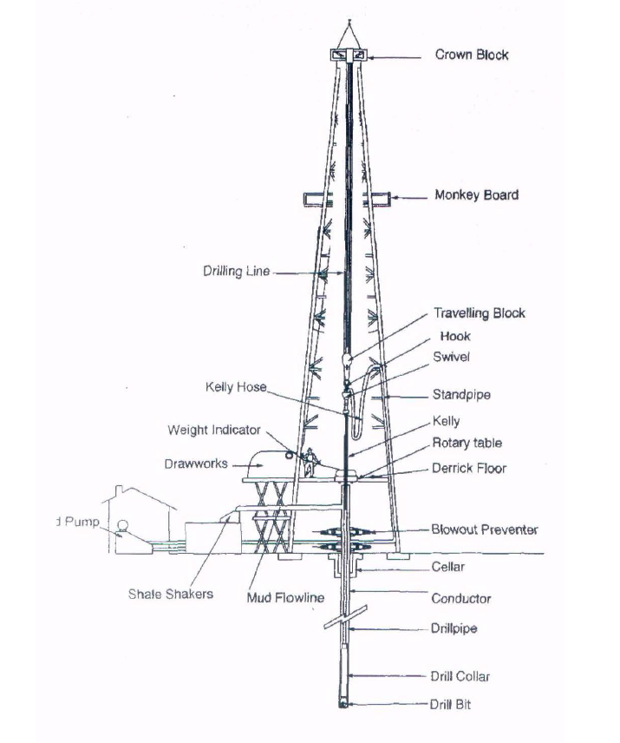

Slide 6
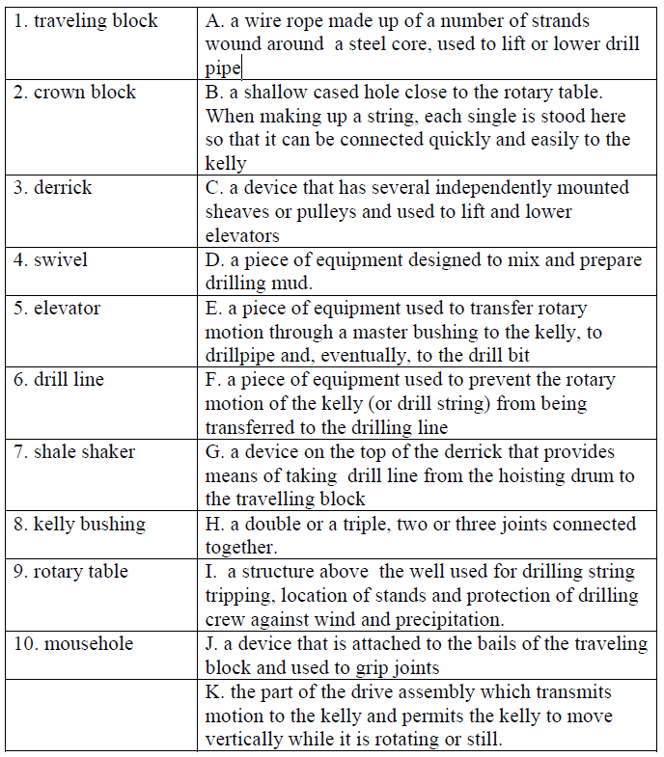
Exercises
1.Match the words in the left column with the definitions in the right one.

Slide 7
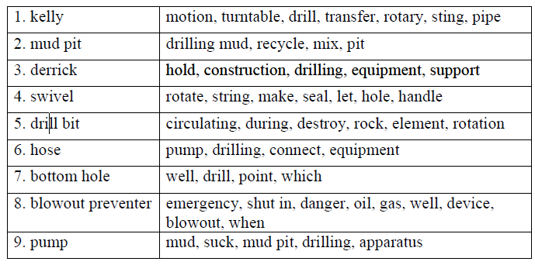
Exercises
2. Describe the function of the following elements, using the words given in the right column.

Slide 8
Exercises
3. State whether the following sentences are true or false. Correct the false ones.
1. The Kelly is hexagonal. The reason for that is to make it possible for the rotary table to turn the Kelly without slipping.
2. Cement job is performed only when quality of casing is poor.
3. Drill pipe is hollow. The reason for this is to make it possible for the mud to pass through it.
4. Elevator is a device for lifting derrickman to the monkey board.
5. Drilling crew members use scratchers to scratch each other and thus clean themselves of oil.
6. Doghouse is a room where security guard and patrol dog live.
7. Drilling cuttings are washed out to the surface with drilling mud made of clay and water.
8. Shale shaker is used for separating fluid from drilling cuttings.
9. Cuttings in a well mean cracks on wellbore walls.
10. Conductor is a person who knows everything at the drilling site. He is in charge of coordinating work of drilling crews.

Slide 9
Exercises
4. Fill in the gaps with the correct words
surveyed dispose Drill bit Electrical generators Shale slide levelled and access roads boundaries reserve pit
1. The land is cleared and ………..may be built.
2. Once the site has been selected, it must be ………to determine its ………
3. They dig a……….., which is used to ……….rock cuttings and drilling mud during the drilling process .
4……… end of the drill that actually cuts the rock.
5…………. conveys cuttings to the reserve pit.
6………. powered by the diesel engines to provide electrical power.

Slide 10
ABBREVIATIONS
POOH | Pull Out Of Hole
RIH | Run In Hole
Dp | Drill pipe
Dc | Drill collar
HWDp | Heavy weight Drill Pipe
BHA | Bottom Hole Assebmly
WOB | Weight On Bit
ROP | Rate Of Pentration
BPM | Barrel Per Stroke

