Slide 1
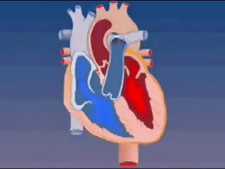
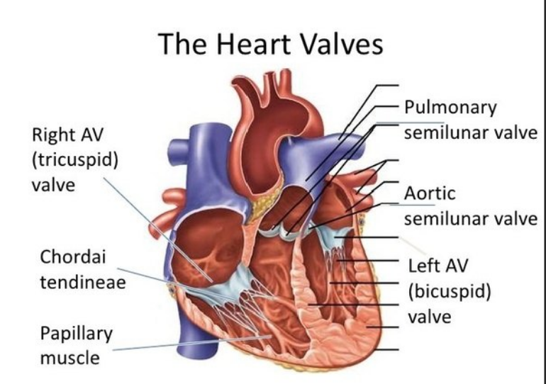
Al-ayen Iraqi university
College of Heaith &Medical Technology
Department of Anasthesia
Chapter 5: cardiac cycle
By: MSC khitam AL-mohammed

Slide 2
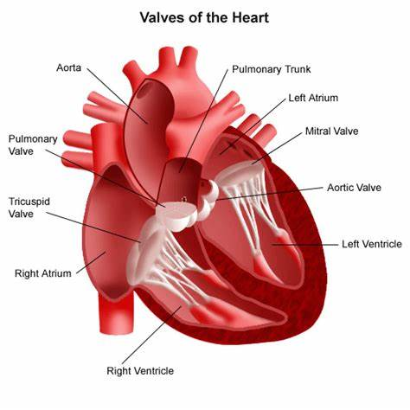

Slide 3
PRESSURE, VOLUME, FLOW
"Why does blood flow?“
Liquids and gases flow down pressure gradients (AP) from regions of higher pressure to regions of lower pressure.
In humans, the heart creates high pressure when it contracts.
As blood moves through the system, pressure is lost because of friction between the fluid and the blood vessel walls. Consequently, pressure falls continuously as blood moves farther from the heart
The highest pressure in the vessels of the cardiovascular system is found in the aorta and systemic arteries as they receive blood from the left ventricle.
The lowest pressure is in the venae cava, just before they empty into the right atrium.

Slide 4
Pressure and Volume Changes during the Cardiac Cycle
In each cardiac cycle, the atria and ventricles alternately contract and relax, forcing blood from areas of higher pressure to areas of lower pressure.
As a chamber of the heart contracts, blood pressure within it increases.
There is a relationship between the heart’s electrical signals (ECG) and changes in atrial pressure, ventricular pressure, aortic pressure, and ventricular volume during the cardiac cycle.

Slide 5
Pressure and Volume Changes during the Cardiac Cycle
The pressures given in the figure apply to the left side of the heart; pressures on the right side are considerably lower.
Each ventricle, however, expels the same volume of blood per beat, and the same pattern exists for both pumping chambers.
When heart rate is 75 beats/min, a cardiac cycle lasts 0.8 sec.

Slide 6
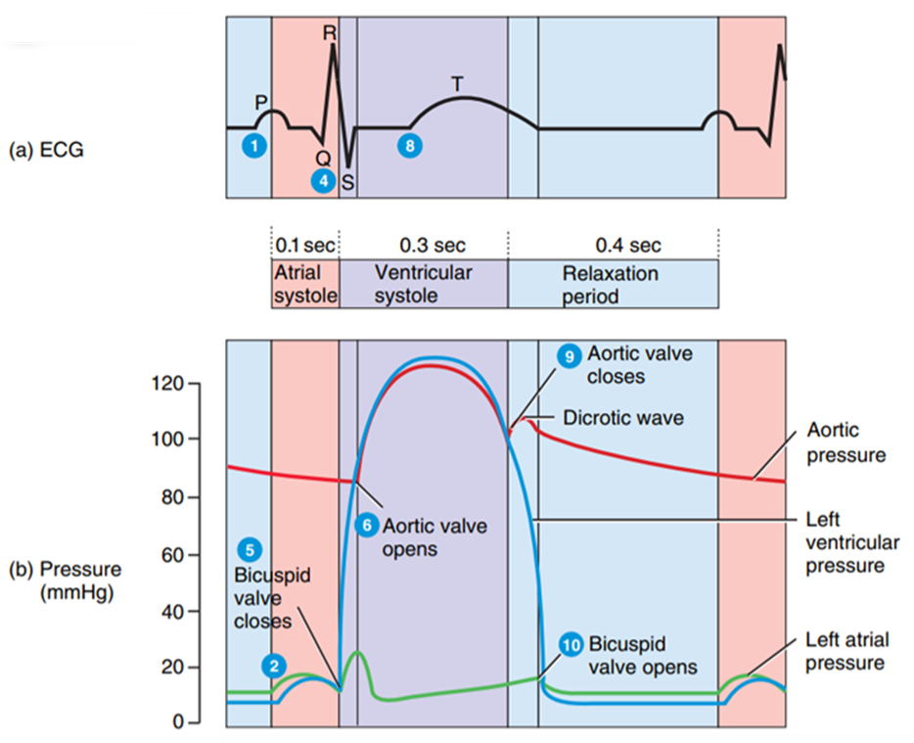
Atrial Systole
During atrial systole, which lasts about 0.1 sec, the atria are contracting. At the same time, the ventricles are relaxed.
1- Depolarization of the SA node causes atrial depolarization, marked by the P wave in the ECG.
2- Atrial depolarization causes atrial systole.
As the atria contract, they exert pressure on the blood within, which forces blood through the open AV valves into the ventricles.

Slide 7
Atrial Systole
3- Atrial systole contributes a final 25 mL of blood to the volume already in each ventricle (about 105 mL).
The end of atrial systole is also the end of ventricular diastole (relaxation).
Thus, each ventricle contains about 130 mL at the end of its relaxation period (diastole).
This blood volume is called the end-diastolic volume (EDV).
4- The QRS complex in the ECG marks the onset of ventricular depolarization.

Slide 8
Ventricular Systole
During ventricular systole, which lasts about 0.3 sec, the ventricles are contracting. At the same time, the atria are relaxed in atrial diastole.
5-Ventricular depolarization causes ventricular systole.
As ventricular systole begins, pressure rises inside the ventricles and pushes blood up against the atrioventricular (AV) valves, forcing them shut.
For about 0.05 seconds, both the SL (semilunar) and AV valves are closed. This is the period of isovolummetric contraction.
During this interval, cardiac muscle fibers are contracting and exerting force but are not yet shortening.
Thus, the muscle contraction is isometric (same length).
Moreover, because all four valves are closed, ventricular volume remains the same (isovolumic).

Slide 9
Ventricular Systole
6- Continued contraction of the ventricles causes pressure inside the chambers to rise sharply.
When left ventricular pressure surpasses aortic pressure at about 80 millimeters of mercury (mmHg) and right ventricular pressure rises above the pressure in the pulmonary trunk (about 20 mmHg), both SL valves open.
At this point, ejection of blood from the heart begins. The period when the SL valves are open is ventricular ejection and lasts for about 0.25 sec.
The pressure in the left ventricle continues to rise to about 120 mmHg, and the pressure in the right ventricle climbs to about 25–30 mmHg.

Slide 10
Ventricular Systole
7- The left ventricle ejects about 70 mL of blood into the aorta and the right ventricle ejects the same volume of blood into the pulmonary trunk.
The volume remaining in each ventricle at the end of systole, about 60 mL, is the end-systolic volume (ESV).
Stroke volume, the volume ejected per beat from each ventricle, equals end-diastolic volume minus end-systolic volume: SV = EDV - ESV.
At rest, the stroke volume is about 130 mL - 60 mL = 70 mL.
8- The T wave in the ECG marks the onset of ventricular repolarization.

Slide 11
Relaxation Period
During the relaxation period, which lasts about 0.4 sec, the atria and the ventricles are both relaxed.
As the heart beats faster and faster, the relaxation period becomes shorter and shorter, whereas the durations of atrial systole and ventricular systole shorten only slightly.
9- Ventricular repolarization causes ventricular diastole.
As the ventricles relax, pressure within the chambers falls, and blood in the aorta and pulmonary trunk begins to flow backward toward the regions of lower pressure in the ventricles.
Backflowing blood catches in the valve cusps and closes the SL valves. The aortic valve closes at a pressure of about 100 mmHg.

Slide 12
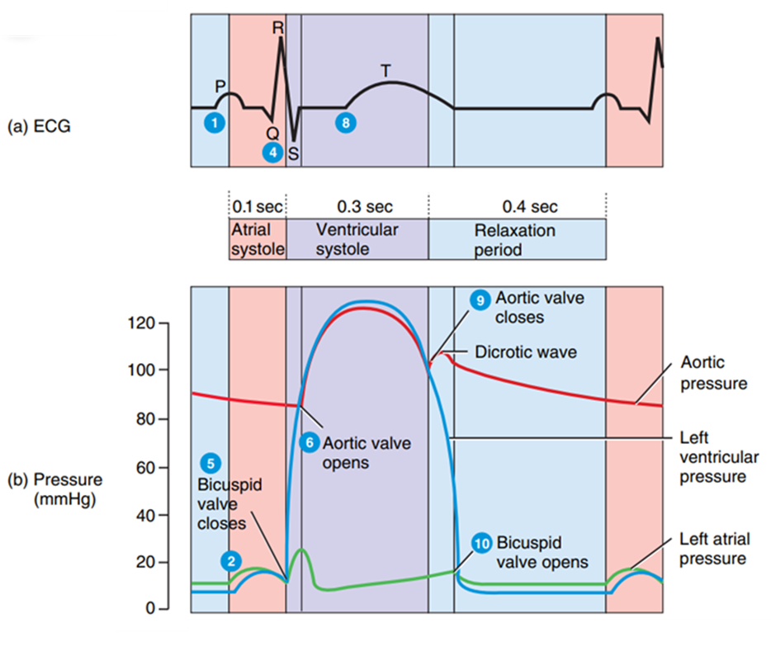
Relaxation Period
9- Ventricular repolarization causes ventricular diastole.
Rebound of blood off the closed cusps of the aortic valve produces the dicrotic wave on the aortic pressure curve.
After the SL valves close, there is a brief interval when ventricular blood volume does not change because all four valves are closed.
This is the period of isovolumetric relaxation.

Slide 13
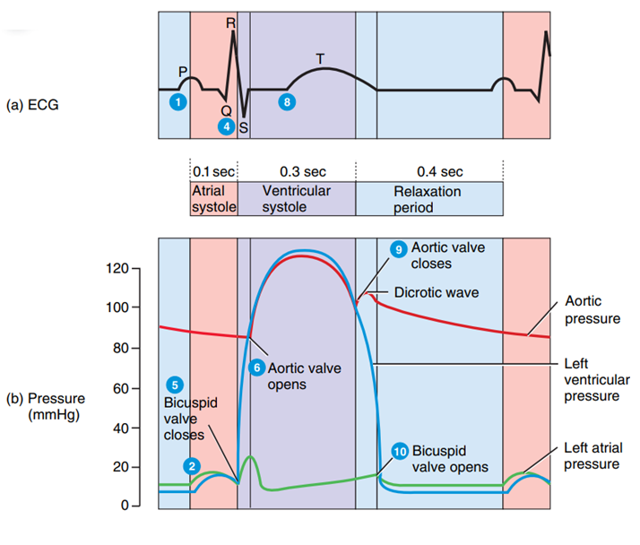
10- As the ventricles continue to relax, the pressure falls quickly.
When ventricular pressure drops below atrial pressure, the AV valves open, and ventricular filling begins.
The major part of ventricular filling occurs just after the AV valves open.
Blood that has been flowing into and building up in the atria during ventricular systole then rushes rapidly into the ventricles.
At the end of the relaxation period, the ventricles are about three-quarters full.
The P wave appears in the ECG, signaling the start of another cardiac cycle.

Slide 14
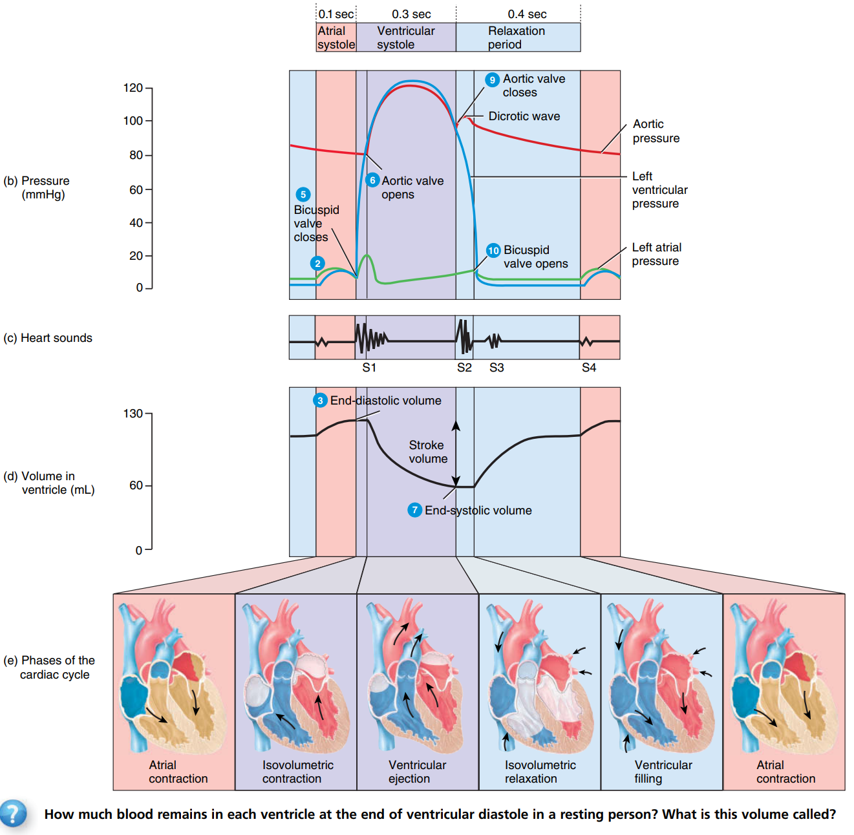

Slide 15
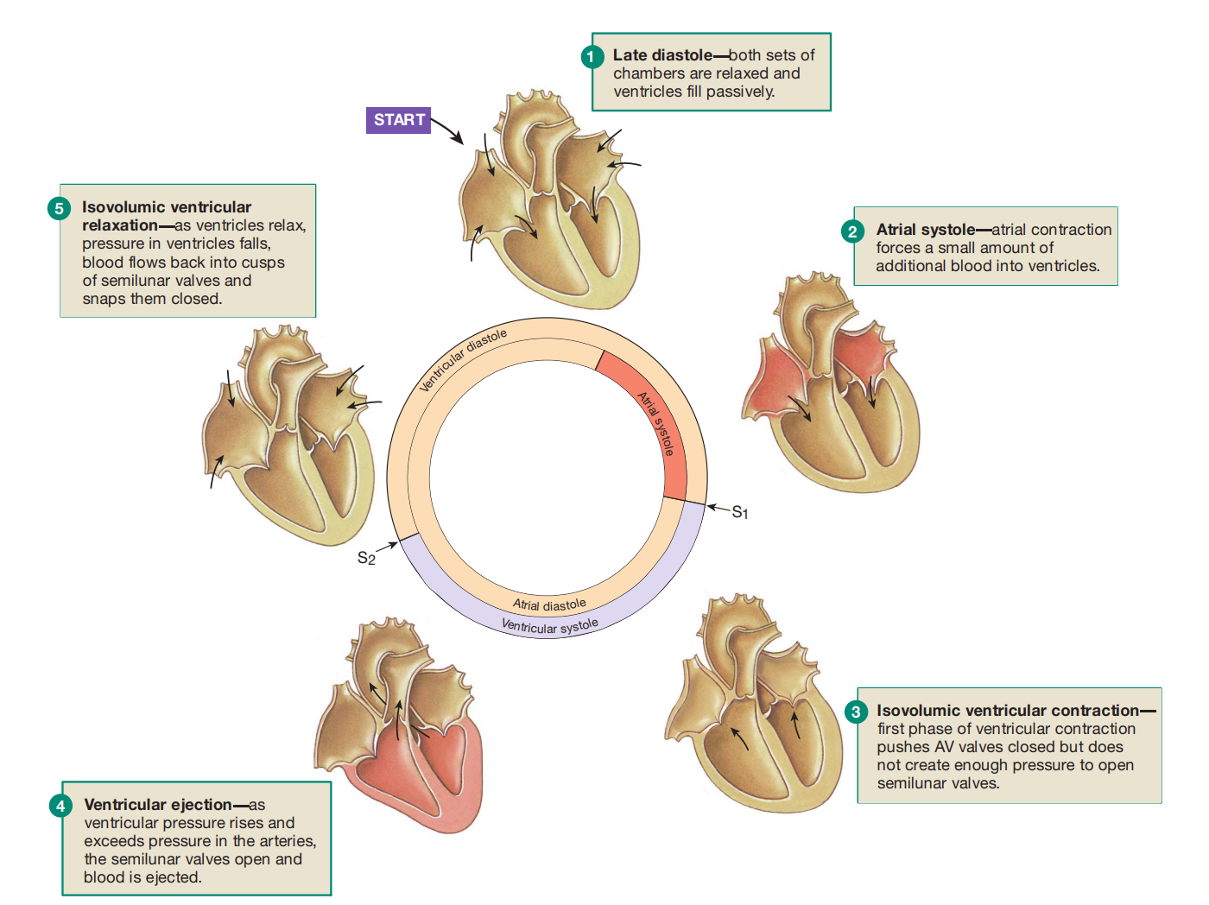

Slide 16
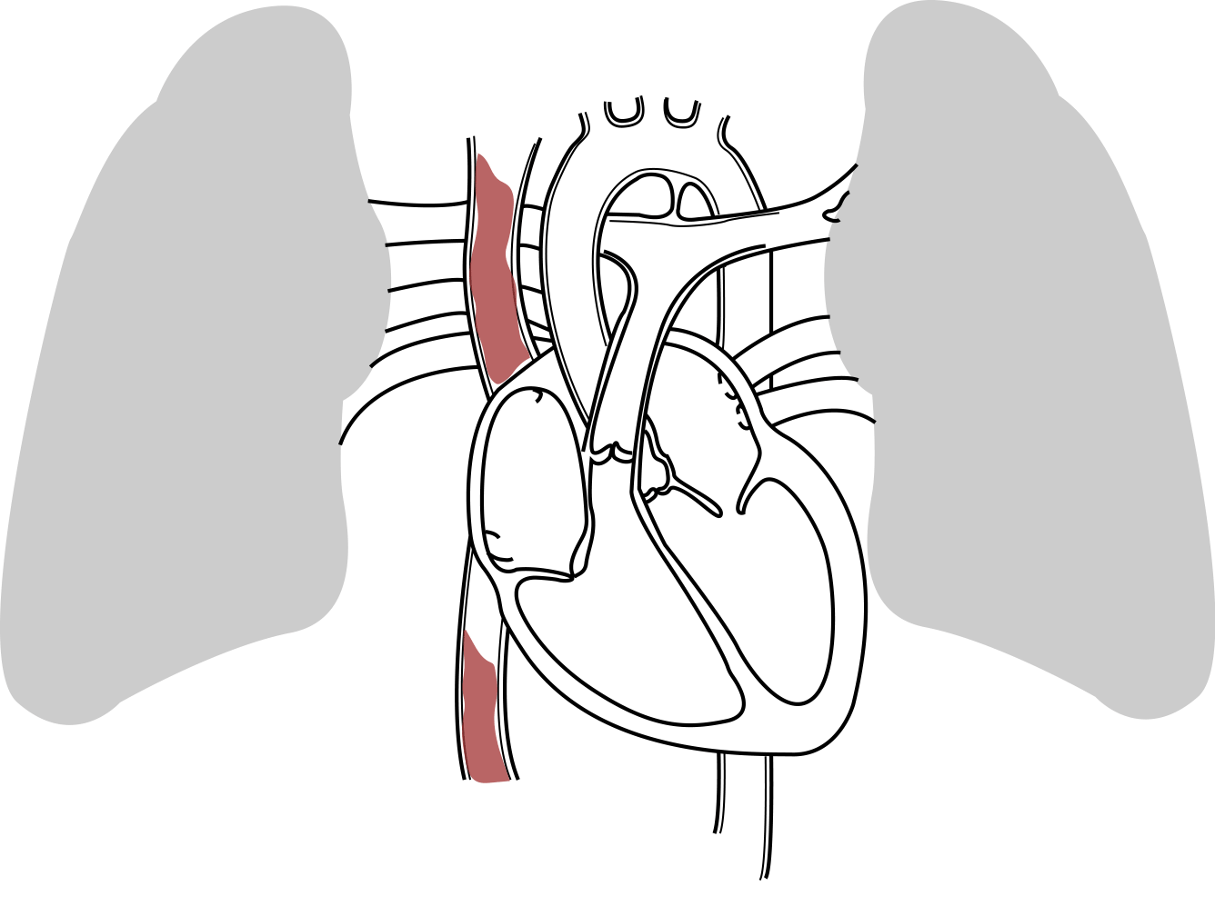
x
false

