Slide 1
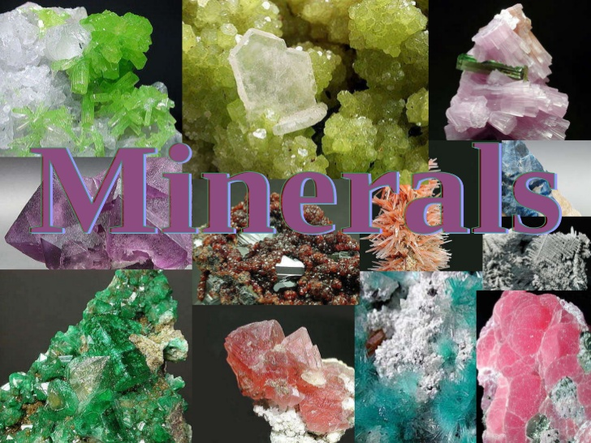

Slide 2
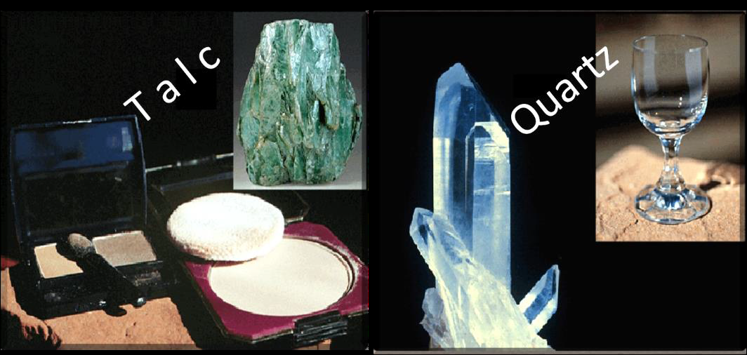
Introduction:
Mineral is inorganic substance which occurs naturally, and typically has a crystalline structure whose characteristics of hardness, luster, color, cleavage, fracture, and relative density can be used to identify it. Each mineral has a characteristic chemical composition.
Earth's crust is the source for a wide variety of useful and essential minerals.
Most people know that copper is used for electrical wiring and gold is used for jewelry.
But most people are not aware that the main ingredient in cosmetics is a powdered form of the mineral talc (Mg3Si4O10(OH)2) or that the mineral quartz (SiO2) is the main ingredient in glass.

Slide 3
In addition to the economic importance of rock and minerals, events such as volcanic eruptions, mountains building, and earthquakes all involve these earth materials.
1-A rock can be defined simply as an aggregate of one or more minerals. Aggregate is mixture of minerals or rock can be sorted by the mechanical means.
2-Although most rocks are composed of more than one mineral, certain minerals are found in large, impure quantities. In these instances, they are considered to be a rock.
3-It is showing limestone outcrop (composed of the mineral calcite).
4- More than 4000 of different minerals have been identified. No more than a few dozen are abundant.
5- Collectively, these few make up most of the rocks of earth's crust; they are classified as rock- forming minerals.

Slide 4
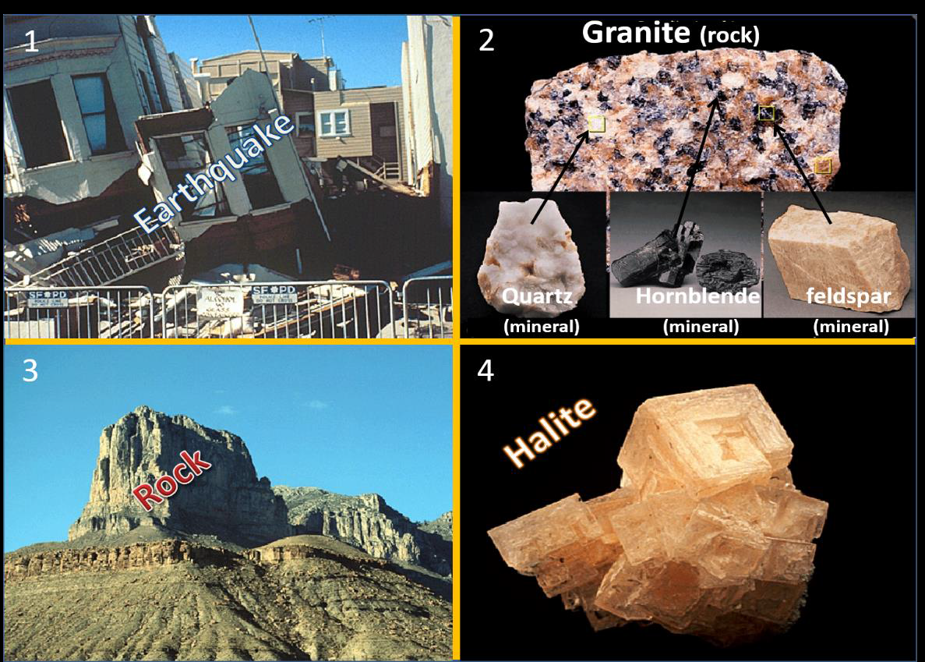

Slide 5
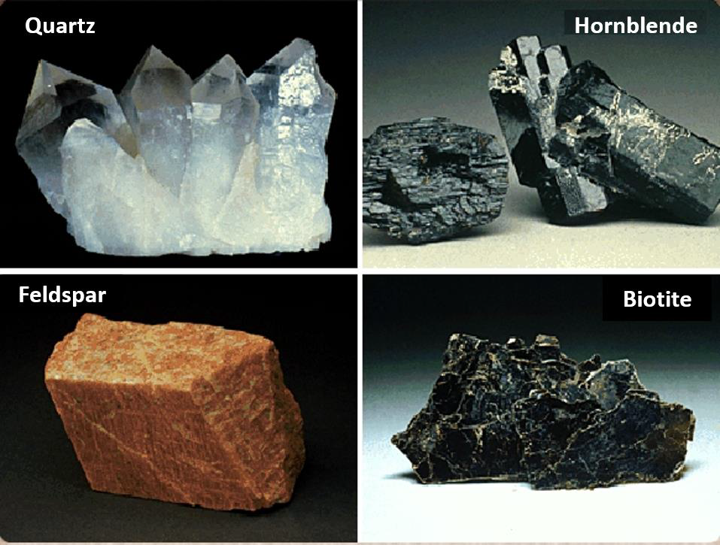
By contrast:
Mineral:
A naturally occurring, inorganic solid with a definite chemical composition and a systematic internal structure.
Mineral Groups:
1- Silicate group:
The most common group of rock forming minerals is the silicates.

Slide 6
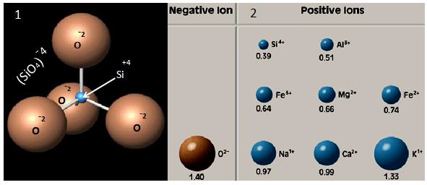
All silicates have the same fundamental building block, the silicon-oxygen tetrahedron.
The silicon-oxygen tetrahedron is not a compound. Rather, it is a complex ion with a charge of (– 4). In nature, tetrahedral form neutral chemical compound (minerals) through the addition of positively charged ions.

Slide 7
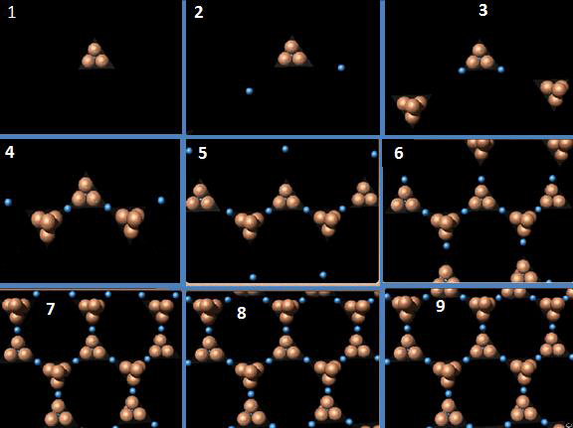
In this way, chemically stable structure is produced, consisting of individual tetrahedral linked together by positively charged ions.

Slide 8
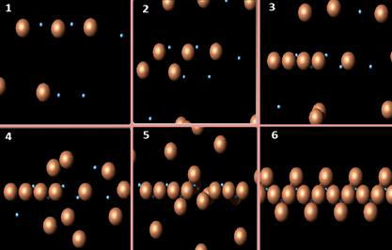
In addition, the tetrahedron may form a variety of structures by sharing the oxygen atoms between silicon atoms in adjacent tetrahedrons.

Slide 9
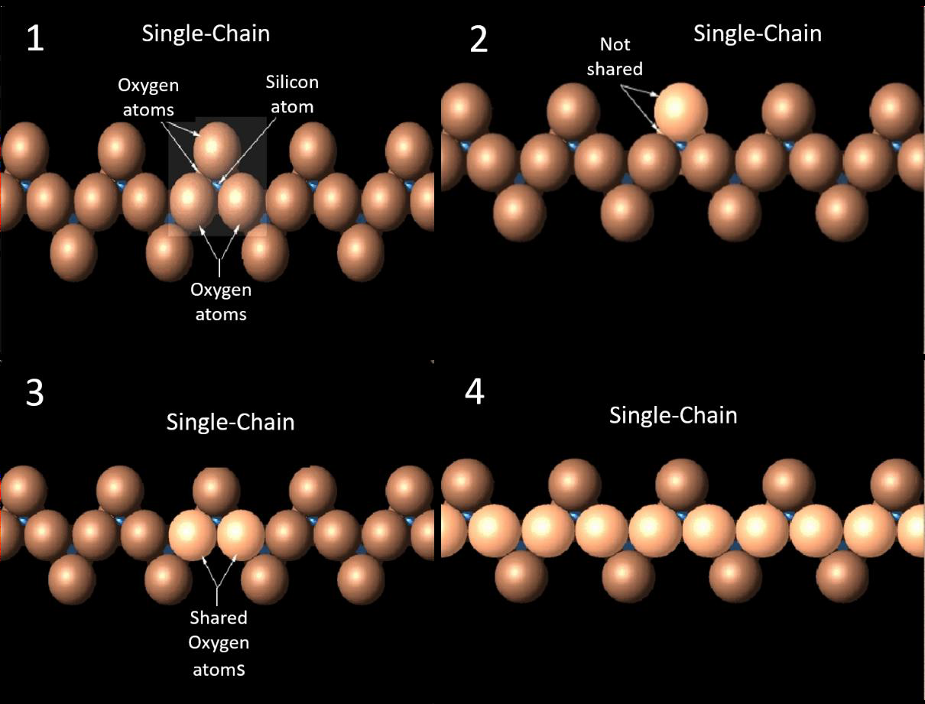
Notice that in this chain structure, each silicon atom is completely surrounded by four larger oxygen atoms.
Also notice that two of the four oxygen atoms are not shared atoms, whereas the other two are jointed to other silicon in this manner. It is the linkage across shared oxygen atoms that joint the tetrahedral into a chain structure.

Slide 10
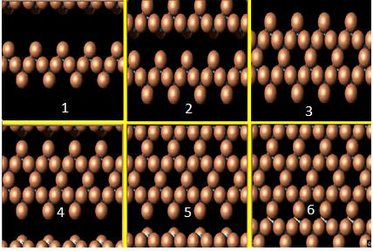
Other silicate structure exists. These include double chains. Sheet structures.

Slide 11
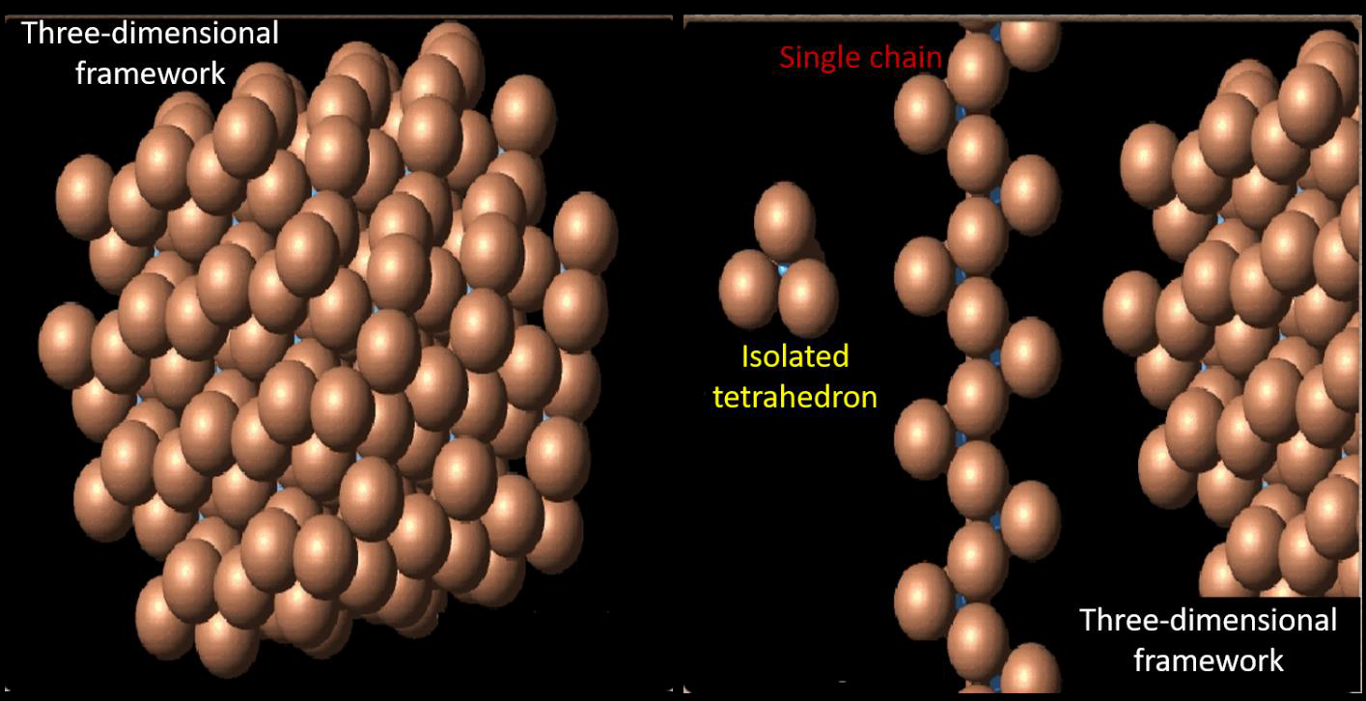
Complex three-dimensional frameworks .
By now we may have noticed that the ratio of silicon atoms to oxygen atoms differs in each silicate structure.

Slide 12
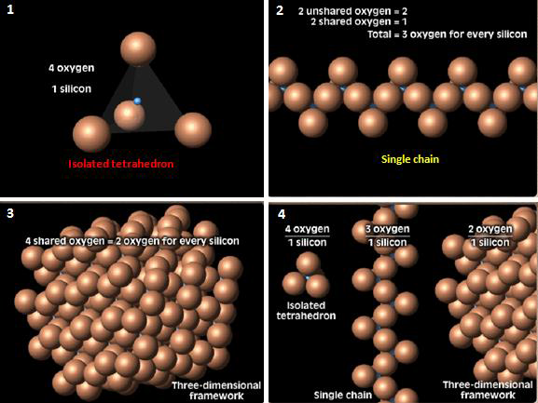
Minerals composed of isolated tetrahedrons contain 1 silicon atom for every 4 oxygen atoms like Olivine. 1.
Whereas in the single chain, the silicon-to oxygen ratio is 1 to 3 like Augite. While in the three- dimensional framework, the silicon to oxygen ratio is 1 to 2 like Quartz 3.
Whenever more oxygen atoms are shared, the percentage of silicone in the minerals increases. 4.

Slide 13
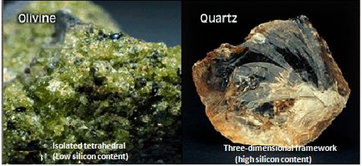
Silicate minerals are described as having "high" or "low" silicon content based on the ratio of silicon to oxygen. This difference in silicon content is important, as we will see when consider igneous rocks.

Slide 14
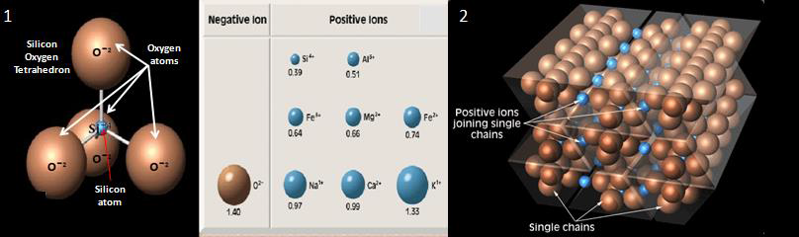
Like the silicon- oxygen tetrahedron, most other silicate structures are not neutral chemical compounds. 1
They are all neutralized by the inclusion of positively charged metallic ions that bind them together into a variety of crystalline configurations.2

Slide 15
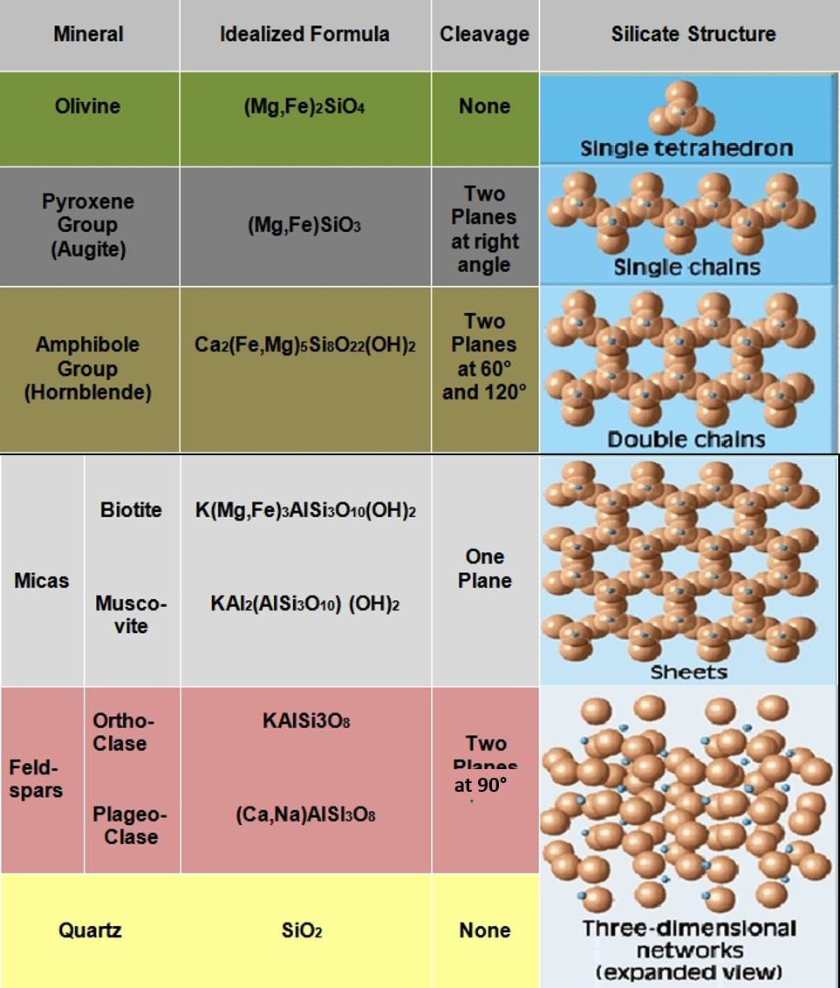
The major groups of silicate minerals and common examples are shown in the following Table.

Slide 16
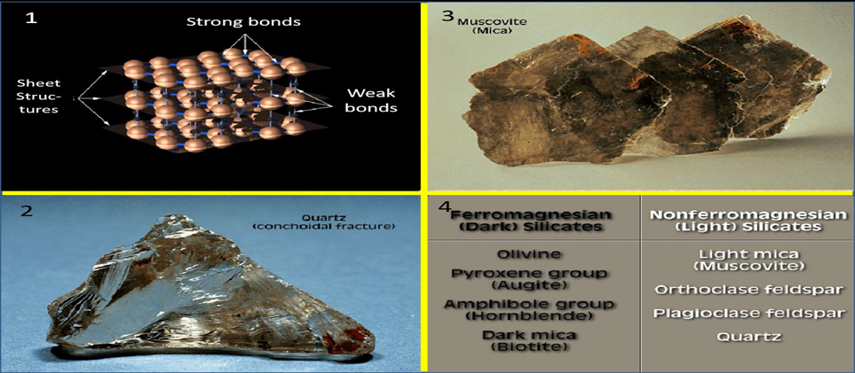

Because the silicone-oxygen bonds are strong, silicate minerals tend to cleave or break between the silicon-oxygen structures rather than across them. 1.
For example, the micas have a sheet structure and thus tend to cleave into flat plates. 2.
Quartz, which has equally strong silicon-oxygen bonds in all directions, has no cleavage, but fractures instead. 3.
The silicates are generally divided into two major groups on the basis of their chemical makeup. 4.

Slide 17
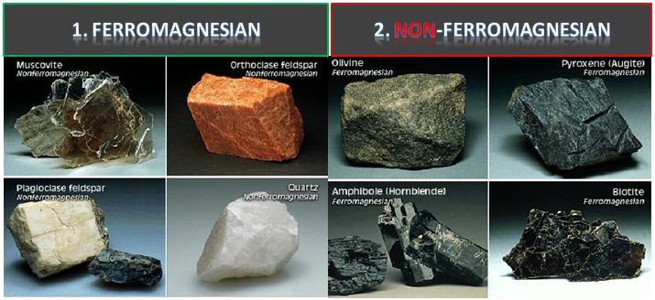
Non ferromagnesian silicate (light).
The ferromagnesian silicates (dark) are minerals in which ions of iron (Iron = Ferro) and/or magnesium join their silicates structures.
Because of their iron content, ferromagnesian silicates are darker in color , 1 and have higher specific gravity than the non ferromagnesian silicates (light). 2.

Slide 18
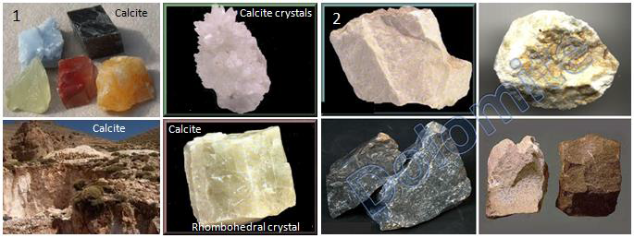
2- Carbonate group:
Other important rock forming minerals groups including the carbonates.
Calcite CaCO3 .1, and dolomite (CaMg) CO3, 2. They are commonly found in the sedimentary rocks limestone and dolostone (dolomite).

Slide 19
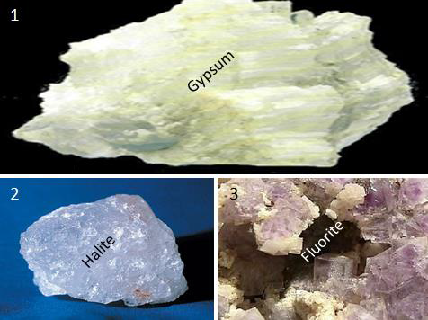
3- Sulphate and Halides groups:
Three other non silicate minerals frequently found in sedimentary rocks are:
gypsum CaSO4.2H2O. 1.
Halite (NaCl). 2
fluorite (CaF2)). 3.
Gypsum and halite are found in thick layers, which are the last vestiges of ancient seas that have long since evaporated.

Slide 20
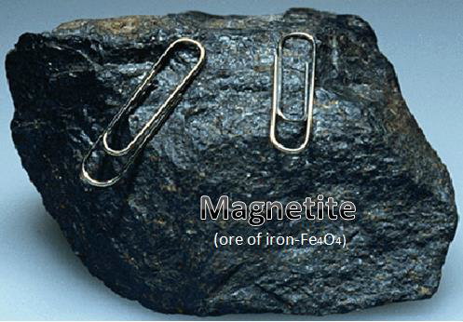
4- Oxides group:
Although scarce when compared to the silicates, other mineral groups are important economically. These include the oxides like Magnetite Fe3O4.

Slide 21
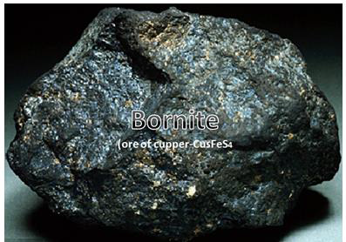
5- Sulfides group: Bornite Cu5FeS4 is the ore of the cupper.

Slide 22
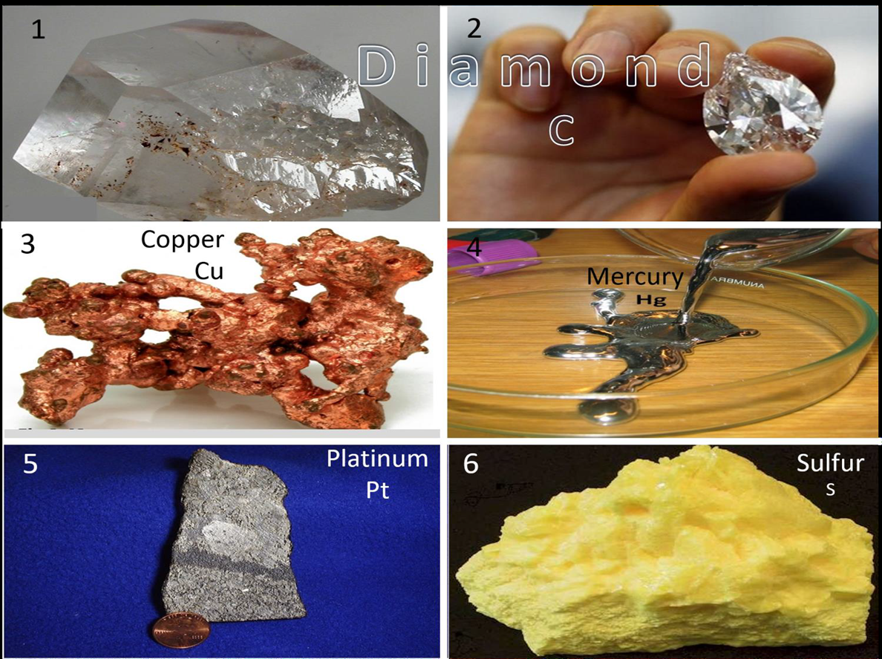
6- Native element:
Any element found in earth crust naturally, unattached in the form of Ore mineral Like:
Native diamond C which is used as gemstone and abrasive . 1&2.
Cupper Cu. 3. , Mercury Hg. 4.
Platinum Pt. 5. , Sulfur. 6.

Slide 23
Physical properties of Minerals:
Every mineral has an orderly arrangement of atoms and a definite chemical composition which gives it a unique set of physical properties.
1- Crystal form:
It is the external expression of a mineral's orderly internal arrangement of atoms like Pyrite (FeS2) of cubic system 1 and quartz (SiO2) of hexagonal crystals, 2 with pyramidal-shaped ends.

Slide 24
2- Luster:
It is the appearance or quality of light reflects
from the surface of mineral. .
A- Pyrite (FeS2) … Metallic luster .1.
B- Fluoride (CaF2) … non metallic luster. 2.
C- Chalk (CaCO3-Very fine pure grains) …
Non metallic earthy luster. 3.
D- Quartz (SiO2) … non metallic glassy
Luster. 4.
E- Bornite (Cu5FeS4-Ore of cupper) … sub
Metallic luster. 5.
F- Muscovite (K2Al4(Si3AlO10)2(OH,F)4 …
Non metallic pearly luster. 6.

Slide 25
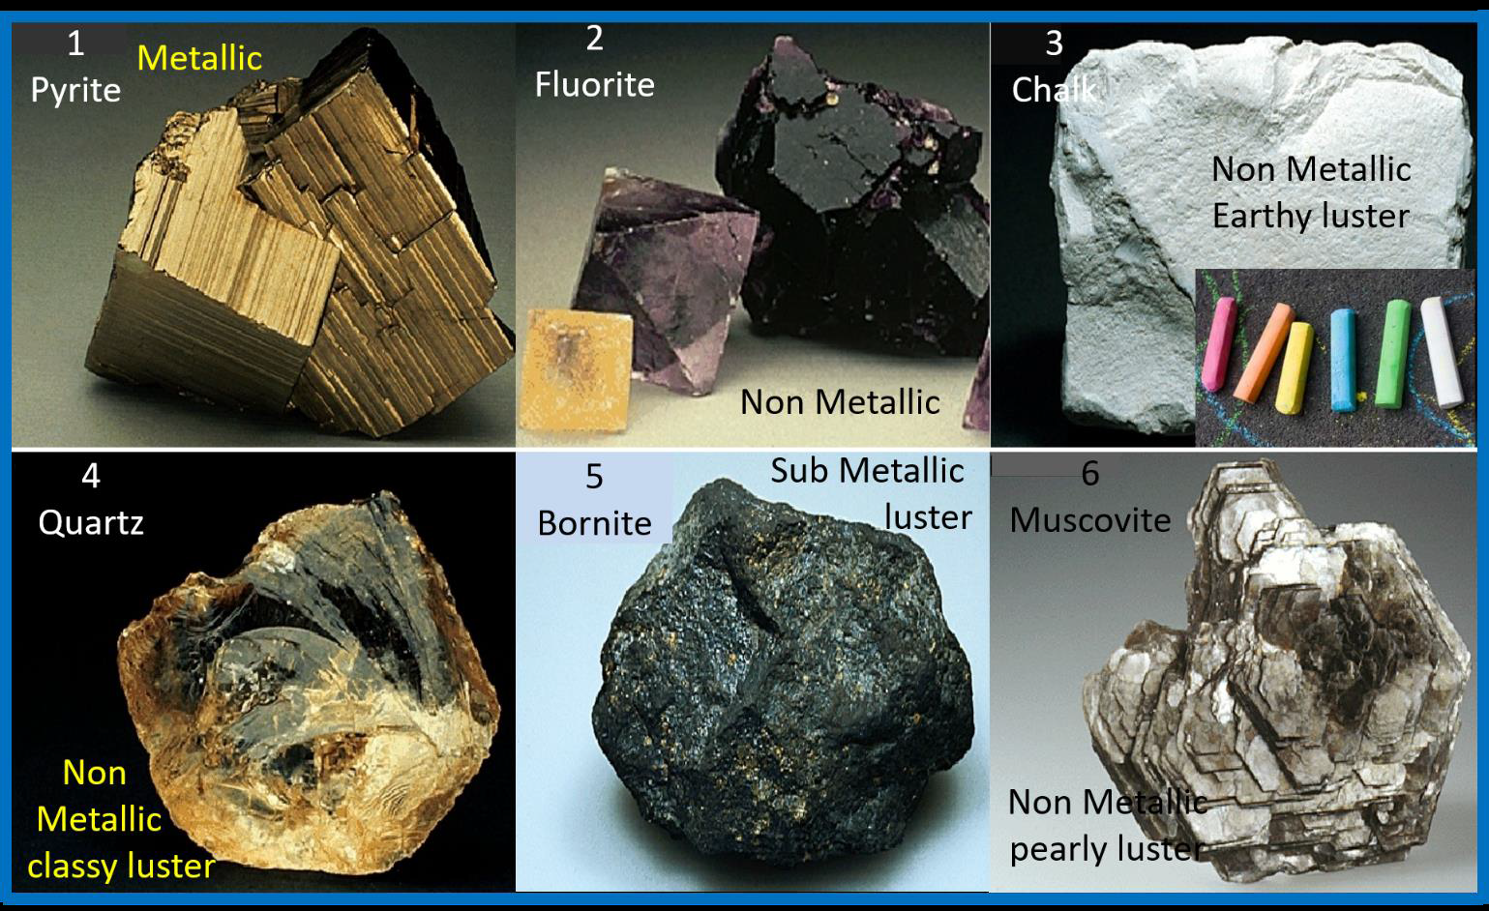

Slide 26
3- Color:
It is surely the most obvious characteristic of a mineral.

Slide 27
Color is not always useful diagnostic property. Example, slight impurities in the mineral quartz (SiO2) give it a variety of colors.

Slide 28
4- Streak:
It is the color of a mineral in it's powdered form and is obtained by rubbing a mineral across a piece of unglazed porcelain called streak plate.1. Although the color of a mineral may vary from sample to sample, but the streak usually does not vary. 2.

Slide 29
5- Hardness:
It is a measure of the resistance of a mineral to abrasion or scratching.
Mohs' scale (scientist) of hardness illustrated a relative scale for the softest and hardest minerals as below:

Slide 30
5- Cleavage:
It is the tendency of mineral to break along planes of weak bonding.

Slide 31
The simplest type of cleavage is exhibited by the mica. 1. Because micas have weak chemical bonds in one direction. 2 … they cleave to form thin, flat sheets. 3. 4.

Slide 32
The sample of muscovite below illustrates mineral that exhibit one plane of cleavage.

Slide 33
The mineral feldspar (The most important group of rock-forming silicate minerals).
It is including the alkali feldspars KAlSi3O8 to NaAlSi3O8 (K-feldspar to albite) and the plagioclase feldspars NaAlSi3O8 to CaAl2Si2O8 (albite to anorthite), has two cleavage directions.

Slide 34
When minerals break evenly in more than one direction, cleavage is described by the number of planes exhibited . 1… And the angles at which they meet like Halite mineral (NaCl). 2.

Slide 35
Calcite (CaCO3) is a mineral whose cleavage angle is 75 degrees. 1.
While hornblende includes:
Hastingsite, Tschermakite, Edenite and Pargasite has 2 cleavage angles, one at 60 degrees and one at 120 degrees. 2.

Slide 36
6- Fractures:
It is important not to confuse cleavage with crystal form. Remember, crystal form is the external expression of a mineral's orderly arrangement of atoms. Whereas, cleavage is the tendency of minerals to break along planes of weakness. All minerals have crystal form, but some minerals lack cleavage.
Minerals that do not exhibit cleavage when broken are said fracture, like Malachite Cu2CO3(OH)2 mineral. 1.
Three kinds of fractures are:
a- Irregular fracture (Bornite Cu5FeS ). 2.
b- Conchoidal fracture (resembling broken glass). (Quartz SiO2). 3.
c- Fibrous fracture. (Serpentine).

Slide 38
7- Specific gravity:
It is a number representing the ratio of the weight of mineral to the weight of an equal volume of water at 4 centigrade.
For example:
The specific gravity of:
Quartz =2.7
Galena =7.5
Gold = 20.
Most common minerals have a specific gravity of between (2.5 – 3).
9- Other properties:
Other properties can be used to identify some minerals.
For example:
Halite (NaCl) is ordinary table salt. It can be identified with your tongue. 1.
And talc (Mg3Si4O10(OH)2 feels soapy. 2.
Some varieties of magnetite (Fe3O4) are natural magnets. 3.
And certain minerals will effervesce (fizz) when hydrochloric acid is added Calcite CaCO3. 4.

Slide 40
Thank You .

