Slide 1
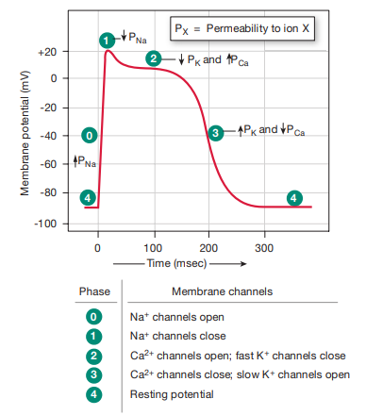
Al-ayen Iraqi university
College of Heaith &Medical Technology
Department of Anasthesia
Action Potential &
Contraction of Contractile Fibers
BY:MSC Khitam AL-mohammed

Slide 2
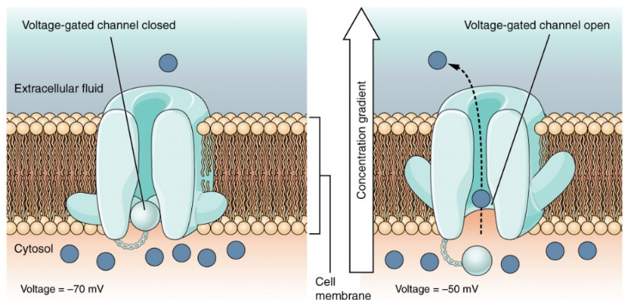
Cell Membranes electrically Activity
Skeletal muscles and neurons use the cell membrane to regulate ion movement between the extracellular fluid and cytosol.
The cell membrane is a phospholipid bilayer, so only substances that can pass directly through the hydrophobic core can diffuse through unaided. However, charged particles, which are hydrophilic, cannot pass through the cell membrane without assistance
Transmembrane proteins, specifically channel proteins, make this possible.
Several channels are necessary to generate a transmembrane potential and to generate an action potential.
the sodium/potassium pump that moves sodium ions (Na+) out of a cell and potassium ions (K+) into a cell
Prepared by Dr. Abbass HAYDAR

Slide 3
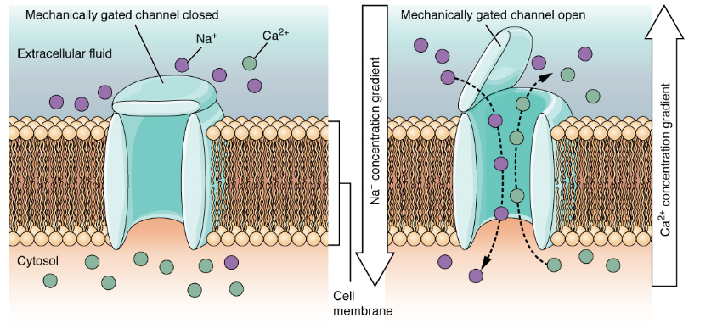
Is not important
Prepared by Dr. Abbass HAYDAR

Slide 4
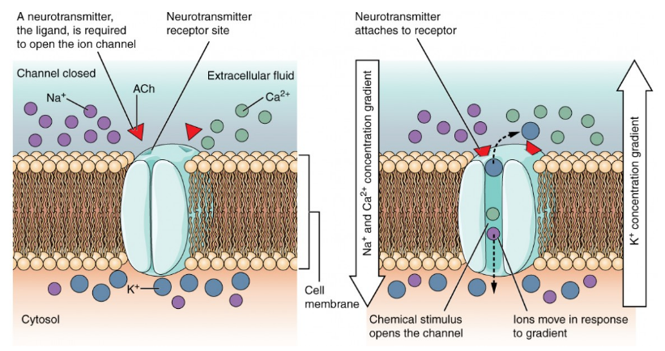
Is not important
Prepared by Dr. Abbass HAYDAR

Slide 5
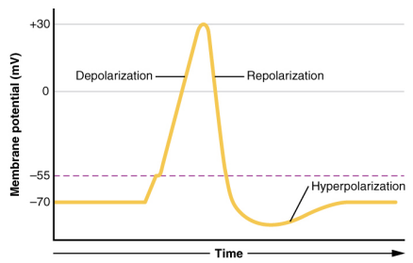
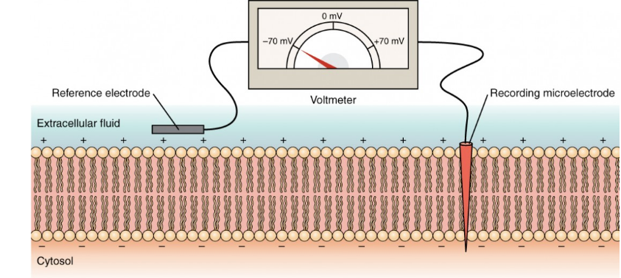
The plasma mbrane Potential
The electrical state of the cell membrane can have several variations.
A potential is a distribution of charge across the cell membrane, measured in millivolts (mV).
The standard is to compare the inside of the cell relative to the outside, so the membrane potential is a value representing the charge on the intracellular side of the membrane based on the outside being zero, relatively speaking
Prepared by Dr. Abbass HAYDAR

Slide 6
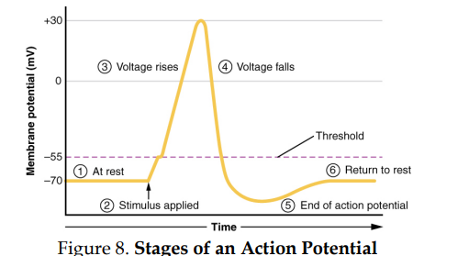
Attention: This figure is observed In neuron and muscles other than heart muscels
Prepared by Dr. Abbass HAYDAR

Slide 7
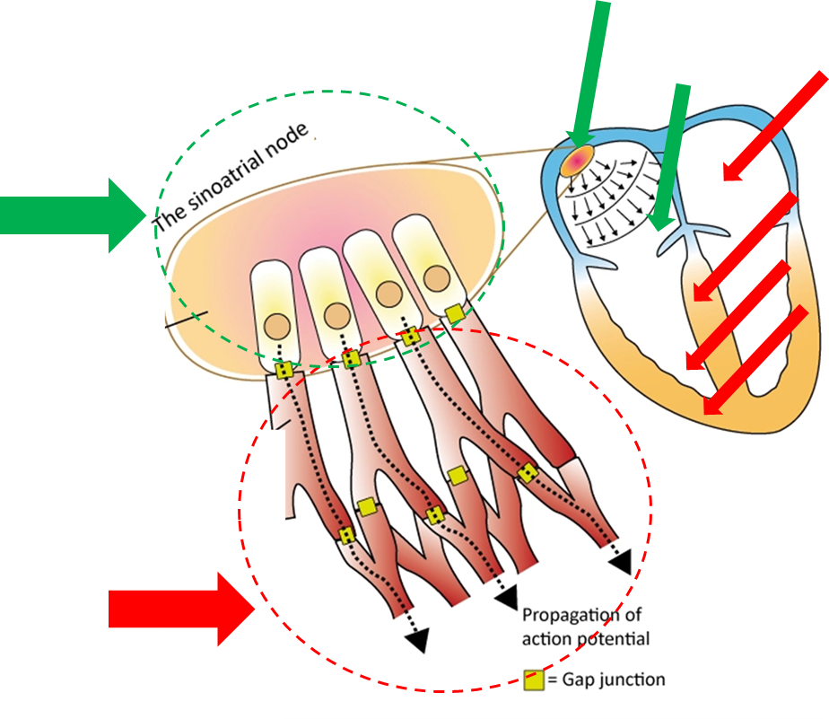
The two primary types of cardiac cells.
First type
One cell type is found in the working (contractile) cells of the atria and ventricles and also in the specialized conduction cells of the His-Purkinje network.
Second type
The second type of cardiac cell is found in the sinoatrial and atrioventricular nodes.
Prepared by Dr. Abbass HAYDAR

Slide 8
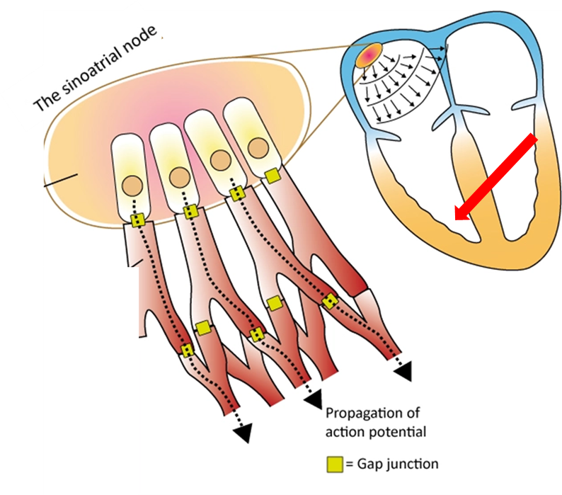
Action potential occurs in a ventricular contractile fiber (first type)
An action potential occurs in a contractile fiber as follows:
Phase 0: Depolarization
Phase 1: initial repolarization
Phase 2: Plateau
Phase3: Repolarization
Phase 4: resting membrane potential
Prepared by Dr. Abbass HAYDAR

Slide 9
Action potential occurs in a ventricular contractile fiber (first type)
Phase 0: Depolarization
Contractile fibers have a stable resting membrane potential that is close to - 90 mV.
When a contractile fiber is brought to threshold by an action potential from neighboring fibers through gap junctions, its voltage-gated fast Na+ channels open, allowing Na+ to enter the cell and rapidly depolarize it.
the membrane potential becomes more positive.
These sodium ion channels are referred to as “fast” because they open very rapidly in response to a threshold-level depolarization.
Prepared by Dr. Abbass HAYDAR

Slide 10
Action potential occurs in a ventricular contractile fiber (first type)
Phayse 0: Depolarization (2)
Opening of these channels allows Na+ inflow because the cytosol of contractile fibers is electrically more negative than interstitial fluid and Na+ concentration is higher in interstitial fluid.
Inflow of Na+ down the electrochemical gradient produces a rapid depolarization.
Within a few milliseconds, the membrane potential reaches about +20 mV before the fast Na+ channels close and Na+ inflow decreases.
Prepared by Dr. Abbass HAYDAR

Slide 11
Action potential occurs in a ventricular contractile fiber (first type)
Phase 1: initial repolarization.
The Na+ channels close
The cell begins to repolarize as K+ leaves through open K+ channels
Prepared by Dr. Abbass HAYDAR

Slide 12
Action potential occurs in a ventricular contractile fiber (first type)
Phase 2: Plateau
The initial repolarization is very brief.
The next phase of an action potential in a contractile fiber is the plateau, a period of maintained depolarization.
The action potential then flattens into a plateau as the result of two events: a decrease in K+ outflow permeability (some fast K+ channels close) and an increase in Ca2+ permeability.
voltage-gated Ca2+ channels present in the plasma membrane have been slowly opening during phases 0 and 1 open after activation by depolarization.
Then, Ca2+ enters cell
Prepared by Dr. Abbass HAYDAR

Slide 13
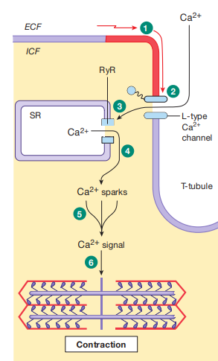
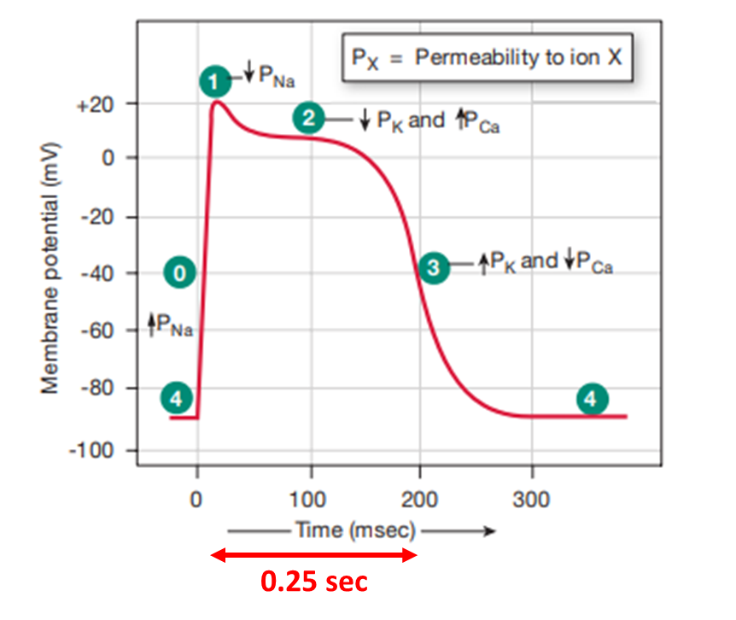
Action potential occurs in a ventricular contractile fiber (first type)
Phase 2: Plateau
Ca2+ enters cell from the interstitial fluid (which has a higher Ca2+ concentration) into the cytosol.
Then, Ca2+ induces Ca2+ release through ryanodine receptor-channels (RyR) from the sarcoplasmic reticulum.
The increased Ca2+ concentration in the cytosol ultimately triggers contraction
Conclusion: The Ca2+ inflow just balances K+ outflow. The plateau phase lasts for about 0.25 sec, and the membrane potential of the contractile fiber is close to 0 mV.
Prepared by Dr. Abbass HAYDAR

Slide 14
By comparison, depolarization in a neuron or skeletal muscle fiber is much briefer, about 1 msec (0.001 sec), because it lacks a plateau phase.
Prepared by Dr. Abbass HAYDAR

Slide 15
Action potential occurs in a ventricular contractile fiber (first type)
Phase 3: Rapid Repolarization
The plateau ends when Ca2+ channels close and K+ permeability increases once more.
The slow K+ channels responsible for this phase are similar to those in the neuron: they are activated by depolarization but are slow to open.
After a delay (which is particularly prolonged in cardiac muscle), additional slow voltage-gated K+ channels open.
When the slow K+ channels open, K+ exits rapidly, returning the cell to its negative resting membrane potential (-90 mv)
At the same time, the calcium channels in the sarcolemma and the sarcoplasmic reticulum are closing, which also contributes to repolarization.
Prepared by Dr. Abbass HAYDAR

Slide 16
Action potential occurs in a ventricular contractile fiber (first type)
Phase 4: resting membrane potential
Myocardial contractile cells have a stable resting potential of about +90 mV
Prepared by Dr. Abbass HAYDAR

Slide 17
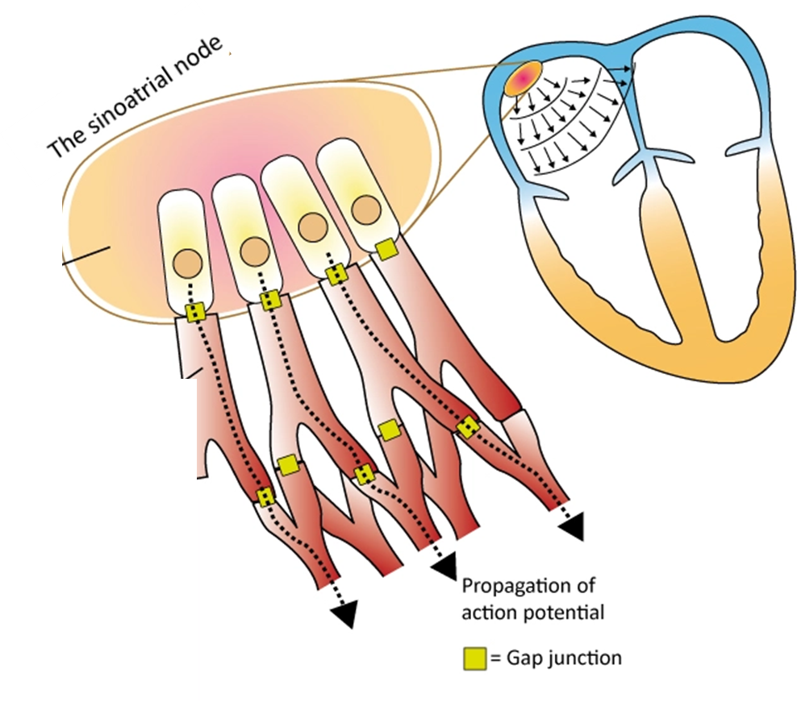
The two primary types of cardiac cells.
Second type
The second type of cardiac cell is found in the sinoatrial and atrioventricular nodes.
Prepared by Dr. Abbass HAYDAR

Slide 18
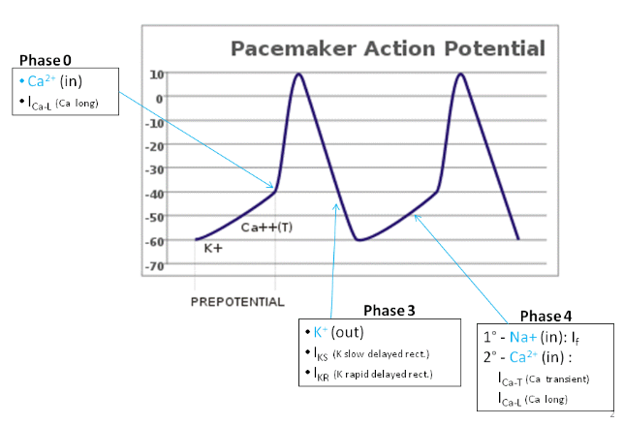
Action potential in SA node (second type)
The action potential in the SA node occurs in three phases
Phase 4 – Pacemaker potential
Phase 0 – Depolarisation
Phase 3 – Repolarisation
Prepared by Dr. Abbass HAYDAR

Slide 19
Action potential in SA node (second type)
Phase 4 – Pacemaker potential
The pacemaker potential occurs at the end of one action potential and just before the start of the next.
It is the slow depolarisation of the pacemaker cells e.g. cells of the sinoatrial node, towards the membrane potential threshold. This is sometimes referred to as the ‘funny’ current, or I_{f}.
The pacemaker potential is achieved by activation of hyperpolarisation activated cyclic nucleotide gated channels (HCN channels).
These allow Na+ entry into the cells, enabling slow depolarisation.
These channels are activated when the membrane potential is lower than -50mV.
Prepared by Dr. Abbass HAYDAR

Slide 20
Action potential in SA node (second type)
Phase 0 – Depolarisation
K+ open, Ca2+ close
Once the HCN channels have brought the membrane potential reach the threshold around -40mV, voltage-gated calcium channels open and an action potential can be fired
This allows an influx of Ca²⁺ which produces a faster rate of depolarisation to reach a positive membrane potential (responsible for the upstroke of the action potential).
HCN channels then start to inactivate.
At the peak of the action potential, Ca²⁺ channels inactivate, and K⁺ channels open.
Prepared by Dr. Abbass HAYDAR

Slide 21
Action potential in SA node (second type)
Phase 3 – Repolarisation
Once the Ca²⁺ channels inactivate, and the K⁺ channels open, there is an efflux of K+ ions out of the cells.
This results in the repolarisation of the membrane, which is seen as the downstroke of the action potential.
Unlike the ventricular action potential, the opening of Ca²⁺ channels is not sustained, and there is no ‘plateau’ stage.
Therefore, the action potential is triangular in shape
the membrane potential must reach negative values. This allows the HCN channels to be reactivated again
K+ open, Ca2+ close
Prepared by Dr. Abbass HAYDAR

Slide 22
Action potential in SA node (second type)
Resting potential ??
the SA node cells do not have a true resting membrane potential;
the membrane potential between APs is not stable but rather exhibits a slow spontaneous depolarization known as pacemaker potential.
the most negative potential the cell reaches between APs is called the maximum diastolic potential.
This potential is less negative than the resting membrane potential of ventricular cells, due to a lower K+ permeability (caused by a lack of IK1 in these cells).
Max diastolic potential
Prepared by Dr. Abbass HAYDAR

Slide 23
Action potential in SA node (second type)
Resting potential ??
The maximum diastolic potential ranges from approximately -55 mV for true primary pacemaker cells, to approximately -70 mV for transitional cells on the border between the SA node and atria.
The pacemaker potential takes the nodal cell from the maximum diastolic potential to the threshold for generating an Action Potential in these cells (approximately -40 mV).
Max diastolic potential
Prepared by Dr. Abbass HAYDAR

Slide 24
Prepared by Dr. Abbass HAYDAR

Slide 25
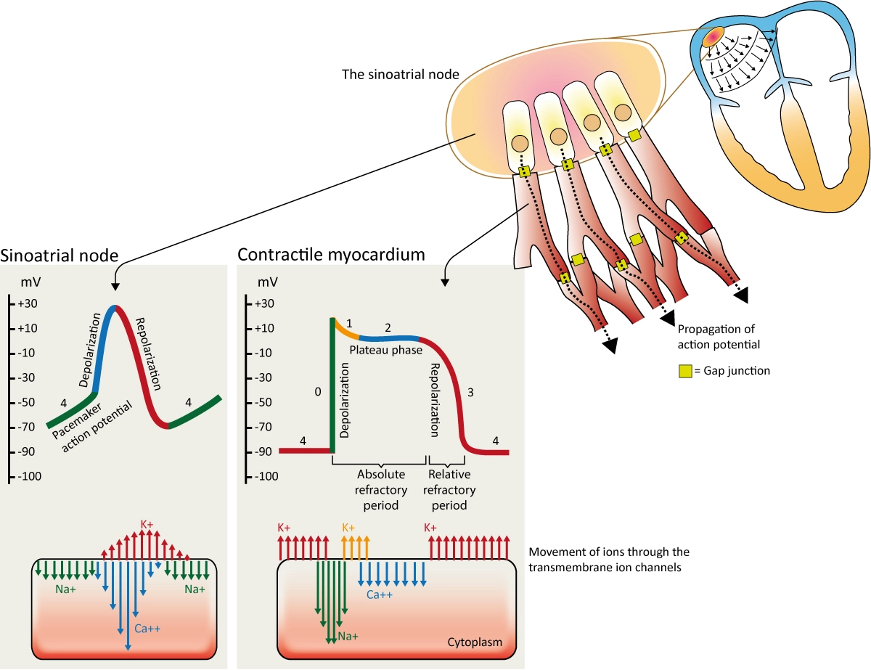
++++
- ----------
Prepared by Dr. Abbass HAYDAR

Slide 26
Conclusion
First type:
These cells have a high resting K+ permeability between action potentials (Aps).
The APs in these cells are generated by a fast Na+ current and are known as fast action potentials (Aps).
The prolonged duration of the action potential in ventricular cells and Purkinje fibers is caused by an approximate balance of inward depolarizing currents (primarily a Ca2+ current) and outward repolarizing K+ currents, which results in a prominent plateau phase.
Atrial cells have a less prominent plateau
Prepared by Dr. Abbass HAYDAR

Slide 27
Conclusion
Second type
The second type of cardiac cell is found in the sinoatrial and atrioventricular nodes.
These cells have a low K+ permeability between APs and are automatic.
The upstroke of these nodal Aps is generated by a Ca2+ current, which is smaller and slower than the fast Na+ current.
There are low density of Ca2+ channels compared to the density of Na+ channels in fast cells,
Conduction in nodal cells is much slower than conduction in regions having Na+-dependent APs.
These nodal APs are known as slow APs.
Prepared by Dr. Abbass HAYDAR

Slide 28
Additional information: not for the exam
Atria
Atrial cells have APs that are similar in many aspects to the ventricular APs described above.
The most distinguishing feature of the atrial AP is that it has a more triangular appearance than the ventricular AP.
That is, atrial cells do not always have a distinct plateau.
This is likely due to the relatively large Ito in atrial cells.
Prepared by Dr. Abbass HAYDAR

Slide 29
Additional information: not for the exam
Atrioventricular Node
The cells of the AV node generate APs that are quite similar to the APs of the SA node.
Thus, these cells fire Ca2+ dependent APs and also display spontaneous phase 4 depolarization (i.e. automaticity).
However, the rate of the phase 4 depolarization in AV nodal cells is much slower than the rate of phase 4 depolarization in SA nodal cells.
Thus, the SA node cells fire APs before the AV node cells fire, which is why the SA node cells are the normal pacemaker cells of the heart.
Prepared by Dr. Abbass HAYDAR

Slide 30
Additional information: not for the exam
Purkinje Fibers
Purkinje APs are in most respects similar to the ventricular APs
Thus, these cells have a negative resting membrane potential between APs (phase 4) and a very rapid upstroke (phase 0) generated by INa.
Purkinje fibers do differ from ventricular cells in that they have a more prominent phase 1 repolarization and a longer plateau (phase 2)
The plateau is followed by a phase 3 repolarization that is virtually identical to phase 3 in ventricular cells
Cells in the bundle of His appear to have APs similar to those in the Purkinje fibers; however, in general, bundle of His cells have not been studied in detail
Prepared by Dr. Abbass HAYDAR

Slide 31
Additional information: not for the exam
Purkinje Fibers
Additionally, Purkinje cells may exhibit automaticity, especially when the extracellular K+ concentration is low
Thus, under some conditions, they exhibit phase 4 depolarization.
Purkinje cells have all the currents found in ventricular cells, described above
However, Purkinje cells also have some additional currents, which are absent or very small in ventricular cells, that are related to the latent pacemaker function of these cells.
These additional currents are described in the following section on automaticity
Prepared by Dr. Abbass HAYDAR

Slide 32
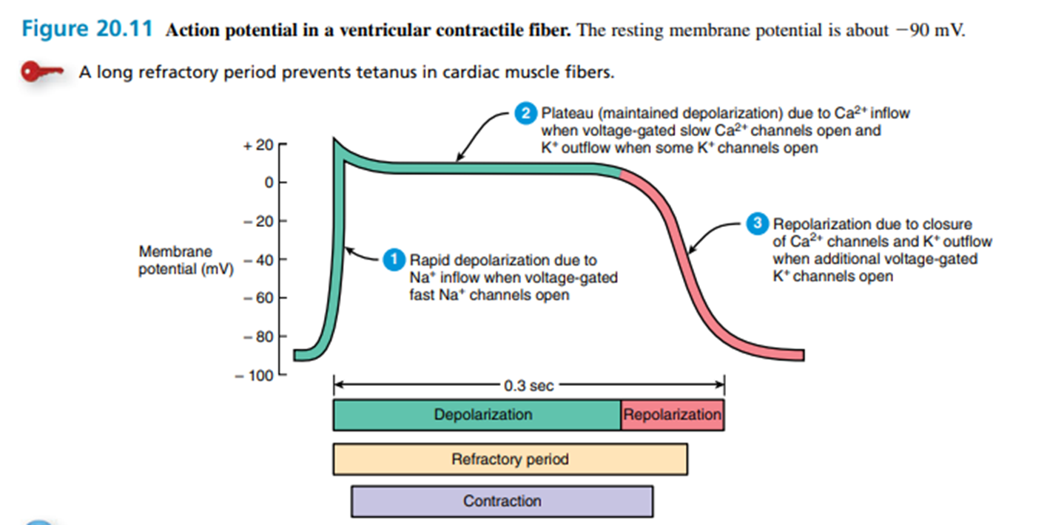
Prepared by Dr. Abbass HAYDAR

