Slide 1
CHAPTE R 1 Medical terminology

Slide 2
List of Contents
Terminology
The Significance of Learning Medical Terms
What is the Medical Term
Roots
Suffixes
Spelling of medical terms
Pronunciation of medical terms
Test
Home work
Set by Lect.
Dr. Laith &Osama / Lect. 1

Slide 3
Terminology
It is the set of terms, expressions, or symbols associated with a certain discipline of study, profession, or activity.
Developing a functional competence in terminology is an essential component of being able to work in a medical field or profession.
Medical terminology is the variety of language that health care professionals and providers use in practicing their careers.
Many medical terms nowadays have been borrowed from ordinary English words such as scanning and screening
In order to learn the meanings of medical terms, students need to familiarize themselves with the way medical terms are structured and created.

Slide 4
Latin and Greek Origins of Some Current Medical Terms
Current Term | Origin
artery | Latin arteria; Greek arteria
cardi(o) the heart | Greek kardia
cell | Latin cella
vein | Latin vena
nerve | Latin nervus
gastr | Greek gaster (stomach)
cancer | Greek carcin

Slide 5
Medical terms constitute a standardized means of communication among health-care providers because all such specialists use special terminology
to describe human body, diseases, symptoms, diagnostic procedures, drug, and treatment in the fields of medicine.
Medical terms are used in both speaking and writing during the process of communication between health care professionals and their clients

Slide 6
The Significance of Learning Medical Terms
Medical terms enable health care workers to communicate efficiently with each other and with their patients in one language.
They ensure complete and mutual understanding of patients’ issues, including diagnosis and treatment.
Medical terms help us decipher complex information because they are made up of roots, prefixes, and suffixes.
Medical terms facilitate the process of documentation and make it easy and fast due to the frequent use of abbreviations in recording medical information.

Slide 7
Medical Term
Roots
Suffixes
Prefixes
Combining Forms

Slide 8
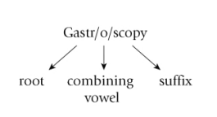
Roots
A root is the part of a word that carries its basic meaning. The root in medical terms cannot stand alone to give a complete meaning.
A prefix or a suffix may be added to it in order to make a full term that has meaning.
visual examination of the stomach
stomach
Visual examination

Slide 9
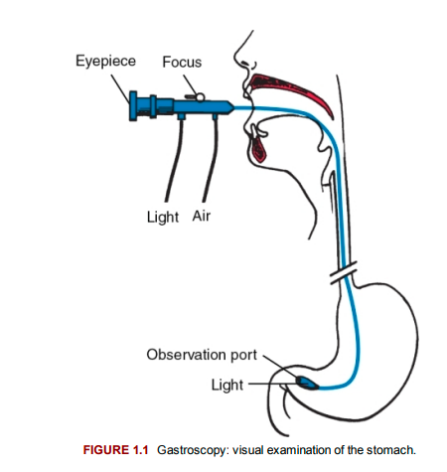

Slide 10
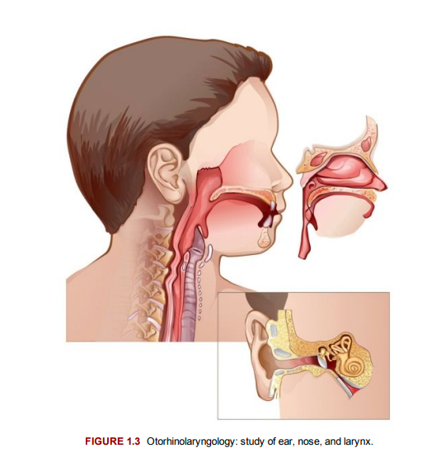
Otology
rhinology
science of ear
science of nose
laryngology
science of Larynx

Slide 11
Spelling of medical terms
it is necessary that learn the correct spelling of the terms you use in your field
Correct spelling to writing is as important as correct pronunciation to speaking.
Test symbol
Developing a functional competence in terminology
A. essential component ,
B. unimportant component,
C. right component.
D. assessment component
The Latin word of nerve is ……….
A. vena , b. nervus , c. never , d. ever
Medical term consist of
A . Root , B. suffix C. prefix D. all of them
Rhinology means
Science related with nose
Science related with Larynx
Science related with Ear

Slide 12
I WISH YOU HAVE
A Nice
Interesting
and Useful
lecture

